Slide 1
Speeding
Notes:
Image source: Institute for Transportation at Iowa State University

Slide 2
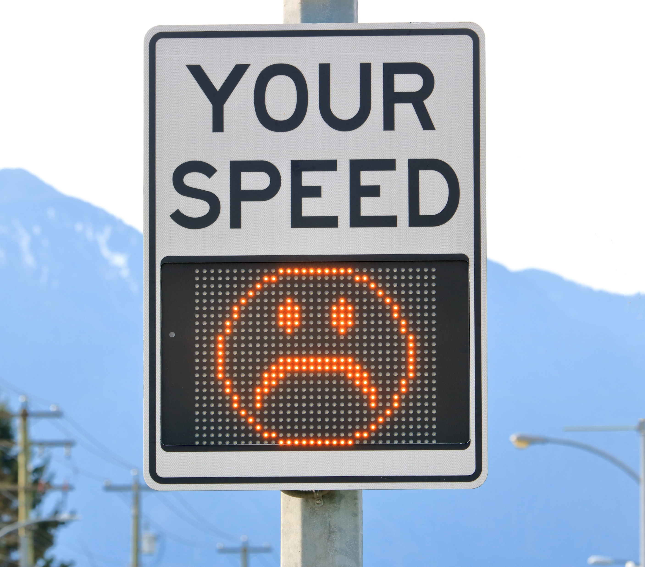
Learning Objectives
Describe speed limit signs in Iowa
Identify the factors used in setting speed limits
Explain why speeding is dangerous
Describe strategies to avoid speeding
Notes:
Image source: Eric Buermeyer/Shutterstock.com

Slide 3
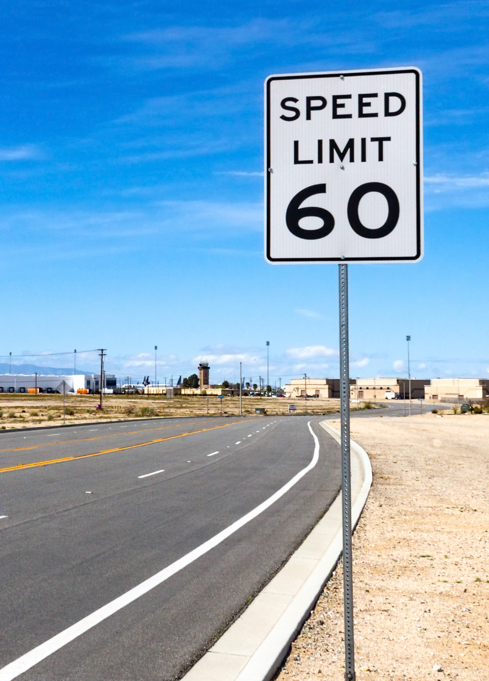
Iowa Speed Limit Signs
Black on white regulatory speed limit signs
Indicate maximum or minimum speed allowed
Indicate maximum limit for ideal conditions
  Drivers need to reduce speed for nonideal conditions (e.g., weather)
Indicate minimum speed limits on some high-speed roads
  Drivers should take other roads if the minimum speed can’t be met)
Notes:
Narrative
Speed limit signs indicate the maximum speed that a driver can travel on that roadway. This maximum is for dry roads and otherwise ideal conditions. Speeds should be reduced under nonideal situations such as low visibility or wet, snow-covered, or icy roads. A few high-speed roadways have a minimum speed limit. These are regulatory speed limits, which means you are legally required to obey. Failure to obey can result in a ticket.
Resources
Information source: This slide is about some of the signs that drivers might see in Iowa. The graphics and information above comes from the Iowa Driver’s License Manual and a DOT speed limit brochure called “Speed Limit Questions Here’s Your Answer” from Iowa DOT Office of Traffic and Safety. The brochure is not dated; however, it may be from 2010—it has the number PM 842 2-8-10 on it.
Image source: Felipe Sanchez/Shutterstock.com

Slide 4
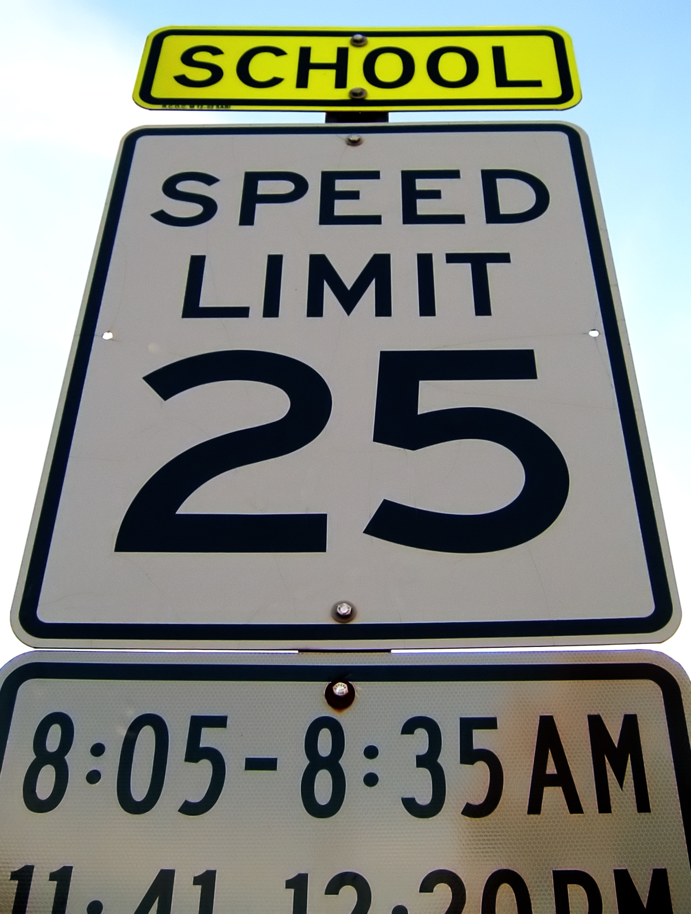
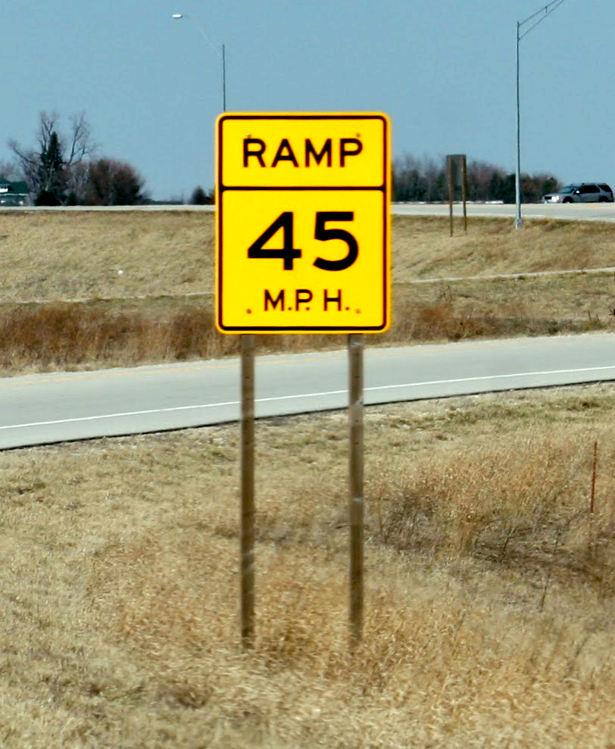
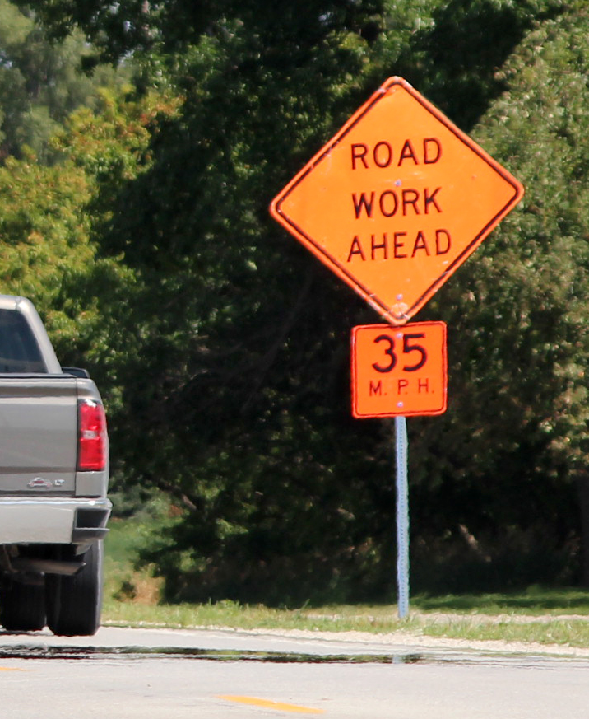
Iowa Speed Limit Signs
Black on white School Zone speed limit signs—indicate regulatory speed limit during specific times
Black on orange—indicate speed for specific situations in work zones
Black on yellow—advise comfortable speed to navigate situations
Notes:
Narrative:
In addition to regular speed limits, there are some situations where the speed limit along a roadway changes. One example is a school zone—speed limits apply during specific times around schools. School zone speed limits are also regulatory.
Other situations indicate a reduced speed limit for certain situations, such as an upcoming curve. These are advisory speeds and are indicated by yellow warning signs.
It’s important to note that there are also speed reductions into and through some work zones that are done with black on white regulatory speed signs. Speeding fines are also increased in Iowa within work zones
Image sources
Left: Gary Paul Lewis/Shutterstock.com
Center and Right: Institute for Transportation at Iowa State University

Slide 5
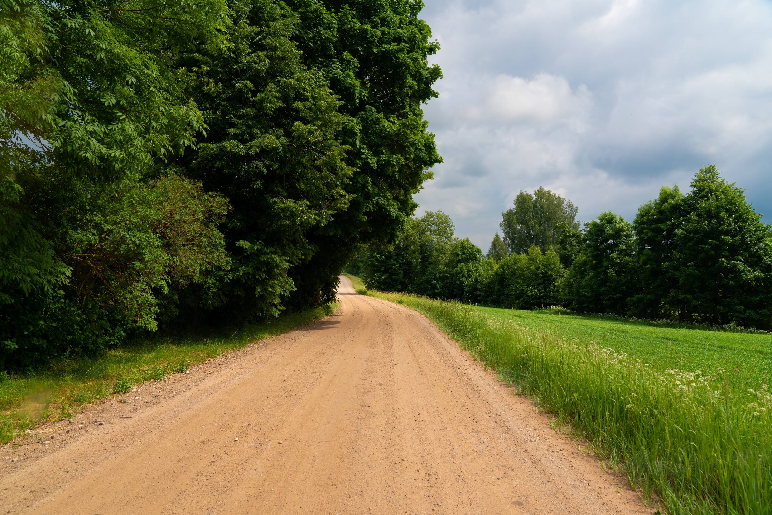
What if the Speed Limit is not Posted?
Iowa code statutory speed limits
Business district: 25 mph
Residential or school districts: 25 mph
Suburban district: 45 mph
Unsurfaced secondary roads (night and trucks all day): 50 mph
Paved primary, urban interstate, and secondary roads (and unpaved during the day): 55 mph
Rural interstate highway: 70 mph
Notes:
Narrative
Statutory speed limits apply when no speed limit sign is posted. They are based on the idea that uniform categories of highway can be traveled at a maximum speed under ideal conditions. The slide includes the speeds and descriptions that are statutory speed limits in the Iowa code (321.285) for particular categories of roadway (often by location).
Resources
Information source: Iowa Driver License Manual
Image source: Miervaldis Ozols/Shutterstock.com

Slide 6
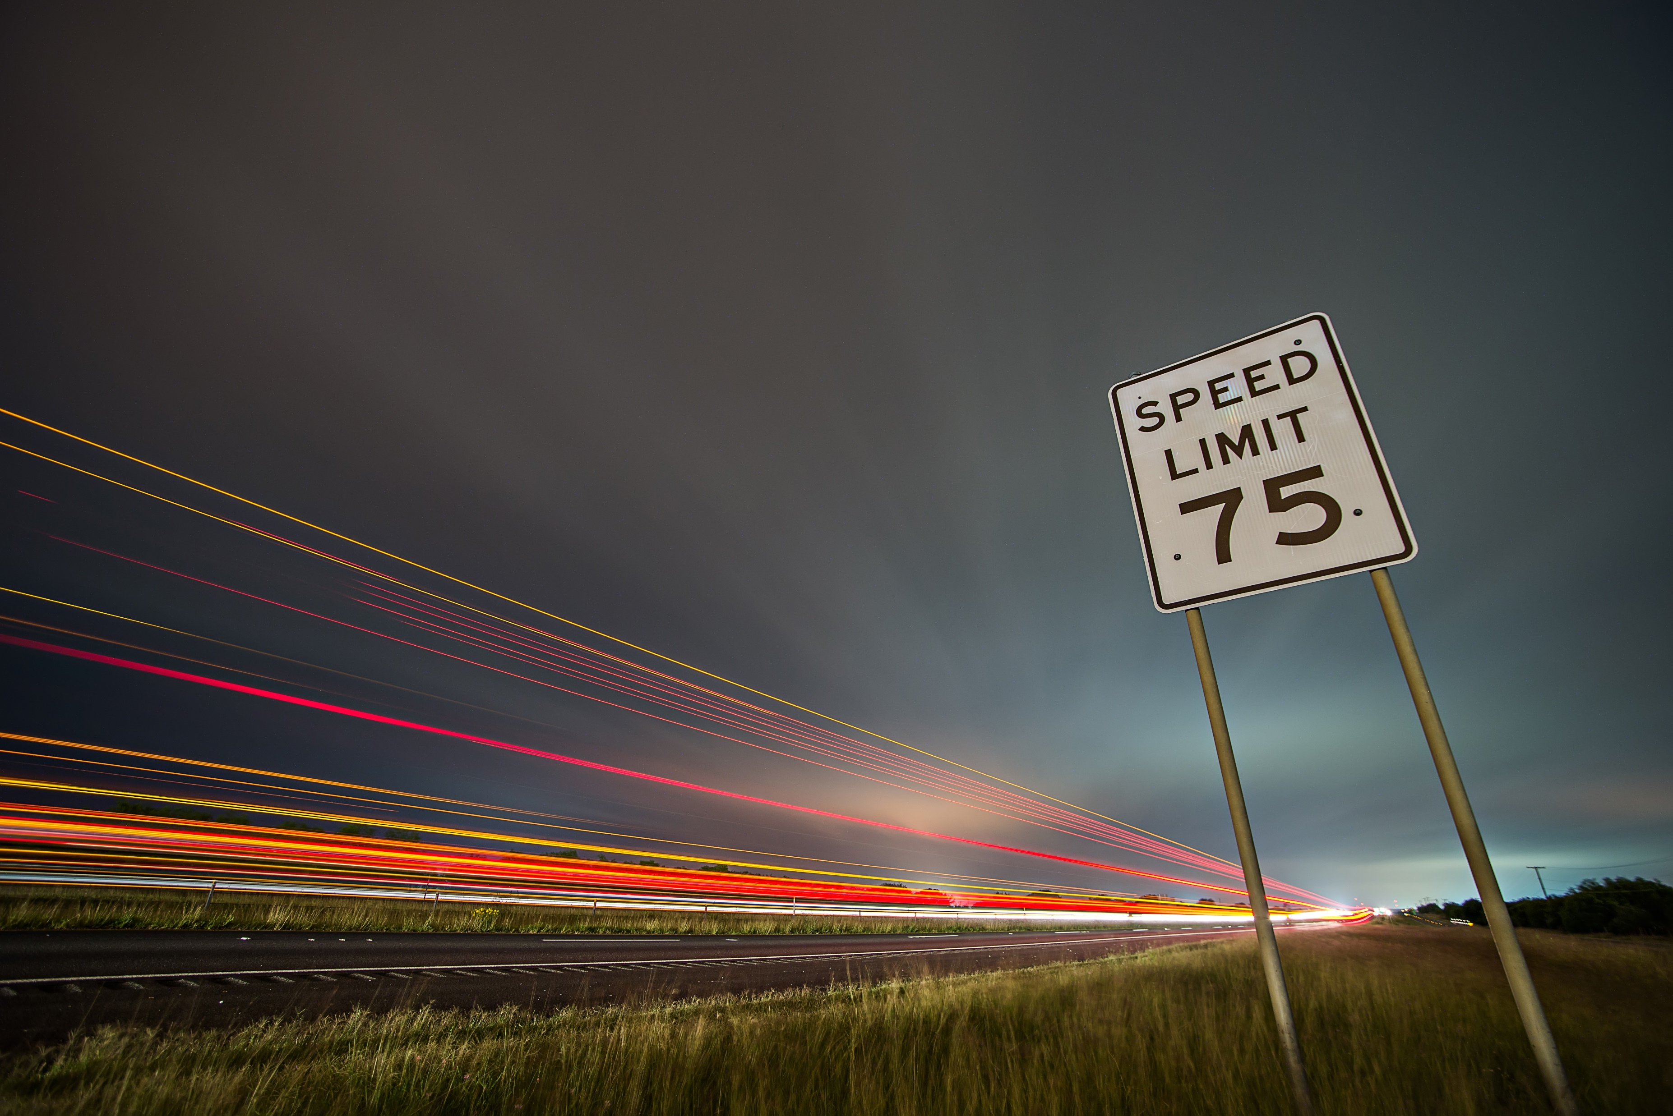
How are Speed Limits Set?
Based on an engineering study
Some factors considered by Iowa DOT:
  Road type and surface
  Location and type of access points
  Existing traffic control devices
  Crash history
  Traffic volume
  Sight distances
  Pedestrian activity
  Results of field review and speed study
Notes:
Narrative
Speed limits aren’t just arbitrarily set. Engineers consider a number of factors to make sure speed limits are appropriate for a particular roadway type. This slide lists the factors that are considered when jurisdictions (Iowa DOT, etc.) set speed limits. Speed limits are for dry conditions. You may need to drive slower than the speed limit in some conditions (i.e., icy roads, low visibility).
Image source: digidreamgrafix/Shutterstock.com

Slide 7
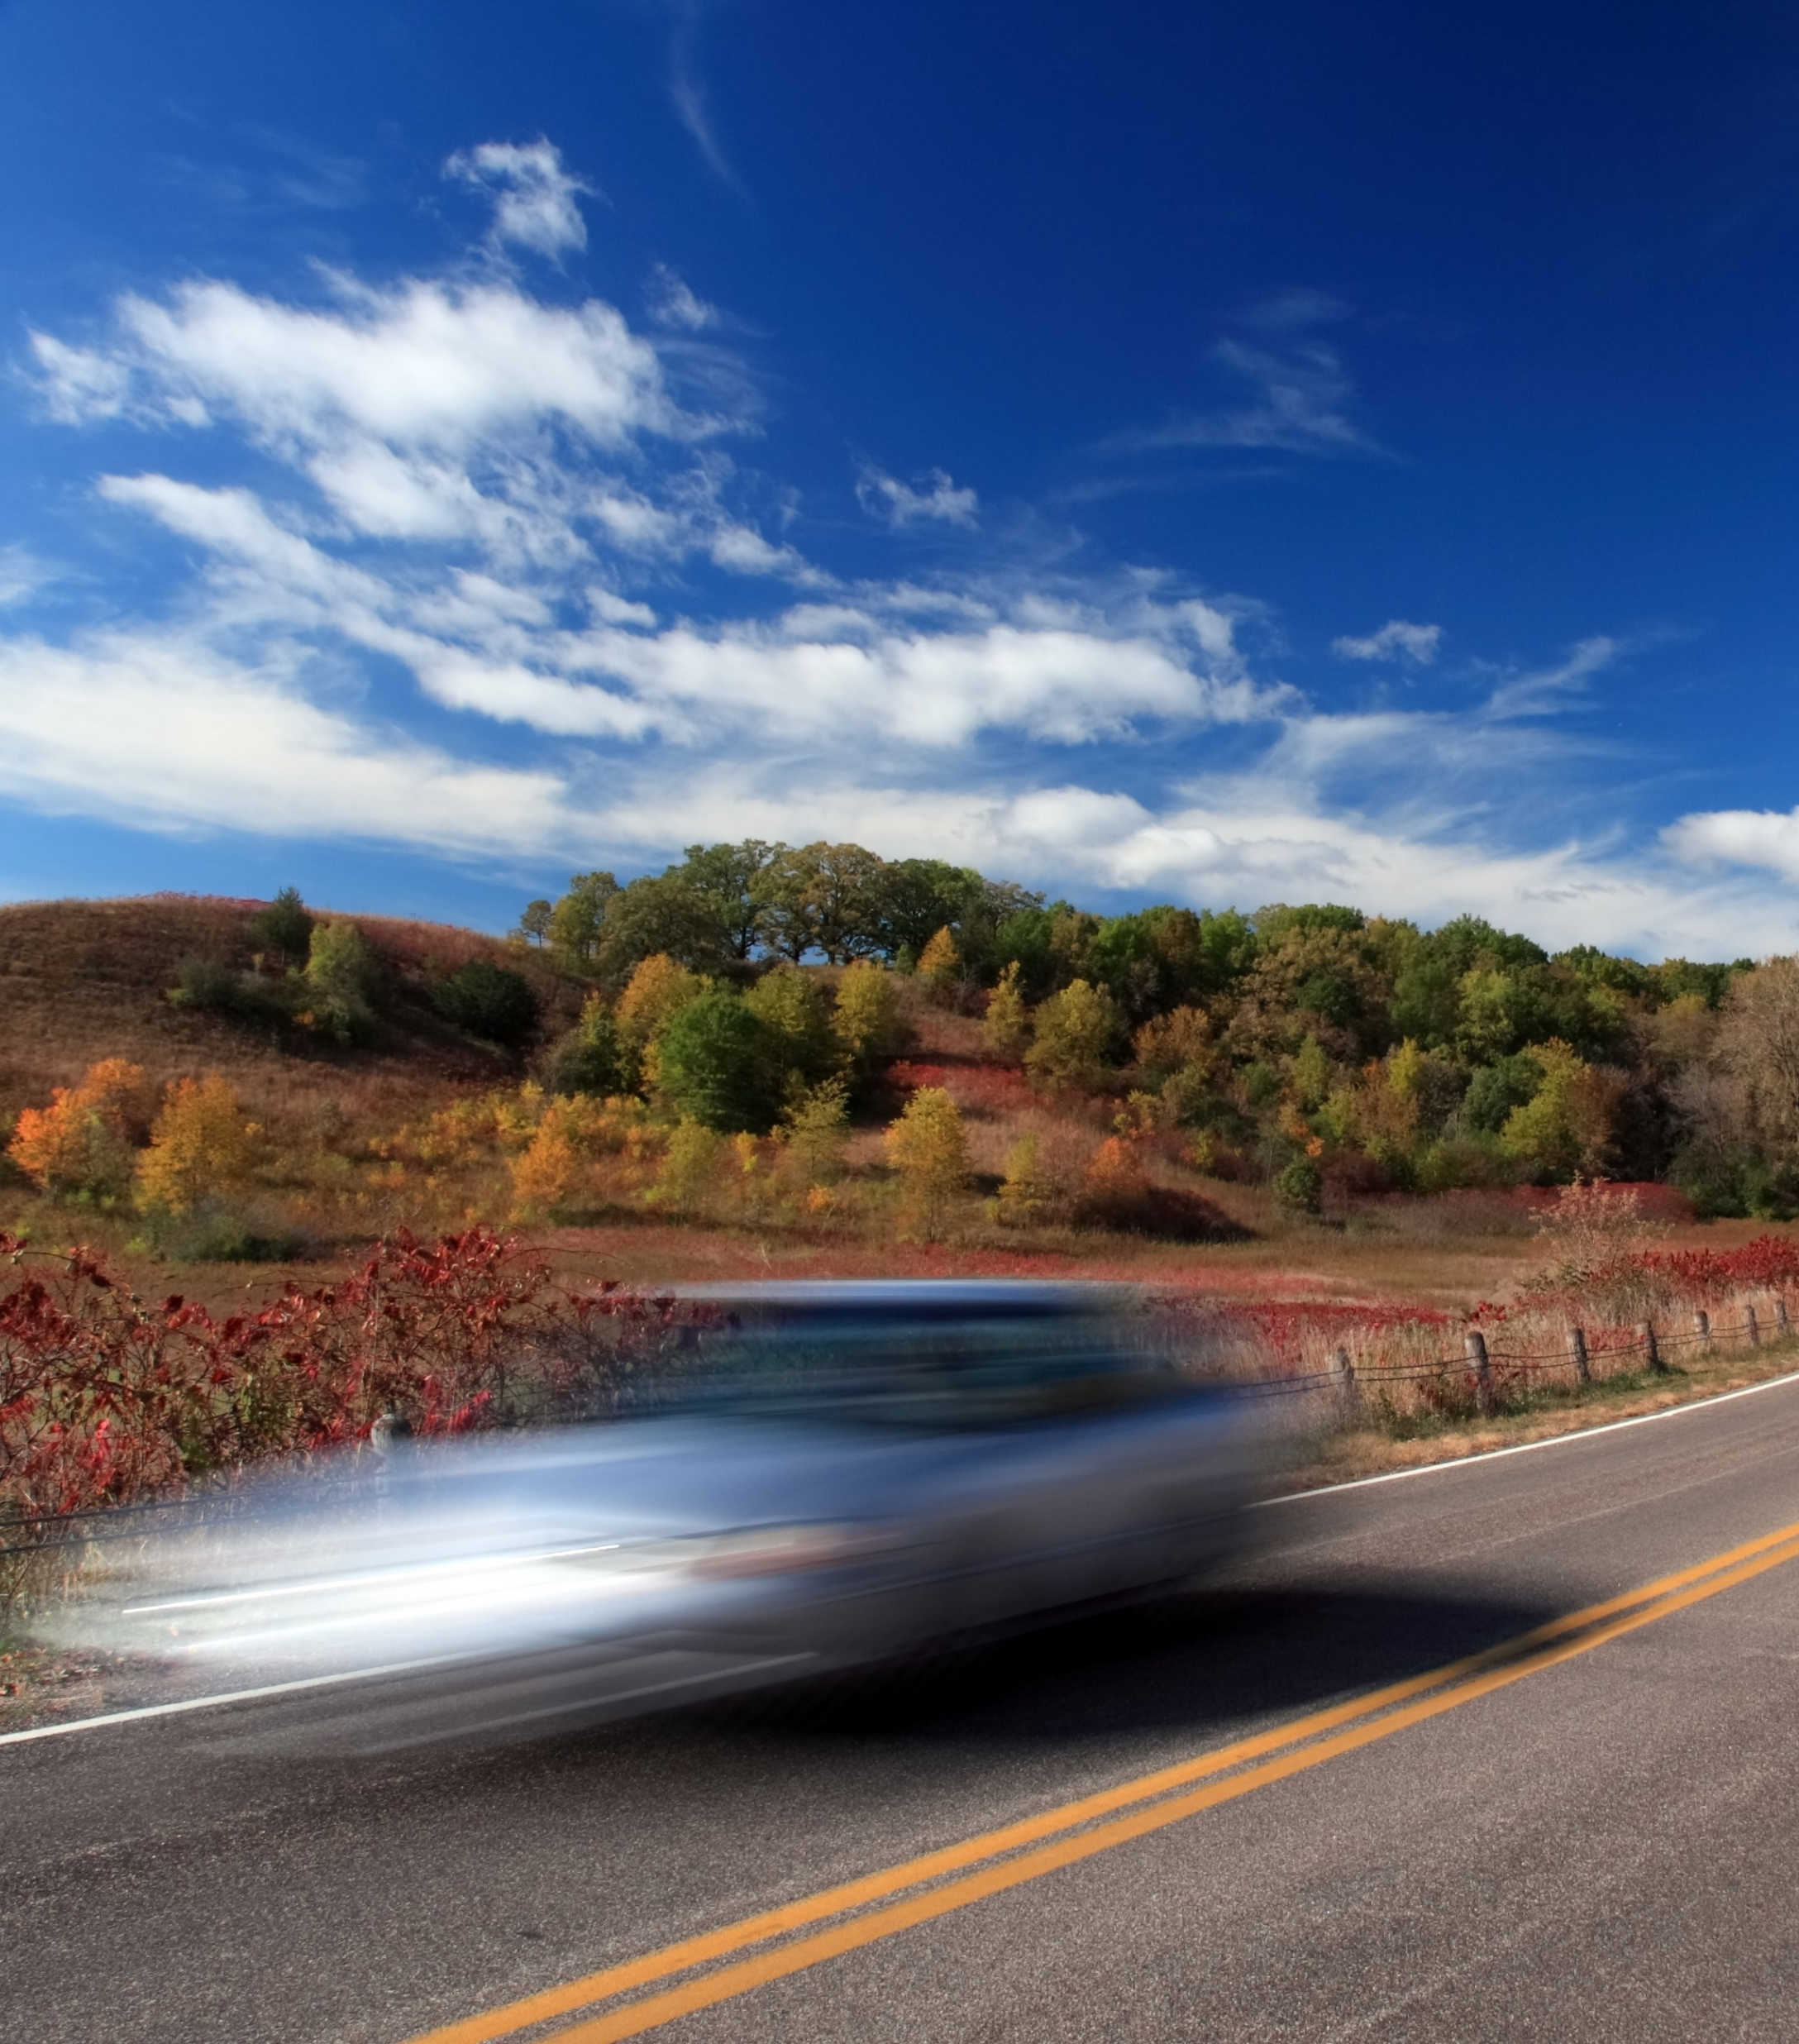
What is Speeding?
Speeding is not just going faster than the posted speed limit.
Speeding is also driving too fast for conditions.
Driving the speed limit on an icy road is too fast for the current conditions.
Drag racing at any speed is also prohibited.
Notes:
Narrative
The main definition of speeding is traveling over the posted speed limit. However, you are considered speeding if you are traveling too fast for conditions. For instance, traveling the speed limit on an icy road or during fog may be too fast for the prevailing conditions. Drag racing is also considered speeding and is illegal at any speed.
Image source: nikitsin.smugmug.com/Shutterstock.com

Slide 8
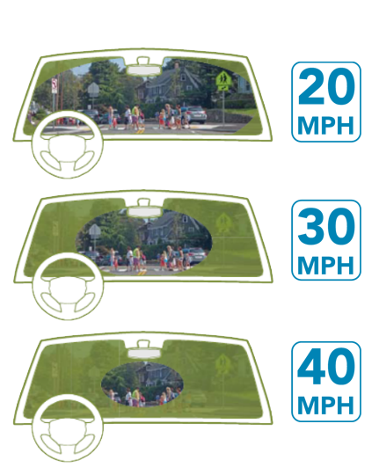
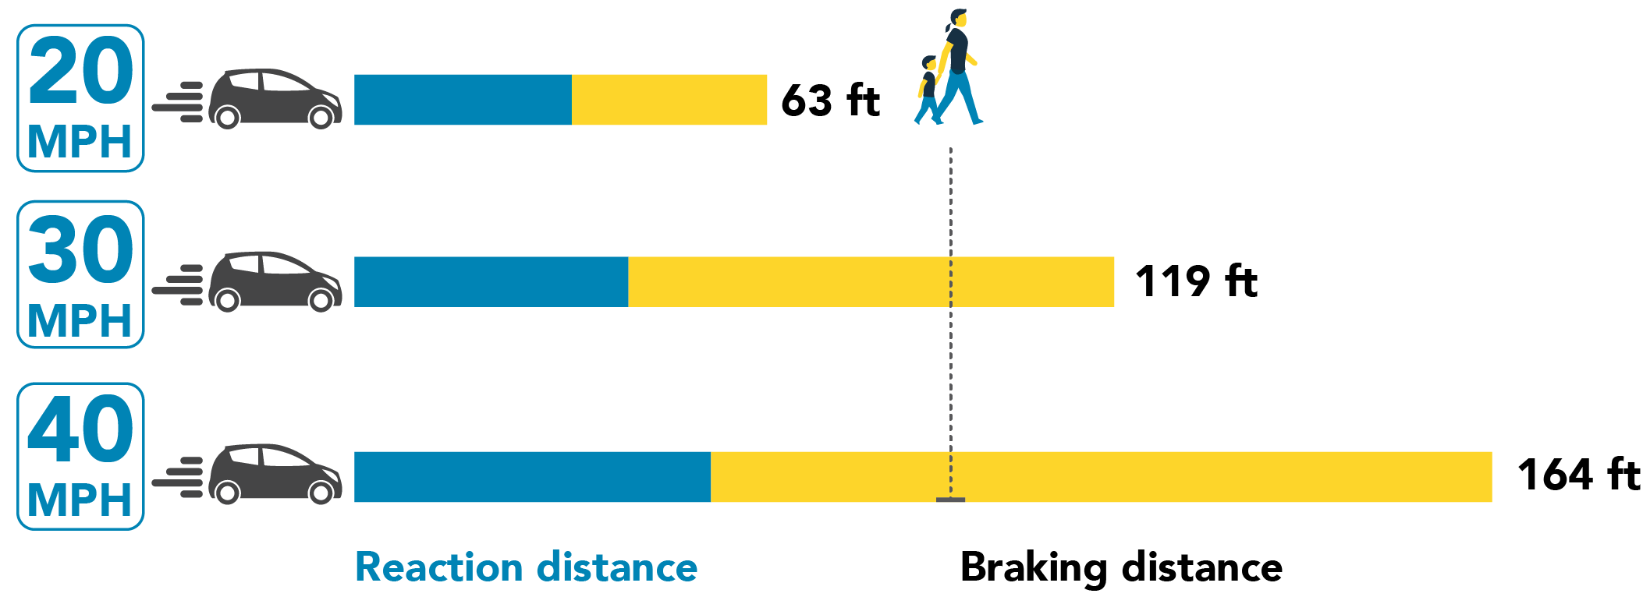
Why is Speeding Dangerous?
CONE OF VISION
Increased speed means less time to react and longer stopping time.
Increased speed reduces how much information you can view.
Notes:
Narrative
Many drivers feel there are few consequences to speeding. However, higher speeds mean less time to react. It takes a normal person about 2.5 seconds to respond to unexpected conditions. At 40 mph, it takes 164 feet to react and stop compared to 63 feet at 20 mph.
Traveling at higher speeds also narrows your field of vision, making it harder to see people or objects in front of you.
Image source: Massachusetts Department of Transportation (https://www.mass.gov/info-details/learn-about-speed-management)/National Highway Traffic Safety Administration; Vision Zero Network (https://visionzeronetwork.org/resources/safety-over-speed/)/National Highway Traffic Safety Administration

Slide 9
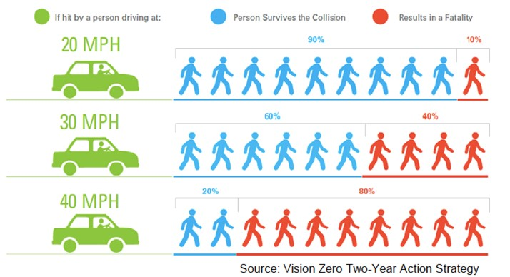
Why is Speeding Dangerous?
You are more likely to lose control of your car or overturn.
Higher speeds create more force that your car (or body or other road user) has to absorb in a crash.
Notes:
Narrative
Another consequence of speeding is that If you take evasive action, you are more likely to lose control of your vehicle or roll over at higher speeds. When you hit an object, your vehicle decelerates, and the faster you decelerate the more force is present.
A pedestrian struck by a vehicle at 20 mph has a 90% chance of surviving the crash. At 40 mph, the pedestrian only has a 20% chance of surviving.
Image and information source: Vision Zero Network (https://visionzeronetwork.org/pioneering-study-affirms-vision-zero-focus-on-speed-management/)

Slide 10
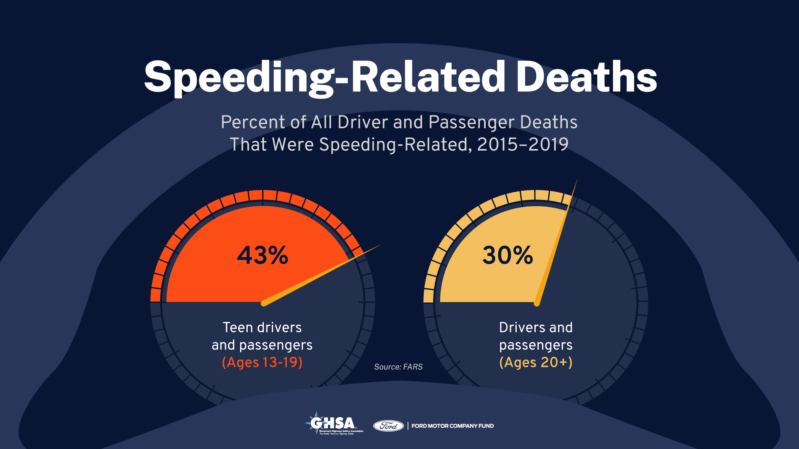
10
Notes:
Narrative
Teen passengers are more likely to be involved in a speeding-related crash. 43% of crashes for drivers 19 years old and younger involved speeding compared to 30% for drivers 20 years and older.
Image source: Governors Highway Safety Association (https://www.ghsa.org/resources/Teens-and-Speeding-Report21)

Slide 11
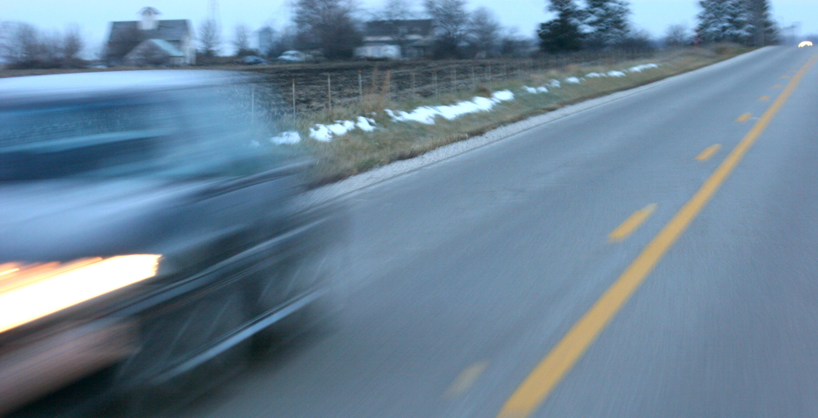
In Iowa, drivers 18 and younger were 1.4 times more likely to be involved in a speeding-related crash than drivers over 18.
Notes:
Narration
In Iowa, drivers 18 and younger were 1.4 times more likely to be involved in a speeding-related crash than drivers over 18.
Resources
Information source: Iowa DOT crash data
Image source: Institute for Transportation at Iowa State University

Slide 12
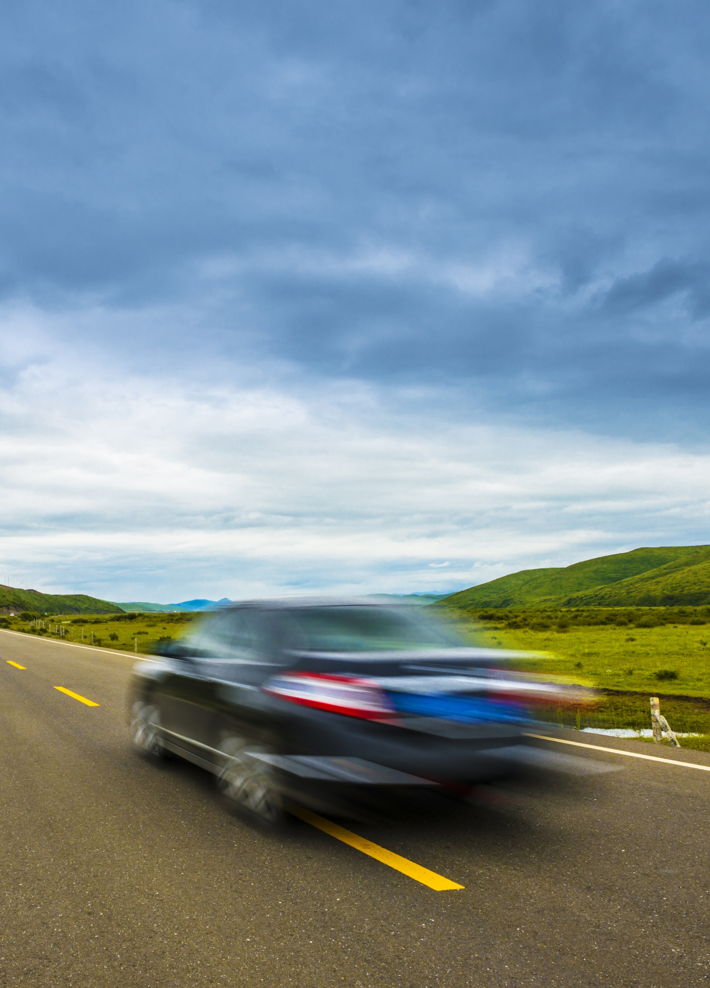
Why do We Speed?
Inexperience and inability to judge hazardous situations
Being in a hurry or late for appointments
Not paying attention to the roadway
Social pressure, feeling the need to keep up with traffic, lack of social stigma
Believing that when others are speeding the risk of a ticket is low
Thrill seeking
Disregard for others
Notes:
Narrative
Drivers speed for a number of reasons. For younger drivers this is often inexperience and inability to judge hazardous situations. Drivers also speed because they are late for an appointment or in a hurry. In many cases, drivers just aren’t paying attention either to their speed or don’t bother to check for speed limits. Other drivers speed because they are pressured by other vehicles (feeling the need to keep up with traffic) or passengers. Speeding also lacks the social stigma associated with driving under the influence. As a result, speeding feels socially acceptable, and when it feels like everyone is speeding, the risk of a ticket feels remote. A few drivers speed because they are looking for a thrill or they just don’t care about the consequences speeding could have for them or others.
Resources
Information source: Governors Highway Safety Association (https://www.ghsa.org/resources/Teens-and-Speeding-Report21); National Highway Traffic Safety Administration (https://www.nhtsa.gov/risky-driving/speeding)
Image source: zhu difeng/Shutterstock.com

Slide 13
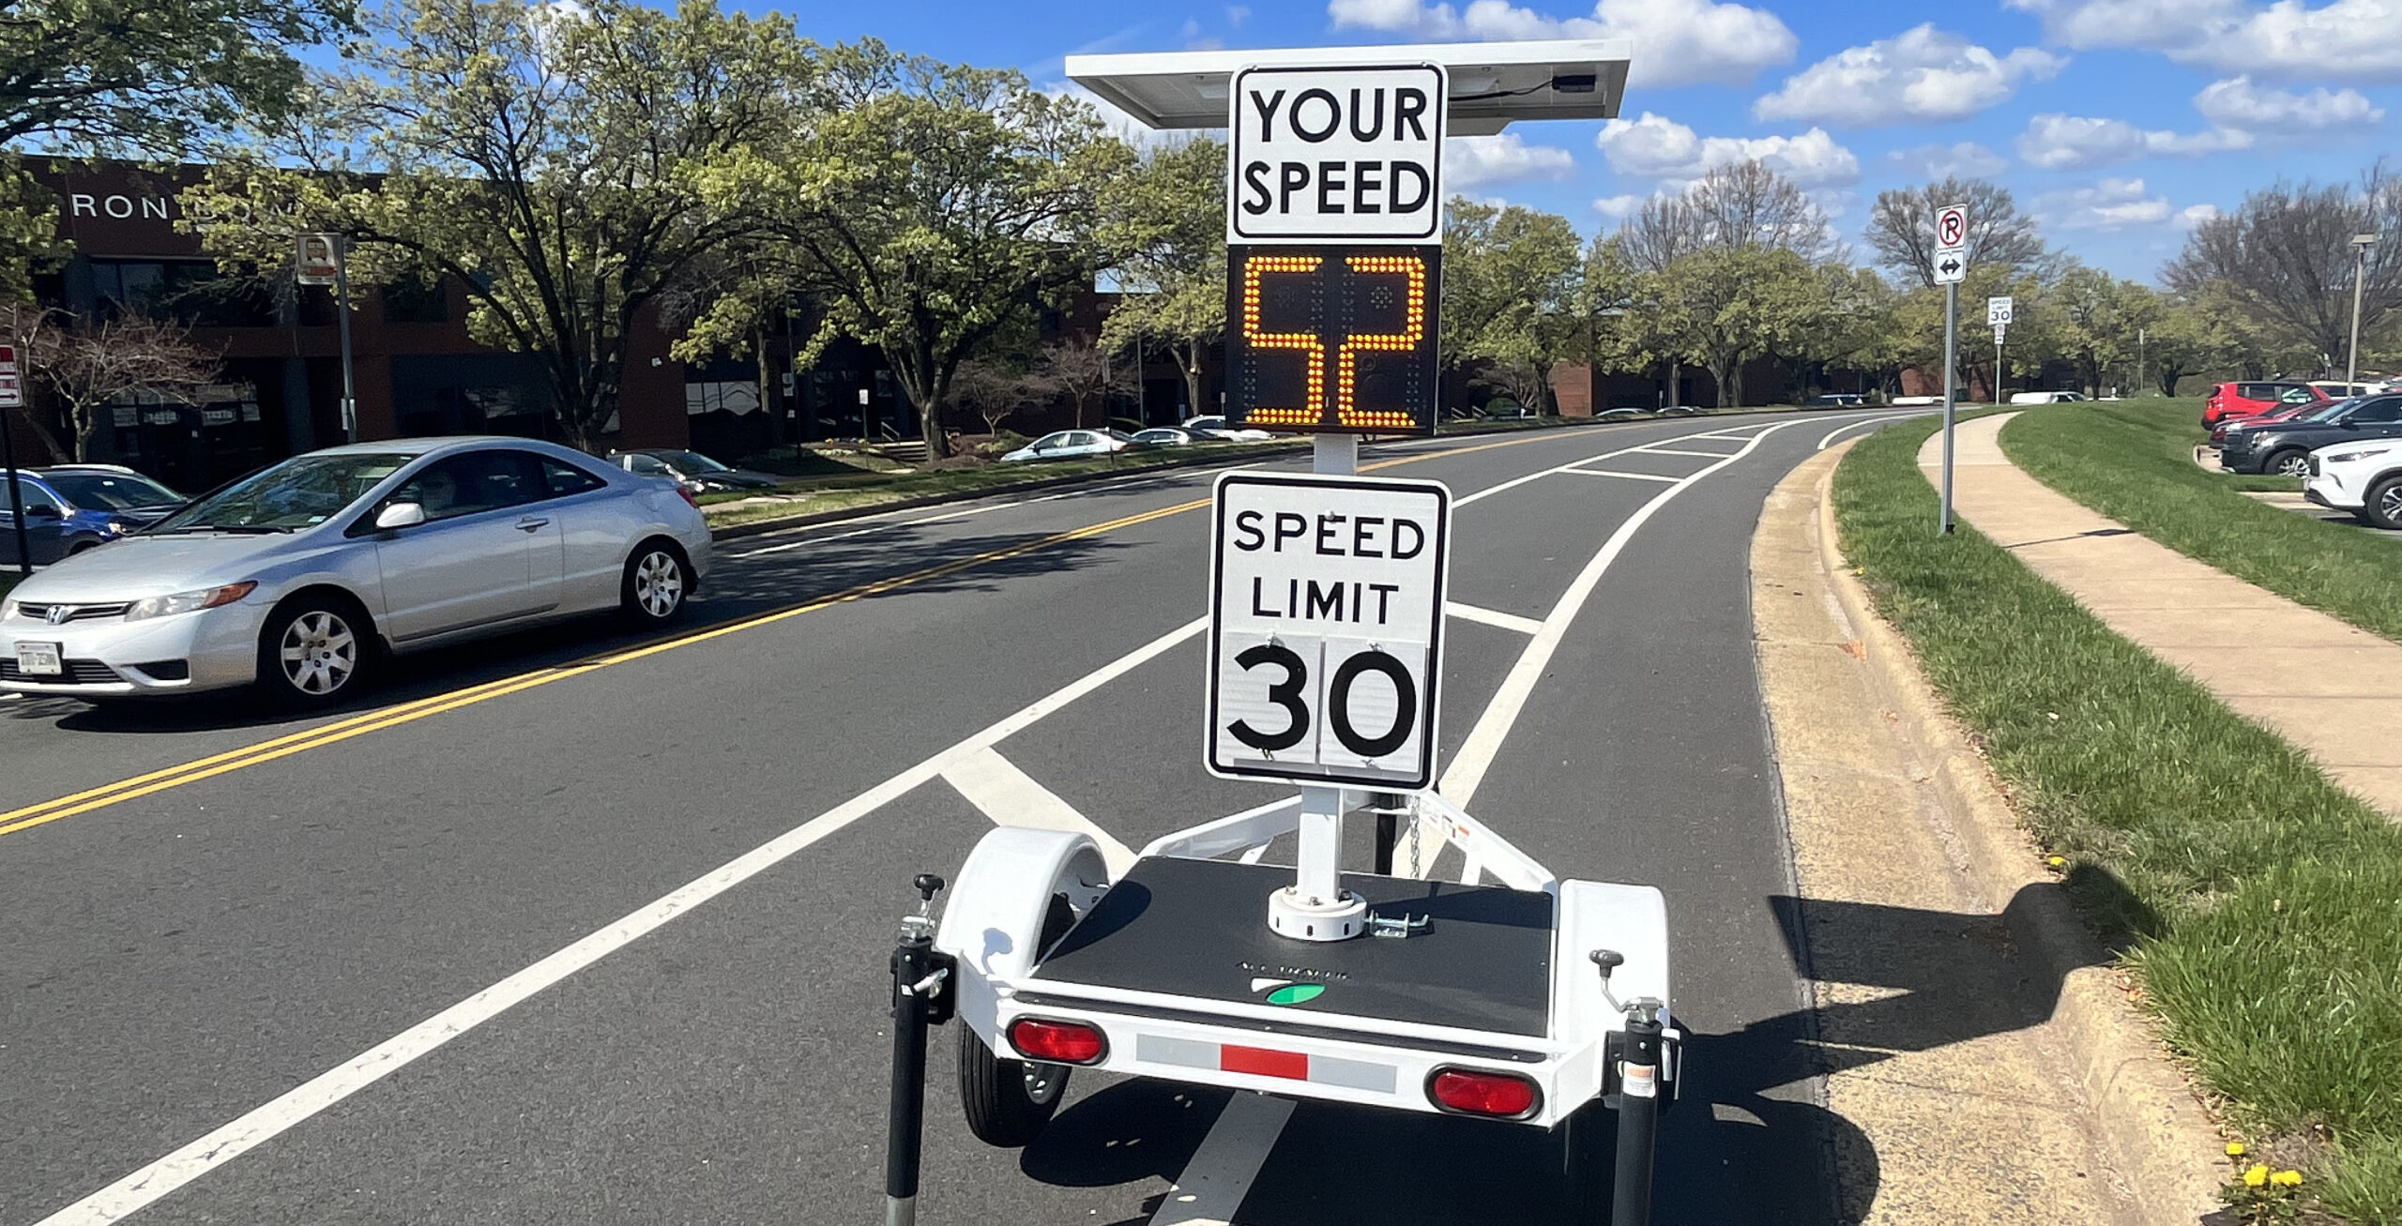
Why do we Speed?
In the US speeding culture, many drivers see speed limits as minimums rather than maximums
Notes:
Narrative
The United States has both a speeding problem and a speeding culture. The speed limit is often seen as the minimum speed they can drive rather than the maximum.
Resources
Information source: Governors Highway Safety Association (https://www.ghsa.org/resources/Teens-and-Speeding-Report21)
Image source: https://www.alltrafficsolutions.com/blog/3-reasons-why-digital-speed-limit-signs-are-used/

Slide 14





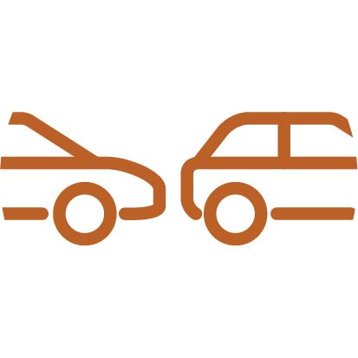
Strategies to Reduce Speeding
Plan ahead so you have plenty of time.
Pay attention to road conditions—slow down for rain, snow, etc.
Don’t give in to peer pressure.
Be aware of the dangers of speeding.
Pay attention to where you are—school zone, work zone, etc.
Let tailgaters pass you or safely move out of traffic if a line of cars is following you and let them pass.
Notes:
Narrative
There are strategies to reduce the chance of speeding. First plan ahead so you have plenty of time to arrive to appointments, work, or school. Even though speeding seems harmless, remember speeding contributes to increased crashes and fatalities. Speed limits change, so pay attention to where you are and check for the nearest speed limit sign if you aren’t sure. Pay attention to school speed limits—habit might take over if you regularly drive a particular roadway and forget about school zones. Even if you drive the speed limit, you need to pay attention to changing conditions. For instance, you may need to slow down if you have adverse weather.
When you are driving, you may feel pressured to speed when vehicles around you are going faster or are passing you. Other drivers may also tailgate, making you feel pressured to speed up to get out of their way. On a multi-lane roadway, move to the right since drivers who are speeding often use the left lane. If someone is tailgating you, safely move into another lane. On a 2-lane roadway, if a line of vehicles is following you, find a safe place to pull over and let them pass.
You may have passengers that make fun of you or tell you to speed up. Remember that you are responsible for the safety of everyone in your vehicle. Learn to speak up in a nonconfrontational manner when you are pressured to speed or when you are riding in a car with someone who is speeding.

Slide 15
Speeding Myths
Myth
Going 5 mph over the posted speed limit is okay.
Fact
Going over the speed limit by any amount is illegal, and an officer can stop you for any amount over the posted speed limit.
Myth
Speeding is not dangerous if I drive safely.
Speed increases the risk of a crash, the time to react, and the distance it takes to stop. Striking another vehicle or object at a higher speed also increases the amount of energy, which can result in more physical harm to vehicle occupants.
Fact

Slide 16
Speeding Myths
Myth
Speeding saves me time.
Fact
Speeding only saves seconds and increases your risk of a crash (which increases travel time).
Myth
It is better to keep up with the flow of traffic than follow the speed limit.
Fact
Keeping up with traffic is not a valid excuse for exceeding the posted speed limit.

Slide 17
Disclaimer Notice
This module was developed by the Institute for Transportation (InTrans) at Iowa State University for the Iowa Department of Transportation (Iowa DOT) with the purpose to provide the material for driver education instructors in Iowa. InTrans is responsible for the facts and the accuracy of the information presented herein as of May 1, 2025.
Driver education instructors may use the material in its entirety or may use any of the slides and material individually. The material is for educational purposes only. It is strictly prohibited to sell any part of this module.
If any of the material is reused, please credit the appropriate source. The resources used for information and images for the module are provided in the notes section. Other material can be cited as Iowa DOT.
For more information or questions, please contact Vania Boyd, Driver Education and Motorcycle Rider Education Manager, Iowa DOT, Vania.boyd@iowadot.us.

