Slide 1
Situational Awareness, Sharing the Road
Notes:
Narrative
This module was developed by the Institute for Transportation at Iowa State University for the Iowa Department of Transportation. The purpose is to provide additional material for driver education instructors in Iowa. This module focuses on situational awareness. The material can be used in its entirety, or a driver education instructor can use any of the slides or material individually. Citations are provided for information sources and images. If these materials are used, please credit the appropriate source. Other material can be cited as Iowa DOT.
Image source: Centers for Disease Control and Prevention. https://www.cdc.gov/transportationsafety/

Slide 2
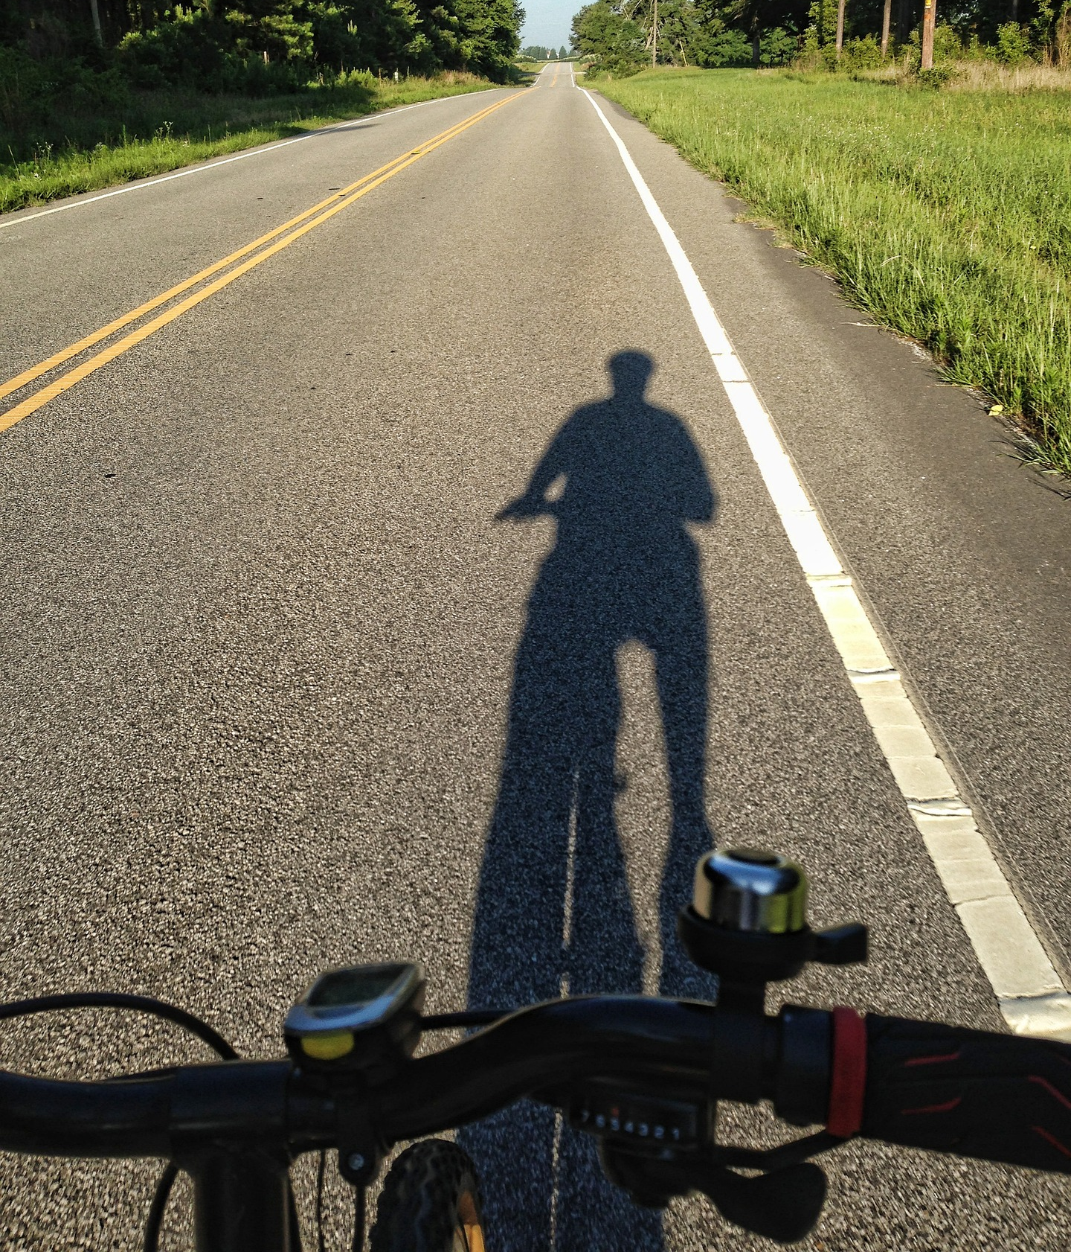
Learning Objectives
Help teen learners understand the importance of situational awareness
Help teens understand other road users
Provide new drivers tips to safely navigate roadways
Notes:
Narrative
The learning objectives for this module are:
Help teen learners understand the importance of situational awareness
Help teens understand other road users
Provide new drivers tips to safely navigate roadways
Image source: William Carr/Pixabay.com

Slide 3
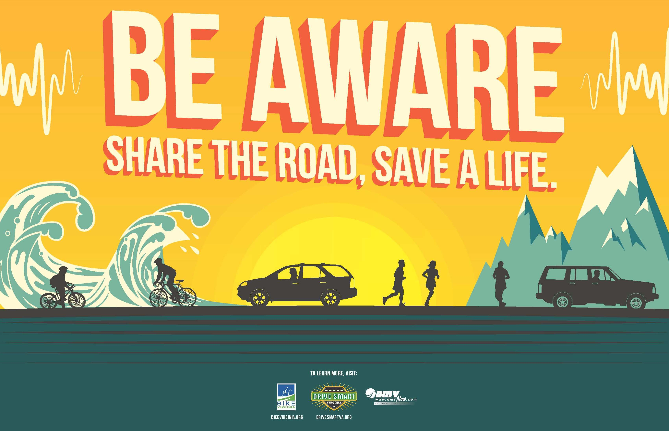
What is Situational Awareness?
Situational awareness is the ability to be aware of everything happening around you while driving.
  This includes the roadway and the environment around you.
Notes:
Narrative
Because driving is not a static activity, the conditions surrounding you while you are driving will always change. Situational awareness in driving refers to being fully aware of your surroundings and how they are changing while operating a vehicle. It involves understanding and anticipating road conditions, traffic patterns, and potential hazards so that you can make safe driving decisions.
Image source: Virginia Risk Sharing Association. https://www.vrsa.us/driving-around-cyclists-and-pedestrians/

Slide 4

What is Situational Awareness?
Situational awareness consists of three levels:
  Perceiving the changes taking place on the roadway (such as the start of a work zone or crash)
  Comprehending what the changes mean and how they will impact driving conditions
  Forecasting how other drivers will react to the changes
Notes:
Narrative
Situational awareness consists of three levels: (1) perception, (2) comprehension, and (3) forecasting. In order to drive safely through changing situations, drivers need to be able to identify changing conditions on the roadway and change their driving patterns to accommodate each new situation. It is also important that they anticipate ways other drivers or road users will respond to the changing situations.
Resources
Information source:
Everyday Speech. 2024. Understanding Situational Awareness: A Practical Guide. https://everydayspeech.com/sel-implementation/understanding-situational-awareness-a-practical-guide/#:~:text=Perception%20involves%20actively%20observing%20and,for%20future%20events%20or%20outcomes.
Image source:
Everyday Speech. https://everydayspeech.com/sel-implementation/understanding-situational-awareness-a-practical-guide/#:~:text=Perception%20involves%20actively%20observing%20and,for%20future%20events%20or%20outcomes

Slide 5
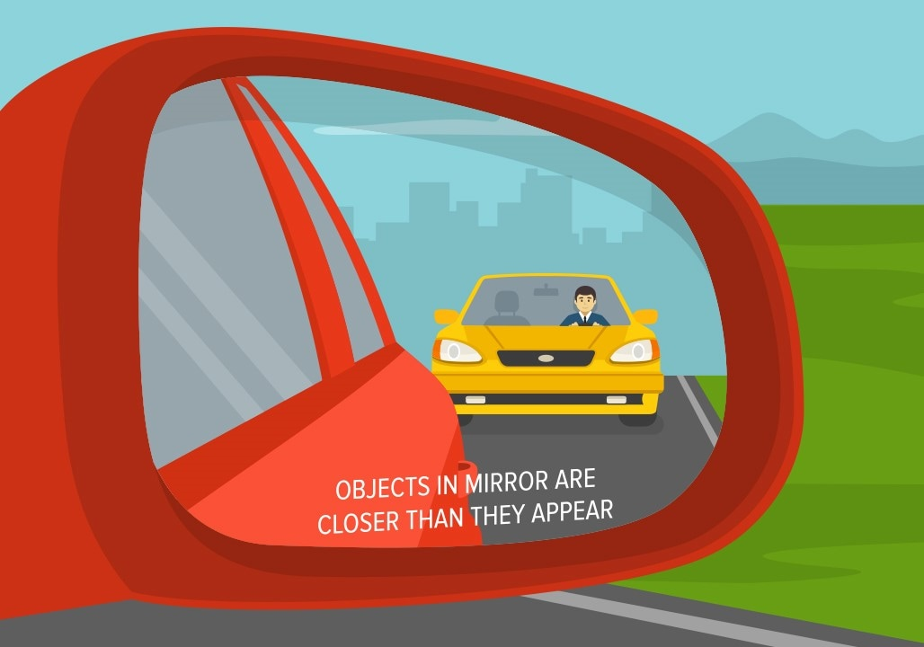
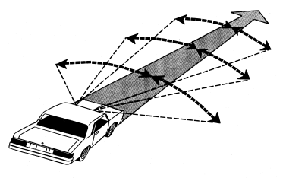
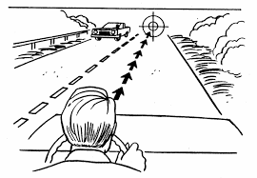
What is Situational Awareness?
A good way to be aware of your surroundings is to scan traffic on all sides of your vehicle:
  You can do this by checking the mirrors of the car and scanning conditions 20 to 30 seconds ahead of you.
  It is helpful to use a systemic search pattern (i.e., look down the middle and then from side to side).
Notes:
Narrative
In order to increase your perception of what is happening on the road, you will need to be fully aware of all your surroundings while you drive. It is helpful to do this in a systematic way, so that you always have an idea of what is happening around you. You can start by looking straight down your path of travel and then by checking the sides. It is also important to check your mirrors so that you can be aware of what is happening behind you, especially when traffic volumes are high.
Resources
Information sources:
The Nemours Foundation. 2024. 5 Ways to Be a Defensive Driver. https://kidshealth.org/en/teens/driving-safety.html#:~:text=Be%20aware%20of%20your%20surroundings,pull%20over%20to%20avoid%20it.
NHTSA. N.d. Perception. National Highway Traffic Safety Administration. https://www.nhtsa.gov/sites/nhtsa.gov/files/perception.pdf.
Image sources:
Flat vectors/Shutterstock.com (top)
National Highway Traffic Safety Administration. https://www.nhtsa.gov/sites/nhtsa.gov/files/perception.pdf (center and bottom)

Slide 6
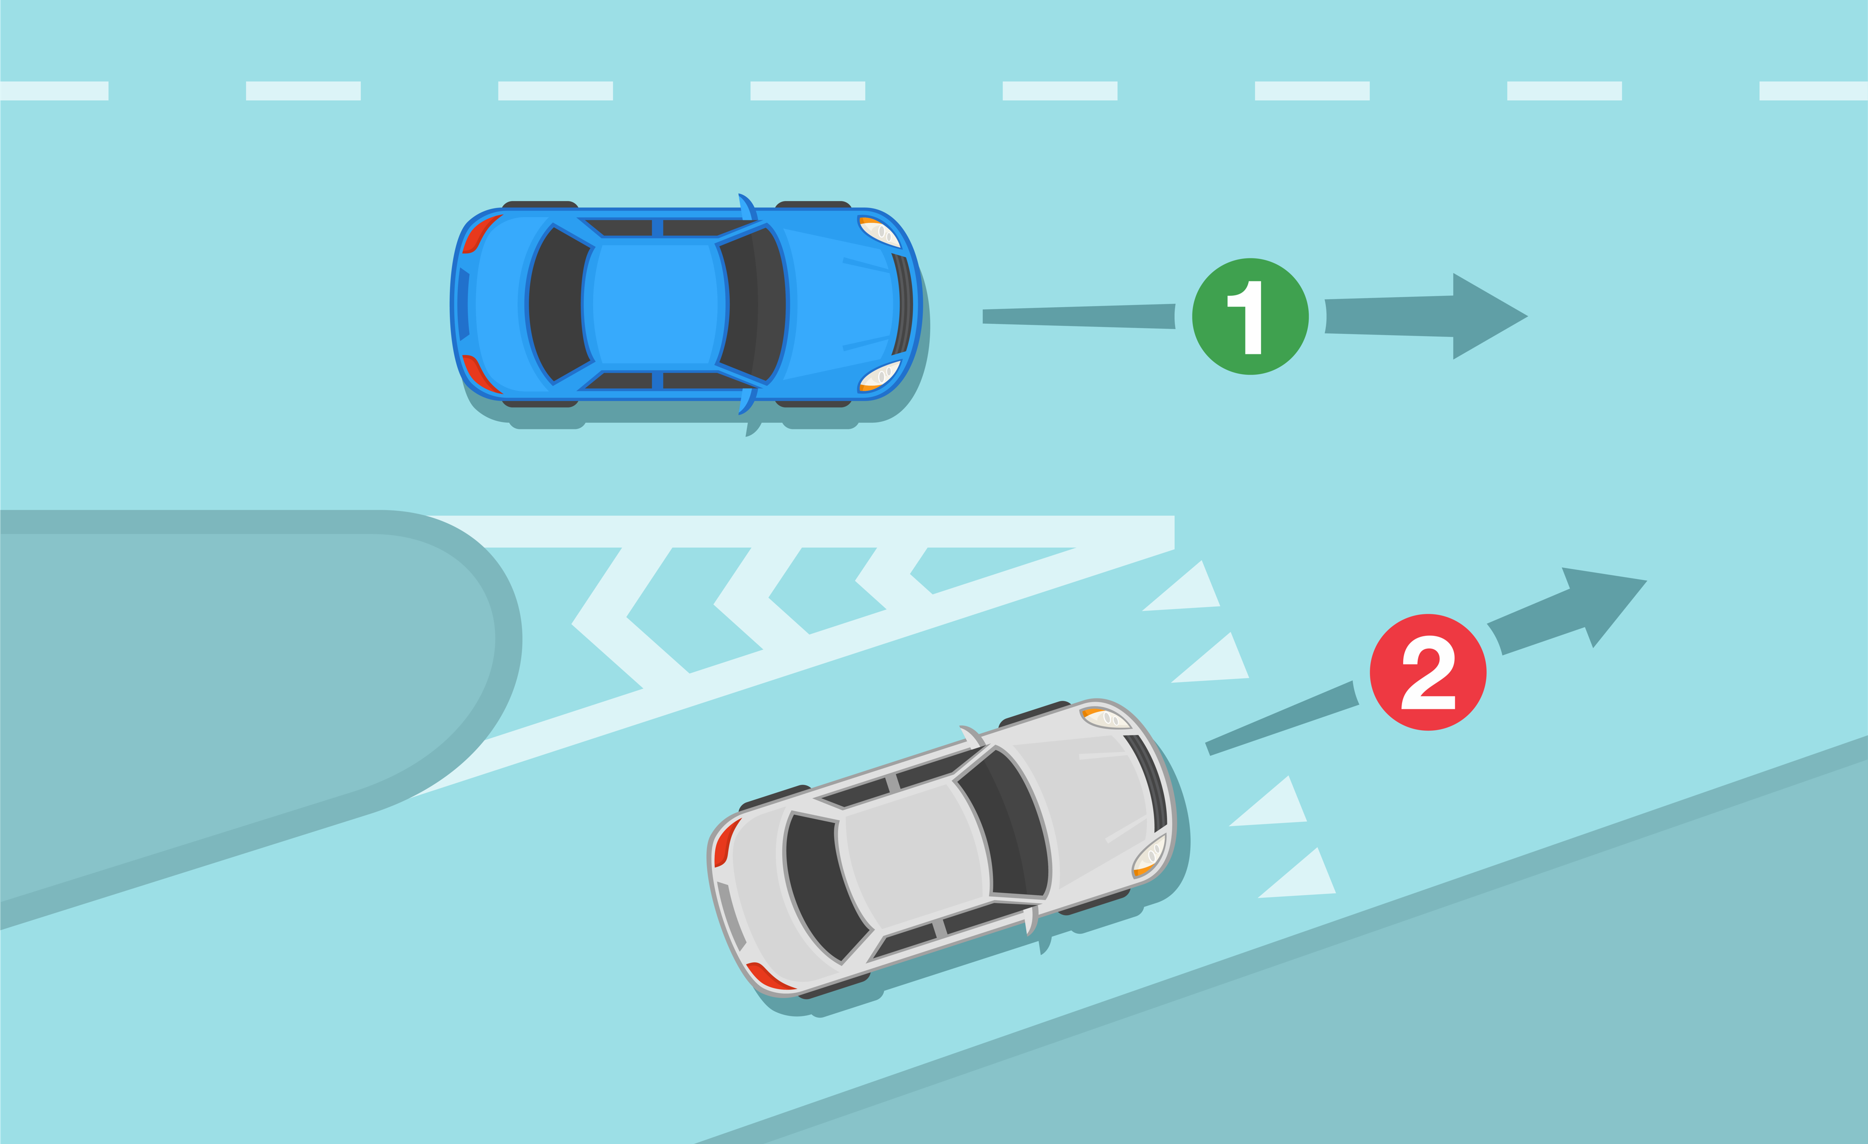
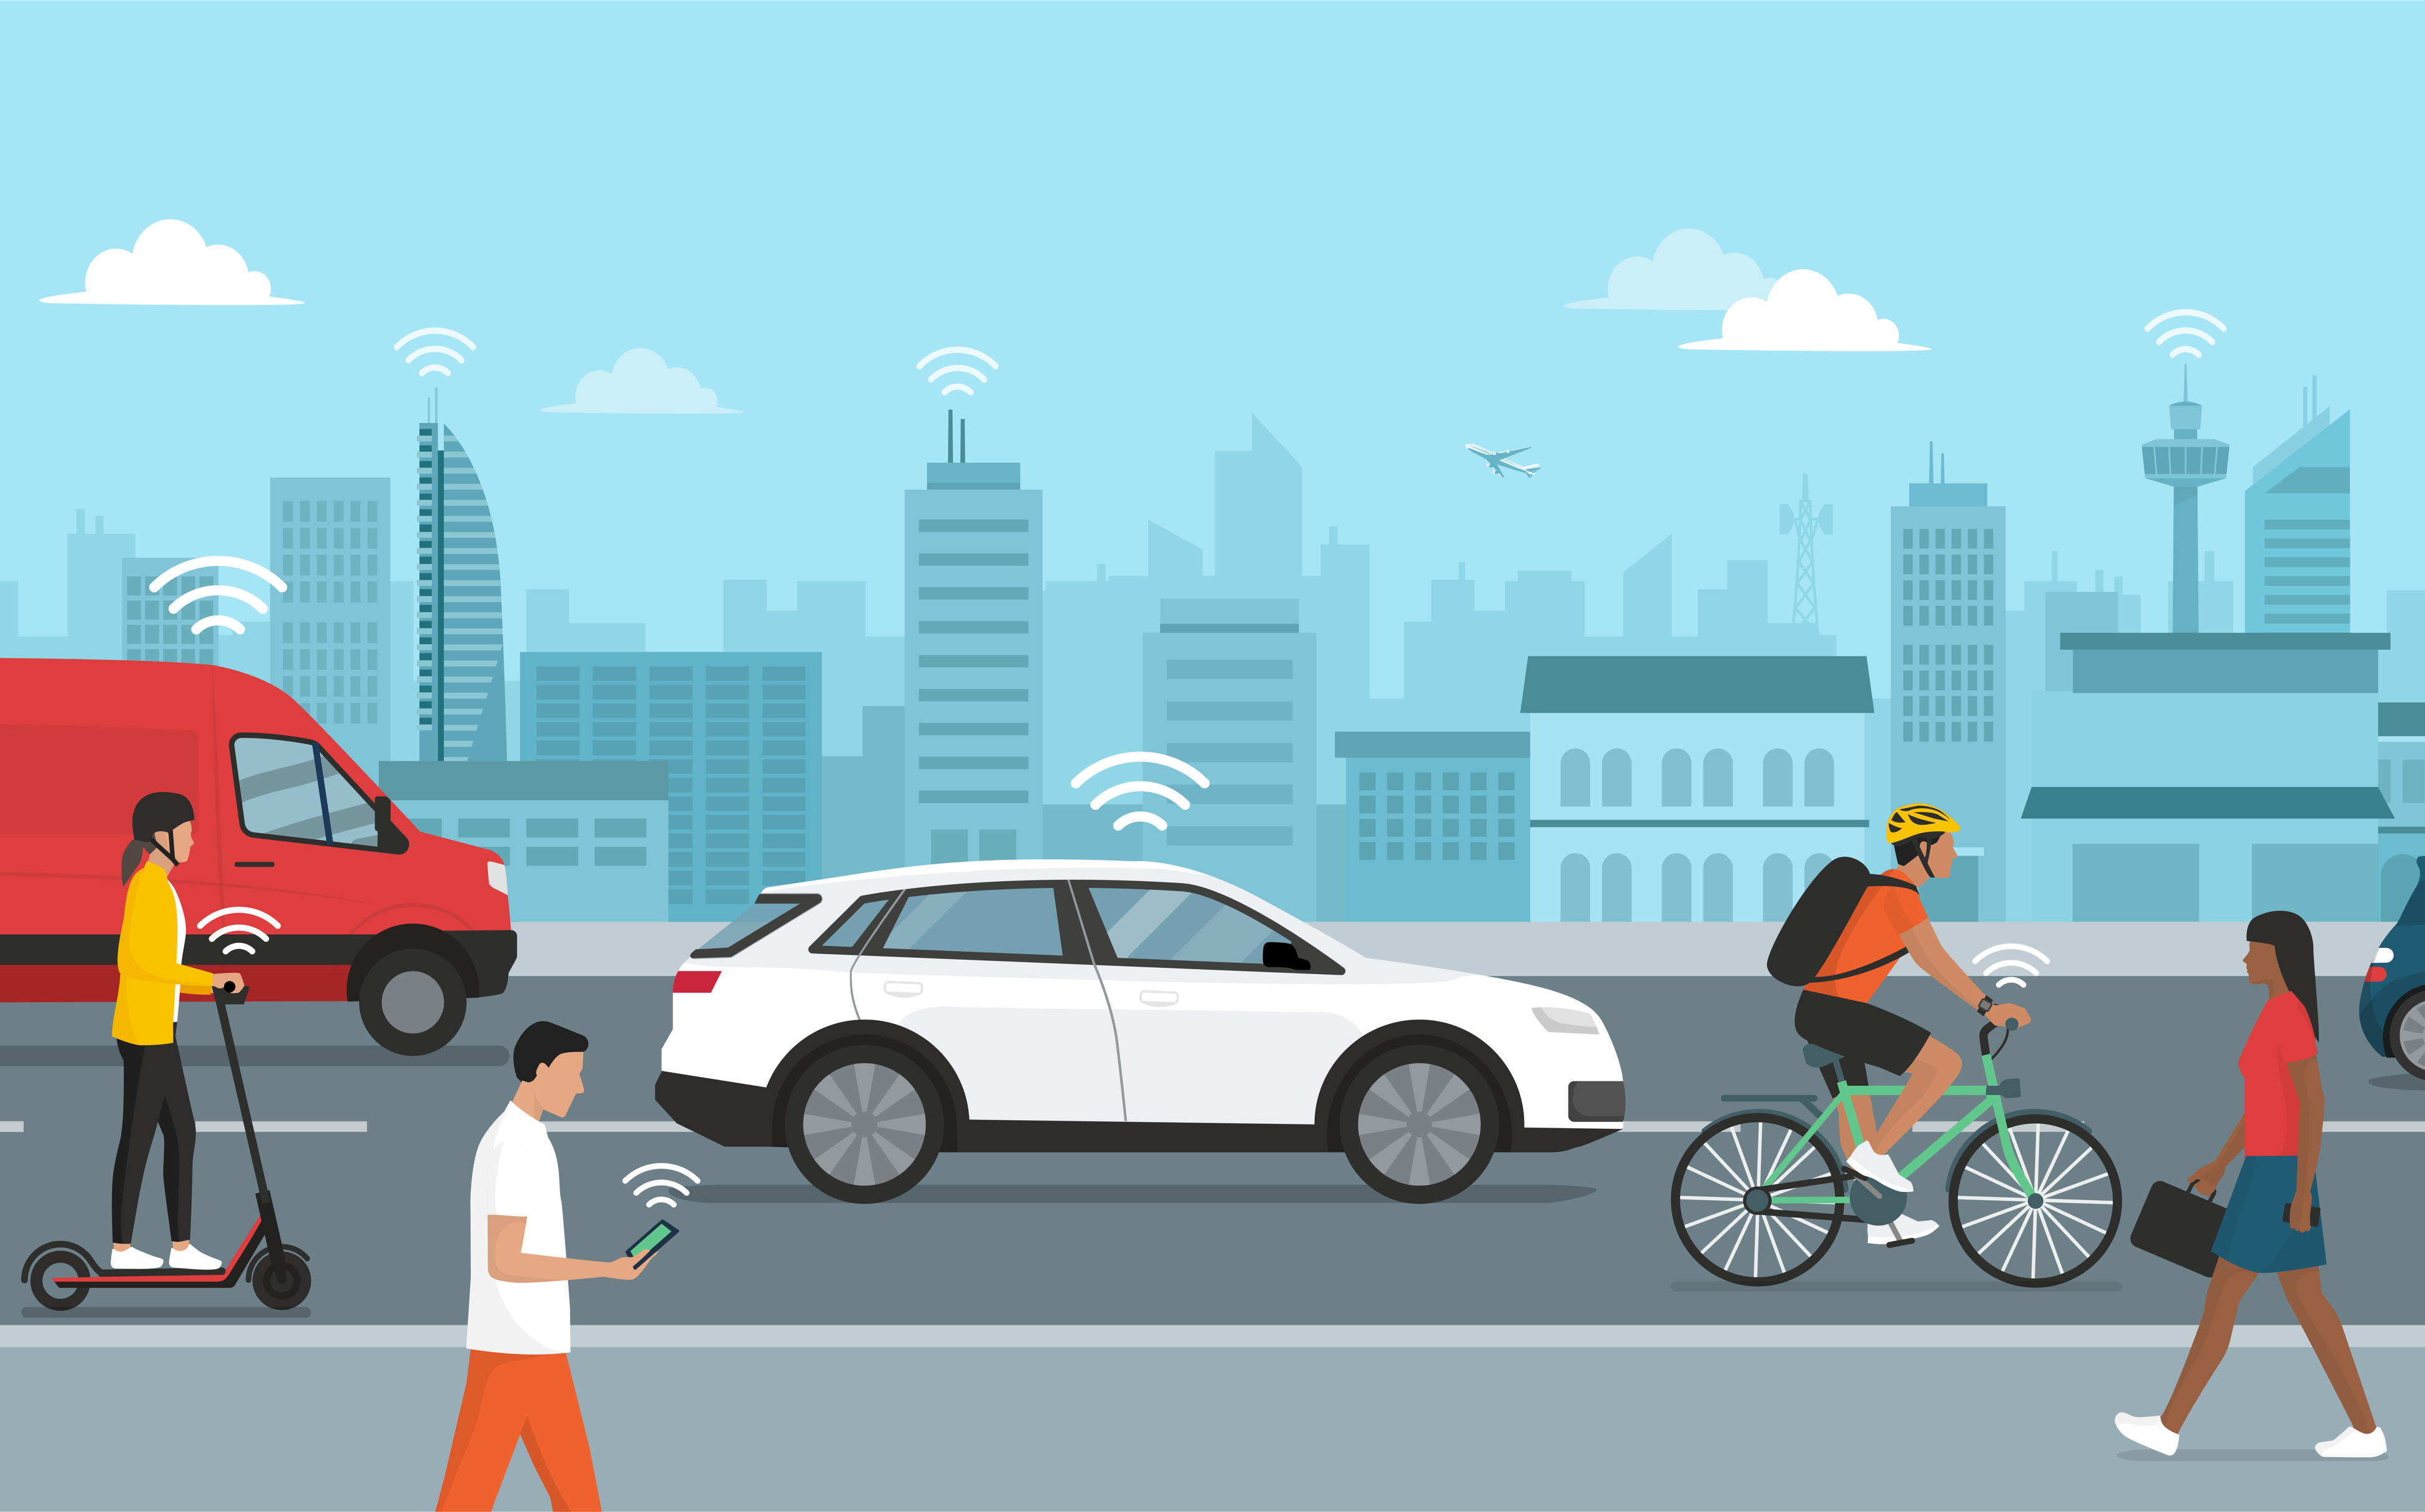
What to Look For?
When scanning your environment, look out for the following:
Vehicles emerging into the roadway, changing lanes, or turning off the roadway
Other road users like cyclists and pedestrians
Traffic in front and at the rear, especially when traffic is heavy
Traffic signals and road signs
Notes:
Narrative
Awareness, anticipation, and planning while driving will help you expect, see, and avoid potential hazards on the road. The more you practice, the more you'll be able to identify hazards (i.e., something that will or “might” happen that could cause you to slow down, change direction, or stop).
There are many things around you to identify when operating a vehicle. Some examples include the following:
Cars emerging
Cyclists ahead
Buses or public transit
Pedestrians
Other traffic and types of vehicles (like farm or slower-moving vehicles, motorcycles, etc.)
Traffic signals and road signs
Image sources:
Flat vectors/Shutterstock.com (top)
elenabsl/Shutterstock.com (bottom)

Slide 7
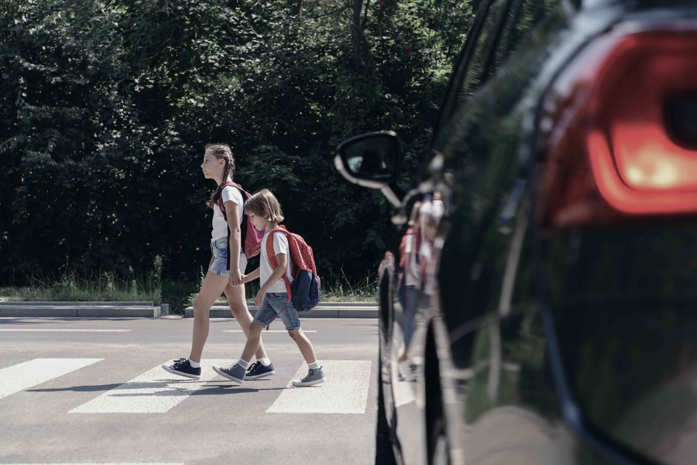
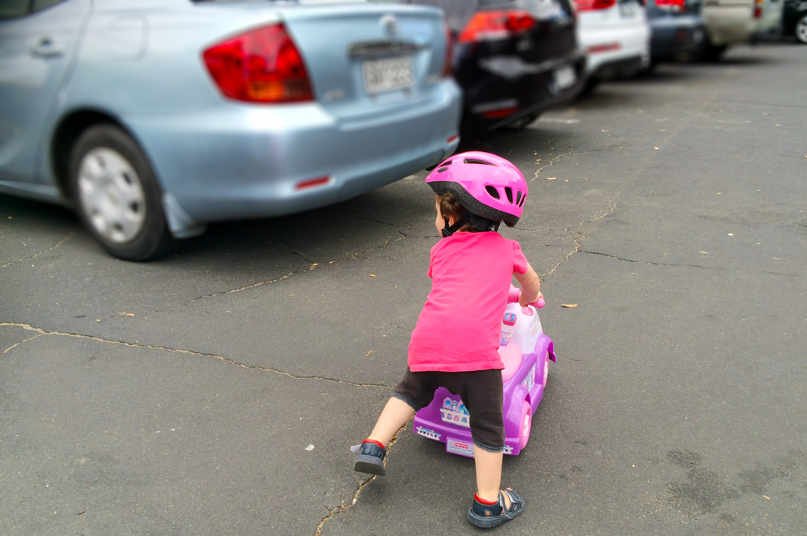
Sharing the Road with Pedestrians
Pedestrians and cyclists have the same rights to the road as you.
They face unique safety challenges because they are smaller and less visible.
Always slow down and be prepared to yield to pedestrians when they are in a crosswalk.
Do not pass vehicles stopped at a crosswalk. There may be pedestrians crossing whom you cannot see.
Be extra cautious when backing up across sidewalks or in parking lots.
Notes:
Narrative
Other road users have a right to the road too. Pedestrians and cyclists are the most vulnerable road users; therefore, extra care needs to be taken when they are around. Always yield to pedestrians and cyclists when they have the right-of-way and be mindful of their presence in parking lots and when driving close to sidewalks. Remember, in places where there are no sidewalks, pedestrians may share the road with vehicles. Slow down as you pass by them to reduce the chances of a crash.
Resources
Information sources:
NHTSA. 2024. Share the Road: It’s Everyone’s Responsibility. National Highway Traffic Safety Administration. https://www.nhtsa.gov/share-road-its-everyones-responsibility.
ADOT. 2017. Sharing the Road with Pedestrians. Arizona Department of Transportation. https://activetransportation.az.gov/sites/default/files/documents/files/adot-pedestrian-book-2017.pdf.
Image sources:
Ground Picture/Shutterstock.com (top)
ChameleonsEye/Shutterstock.com (bottom)

Slide 8
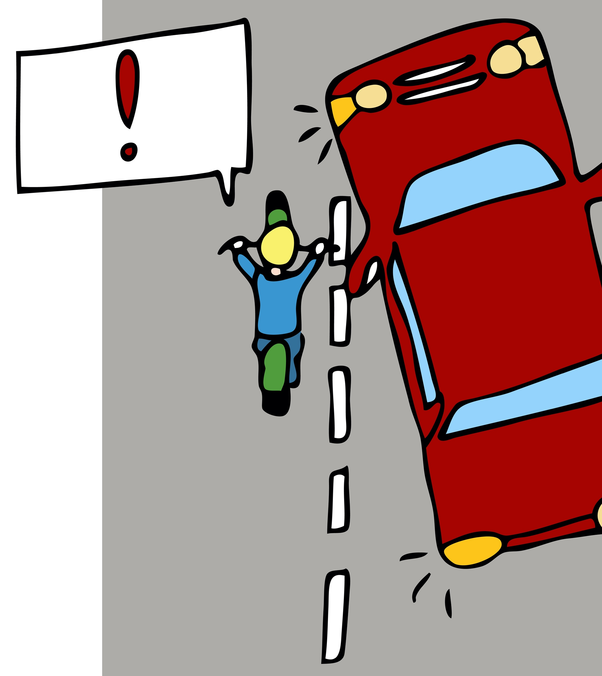
Sharing the Road with Cyclists
Look out for cyclists in places where vehicles do not appear (like before making a left-hand turn at an intersection).
Do not forget to check your blind spots since smaller vehicles like bicycles and motorcycles could be there.
Leave a full lane for the motorcycle—do not crowd into the same lane as the cycle.
Always remember that motorcyclists may have to downshift and weave to avoid bumps and road hazards when driving.
Notes:
Narrative
Driving with motorcyclists requires a lot of attention. They can be easily missed because they are small. Always check your blind spots before changing lanes or making a turn. Whenever you are following a motorcycle on the road, you should pay extra attention because they are more susceptible to hazards and bumps and may need to downshift and weave through traffic to stay safe.
Resources
Information sources:
NHTSA. 2024. Share the Road: It’s Everyone’s Responsibility. National Highway Traffic Safety Administration. https://www.nhtsa.gov/share-road-its-everyones-responsibility.
ADOT. 2017. Sharing the Road with Pedestrians. Arizona Department of Transportation. https://activetransportation.az.gov/sites/default/files/documents/files/adot-pedestrian-book-2017.pdf.
Image source:
John T Takai/Shutterstock.com

Slide 9
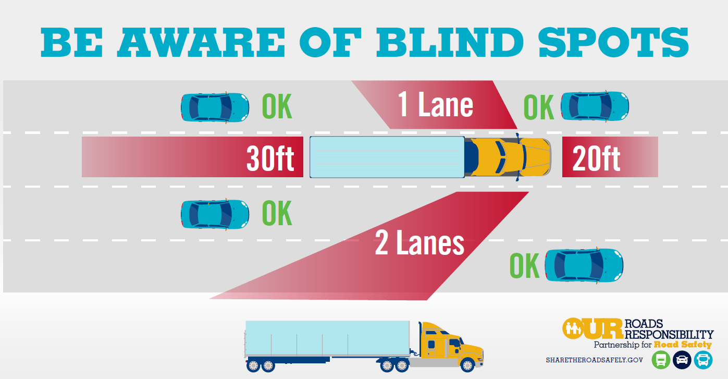
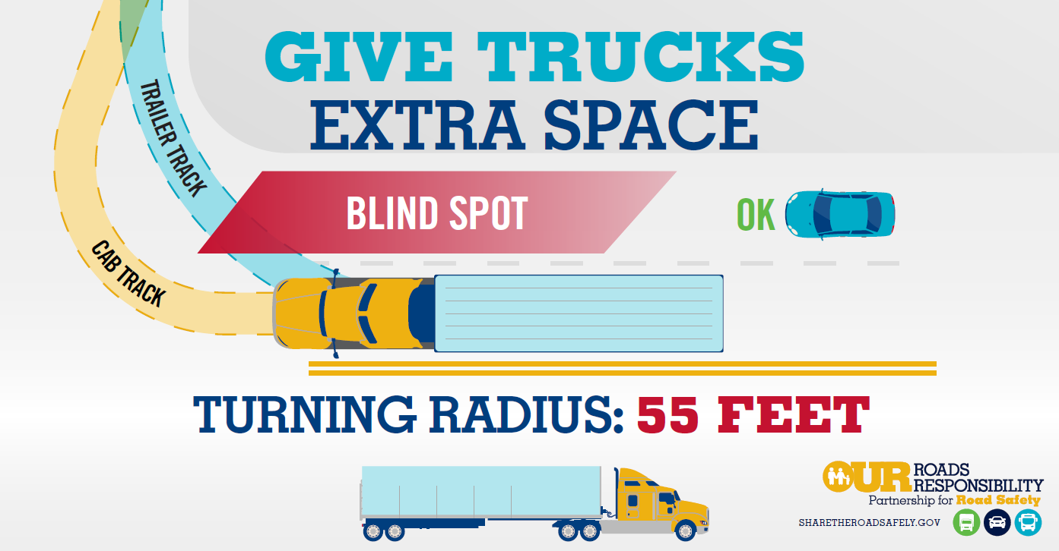
Sharing the Road with Large Trucks
Sharing the road with large trucks and oversized vehicles can be challenging because they have several blind spots and require larger turning radii.
Always make sure you are visible and give trucks plenty of room, especially when they are turning.
Notes:
Narrative
It is not only important for you to check your blind spot as a driver, but you should also know when you are likely to be in another vehicle’s blind spot. It is more difficult for trucks to check their blind spots. Therefore, you should be mindful of your position relative to them while on the road. Stay visible as much as you can and give trucks plenty of room when they need to turn.
Resources
Information source:
FMCSA. 2021. Truck Infographics. Federal Motor Carrier Safety Administration. https://www.fmcsa.dot.gov/ourroads/truck-infographics.
Image source:
Federal Motor Carrier Safety Administration. https://www.fmcsa.dot.gov/ourroads/truck-infographics

Slide 10
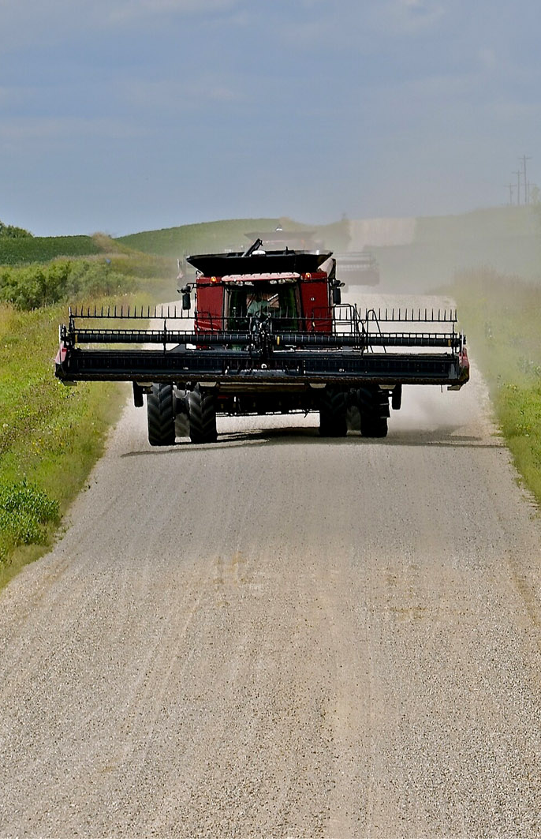
Sharing the Road with Farm Equipment
Farm vehicles are larger than street vehicles and drive slower than the speed limit.
Reduce speed when approaching farm equipment.
Recognize orange and red triangles that warn of slow vehicles.
Operators may not see you, so allow for unexpected and wide turns.
Pass equipment only when safe to do so.
Slow down for hills, curves, etc.
Notes:
Narrative
Another challenge on rural roadways is the presence of farm equipment. Many types of farm equipment are much larger and wider than street vehicles. They may overhang into the existing lane and make seeing around them difficult. Additionally, they are usually driving much slower than the posted speed limit.
Farm vehicles should be marked with a large orange and red triangle. If you encounter a farm vehicle, first reduce your speed. Next, wait to see if they will turn off the roadway. Many times, they are being moved from farm to farm and are only on the roadway for a short amount of time. If you do need to pass them, make sure you can fully see around the farm vehicle and only pass when it is safe. Remember, farm equipment operators may have a hard time seeing you.
Image source: CanStock/rjfiskness

Slide 11
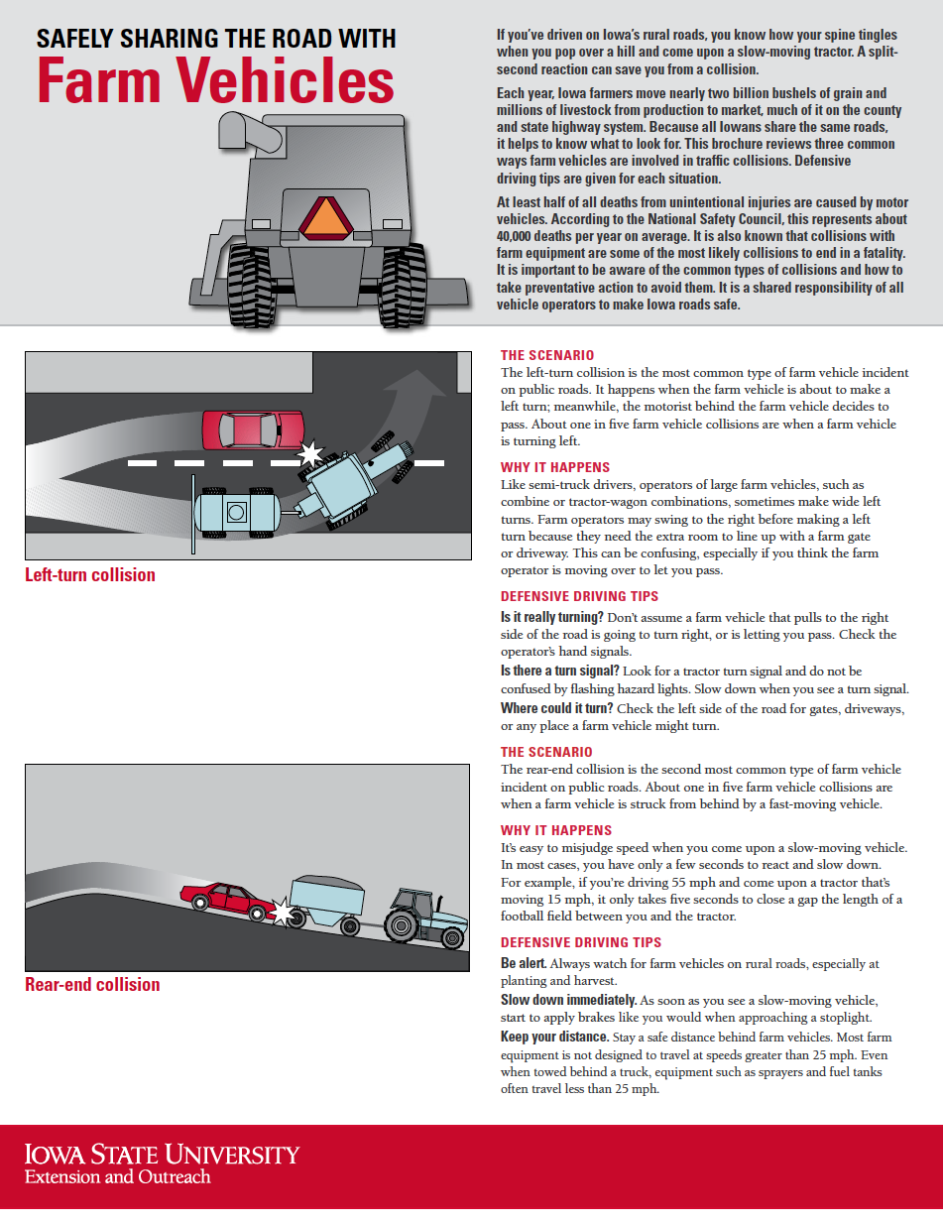
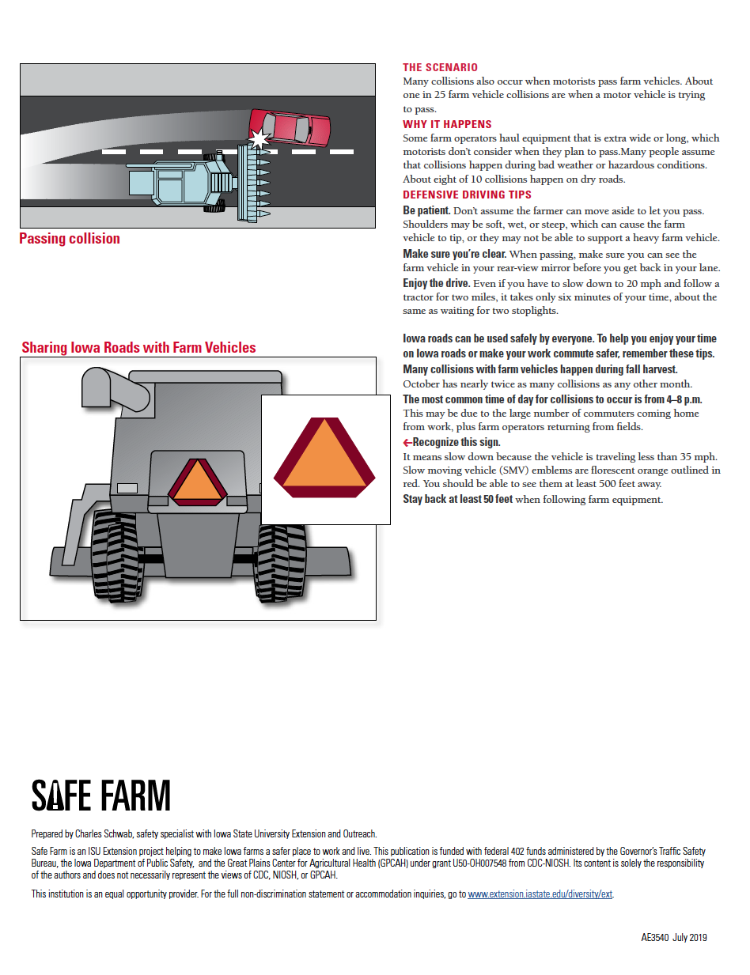
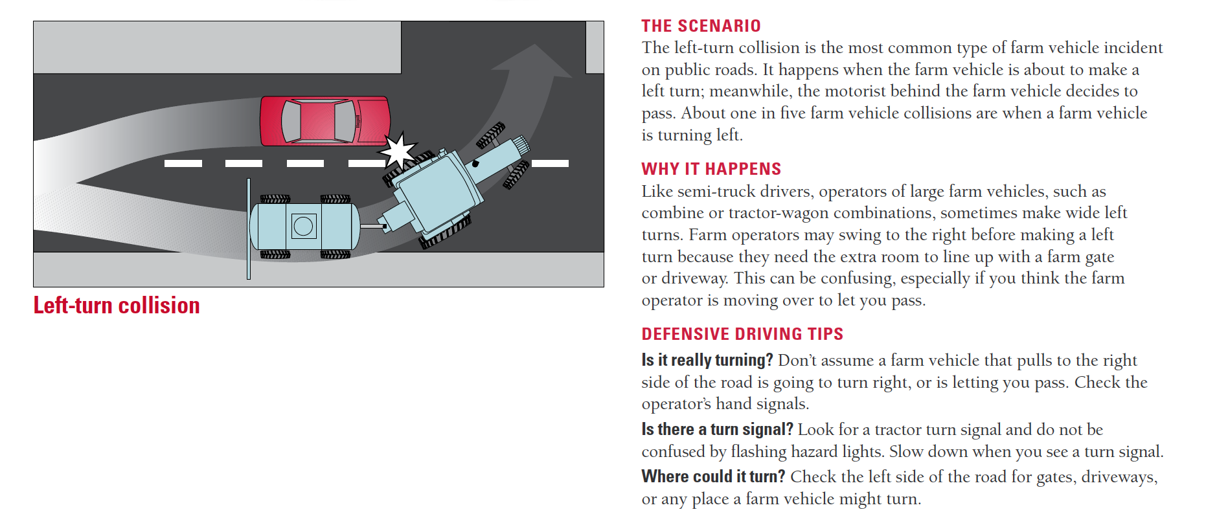
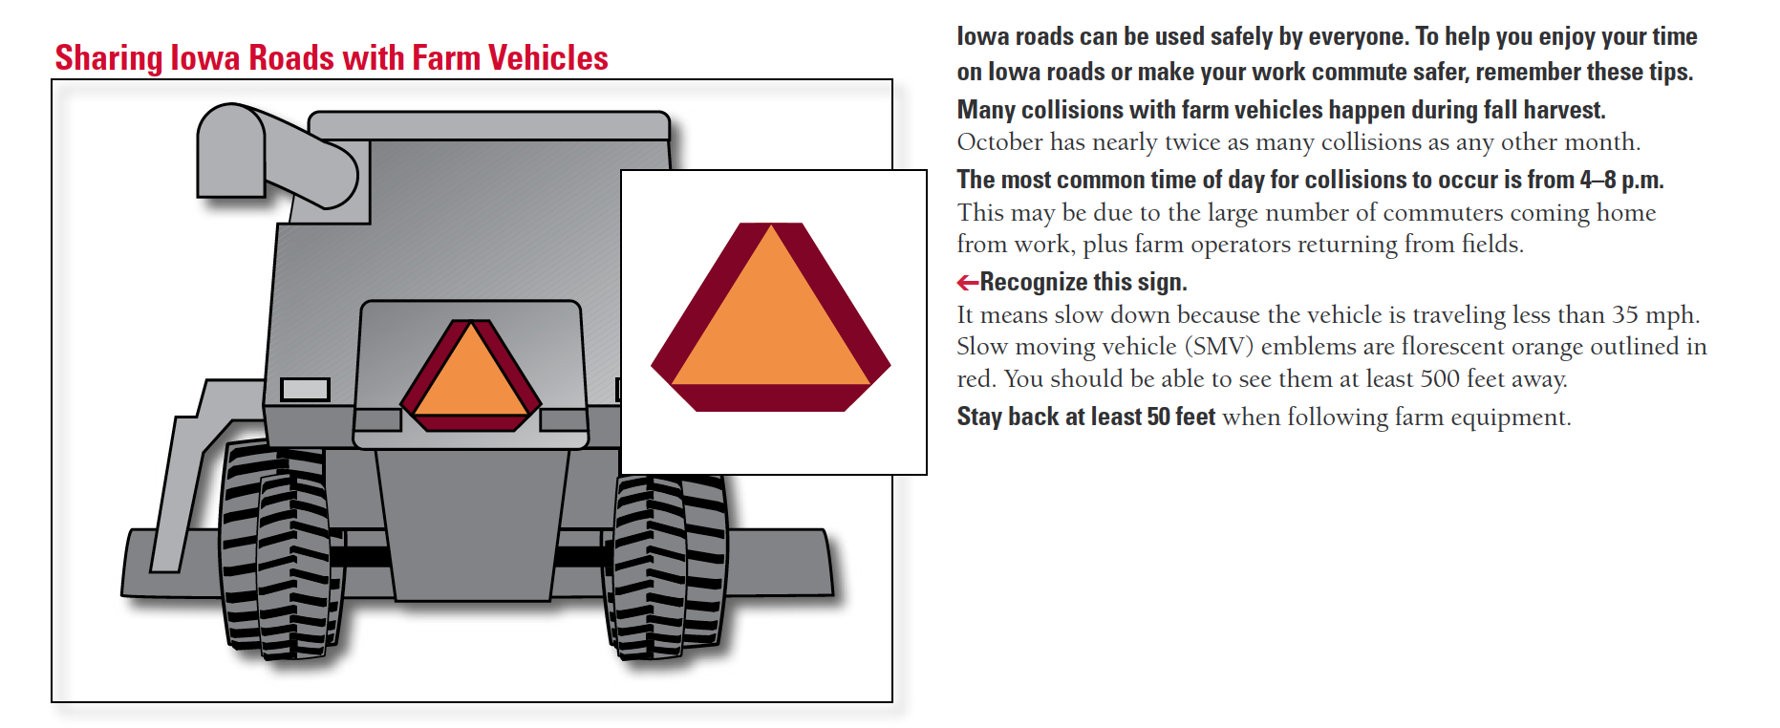
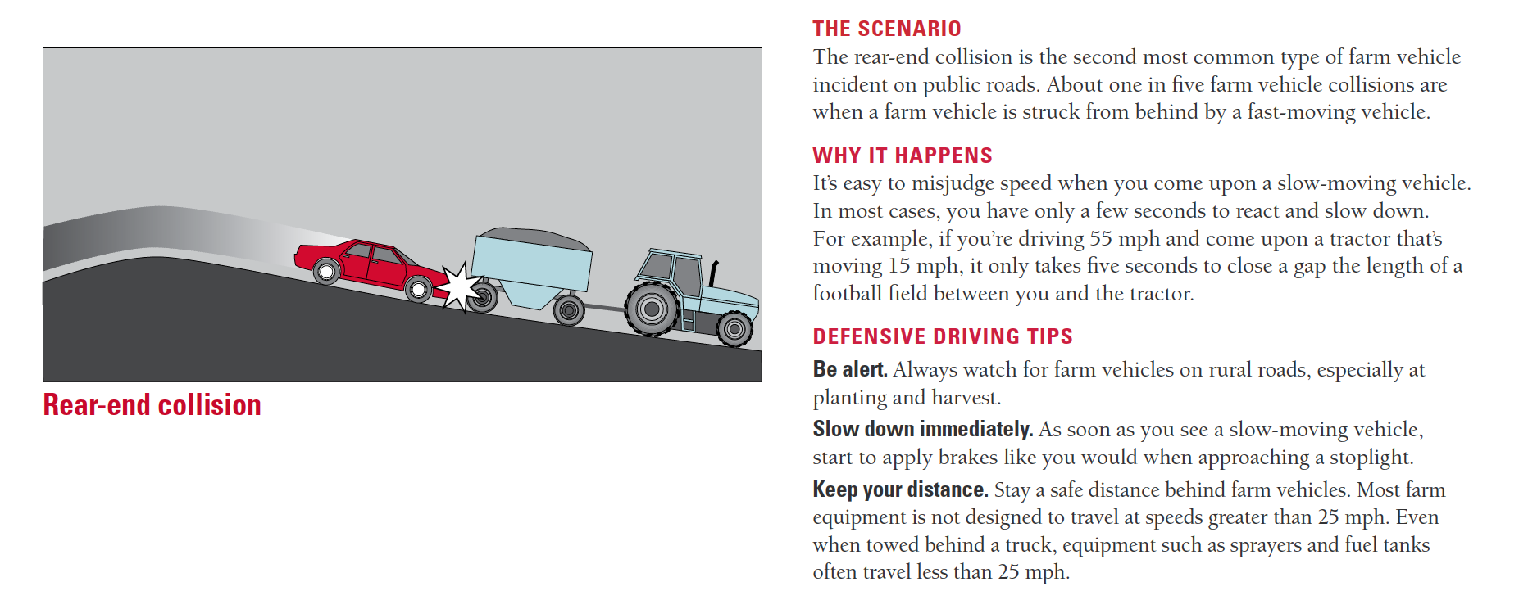
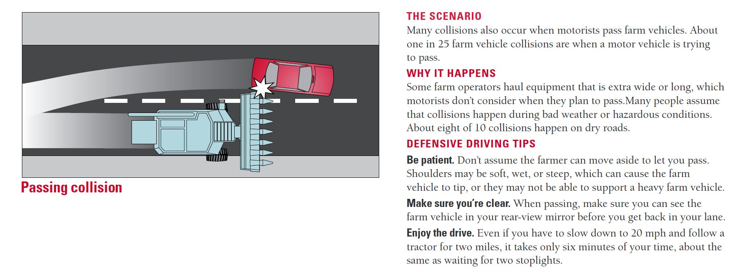
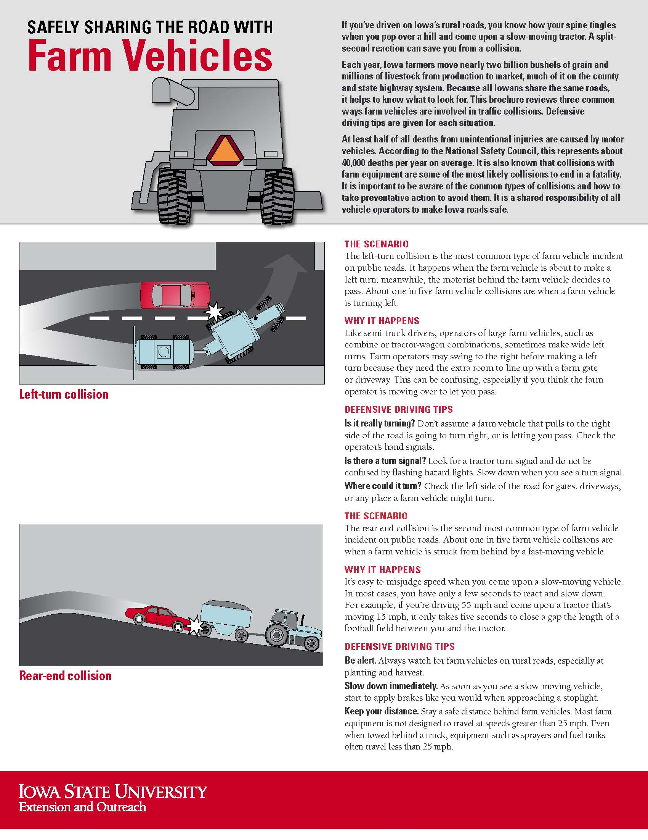
Notes:
Narrative
This graphic was created by Iowa State University Extension and Outreach and provides some additional facts about sharing the road with farm vehicles.
Image source: Iowa State University Extension and Outreach. https://store.extension.iastate.edu/product/5134.

Slide 12
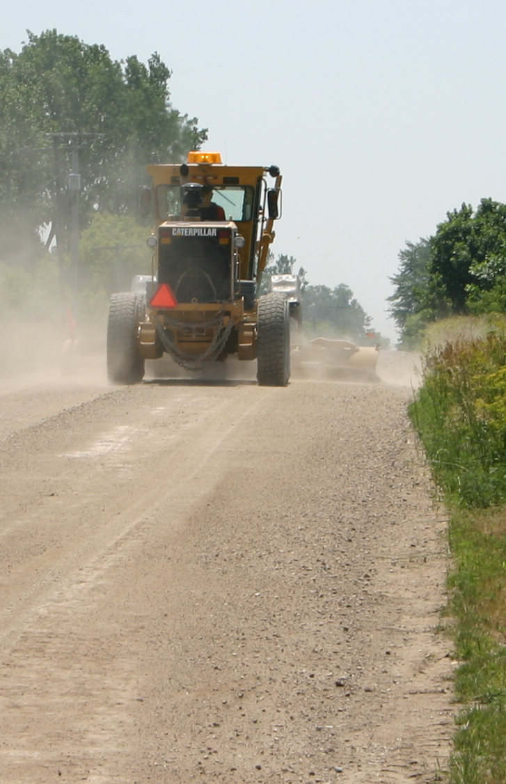
Sharing the Road with Slow-Moving Vehicles
ATV/UTVs, bicycles, horse-drawn vehicles, and road maintenance equipment move slower on the road and their users are unprotected in a crash.
Identify these vehicles as you approach and slow down.
Be ready to stop if necessary.
Proceed with caution and be aware that you may be in their blind spot.
Wait until there is sufficient room to pass and no oncoming traffic.
Notes:
Narrative
Besides farm equipment, there may be other slow-moving vehicles on Iowa roads. Several communities use horse-drawn vehicles and buggies. You may also see all-terrain vehicles, road maintenance vehicles, and bicycles. Pedestrians may also be present both in urban and rural roadways.
Bikers, pedestrians, buggy occupants, and horses are all vulnerable road users since they are unprotected in a crash. As a result, they are much more likely to die or be seriously injured when struck. Horses with a buggy are likely to be familiar with other roadway vehicles. However, they can still be startled by loud noises, which can be dangerous.
When approaching slow-moving vehicles, including pedestrians, slow down and be ready to stop if necessary. Pass with caution since you may be in their blind spot. Make sure you can safely pass them while also giving them plenty of room.
Resources
Information source:
Iowa Department of Transportation. 2024. Iowa Driver’s License Manual. https://iowadot.gov/mvd/driverslicense/dlmanual/dlmanual.pdf.
Image source: Institute for Transportation at Iowa State University

Slide 13
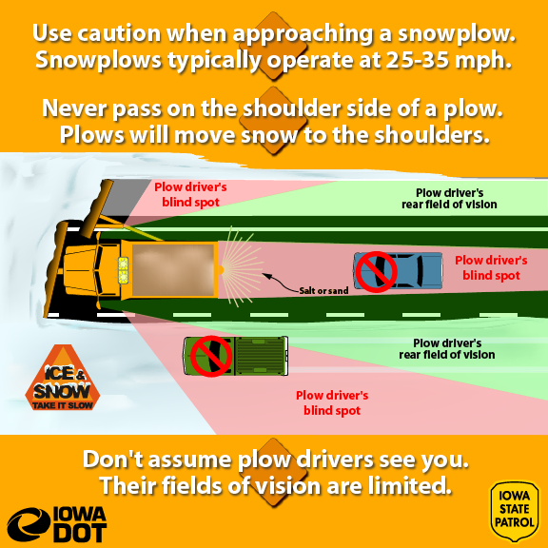
Sharing the Road with Snowplows
Use caution when approaching a snowplow
Approach at a reduced speed
Never pass on the shoulder
Stay back and wait until it is safe to pass
Allow plenty of room when passing and be aware of blowing snow affecting your visibility
Notes:
Narrative
In addition to focusing on keeping your vehicle under control in winter weather, you also need to be prepared to operate it in the vicinity of snowplows. When you are approaching a snowplow, particularly when coming up from behind, approach at a reduced speed and keep your distance. Never pass a plow on the shoulder. If you do need to pass a plow, stay back until you have determined you can safely complete the pass—this means no oncoming traffic is approaching and you have good visibility. Visibility is key for two reasons: (1) blowing snow from the plow can restrict your ability to see and (2) blowing snow, and blind spots on the plow equipment in general, can limit the ability of a plow operator to see you.
Resources
Information sources:
Iowa Department of Transportation. 2024. Iowa Driver’s License Manual. https://iowadot.gov/mvd/driverslicense/dlmanual/dlmanual.pdf
Illinois Department of Transportation. Don’t Crowd the Plow. https://www.youtube.com/watch?v=KoKxZegdRwk&t=6s.
Image source:
Iowa State Patrol, Iowa DOT

Slide 14
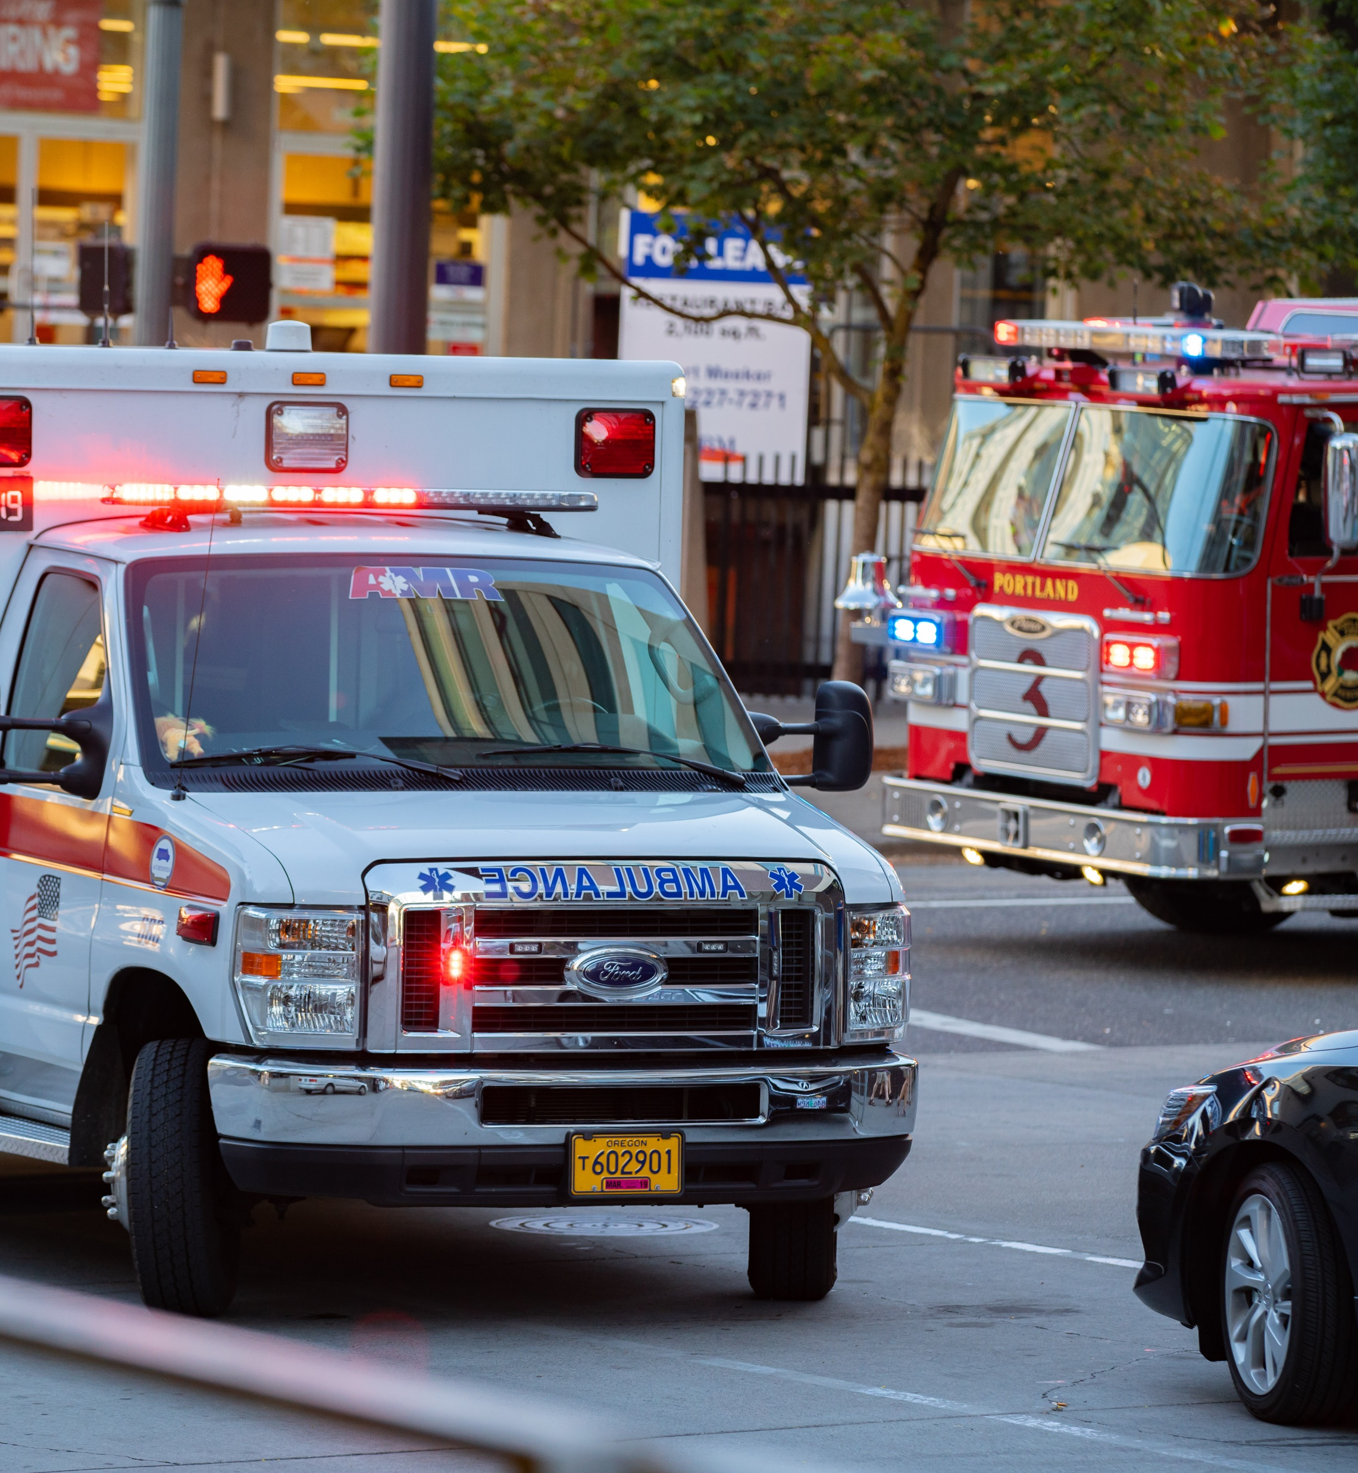
Sharing the Road with Emergency Vehicles
When a police vehicle, fire engine, ambulance, or other emergency vehicles are using a siren or flashing lights
  Pull over to the right as far as possible when you see an emergency vehicle from either direction to allow them to pass
  If you are at an intersection, drive through the intersection first, then pull over
On a divided roadway with a median, if an emergency vehicle is on the other side, you do not need to stop
If following an emergency vehicle, stay at least 500 feet behind
Notes:
Image source: Alexander Oganezov/Shutterstock.com

Slide 15
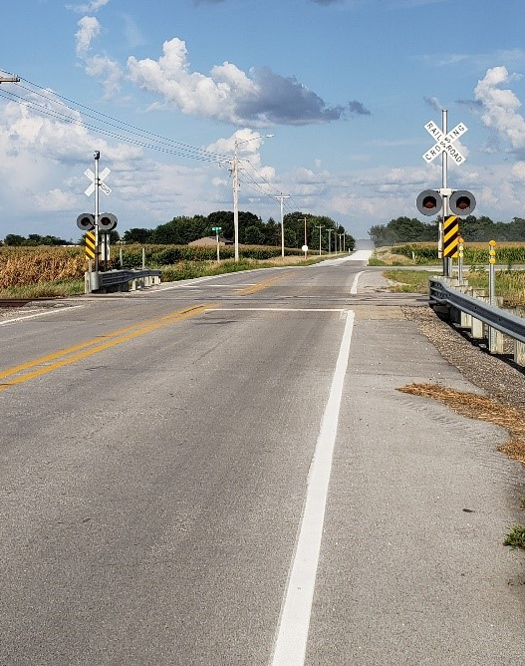
Sharing the Road with Trains
Only cross a train track at a designated crossing
Trains always have the right-of-way
Obey warning signs and signals
Multiple tracks means multiple trains
When approaching a railroad crossing
  Get rid of distractions
  Roll down windows so you can hear an approaching train
  Always expect a train
  Do not cross when lights are flashing or gates are down
  Make sure you can completely cross the tracks before starting—do not stop on tracks
  If you get stuck on the tracks, get everyone out of the vehicle and call 911
Notes:
Image source: Institute for Transportation at Iowa State University

Slide 16
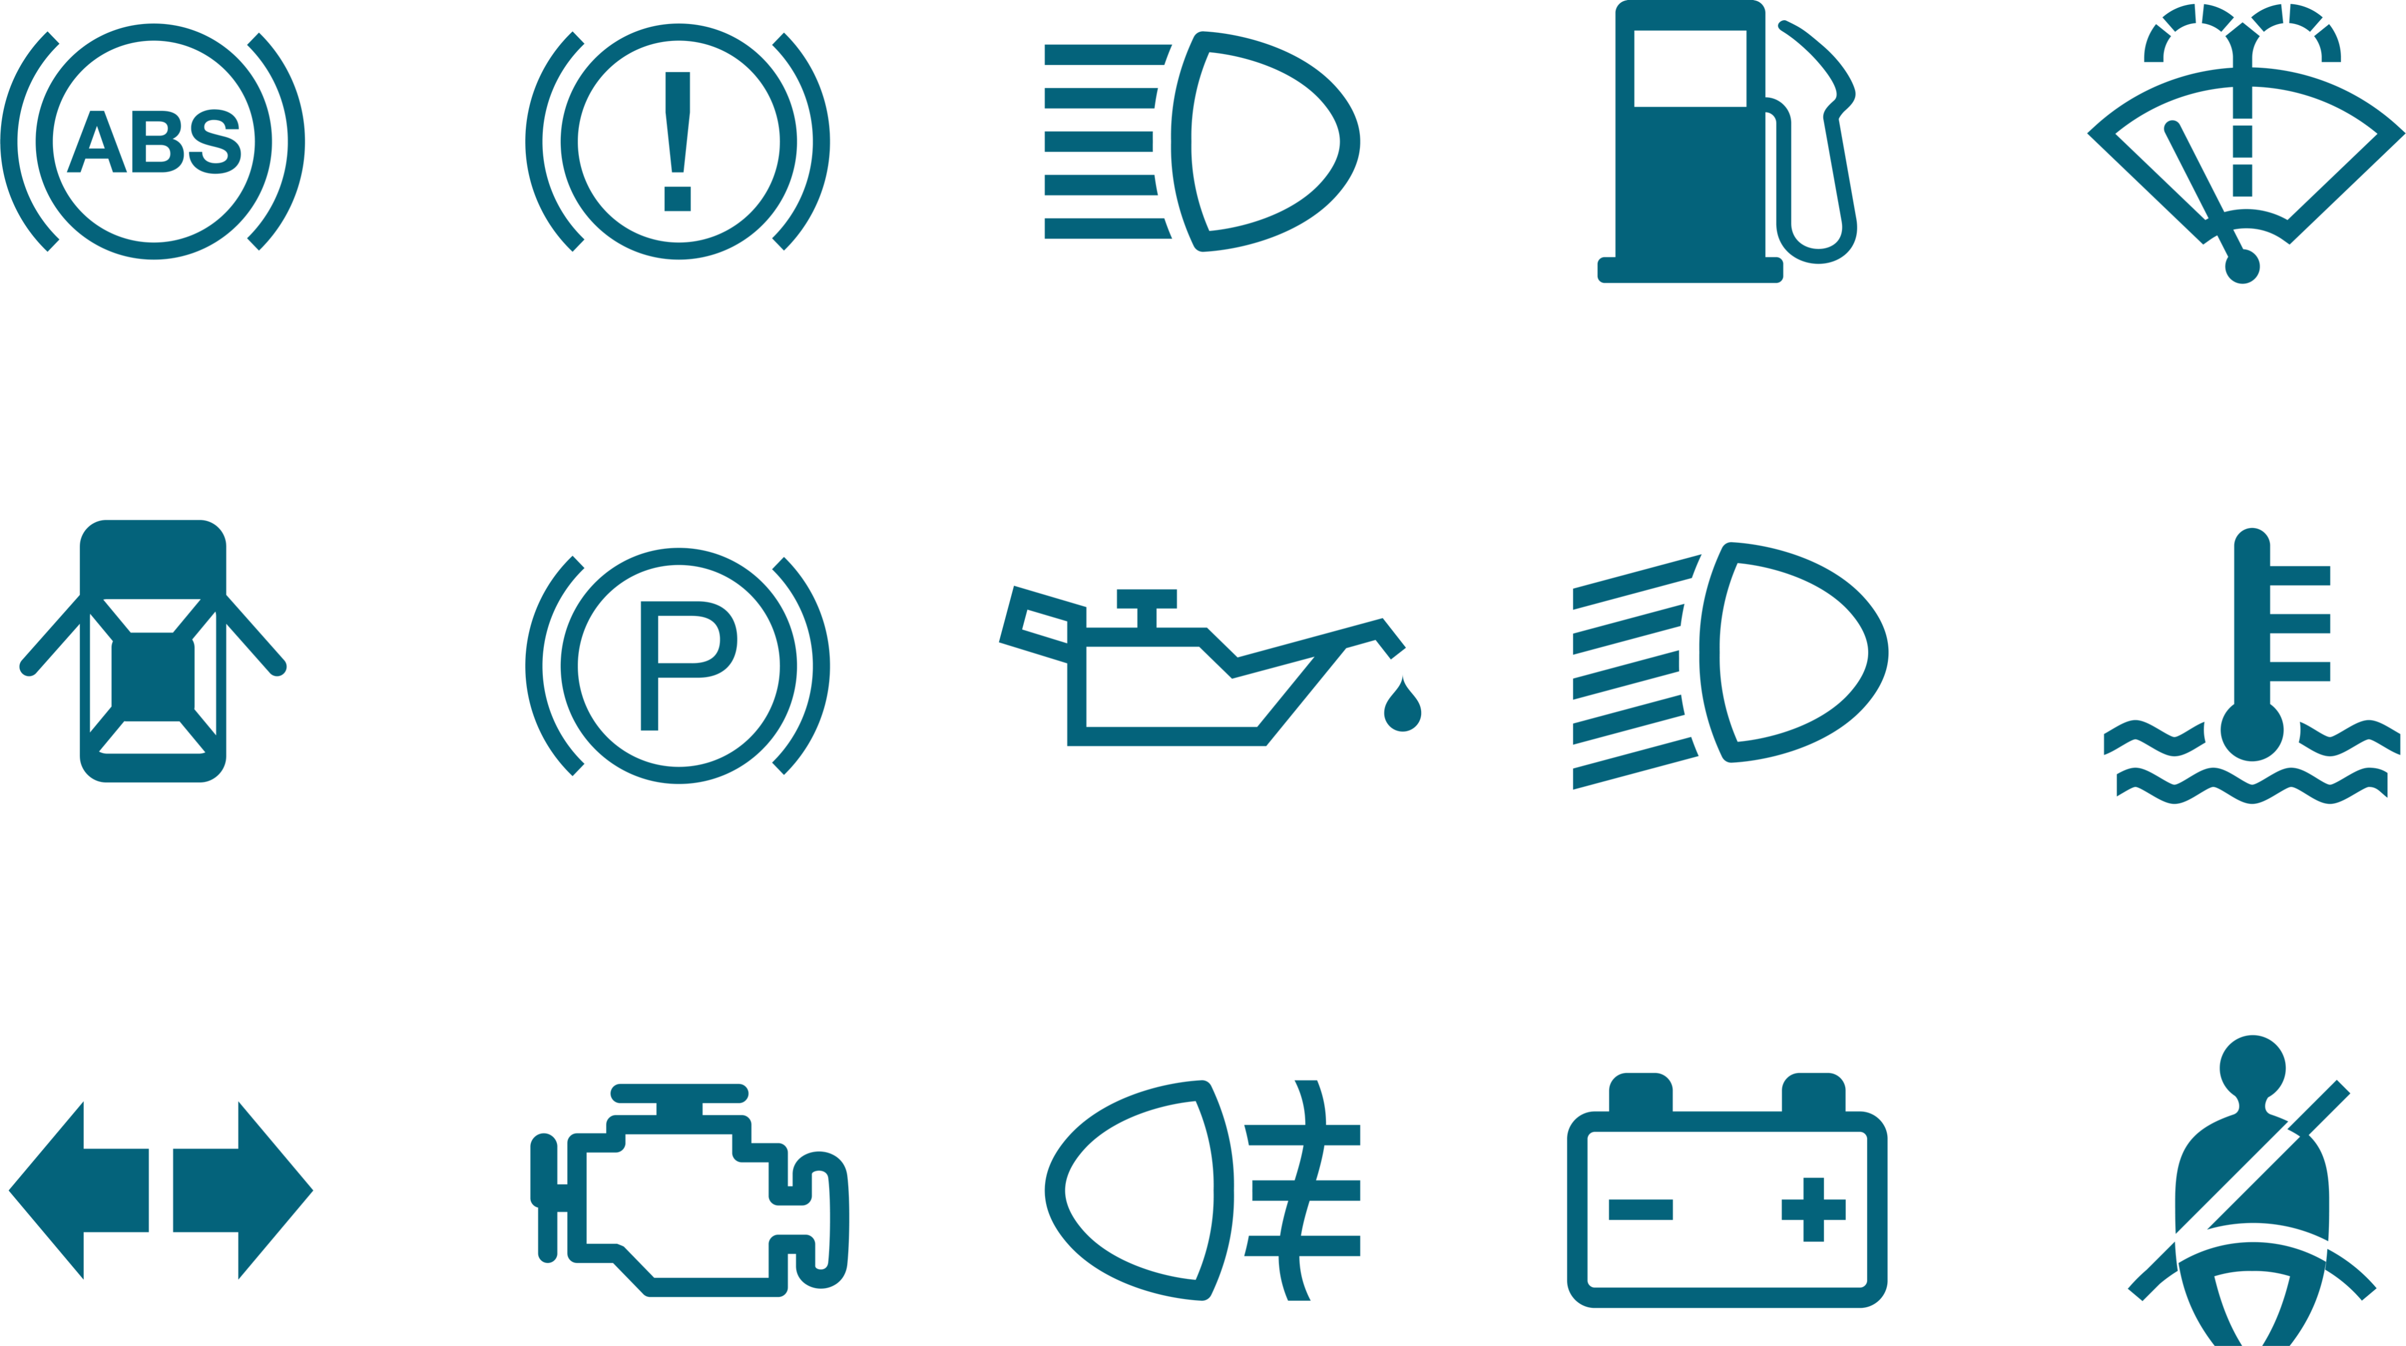
General Tips for Improving Driving Situations and Awareness
Know your vehicle specification and identify the equipment and technology in your car.
Identify various dashboard lights and other sounds and signals before, during, and after driving.
Check and adjust your equipment to provide maximum visibility and comfort when driving.
Notes:
Narrative
First, it is important to get to know your vehicle. All-around observation is critical for safe driving. Familiarize yourself with your car by spending time understanding your vehicle's specific make and model. This includes reading the owner's manual, studying the layout of the engine bay, and knowing the functions of various components. Familiarize yourself with your car’s equipment and technology. Your car’s internal rear-view mirror and two side mirrors allow you to see what’s going on behind and to the sides of your vehicle. It’s important that you adjust your car mirrors so that they provide the maximum visibility possible.
Other safety measures include the following:
Blind spot detection (uses sensors to detect vehicles in your blind spot and alerts you with a warning light or sound)
Automatic emergency braking (AEB) (uses sensors to detect an imminent crash and automatically applies the brakes to prevent or minimize an impact)
Forward collision warning (FCW) (alerts you if the vehicle detects that an impact is imminent)
Lane keeping assist (helps keep your car safely in its lane on the roadway)
Seat belts
Air bags
Electronic stability control
Backup camera
Driver assistance
Image source: nendra wahyu kuncoro/Shutterstock.com

Slide 17
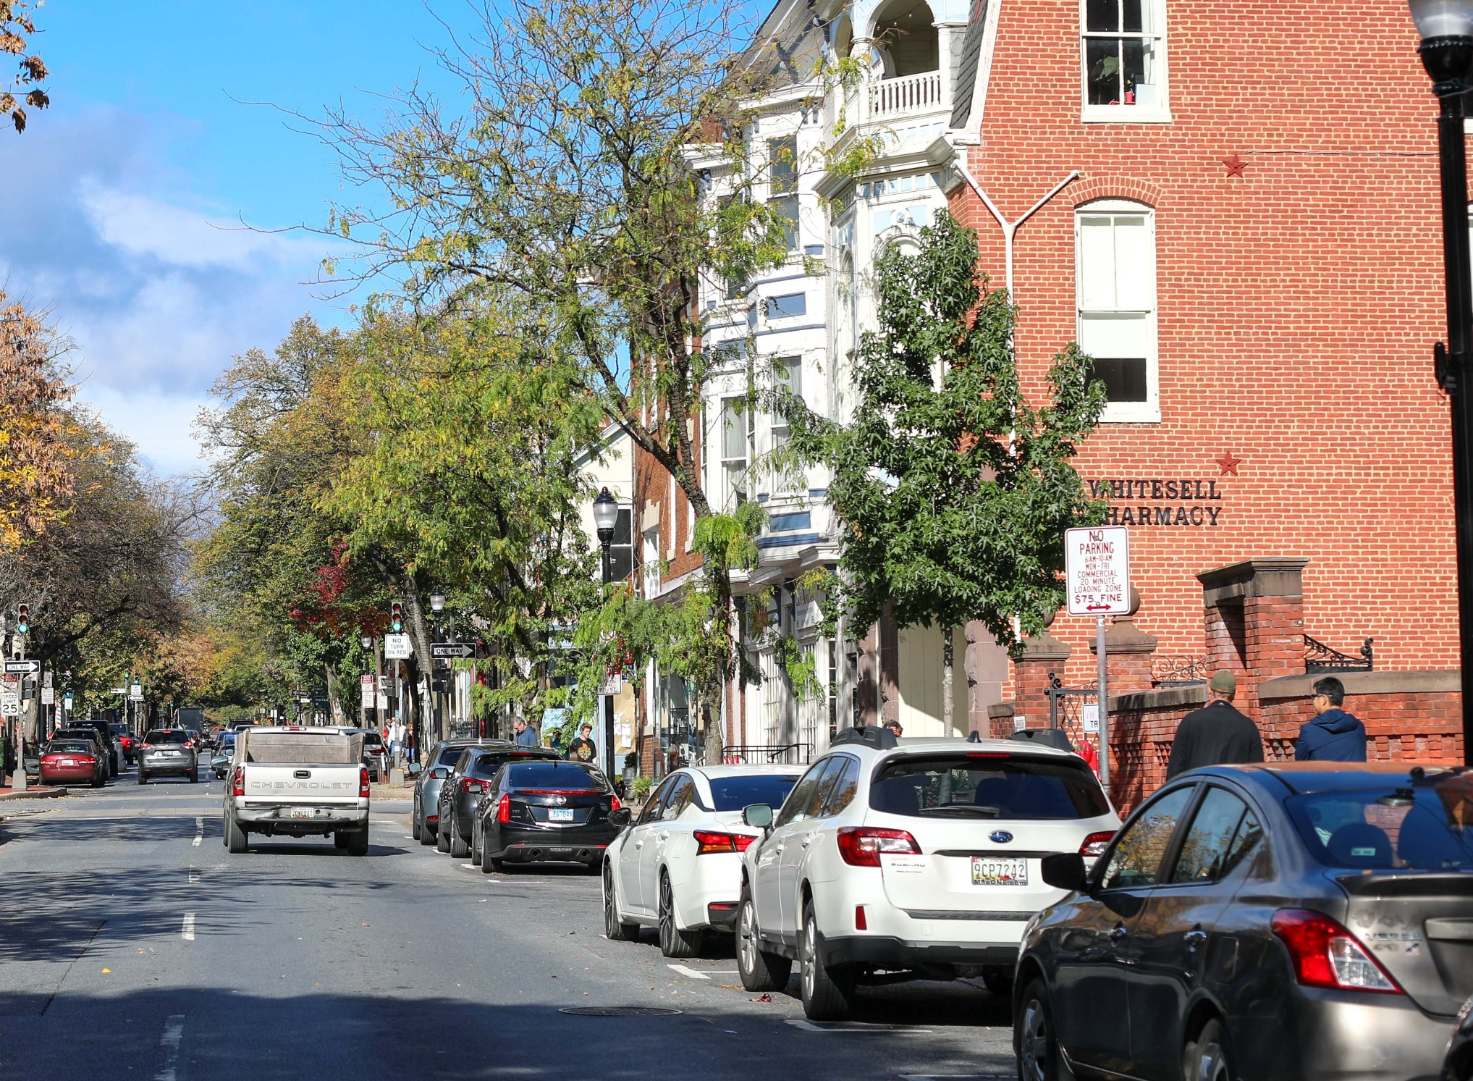
General Tips for Improving Driving Situations and Awareness
Social driving
  This refers to the pressure from others for you to maneuver your vehicle safely around them or nearby obstacles.
Space management
  Stopping distances are important to know, especially around trucks and other large vehicles.
  Parked cars can narrow the street, especially with oncoming traffic. It helps to slow down significantly when using such roads.
Notes:
Narrative
When driving, it is important to constantly be aware of the space surrounding your vehicle. The spaces in front and to the sides of your vehicle are particularly important. As a rule of thumb, there should be a 2- to 4-second gap between your vehicle and the vehicle in front of you. When driving on a multilane highway, you should keep your vehicle centered in the middle of the lane and not lean to the left or right. Always recenter your vehicle as soon as you complete a lane change maneuver. Note, the slower is your speed, the easier it is to maintain a safe cushion around your vehicle. This is especially beneficial when you are driving in areas with on-street parking.
Image source: Nicole Glass Photography/Shutterstock.com

Slide 18
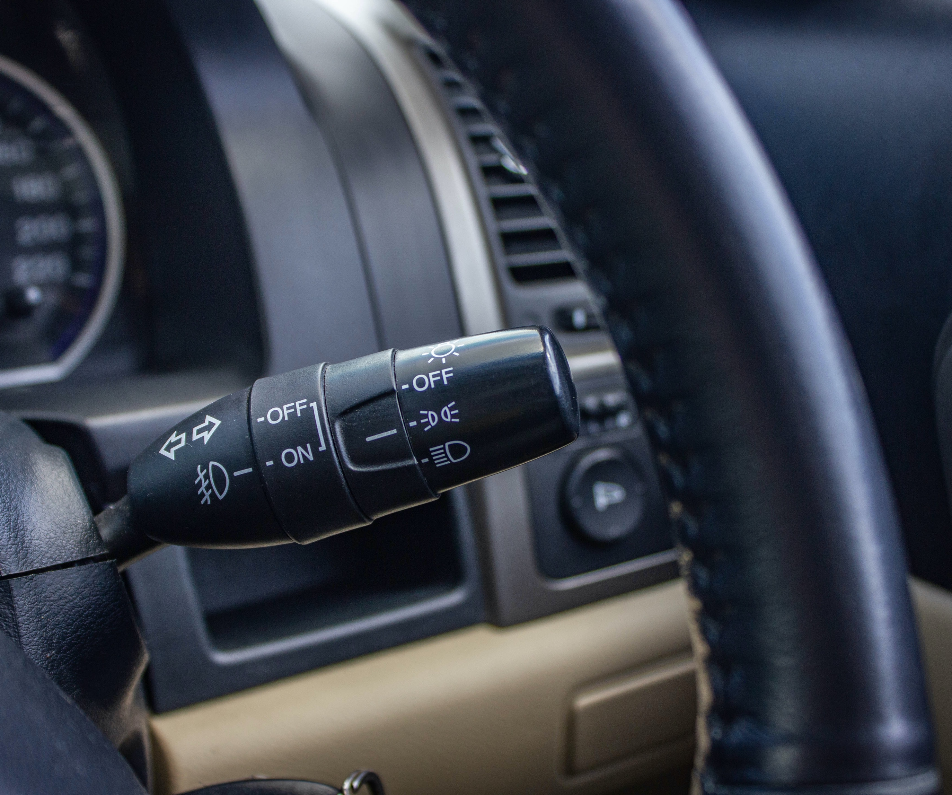
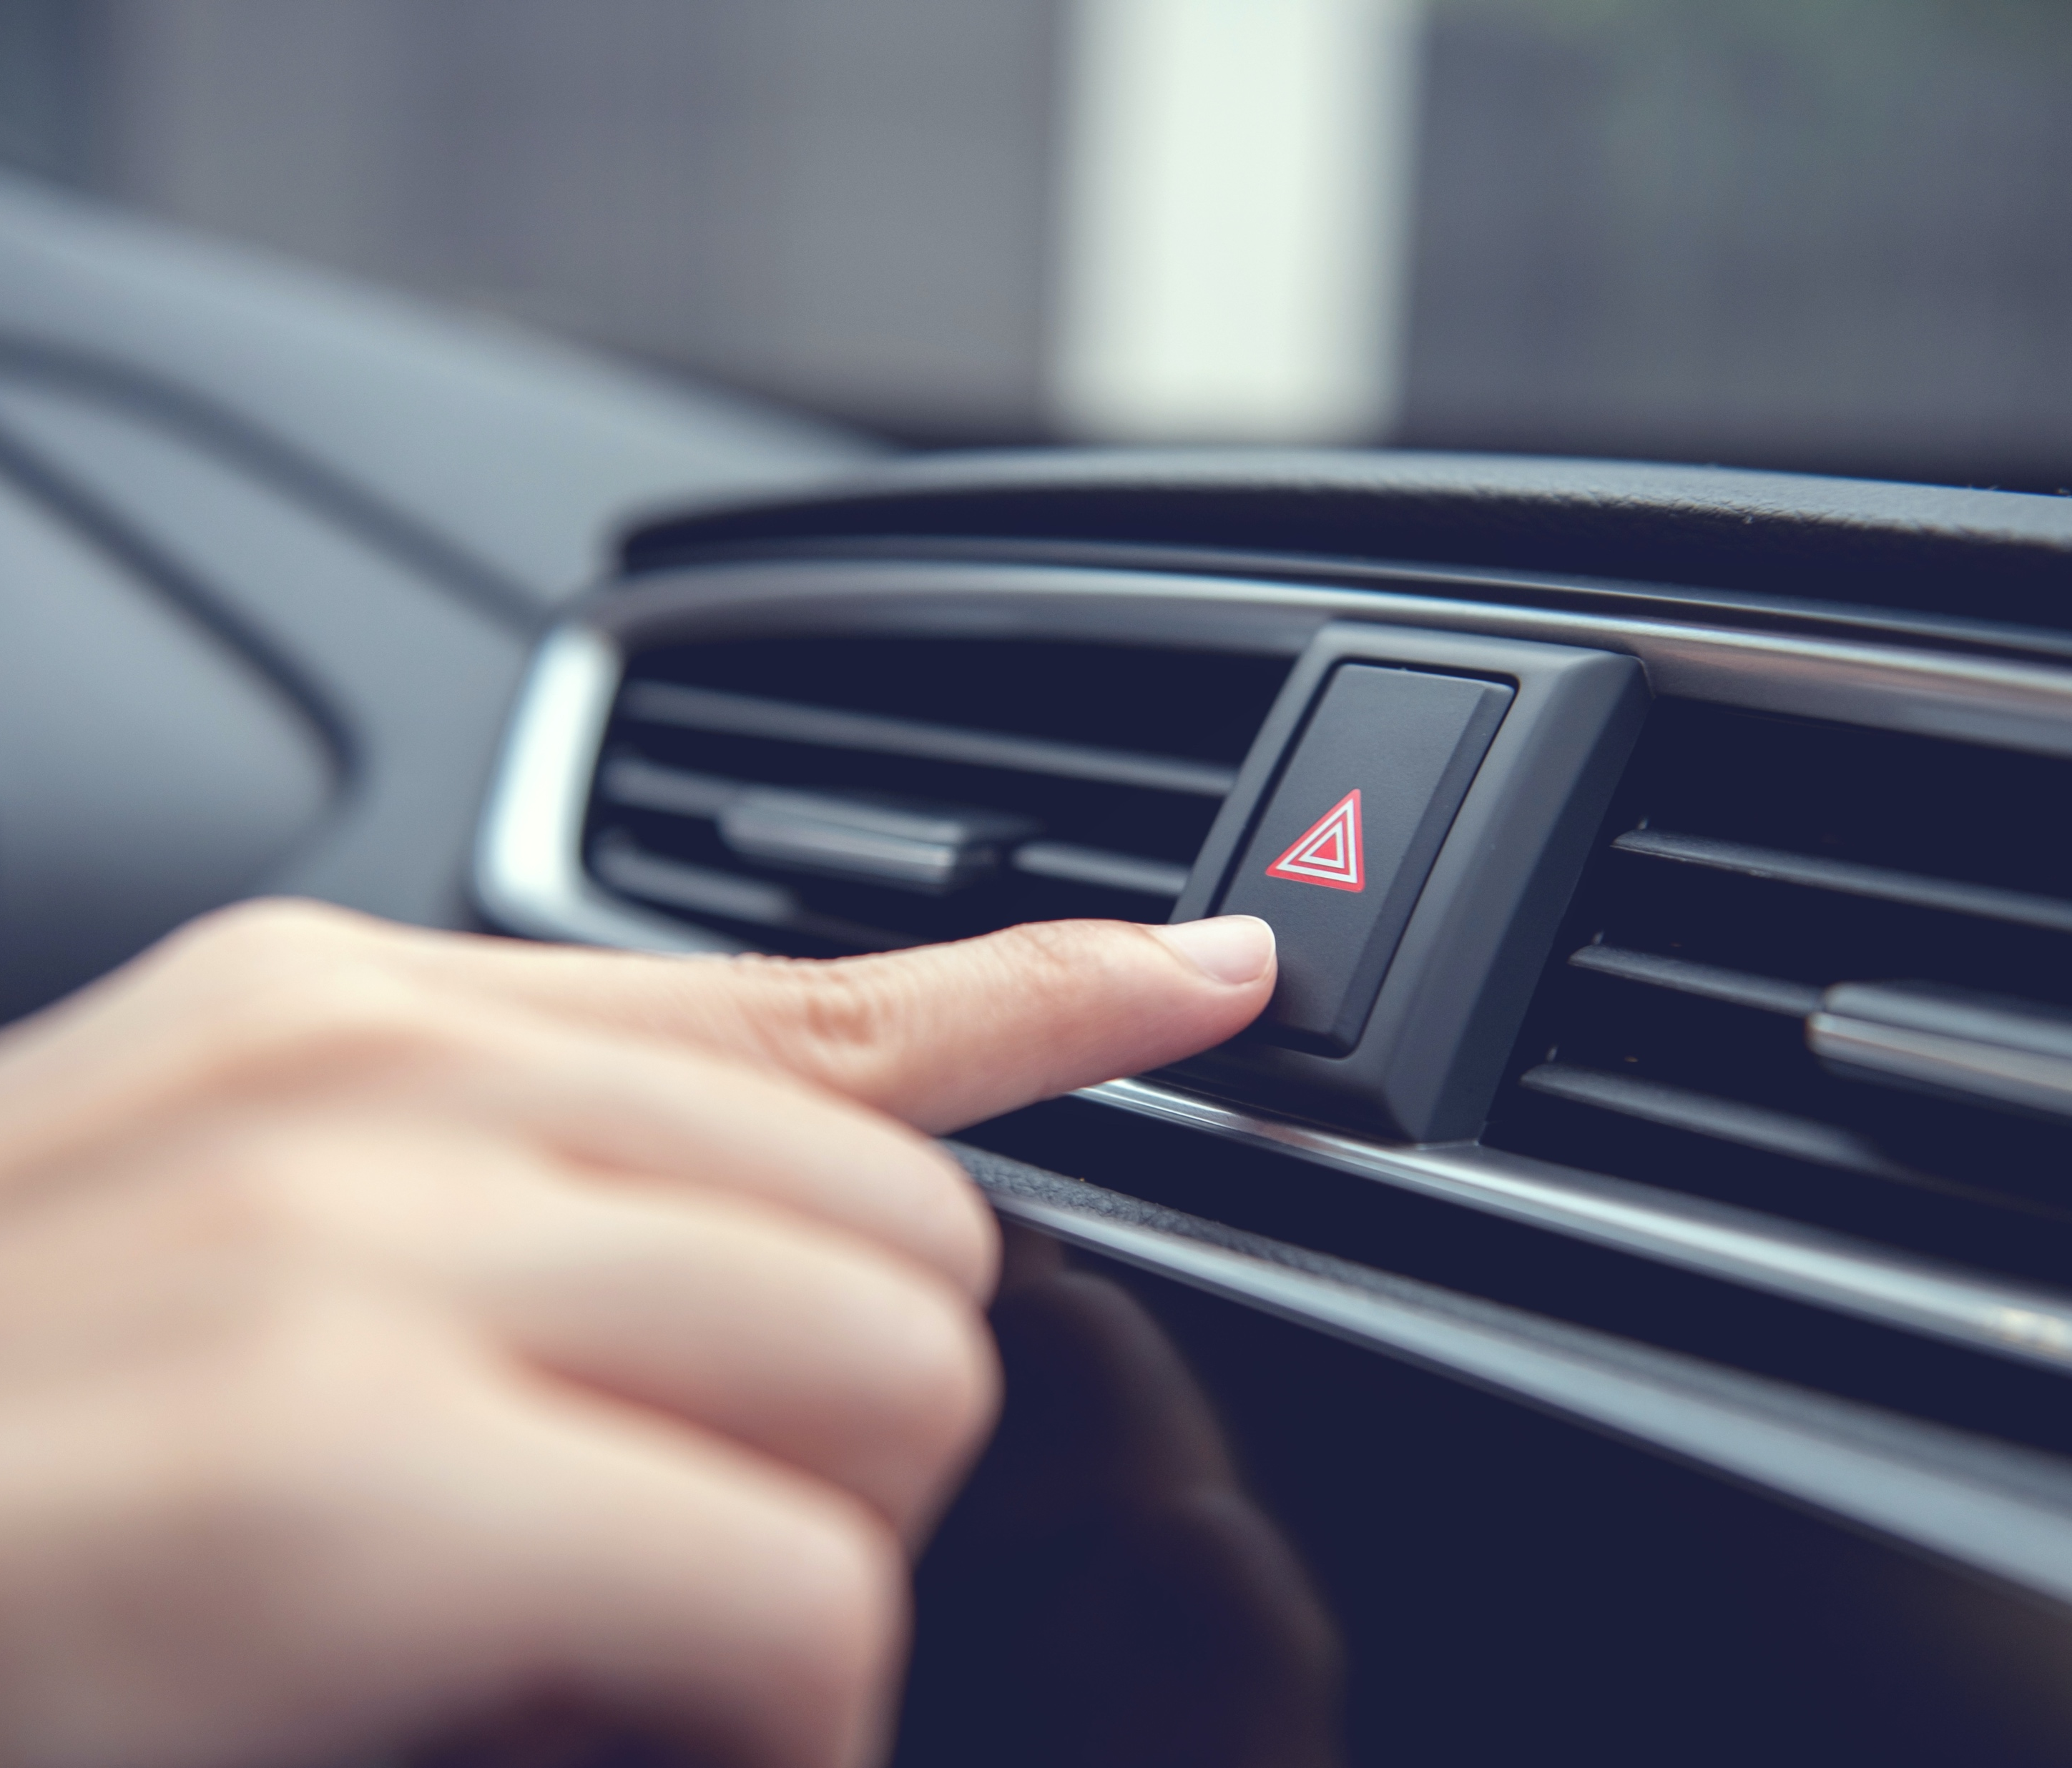
General Tips for Improving Driving Situations and Awareness
Communicate with other road users:
Use turn signals to communicate your plans to turn or switch lanes
Use your horn to draw the attention of other road users
Note that flashing lights on heavy machinery may indicate that they are in operation
Listen for loud beeping from work zone vehicles such as trucks or forklifts
Notes:
Narrative
While driving, it is important to communicate your presence and intentions to other drivers so that they can respond and make room for you. You should be familiar with standard communication practices, including light and hand signals.
Image sources:
Muanpare Wanpen/Shutterstock.com (top)
Oatawa/Shutterstock.com (bottom)

Slide 19
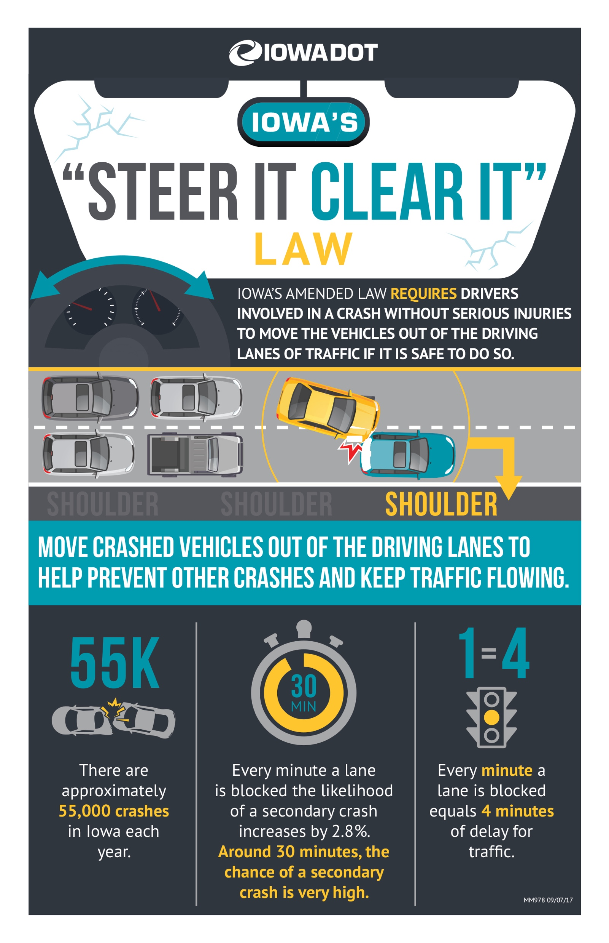
Make Way for Other Road Users
Move your vehicle out of the driving lanes if you are involved in a crash where there are no serious injuries.
Notes:
Narrative
Be mindful of how your situation might impact other road users. If you are involved in a crash and there are no serious injuries, you should safely clear the path, when possible, to allow other road users to have access.
Image source: Iowa Department of Transportation. https://iowadot.gov/mvd/driverseducation/resources/Steer-it-Card%20.pdf

Slide 20
Disclaimer Notice
This module was developed by the Institute for Transportation (InTrans) at Iowa State University for the Iowa Department of Transportation (Iowa DOT) with the purpose to provide the material for driver education instructors in Iowa. InTrans is responsible for the facts and the accuracy of the information presented herein as of May 1, 2025.
Driver education instructors may use the material in its entirety or may use any of the slides and material individually. The material is for educational purposes only. It is strictly prohibited to sell any part of this module.
If any of the material is reused, please credit the appropriate source. The resources used for information and images for the module are provided in the notes section. Other material can be cited as Iowa DOT.
For more information or questions, please contact Vania Boyd, Driver Education and Motorcycle Rider Education Manager, Iowa DOT, Vania.boyd@iowadot.us.

