Slide 1
Passengers
Notes:
Narrative
This module was developed by the Institute for Transportation at Iowa State University for the Iowa Department of Transportation. The purpose is to provide additional material for driver education instructors in Iowa. This module focuses on the impact of passengers (particularly teen passengers) on teen drivers. The material can be used in its entirety, or a driver education instructor can use any of the slides or material individually. Citations are provided for information sources and images. If these materials are used, please credit the appropriate source. Other material can be cited as Iowa DOT.
Image Source
National Highway Traffic Safety Administration. https://www.nhtsa.gov/nhtsa-image-library.

Slide 2
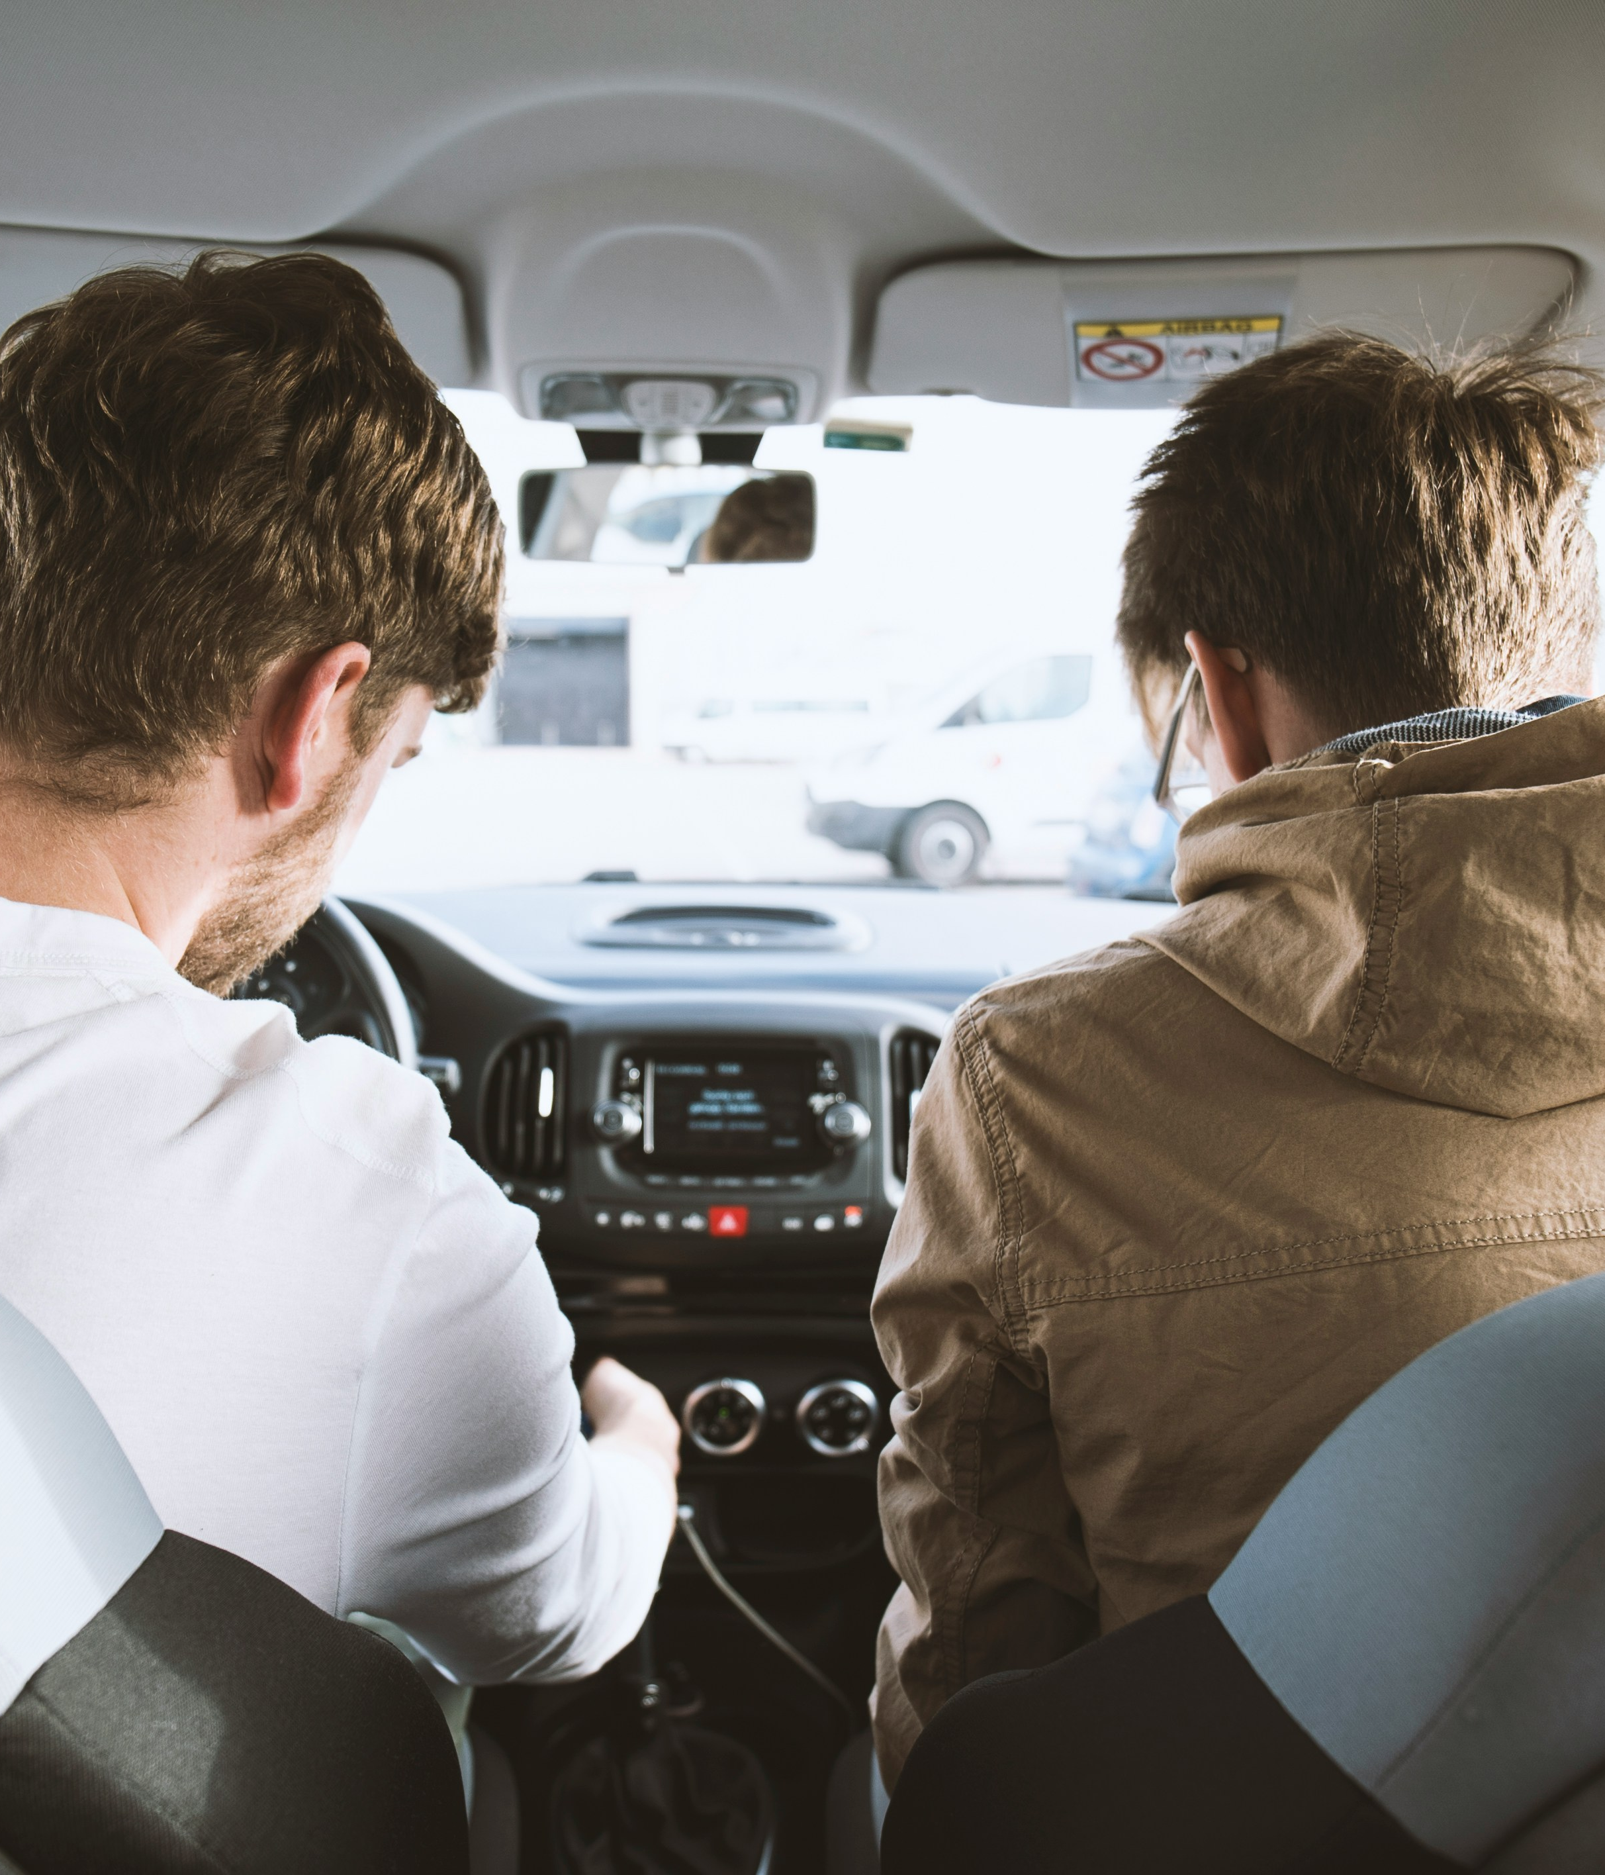
Learning Objectives
Recognize the distractions passengers can create
Understand the magnitude of the problem
Learn tools to combat peer pressure from passengers
Notes:
Narrative
Learning objectives include the following:
Recognize the distractions passengers can create
Understand the magnitude of the problem
Learn tools to combat peer pressure from passengers
Image source:
David Emrich/Unsplash.com

Slide 3
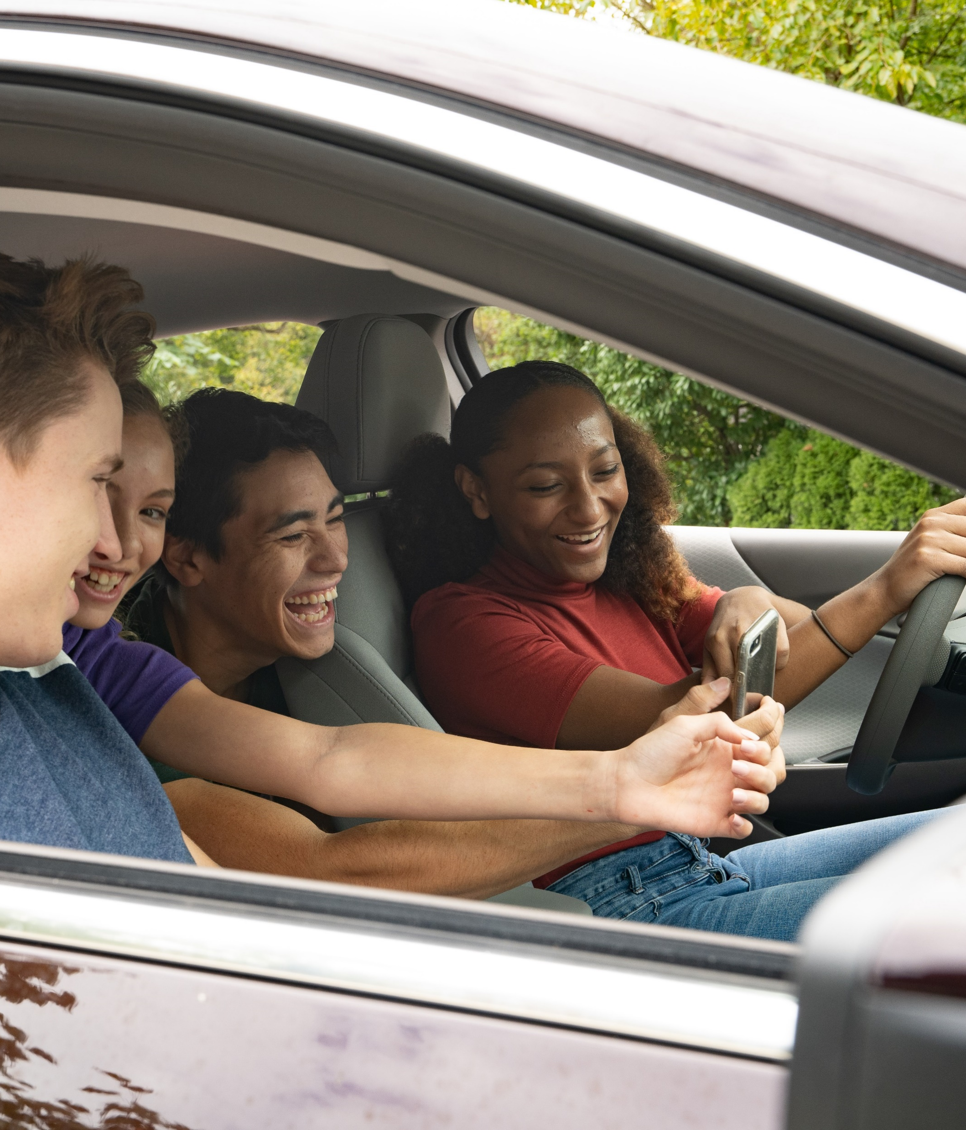
Driver Distractions: Passengers
Passengers can present a cognitive distraction for younger drivers in the following ways:
  Take your attention off the road
  Create noise and general disturbances
  Physically distract
  Pressure you to drive aggressively
Notes:
Narrative
Passengers in your vehicle can be another distraction you’re faced with. Whether young or old, passengers can be a distraction, particularly if you’re holding a conversation with them. If you have younger passengers, studies have shown that teen drivers are 2.5 times more likely to engage in a risky behavior (think peer pressure). When driving, a passenger can take your focus off the road, create noise and other disturbances, and even become a physical distraction (e.g., having to turn around to get a child in the back seat to calm down).
Resources
Information source:
NHTSA. 2012. The Effect of Passengers on Teen Driver Behavior. National Highway Traffic Safety Administration website. https://www.nhtsa.gov/sites/nhtsa.gov/files/811613.pdf.
Image source:
National Highway Traffic Safety Administration. https://nhtsaimages.zenfolio.com/f59450699

Slide 4
Why Do Passengers Matter?
4x with 3+ passengers <21
2x with 2 passengers <21
44% with one passenger <21
Nationally, a 16- to 17-year-old driver’s risk of death per mile driven increases exponentially:
Notes:
Narrative
At the national level, a 16- to 17-year-old driver’s risk of death per mile driven increases 44% when riding with a passenger below the age of 21. This risk doubles when carrying two passengers under 21 and quadruples when carrying three or more passengers under 21. So, there are reasons why passenger limitations are placed on licensing.
Information source: AAA Foundation for Traffic Safety. 2012. Teen Driver Risk in Relation to Age and Number of Passengers. AAA. https://aaafoundation.org/teen-driver-risk-relation-age-number-passengers/.

Slide 5
In Iowa…
Carrying passengers, especially teens, increases crash risk
35.4% of fatal, suspected serious injury crashes involving drivers under the age of 16 had two to four passengers
24.5% of the same crashes involving drivers between the ages of 16 and 18 had two to four passengers in the vehicle
Notes:
Narrative
Here in Iowa, data have shown that carrying passengers, especially other teenagers, increases the risk of a crash for younger drivers. A total of 35.4% of fatal, suspected serious injury crashes involving drivers under the age of 16 had two to four passengers in the vehicle, and 24.5% of the same type of crashes involving drivers between the ages of 16 and 18 had two to four passengers in the vehicle.
Resources
Information source: Iowa Department of Transportation. 2024. Iowa Crash Analysis Tool. https://icat.iowadot.gov/.
Image source: NHTSA. https://www.nhtsa.gov/nhtsa-image-library.

Slide 6
Peer Pressure
Are you sure this is the right way to get there?
Passengers can be a problem when they “backseat” drive or pressure a driver to engage in unsafe actions
Even a “helpful advice” can cause stress for the driver or lead to arguments that can distract from the driving task
Speed up! You drive like your grandpa.
Notes:
Narrative
Passengers in the car can pressure a teen driver. First, a passenger may attempt to correct your driving. For instance, they point out upcoming Stop signs. While well intentioned, this can still be distracting and stressful to the driver. Second, passengers can pressure a driver to disobey traffic laws and engage in risky actions. For instance, you are coming up to an intersection where the signal is turning yello. Your friend yells that you can easily make it, so you end up running a red light. Both types of pressure can also be stressful to the driver, which can cause them to make mistakes.

Slide 7
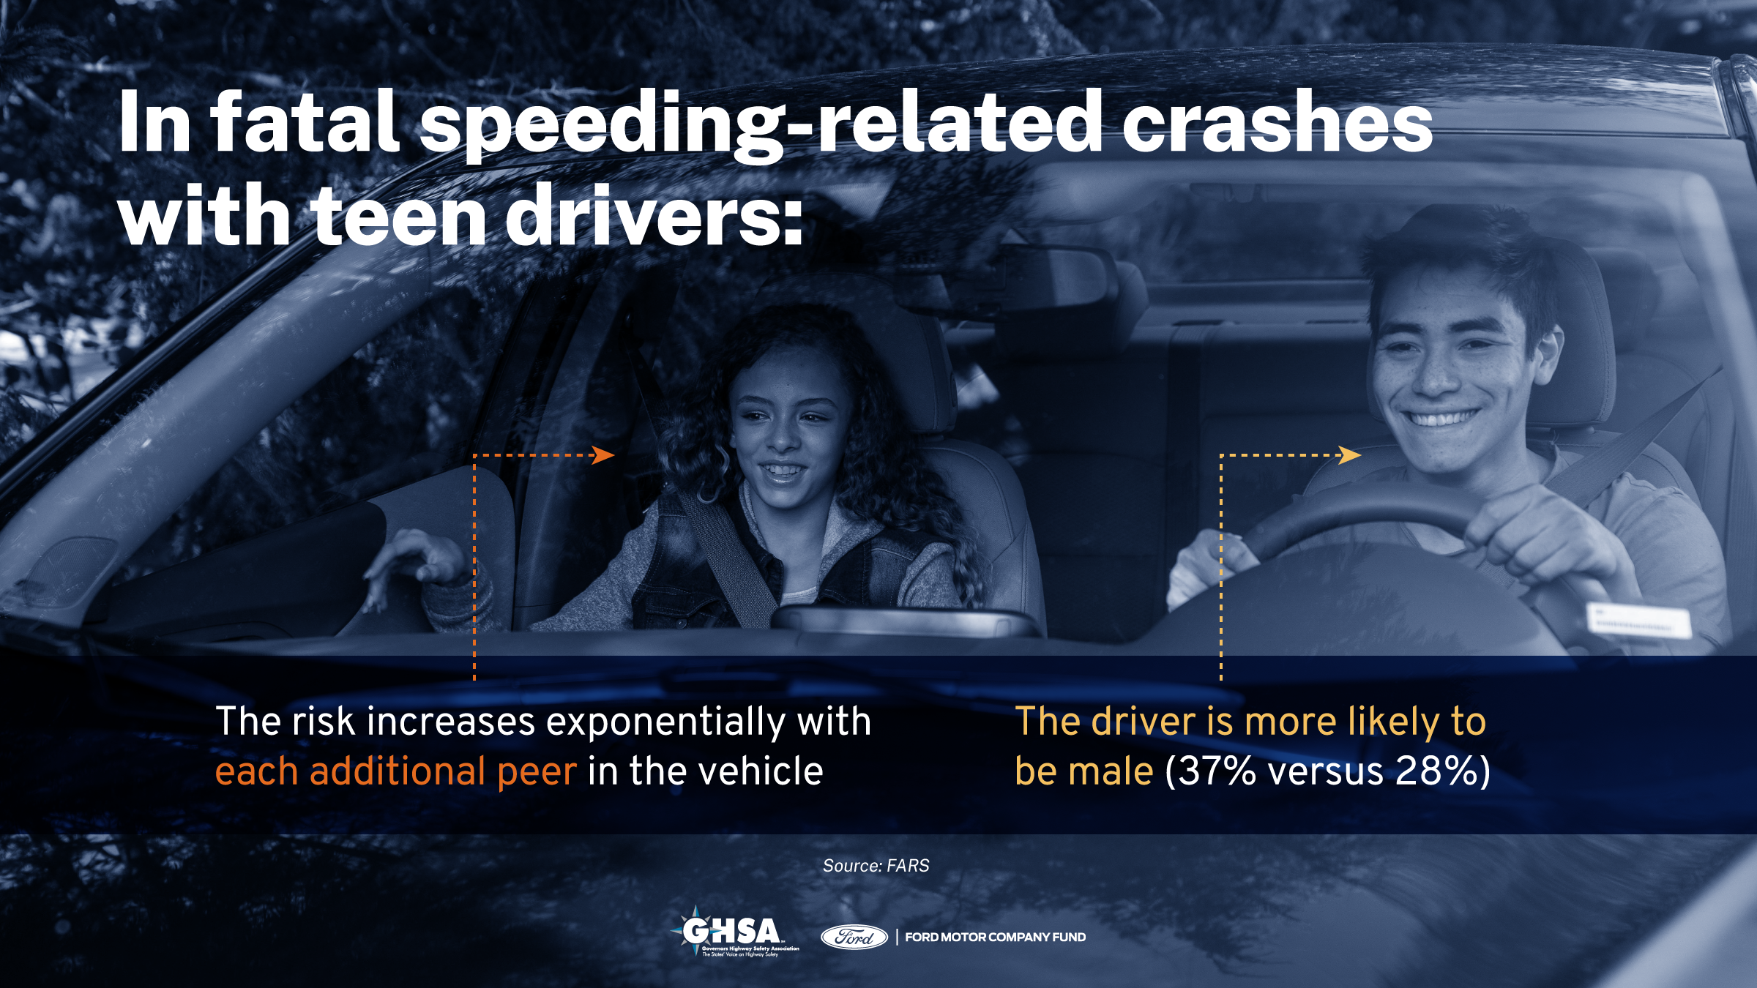
7
Notes:
Narrative
Having teen passengers in the car is especially problematic since the risk of being involved in a speeding-related fatal crash increases exponentially with each additional teen passenger in the vehicle.
Resources
Information source:
GHSA. 2021. Teens and Speeding: Breaking the Deadly Cycle. Governors Highway Safety Association. https://www.ghsa.org/sites/default/files/2021-02/GHSA_TeenSpeeding_Feb16.pdf.
Image source:
Governors Highway Safety Association. https://www.ghsa.org/resources/Teens-and-Speeding-Report21.

Slide 8
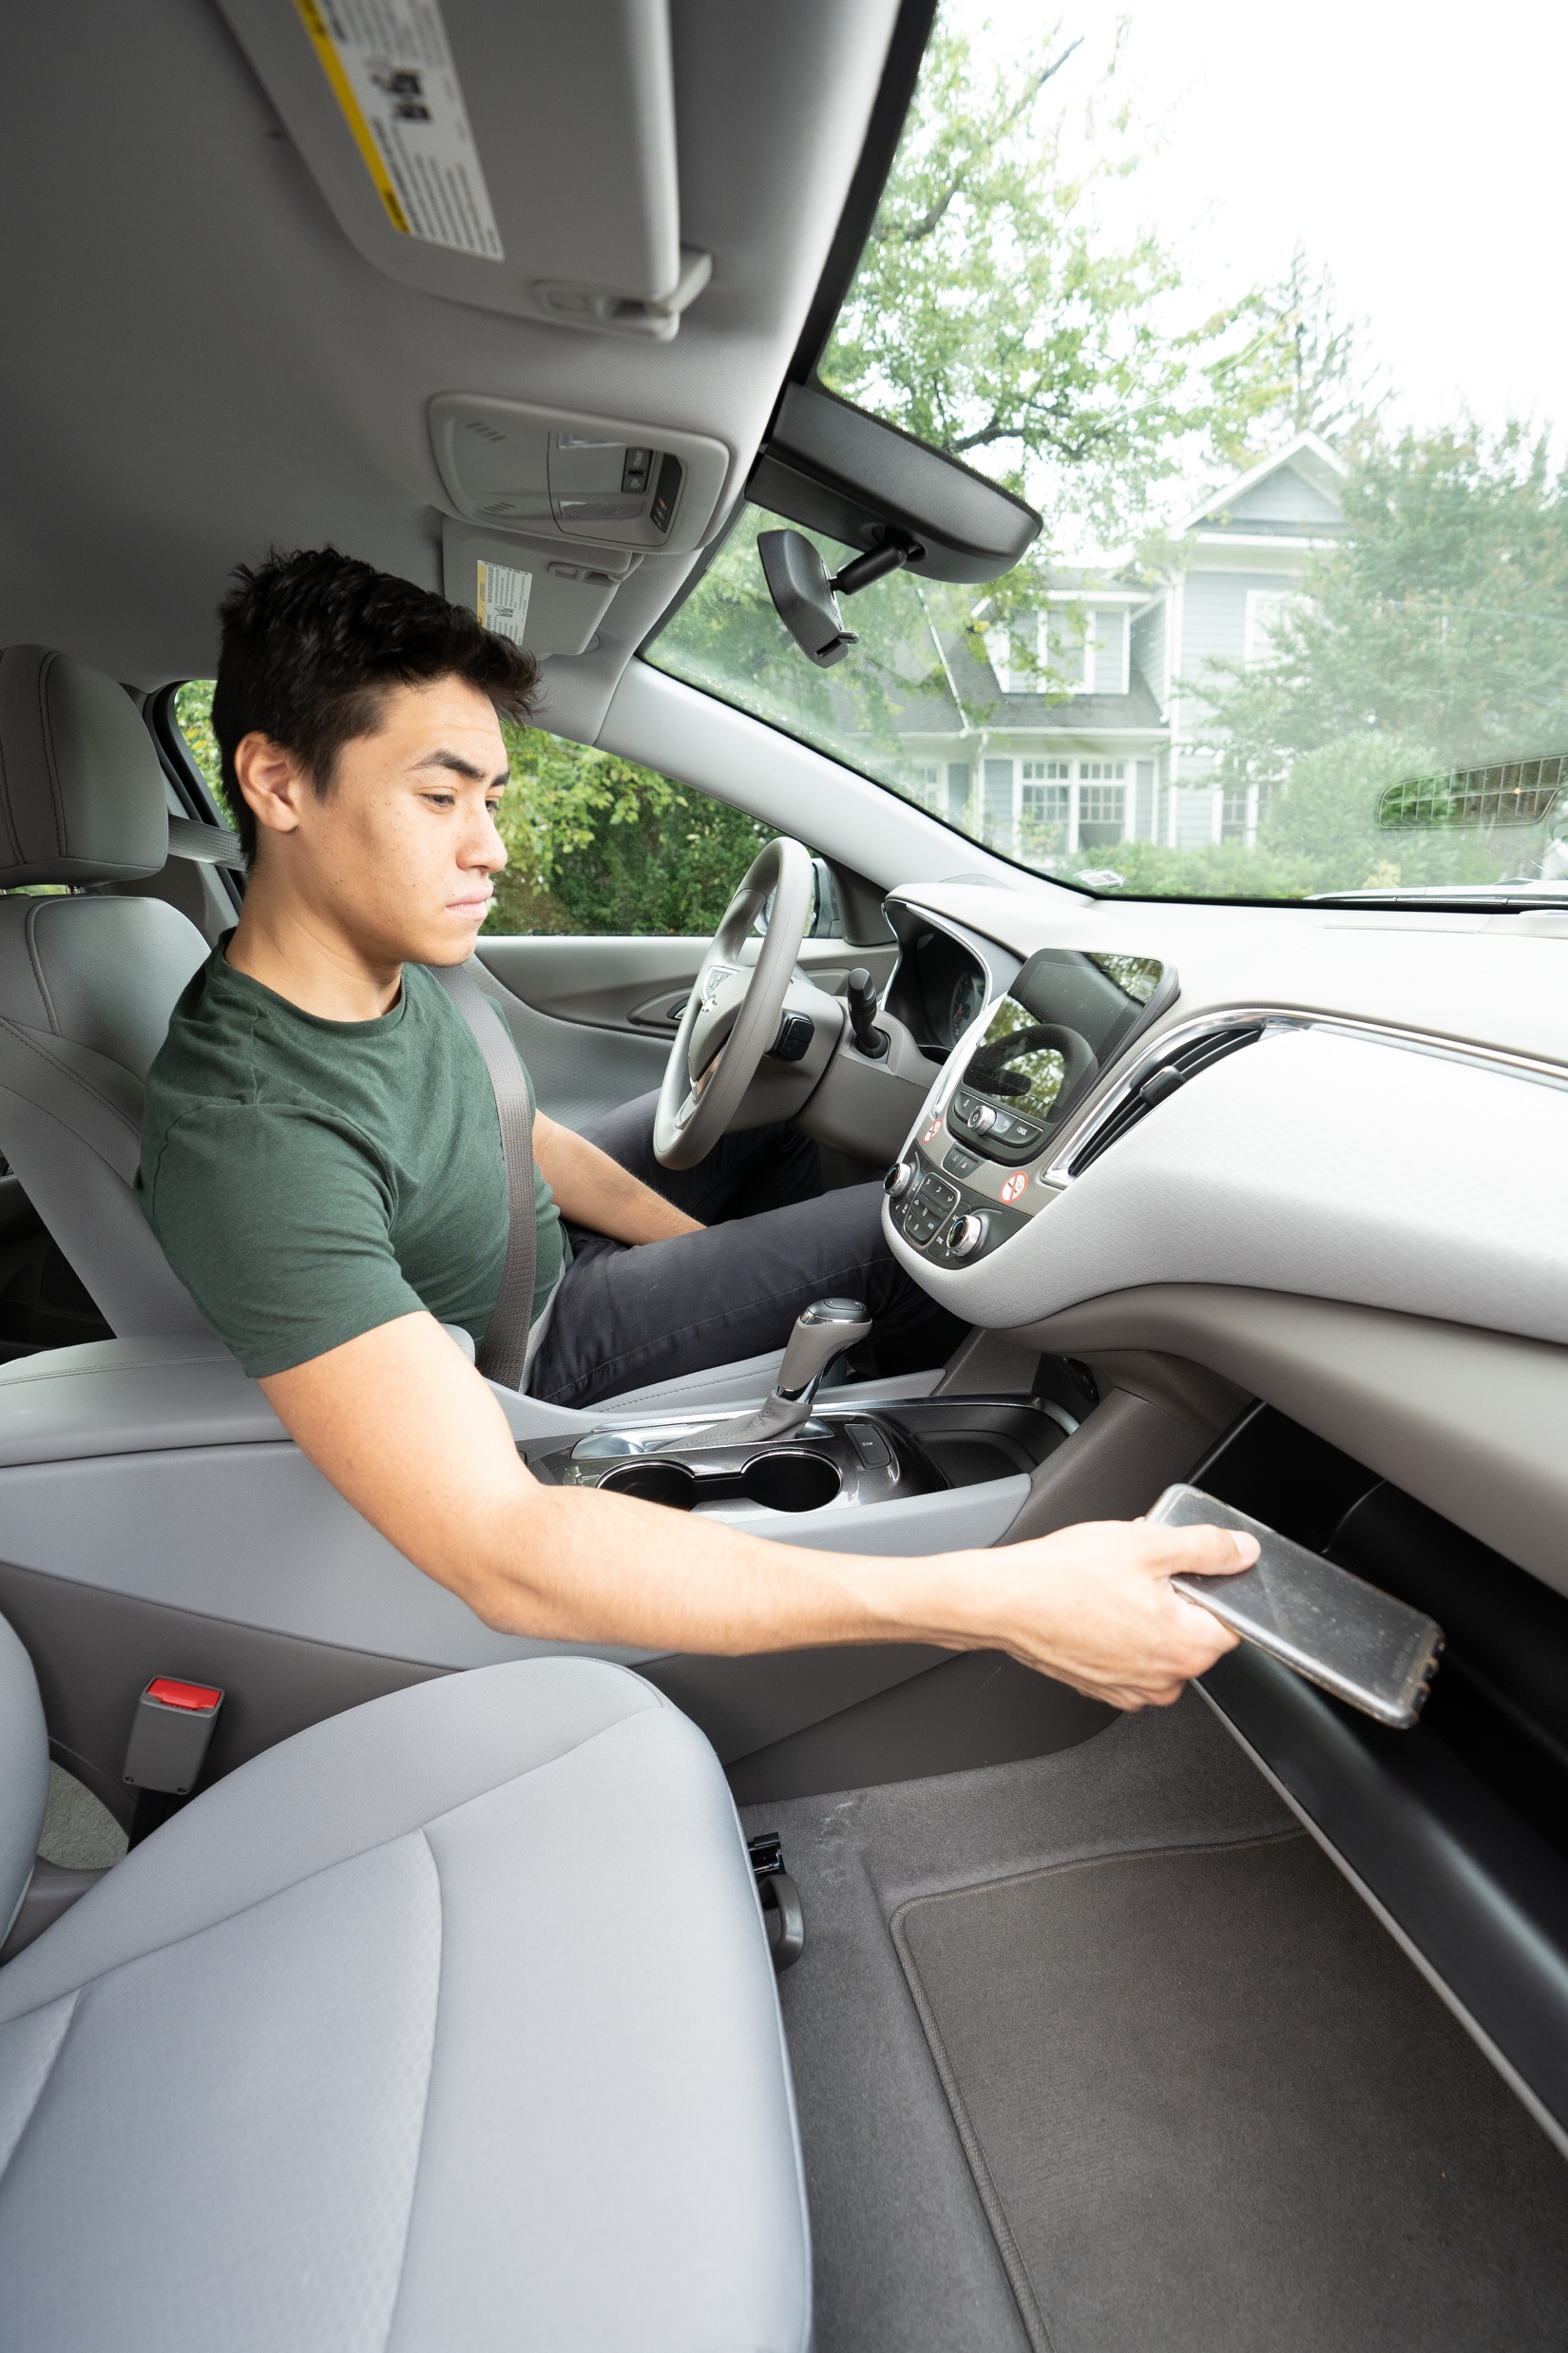
Addressing Passenger Distraction
Distraction from passengers can be addressed in a number of ways:
Limiting the number of passengers in the vehicle (especially other teens)
Eliminating noise (turn radio down or off, turn off cell phone, etc.)
Reducing in-vehicle physical distractions as much as possible
Being a good passenger
  If under 18, you are required by Iowa law to wear a seatbelt, regardless of a seating position (front or back)
  Do not pressure the driver to speed, etc.
  Assist in navigation, spotting hazards, etc.
Notes:
Narrative
To address in-vehicle passenger distractions, younger drivers can do a number of different things. They (or their parents/guardians) can limit the number of passengers, especially teenage passengers, being carried in a vehicle. Passengers’ cell phones can be turned off to eliminate the potential for distraction. In-vehicle physical distractions can also be reduced or eliminated. This would include passengers rough housing with each other, carrying young children as passengers, etc. Finally, recognize how you can be a good passenger, such as by wearing a seatbelt, not applying peer pressure to your driver, and helping the driver with navigation tasks such as spotting hazards, etc.
Resources
Information sources:
NHTSA . 2012. The Effect of Passengers on Teen Driver Behavior. National Highway Traffic Safety Administration. https://www.nhtsa.gov/sites/nhtsa.gov/files/811613.pdf.
National Research Council, Institute of Medicine, and Transportation Research Board. 2007. Preventing Teen Motor Crashes: Contributions from the Behavioral and Social Sciences: Workshop Report. Program Committee for Workshop on Contributions from the Behavioral and Social Sciences in Reducing and Preventing Teen Motor Crashes, Washington, DC. https://www.ncbi.nlm.nih.gov/books/NBK9662/.
Image source:
National Highway Traffic Safety Administration. https://nhtsaimages.zenfolio.com/p146176197.

Slide 9
Speaking up to Passengers
I'm driving, let me decide, thanks.
Calmly express how they are making you feel.
Think about your driving: Are you making your passengers feel unsafe?
Blame your parents: “My mom will take away my keys if I speed.”
Give passengers a task (such as answering texts).
Plan ahead, talk about where you are going, and leave in time to avoid being late.
Stop giving rides to distracting passengers.
When you tell me to go faster, it stresses me out.
I don’t want to get a ticket.
Notes:
Narrative
As a driver, there are different things you can do to combat peer pressure. The most basic approach is to just say “no” and give a reason why you refused, such as saying no to speeding because you could get a ticket. You can also avoid situations where you think peer pressure might become an issue. For example, if you suspect that you’ll be encouraged to speed to get somewhere faster, choose instead to drive alone rather than give people a ride.
When pressured to do something unsafe while driving, (1) ask questions about why you should do what is being asked and (2) ask others to consider the consequences of an action. For example, ask why you should pass a slower vehicle on a two-lane roadway when there is frequent oncoming traffic, and then point out that you could get into a head-on crash.
If nothing else, blame it on your parents and point out the consequences if you were to be caught.
Finally, if you have a passenger that is regularly distracting or pressuring you to drive unsafely, stop letting them ride with you.
Information sources:
CPTC. 2018. Strategies to Handle Peer Pressure. Center for Parent & Teen Communication. https://parentandteen.com/handle-peer-pressure.
WTOV9. 2019. 6 Polite Ways to Deal with a Backseat Driver. https://wtov9.com/features/drive-safe/6-polite-ways-to-deal-with-a-backseat-driver.
California State Courts. 2024. Develop your Refusal Skills. https://www2.courtinfo.ca.gov/stopteendui/teens/stop/yourself/develop-refusal-skills.cfm.

Slide 10
What about Passengers?
How can passengers reduce risky behavior by a driver?
Notes:
Narrative
How can passengers reduce risky behavior by a driver?

Slide 11
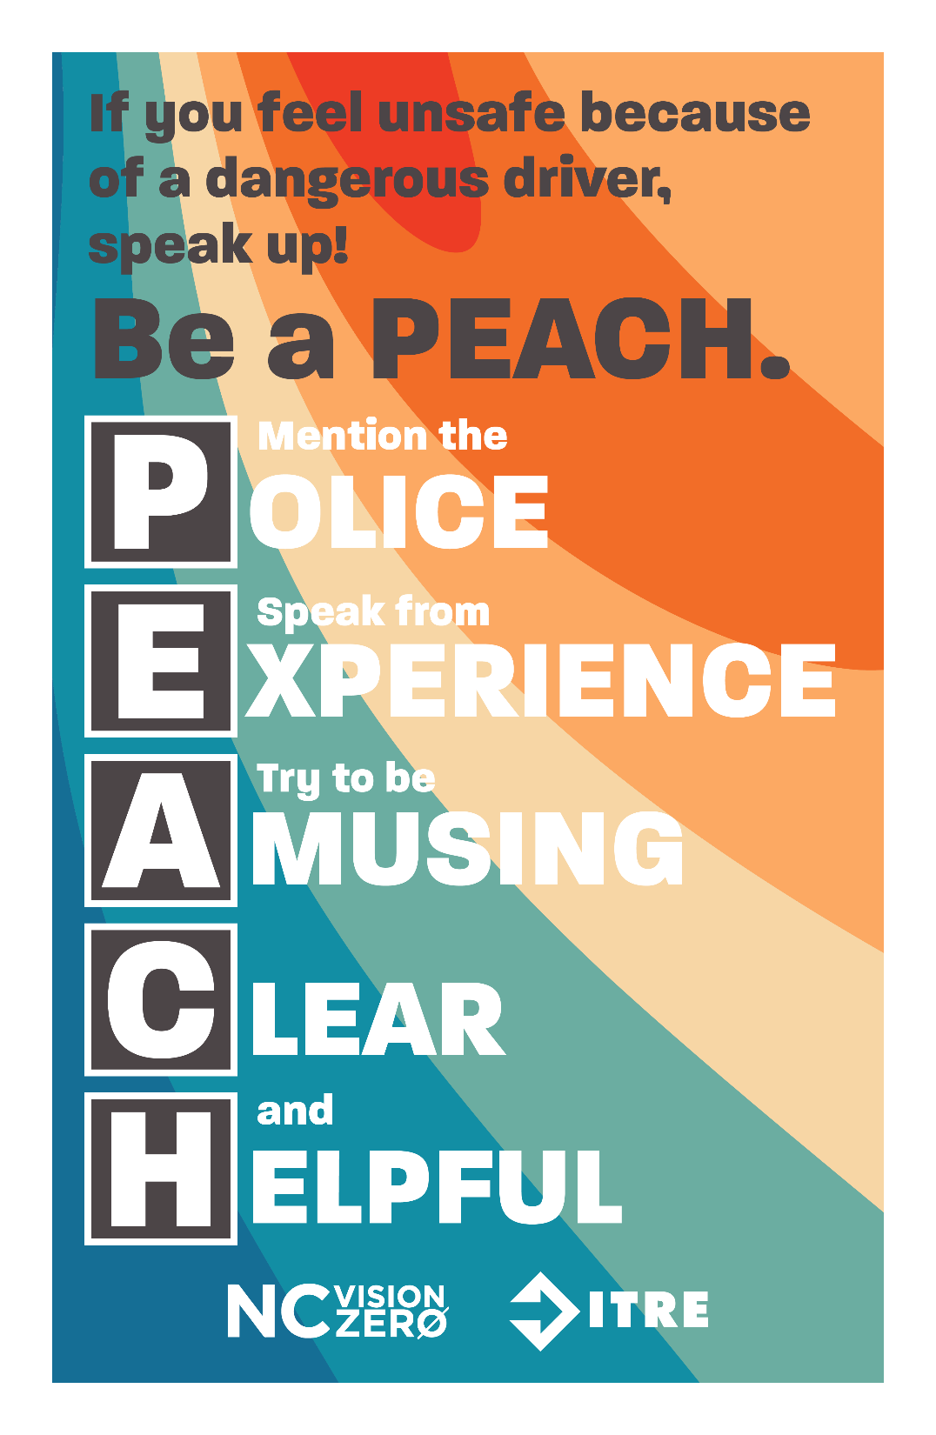
How can Passengers Reduce Risky Behavior by a Driver?
Risky Behavior—Speak Up!
Notes:
Narrative
A difficult conversation for a passenger to have with a driver is one that focuses on actions they believe are risky or dangerous. This is an even more difficult conversation for teens that are passengers of a teen driver.
The objective of the next few slides is to share some graphics and materials that might help a driver education instructor with a discussion about what someone might do in this type of situation. There are many documents available on how to have difficult conversations on various topics (often within a business setting). However, the information provided here out of North Carolina is something that focuses on teen drivers (and applies to all types of drivers). The program created by North Carolina’s Vision Zero encourages passengers to speak up if someone is driving dangerously.
Resources
Information source:
North Carolina Vision Zero Initiative. 2020. Speak up if someone is driving dangerously. Be a PEACH! https://ncvisionzero.org/speak-up-if-someone-is-unsafe-be-a-peach/.
Image source:
North Carolina Vision Zero Initiative. https://ncvisionzero.org/speak-up-if-someone-is-unsafe-be-a-peach/.

Slide 12

P = Mention the Police
Notes:
Narrative
The “P” in PEACH is for “mention the Police.” North Carolina Vision Zero’s traffic safety blog recommends that “One easy way to encourage a driver to change their behavior is to remind them of the threat of a traffic ticket.” It provides two examples: (1) “I’ve seen a lot of cops out today, you might want to slow down.” (2) “My cousin got a ticket for not wearing a seat belt last week – I think they’re cracking down on that around here.”
Resources
Information source:
North Carolina Vision Zero Initiative. 2020. Speak up if someone is driving dangerously. Be a PEACH! https://ncvisionzero.org/speak-up-if-someone-is-unsafe-be-a-peach/.
Image source:
North Carolina Vision Zero Initiative. https://ncvisionzero.org/speak-up-if-someone-is-unsafe-be-a-peach/.

Slide 13
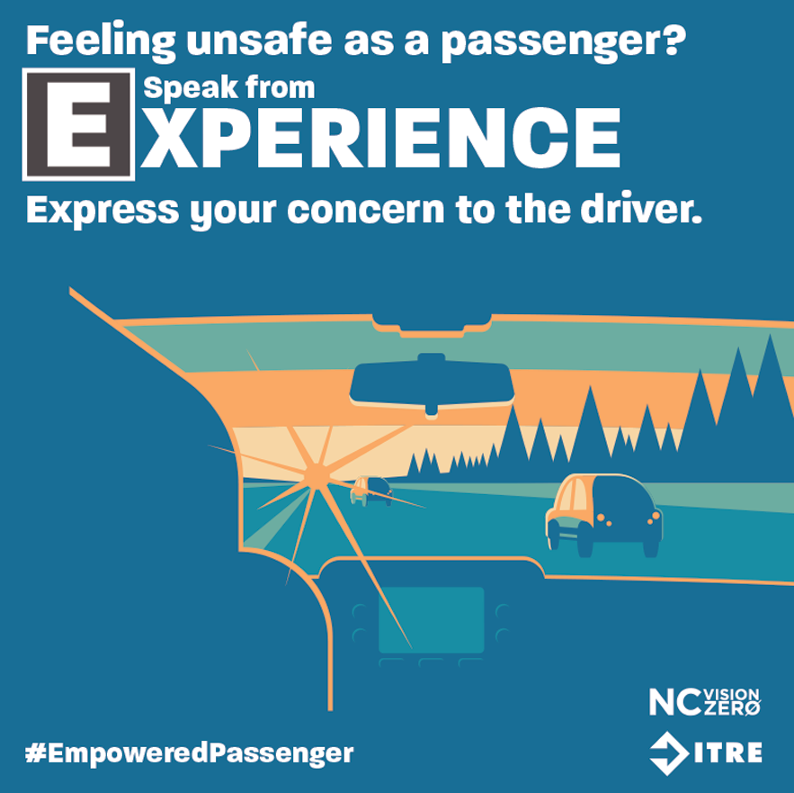
E = Speak from Experience
Notes:
Narrative
The “E” in PEACH is for “speaking from Experience.” North Carolina Vision Zero’s traffic safety blog recommends that “Sharing a story or a personal experience may also help to persuade a driver to be safe.” It provides two examples: (1) “My friend got hit by someone driving distracted last week. It really freaked me out.” (2) “I read a story this morning about a family killed by a speeding driver. It was heartbreaking.”
Resources
Information source:
North Carolina Vision Zero Initiative. 2020. Speak up if someone is driving dangerously. Be a PEACH! https://ncvisionzero.org/speak-up-if-someone-is-unsafe-be-a-peach/.
Image source:
North Carolina Vision Zero Initiative. https://ncvisionzero.org/speak-up-if-someone-is-unsafe-be-a-peach/.

Slide 14
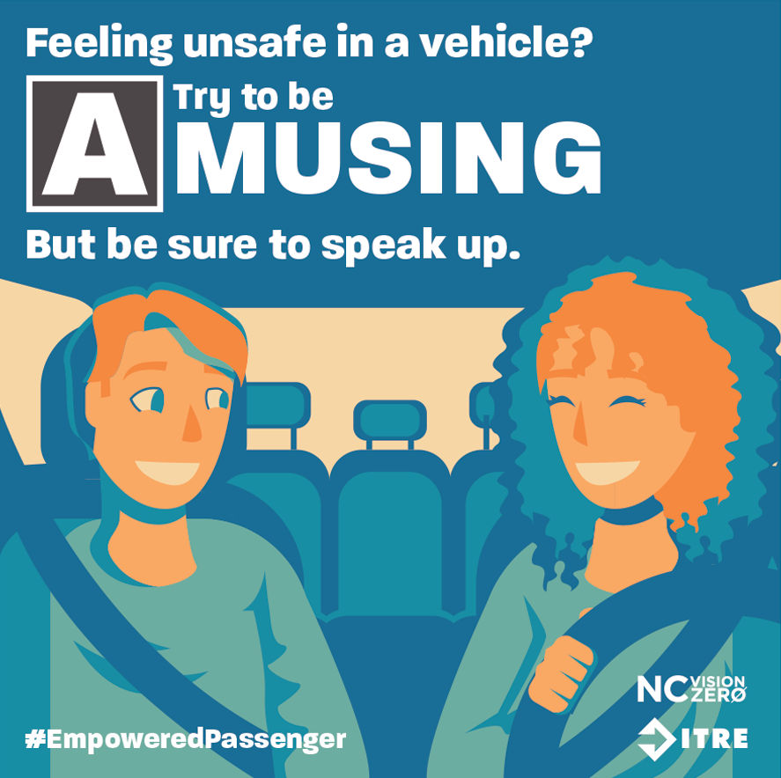
A = Try to be Amusing
Notes:
Narrative
The “A” in PEACH is for “try to be Amusing.” North Carolina Vision Zero’s traffic safety blog recommends that “If you can think of a joke, humor can be used to call attention to something that isn’t safe.”
Resources
Information source:
North Carolina Vision Zero Initiative. 2020. Speak up if someone is driving dangerously. Be a PEACH! https://ncvisionzero.org/speak-up-if-someone-is-unsafe-be-a-peach/.
Image source:
North Carolina Vision Zero Initiative. https://ncvisionzero.org/speak-up-if-someone-is-unsafe-be-a-peach/.

Slide 15
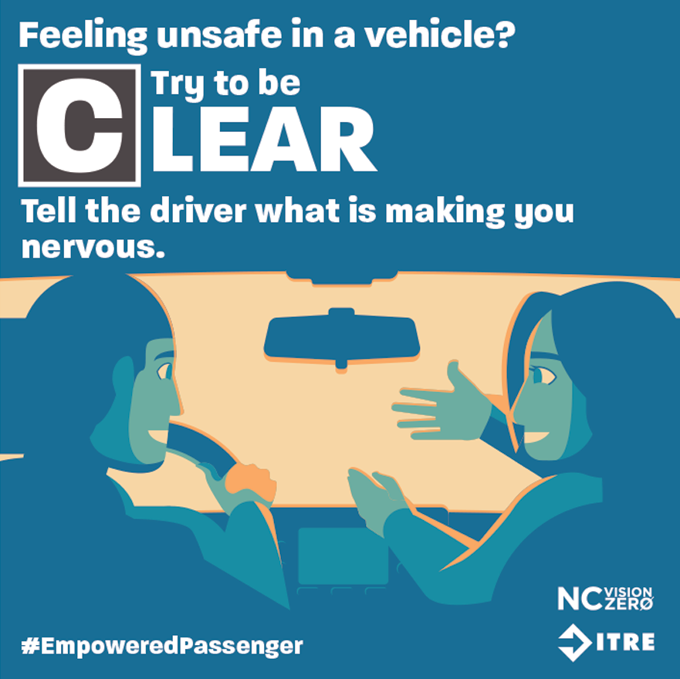
C = Try to be Clear
Notes:
Narrative
The “C” in PEACH is for “try to be Clear.” North Carolina Vision Zero’s traffic safety blog recommends that “Sometimes being direct is the best option. If you feel safe to confront the driver directly, tell them what is making you nervous and ask them to stop.” It provides two examples: (1) “Hey, you’re driving really close to that other car’s bumper. It’s making me nervous. Can you please stop?” (2) “Please don’t use your phone while you’re driving – I don’t feel safe.”
Resources
Information source:
North Carolina Vision Zero Initiative. 2020. Speak up if someone is driving dangerously. Be a PEACH! https://ncvisionzero.org/speak-up-if-someone-is-unsafe-be-a-peach/.
Image source:
North Carolina Vision Zero Initiative. https://ncvisionzero.org/speak-up-if-someone-is-unsafe-be-a-peach/.

Slide 16
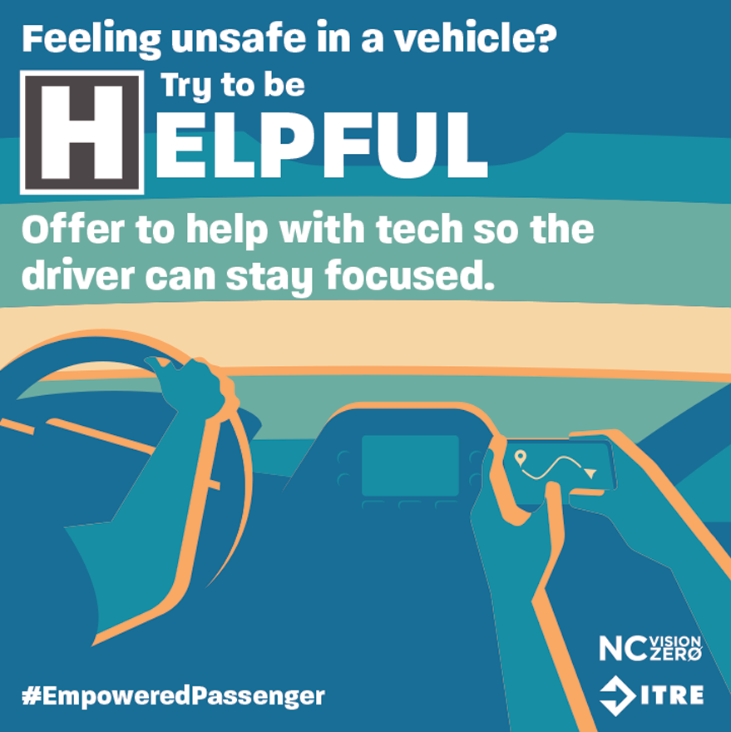
H = Try to be Helpful
Notes:
Narrative
The “H” in PEACH is for “try to be Helpful.” North Carolina Vision Zero’s traffic safety blog recommends that “In some cases, it may be easier to offer to help rather than confronting someone directly.”
It provides two examples: (1) “Here, let me type that for you so you can keep your eyes on the road.” (2) “Want me to call them and tell them we’re late so you don’t have to speed?”
Lastly, the blog recommends that if you have tried to speak to the driver and they continue their unsafe behavior, then you should get out of the car in a safe place or not ride with them again.
Resources
Information source:
North Carolina Vision Zero Initiative. 2020. Speak up if someone is driving dangerously. Be a PEACH! https://ncvisionzero.org/speak-up-if-someone-is-unsafe-be-a-peach/.
Image source:
North Carolina Vision Zero Initiative. https://ncvisionzero.org/speak-up-if-someone-is-unsafe-be-a-peach/.

Slide 17
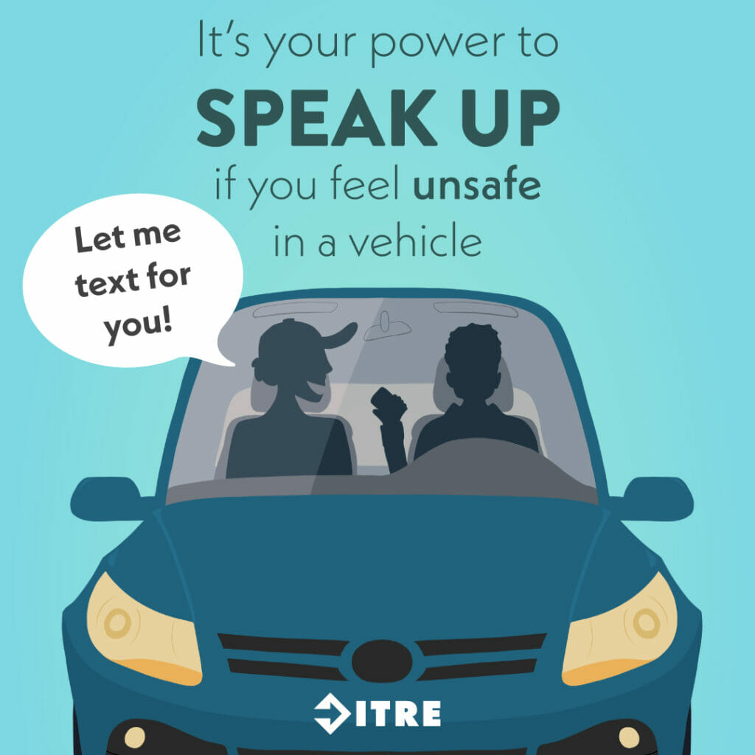
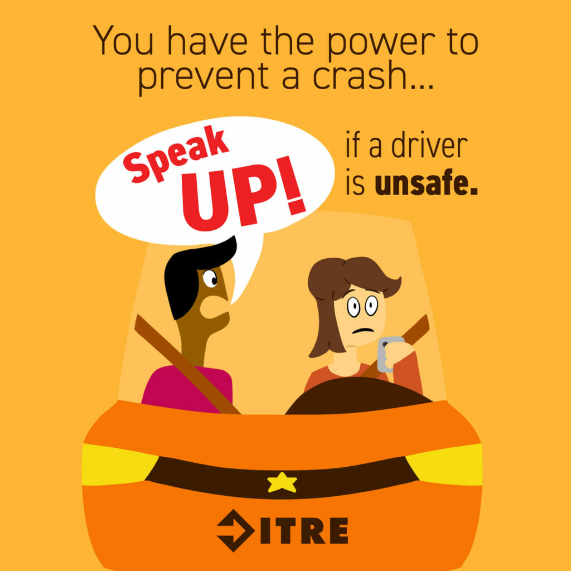
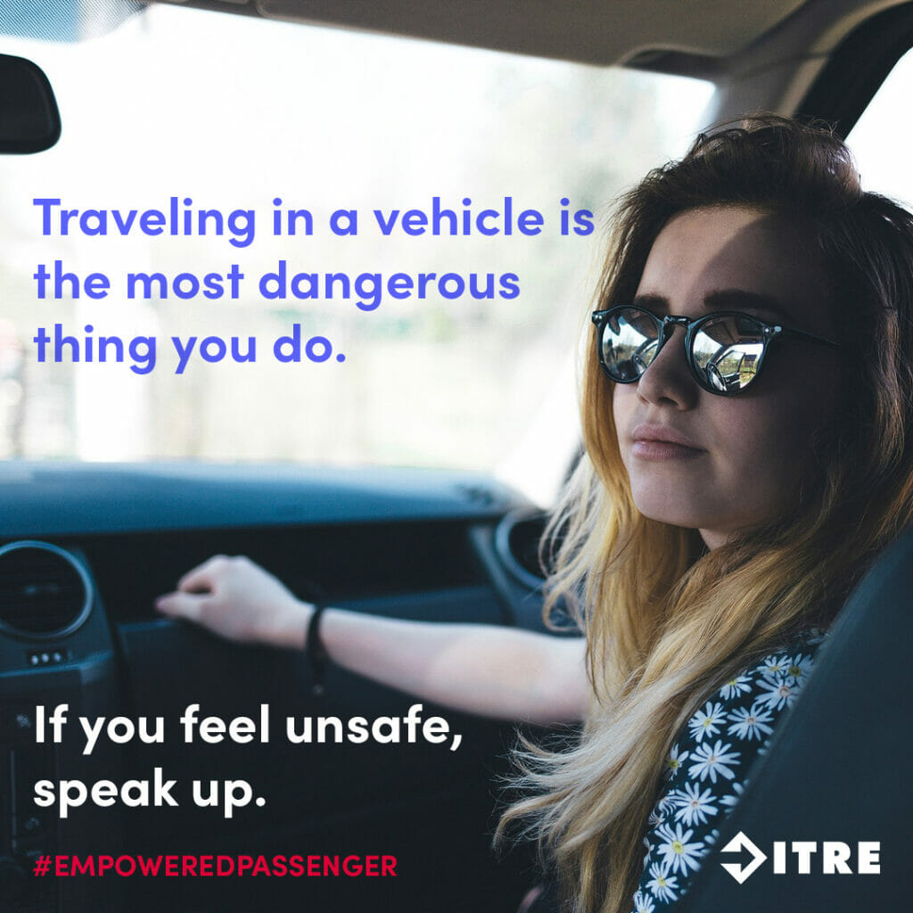
Notes:
Narrative
Here are some other images from the North Carolina Vision Zero’s traffic safety PSA “Be a PEACH.”
Image source: North Carolina Vision Zero Initiative. https://ncvisionzero.org/album/speak-up-empowered-passenger/.

Slide 18
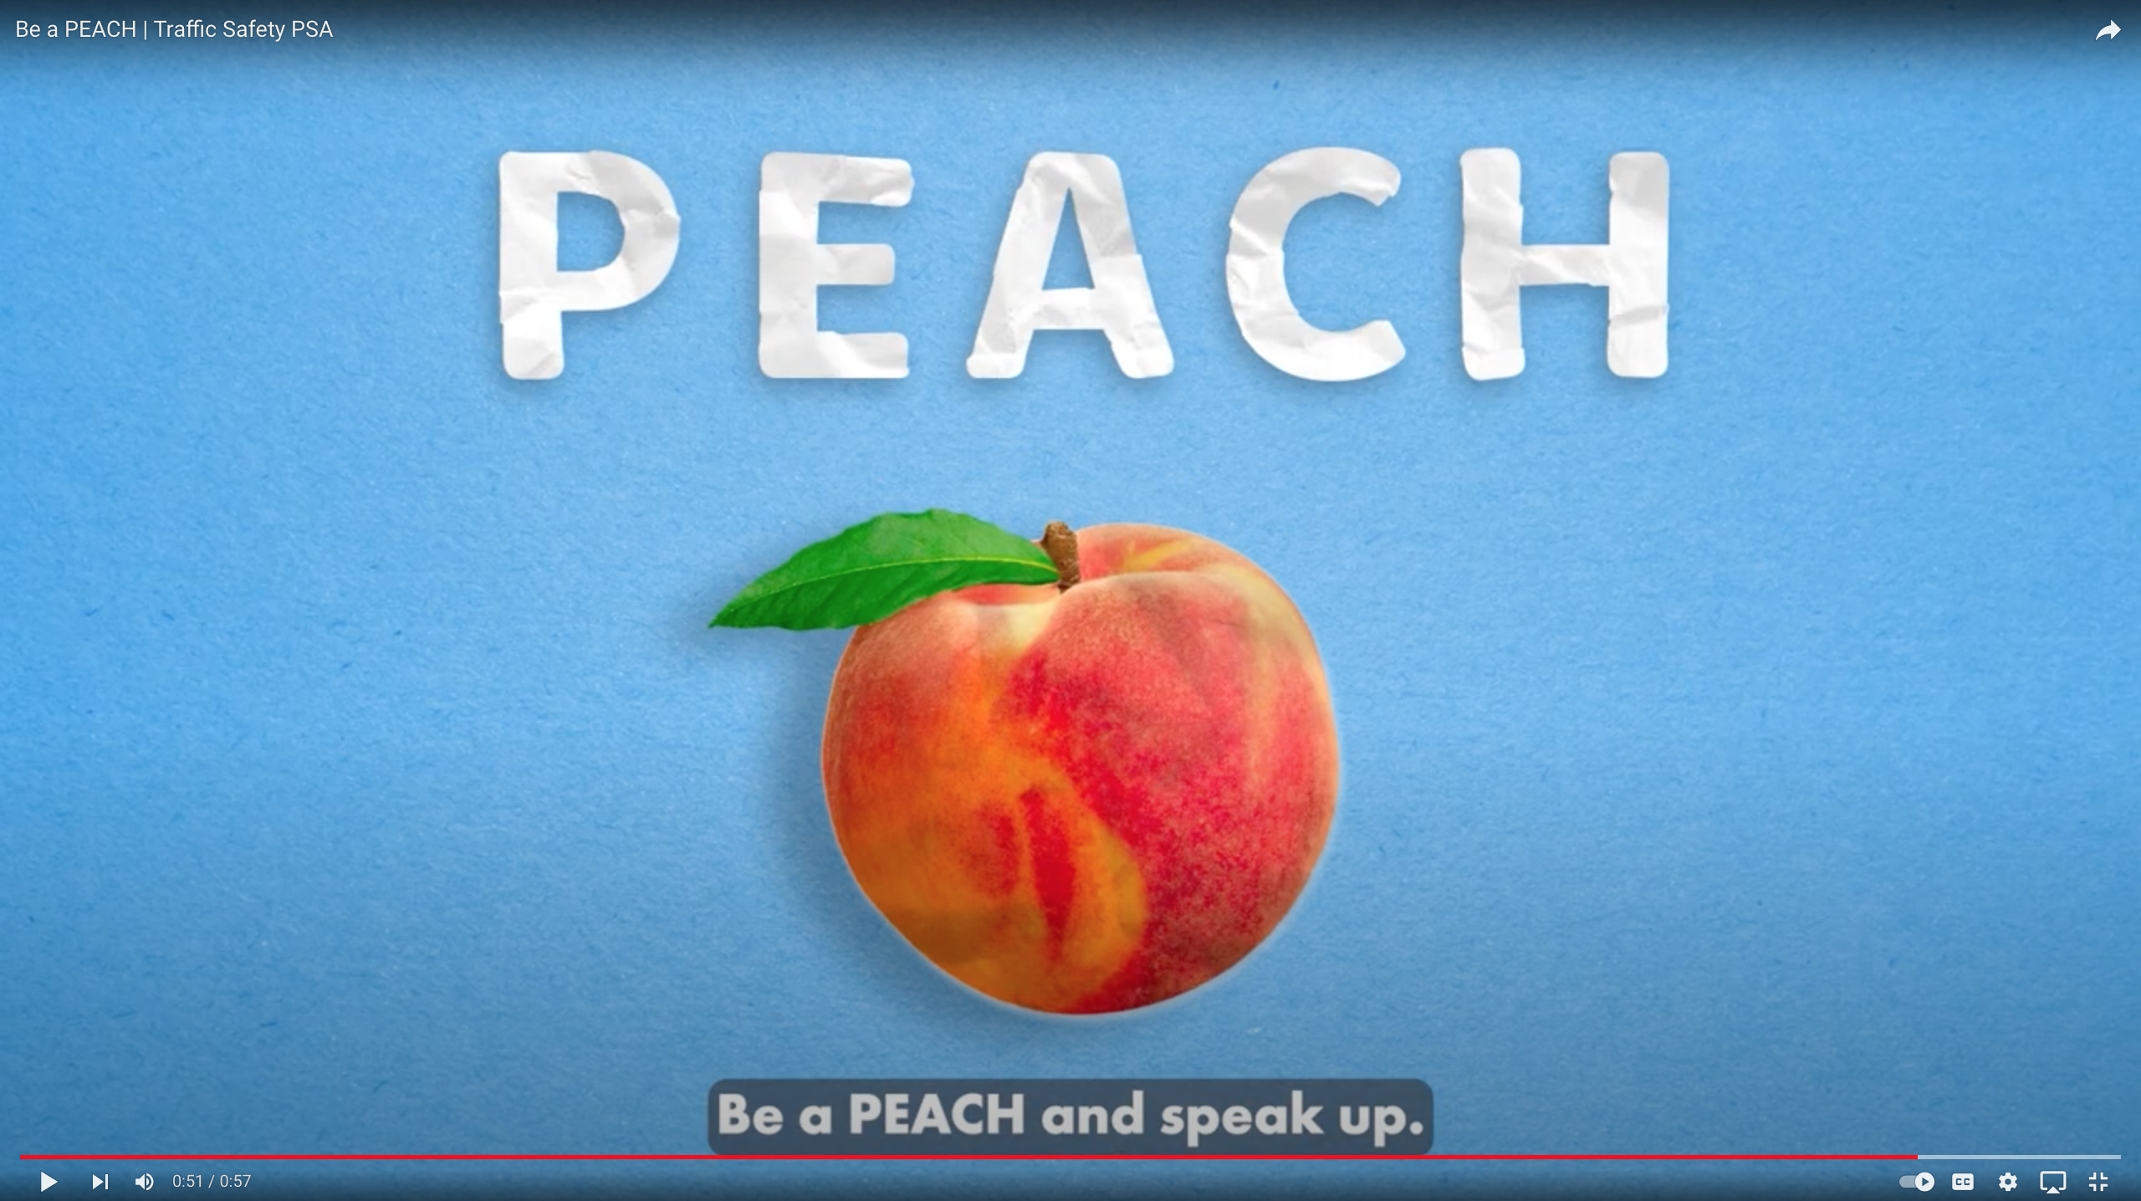
Notes:
Narrative
This is a video about the North Carolina Vision Zero’s traffic safety PSA “Be a PEACH.” It is available on YouTube at https://youtu.be/0dG5QIDv4bQ?si=ZLrn9xN9rx9Jb639.
Information sources:
Gottlieb, S. C. 2018. Talk to Teens about Distracted Driving. https://www.scottgottlieblaw.com/talk-to-teens-about-distracted-driving/. (Note: Based in New York).
National Safety Council. 2024. Course: Alive at 25 for Teen and Young Adult Drivers. https://www.nsc.org/safety-training/defensive-driving/teen-young-adult-defensive-driving-courses.
Center for the Study of Young Drivers at the University of North Carolina Highway Safety Research Center. https://www.hsrc.unc.edu/our-work/.
The Human Factors Safety Laboratory (HFSL) at the University of Minnesota. https://hfsl.umn.edu/.

Slide 19
Additional Resources
National Highway Traffic Safety Administration. Teen Driving: https://www.nhtsa.gov/road-safety/teen-driving
AAA Foundation for Traffic Safety. Teen Driver Risk in Relation to Age and Number of Passengers.
https://aaafoundation.org/teen-driver-risk-relation-age-number-passengers/
Children’s Hospital of Philadelphia. The Developing Brain and Teen Driving. https://injury.research.chop.edu/blog/posts/developing-brain-and-teen-driving
Governors Highway Safety Association. Teen Driver Safety. https://www.ghsa.org/issues/teen-drivers
Notes:
Narrative
These are resources that can be reviewed in conjunction with the slides in this presentation.

Slide 20
Disclaimer Notice
This module was developed by the Institute for Transportation (InTrans) at Iowa State University for the Iowa Department of Transportation (Iowa DOT) with the purpose to provide the material for driver education instructors in Iowa. InTrans is responsible for the facts and the accuracy of the information presented herein as of May 1, 2025.
Driver education instructors may use the material in its entirety or may use any of the slides and material individually. The material is for educational purposes only. It is strictly prohibited to sell any part of this module.
If any of the material is reused, please credit the appropriate source. The resources used for information and images for the module are provided in the notes section. Other material can be cited as Iowa DOT.
For more information or questions, please contact Vania Boyd, Driver Education and Motorcycle Rider Education Manager, Iowa DOT, Vania.boyd@iowadot.us.

