Slide 1
Intersection/Right-Of-Way
Notes:
Image source: Institute for Transportation at Iowa State University

Slide 2
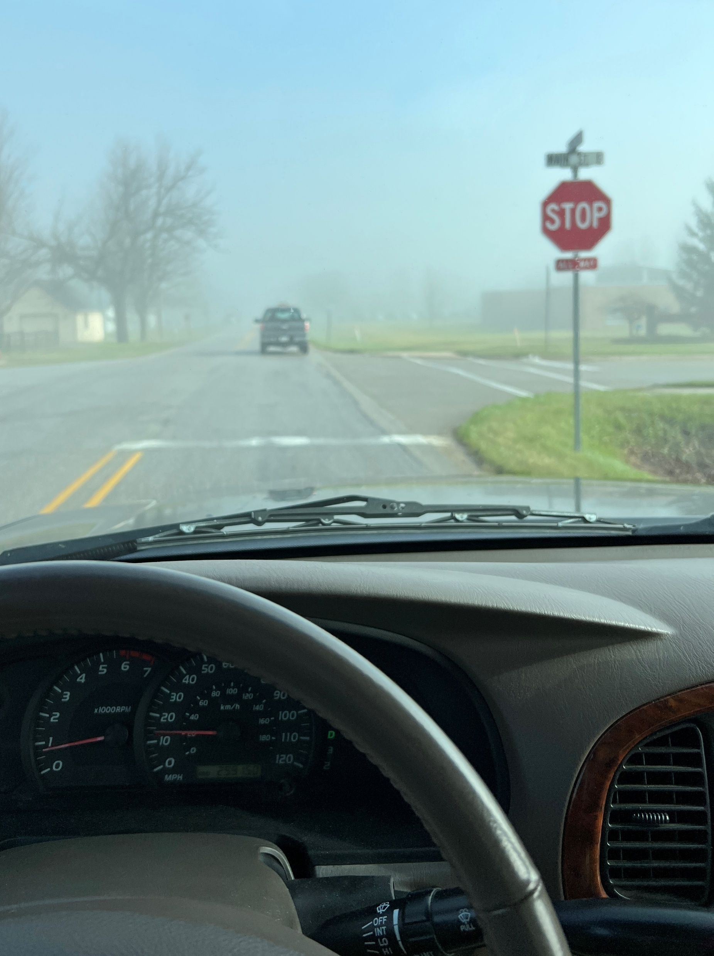
Learning Objectives
Define the meaning of yielding right-of-way (ROW)
Summarize the safety impacts of failing to yield ROW for driver below 16 years old
Describe the rules of yielding ROW for basic driving situations
Apply yielding ROW rules when driving under more complex situations, such as a roundabout or reduced-conflict intersection (RCUT)
Notes:
Narrative:
This slide summarizes the learning objectives of what students in the course (if this material is used in its entirety) should be able to do after it is over.
Image source: Institute for Transportation at Iowa State University

Slide 3
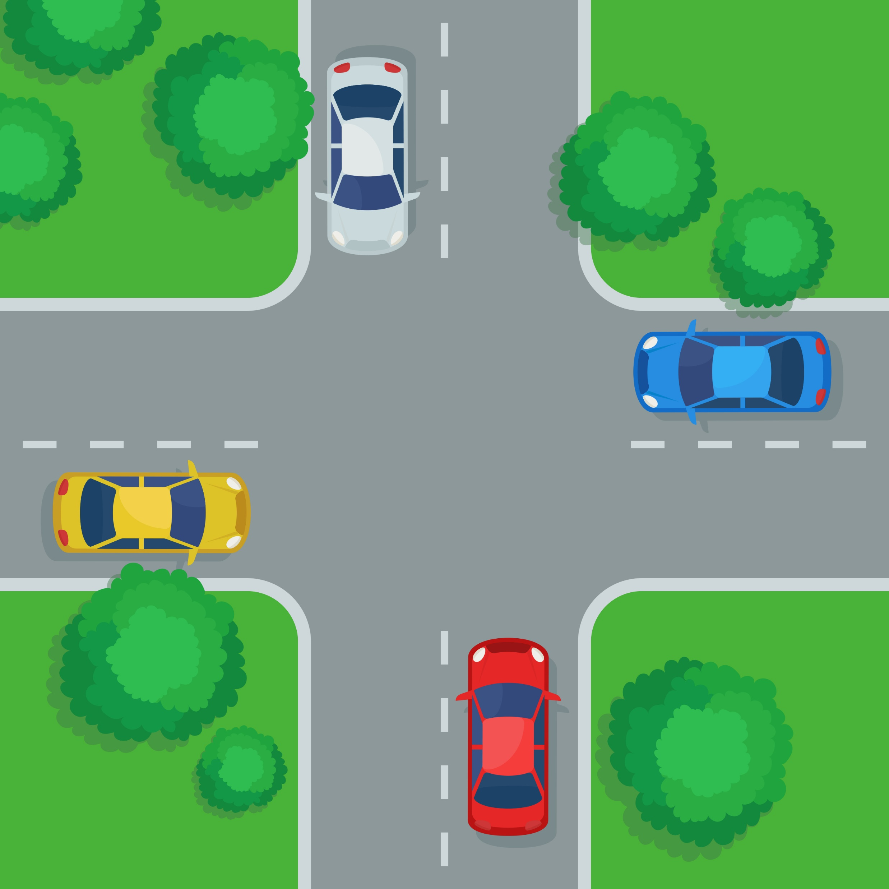
What do We Mean by Yielding ROW?
Two road users want to occupy the same physical space—this includes vehicles, bikes, pedestrians, etc.
Rules of who yields ROW (the space) tell road users who can proceed and who has to yield
These rules help avoid confusion and crashes
Notes:
Narrative:
Yielding ROW is defined here with the identification of situations when two road users want to be in the same place at the same time, recognizing that road users are more than just vehicles. It’s at these times that the rules of ROW apply.
Every driver/road user should know these rules as they are in place to avoid crashes. Some examples of the places and situations where yielding ROW is needed include intersection, pedestrian crossings, and interchange entrance ramps.
Image source: vectorlab2D/Shutterstock.com

Slide 4
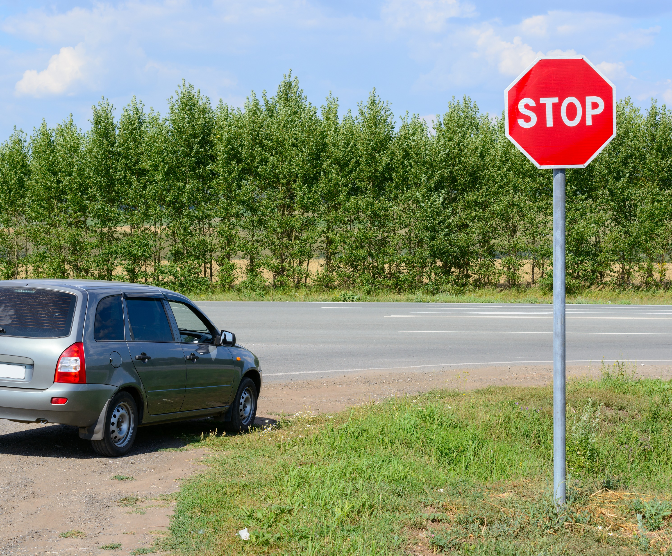
Why Does it Matter?
If we compare drivers in Iowa who are under 16 years old to drivers who are older than 16, we find that they are overrepresented in crashes when failure to yield ROW is noted as a major cause.
This includes the following:
  Running a Stop sign
  Failing to yield at uncontrolled intersection
  Turning right on red at a sign
  Failing to yield when a Yield sign is present
Notes:
Narrative:
This slide shares overrepresented crash data related to yielding ROW. A comparison is made between total and KAB (K=Fatal, A=Suspected Serious Injury, B=Suspected Minor Injury) crash data for drivers who are 16 years old and younger and for those greater then 16 years old.
Iowa crash data from 2018, 2019, and 2022 were used. The years 2020 and 2021 were not used because of the potential impacts of the COVID pandemic.
When crashes were labeled FTYROW crashes, it was found that drivers 16 years old or younger were overrepresented in the following locations for total and/or injury crashes—intersections/driveways, 4-way and T-intersections, no Stop/Yield sign existence, and school zones.
When FTYROW was listed as the major cause, it was also found that drivers 16 years old or younger were overrepresented for the following maneuvers for total and/or KAB crashes—running a Stop sign and failure to yield at uncontrolled intersections and/or when making various maneuvers.
Image source: Ramil Gibadullin/Shutterstock.com

Slide 5
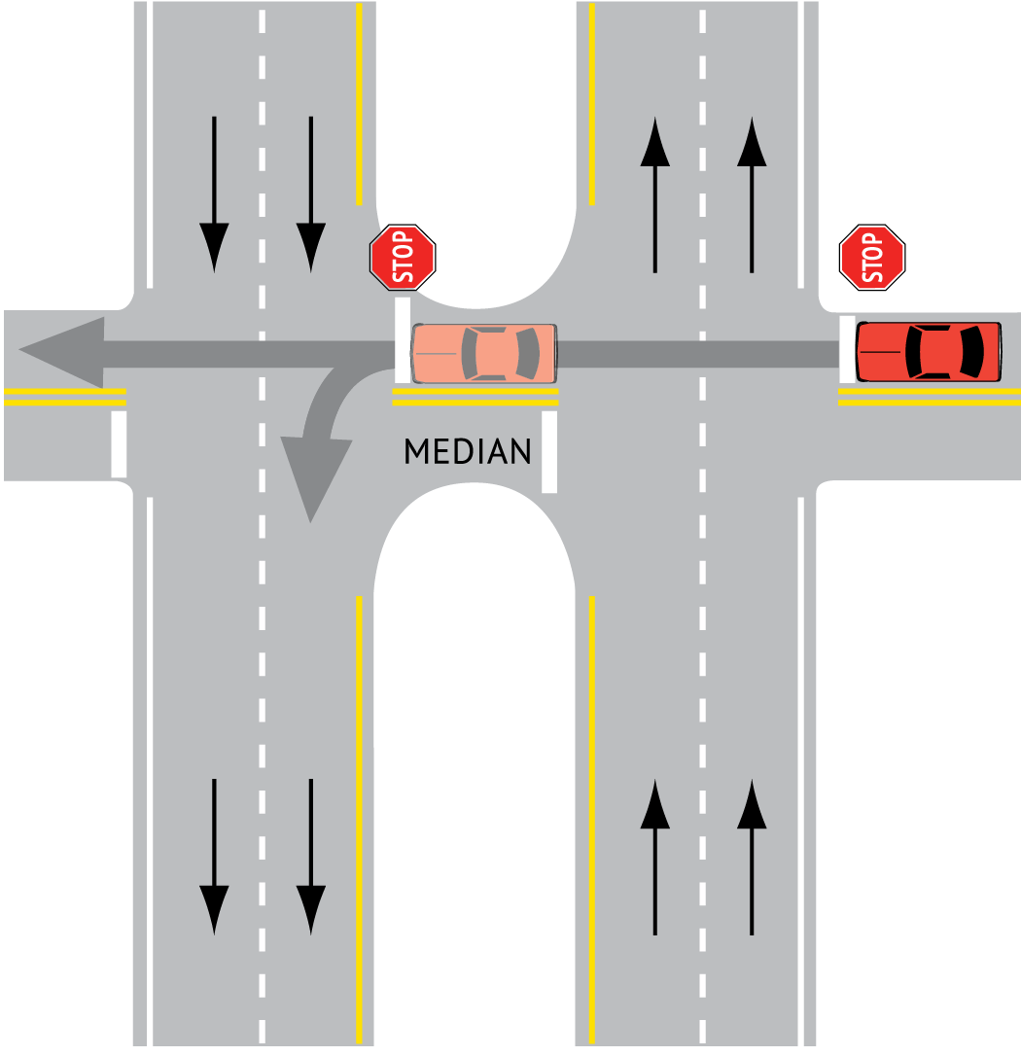
Crossing/Turning Left at a Divided Highway
Do not try to cross both directions at one time
  Stop at first Stop sign, look left, and proceed when safe to do so
  Stop in median, look right, cross or turn left when safe to do so
High speeds require caution and concentration
Be aware of median space and whether your vehicle will fit
Notes:
Narrative:
A rural divided highway is a roadway which has a wide median which is usually grass. In most cases, the median is designed to have space for a vehicle and a Stop or Yield sign. In this case, if you are turning left or going straight, you should stop and select a gap in the first set of lanes and then stop in the median where you will select a gap to cross the second set of lanes.
It should also be noted that some vehicles do not fit within the median. This is more typical for longer vehicles or vehicles with trailers. Be careful if your vehicle does not fully fit within the median.
Image source: Iowa Driver’s License Manual

Slide 6
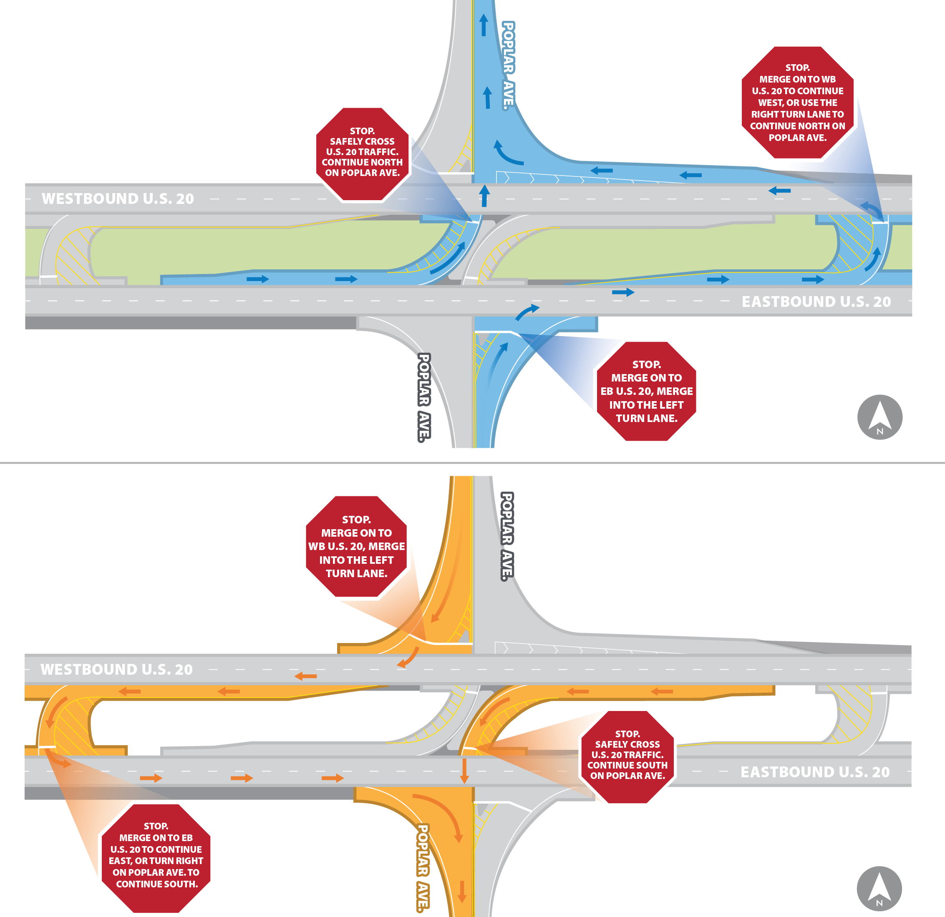
Driving a Reduced-Conflict Intersection
Newer design to reduce conflicts and improve safety at divided highways
Drivers turning left from side road must turn right, merge into the left lane, and make a U-turn
Notes:
Narrative:
From a safety point view, one of the solutions for the at-grade divided highway crossing is the reduced-conflict intersection. This intersection allows left turns off the divided roadway but no crossing or left turns on to the divided roadway. Vehicles crossing or turning left on to the main highway need to turn right and do a U-turn before proceeding.
As of January 2024, there is now one of these intersections in Iowa. The DOT website on this intersection (Reduced-conflict intersection (https://iowadot.gov/traffic/reducedconflictintersection)) indicates that studies show that this design reduced fatalities by 70 percent and injury crashes by 42 percent.
Image source: Iowa Driver’s License Manual

Slide 7
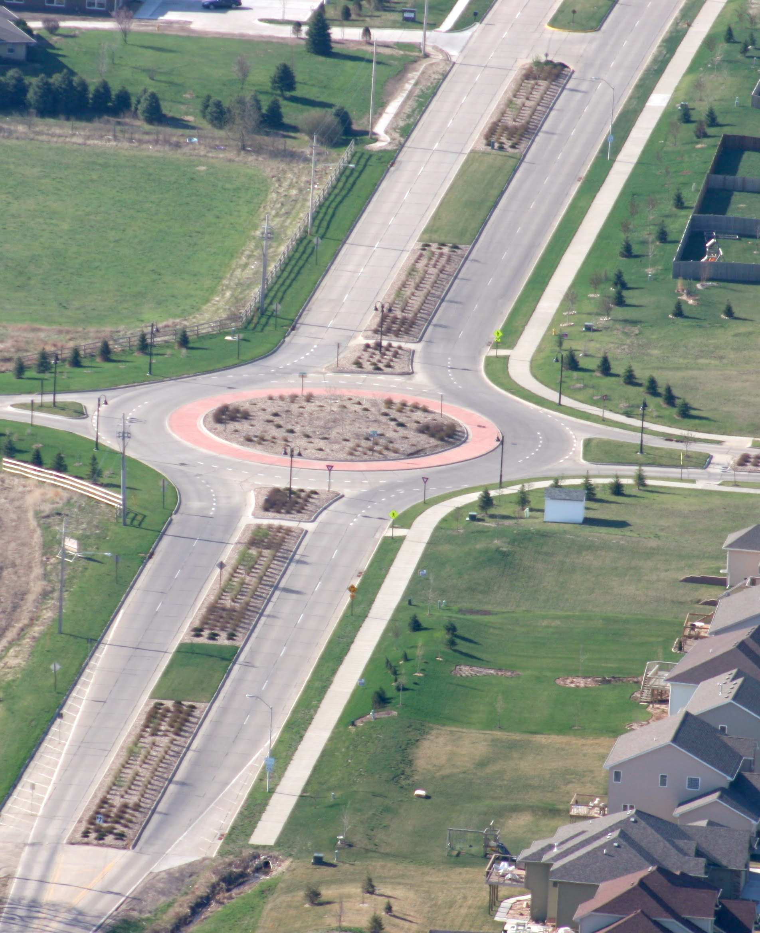
Driving a Roundabout
Signs and pavement markings guide traffic
Single lane roundabouts
  Slow on approach and yield to pedestrians as needed
  Yield to vehicles in roundabout, wait for gap, and merge into the roundabout
  Continue until your exit (don’t stop)
  Signal and exit roundabout; yield to pedestrians as needed
Multilane roundabouts
  Pick proper approach lane
  Yield as you enter roundabout
  Signal just before your exit
  Be aware of traffic in the other lane
Notes:
Narrative:
A second intersection design that is becoming more and more prevalent in Iowa is the roundabout (both single and multilane). Roundabouts have existed for a long time throughout the world and United States. They improve safety and efficiency. If properly designed and signed/marked, the traffic control should guide traffic through this design (which can be different from location to location).
The slide shares information about driving through single lane and multilane roundabouts, which are also discussed in the Iowa Driver’s License Manual. In general, all maneuvers within the roundabout (if it’s designed correctly) will also be done at relatively slow speeds. Approaching traffic yields to the traffic already in the roundabout and, as always, traffic needs to yield to pedestrians (who should only be crossing roundabout approach and departure lanes). Roundabouts improve safety at intersections.
There are also some roundabout don’ts. For both single and multilane roundabouts—don’t stop in a roundabout. For multilane roundabouts—don’t change lanes in a roundabout, don’t pass or drive besides trucks/buses (they may straddle lane lines and may not see you), and don’t drive in the outside lane farther than allowed (for multilane roundabouts) as you may create a hazard with those legally exiting from the inside lane.
An example video of driving through a roundabout is available at https://www.youtube.com/watch?v=_dy4FFfzrU4&t=3s.
Image source: Institute for Transportation at Iowa State University

Slide 8
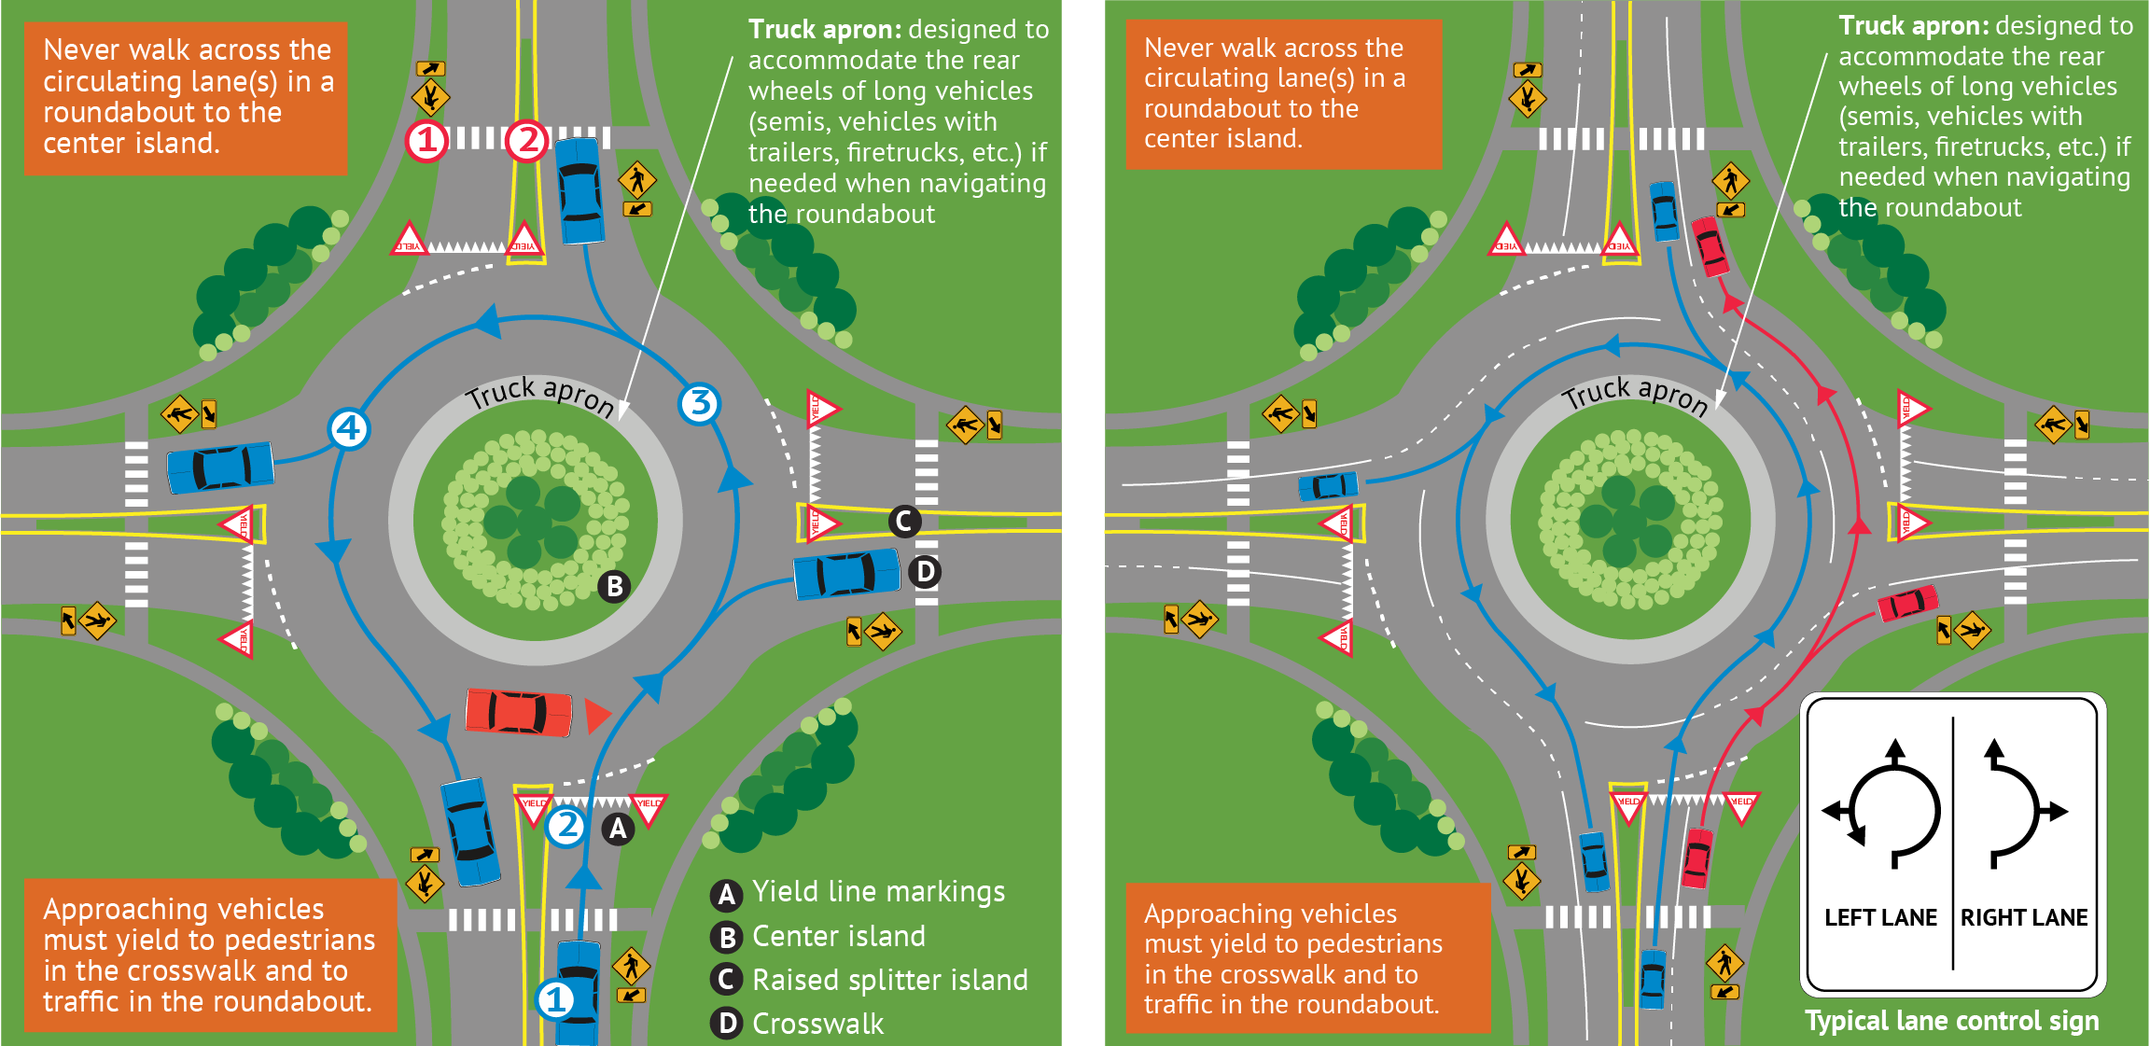
Driving a Roundabout
Single-lane roundabout
Multi-lane roundabout
Notes:
Narrative:
This figure shows yielding ROW and other rules for roundabouts. The notes about yielding, truck aprons, and pedestrians crossing to the center island are the same on both sides of the figure. Drivers also need to yield to pedestrians crossing on their departures from the roundabout.
This figure does not mention bicyclists. Bicyclists, per the Iowa Driver’s License Manual, can either walk their bikes like pedestrians or ride (if an experienced bicyclist) in the center of the proper lane through the roundabout like a vehicle (also yielding to pedestrians just like a vehicle).
Bicycle ramps are provided in roundabout design to allow bicyclists to exit the roadway and operate as a pedestrian. These are not shown on the figures above.
An example video of driving through a roundabout is available at https://www.youtube.com/watch?v=_dy4FFfzrU4&t=3s.
Image source: Iowa Driver’s License Manual

Slide 9
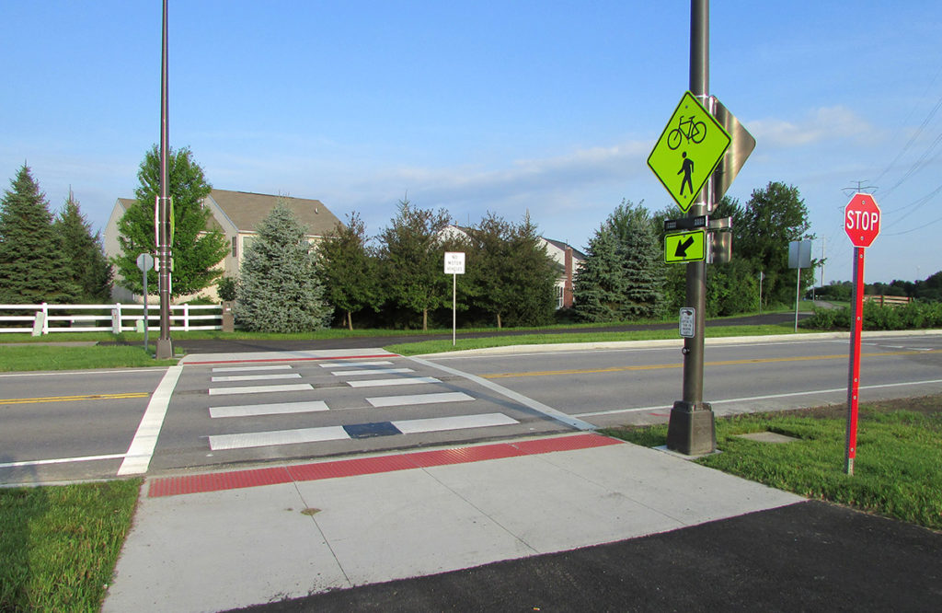
Rectangular Rapid Flashing Beacons (RRFBs)
RRFBs are used at mid-block pedestrian crossings
Pedestrians push a button to activate flashing lights
Drivers are required to yield to pedestrians
RRFBs allow pedestrians to cross a road safely
Notes:
Narrative:
This slide and next one are provided for information to instructors about “newer” traffic control devices that are now being installed in Iowa. These are devices that may cause some confusion until they become more commonplace.
What is pictured here is the Rectangular Rapid Flashing Beacon (RRFB). These are placed at pedestrian crossings to alert drivers that a pedestrian is present and to yield. Here is a short video that shows RRFBs in operation: https://www.youtube.com/watch?v=u7-R--i5e-o.
RRFBs are placed on both sides of a crosswalk below the pedestrian crossing sign and above the diagonal downward arrow plaque pointing at the crossing. The flashing pattern can be activated with pushbuttons or passive (e.g., video or infrared) pedestrian detection and should be unlit when not activated.
Resources
Information source: https://highways.dot.gov/safety/proven-safety-countermeasures/rectangular-rapid-flashing-beacons-rrfb
Image source: LJB Inc. (https://www.ljbinc.com/project/odot-pedestrian-safety-improvement-program/)

Slide 10
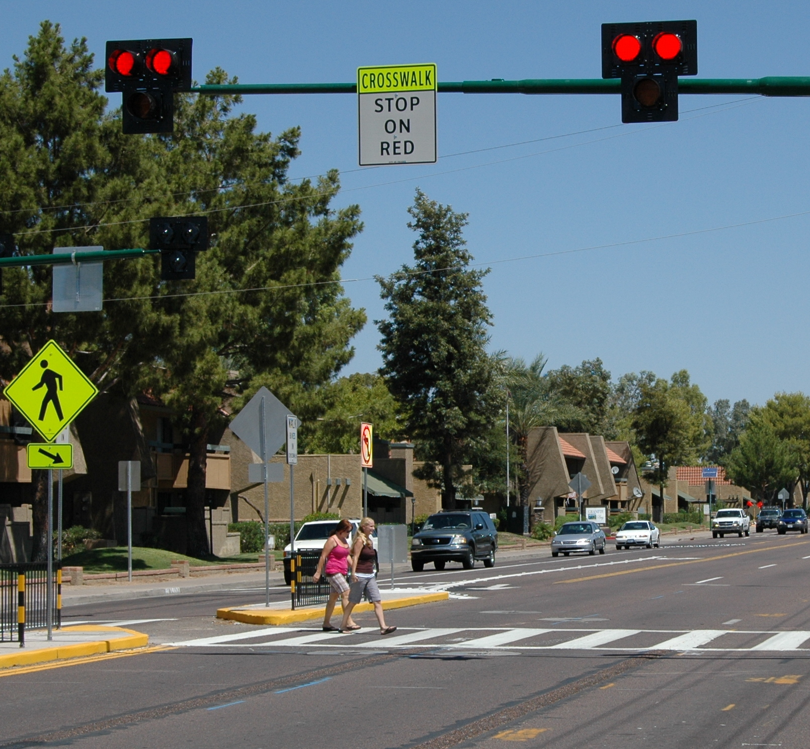
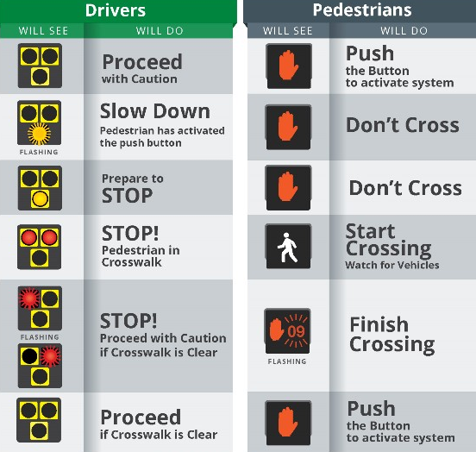
Pedestrian Hybrid Beacon (PHB)
Similar to RRFB
Pedestrians activate the PHB
Lighting sequence tells drivers what to do, as shown in the figure to the far right
Notes:
Narrative:
Another measure that is becoming more common in Iowa are pedestrian hybrid beacons (PHBs). They are used to alert drivers to the presence of a pedestrian so the driver can yield. The operation of the PHB is shown in the figure from both the vehicle driver and pedestrian point of view. The lights facing the drivers are in a T-shape and there are often signs that can be read once the driver is stopped about how to proceed.
The description of how to negotiate a PHB is from the City of Cedar Rapids and can be found here: https://www.cedar-rapids.org/local_government/departments_g_-_v/public_works/hawk_signals.php.
Photo source: www.pedbikeimages.org/Mike Cynecki

Slide 11
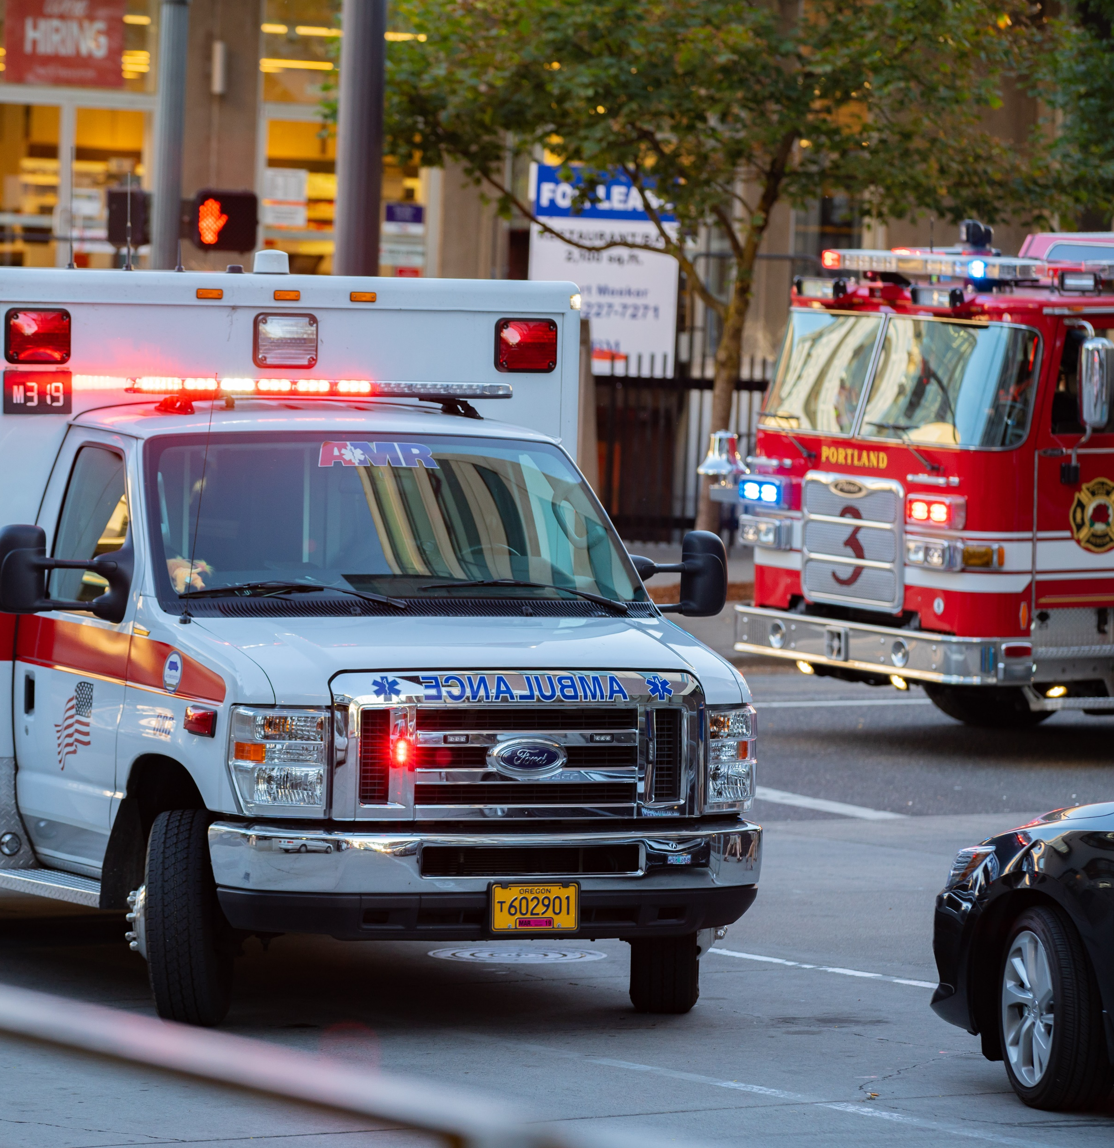
Emergency Vehicles
Emergency vehicles include fire trucks, ambulance, and police vehicles
When encountering an emergency vehicle using siren/air horn and/or flashing lights, you should do the following:
  Pull to the right edge of the road when they approach from any direction, except the opposite of a roadway with a median
  In an intersection, pull through it and pull over
  Stay at least 500 feet behind emergency vehicle
Notes:
Narrative:
This slide explains what to do when yielding ROW to emergency vehicles as they approach a vehicle from either direction. The text is primarily from the Iowa Driver’s License Manual, but the word “moving” has been added to the initial point because Iowa has a “move over” law that is explained on the next slide for situations when they are on the side of the road. Of value to add to this type of discussion may be what to do when approaching an intersection with a green signal and there is also an approaching and opposing emergency vehicle with lights, etc.
Image source: Alexander Oganezov/Shutterstock.com

Slide 12
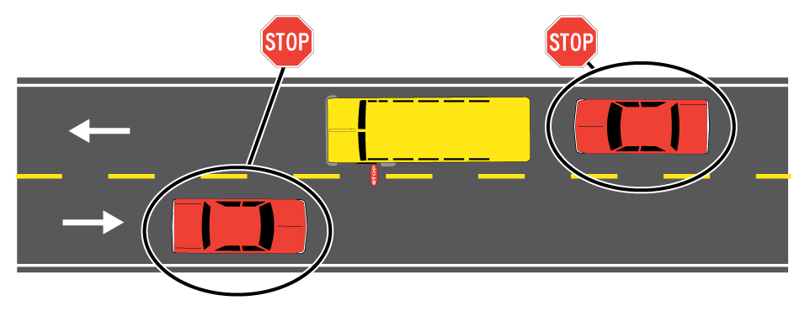
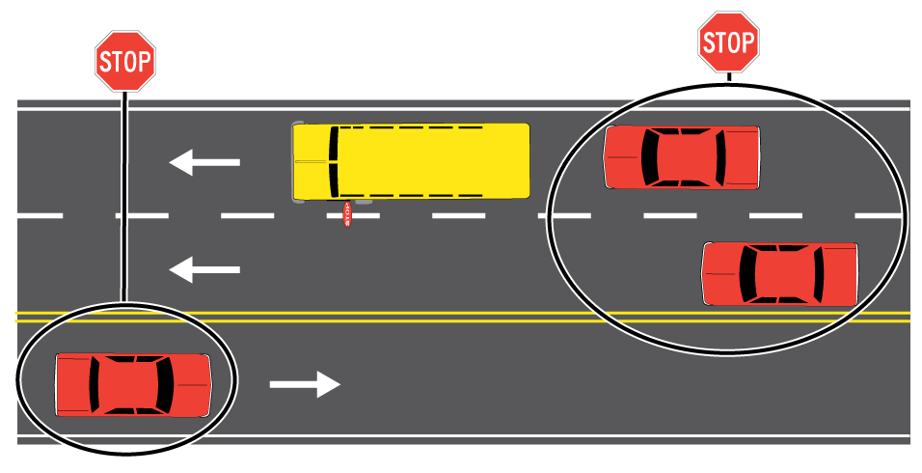
School Buses
When approaching a school bus with flashing lights on a 2 or 3 lane road
Approaching from the rear:
  Slow and prepare to stop
  When the stop arm is extended, stop at least 15 feet from the rear of the bus
  Remain stopped until the stop arm is redacted and the bus starts moving
Approaching from the front:
  Slow down to 20 mph and prepare to stop
  When the stop arm is extended, stop in front of the bus
  Remain stopped until the stop arm is redacted and then proceed with caution
Notes:
Image source: Iowa DOT

Slide 13
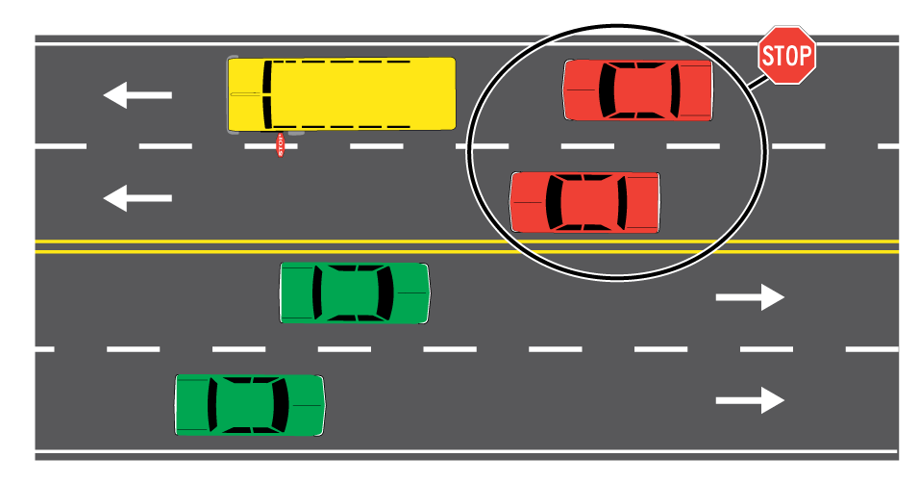
School Buses
When approaching a school bus with flashing lights on a road with 4 or more lanes
Approaching from the rear:
  Slow and prepare to stop
  When the stop arm is extended, stop at least 15 feet from the rear of the bus
  Remain stopped until the stop arm is redacted and the bus starts moving
Approaching from the front:
  You do not need to stop, but proceed with caution
Notes:
Image source: Iowa DOT

Slide 14
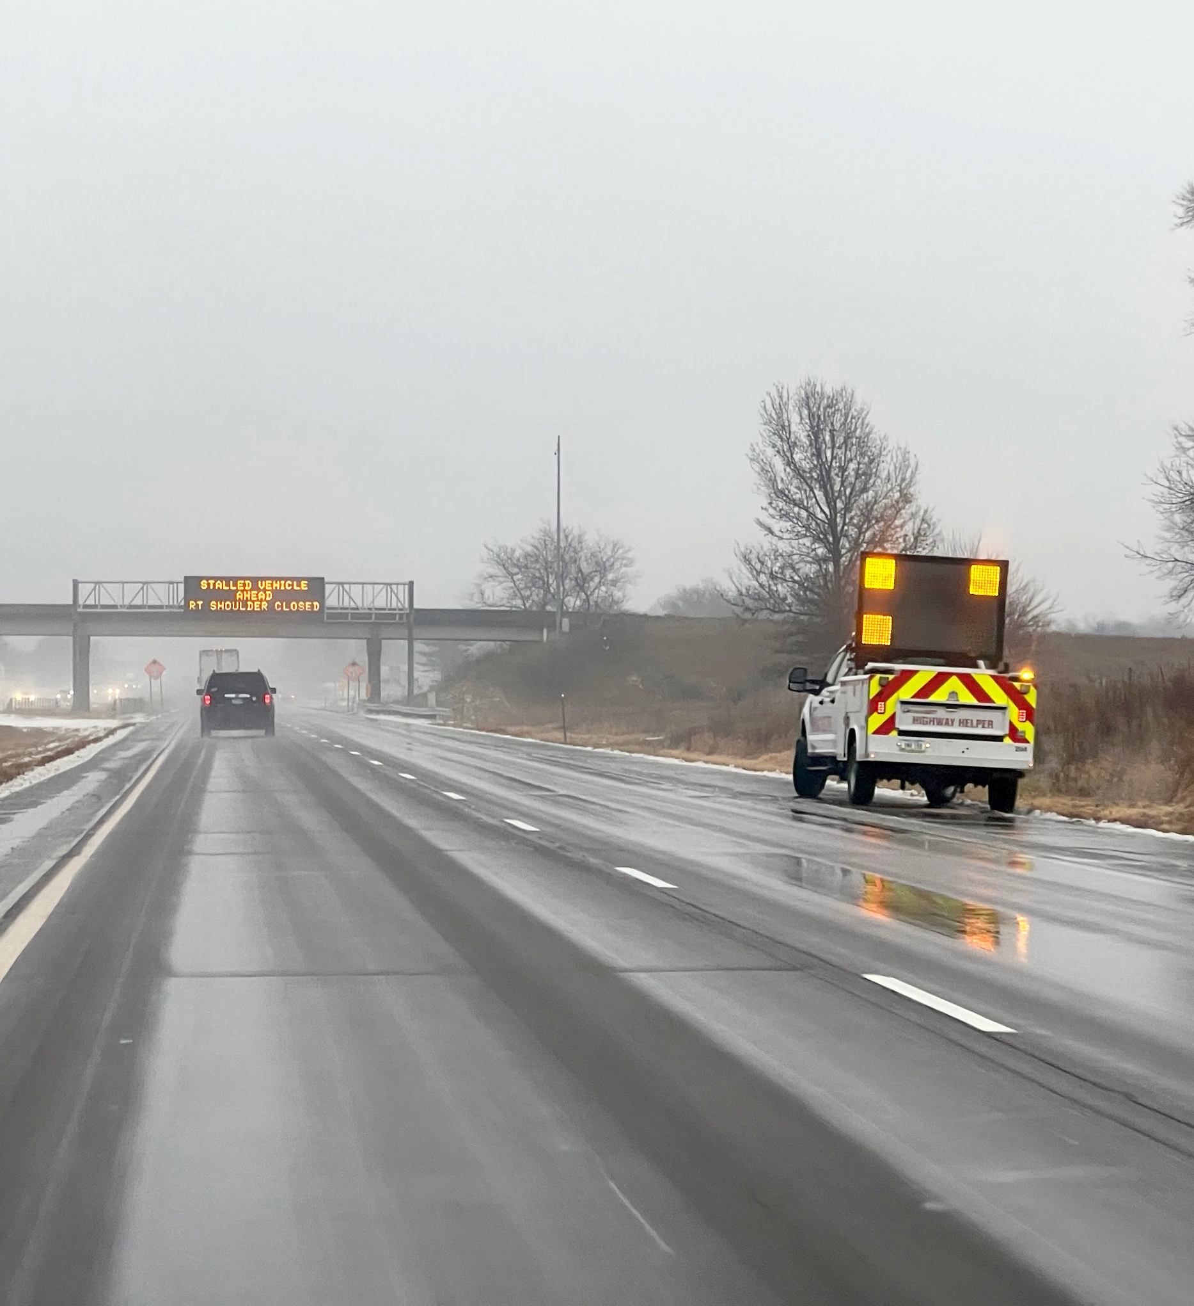
Iowa’s Move Over or Slow Down Law
You are required to change lanes when approaching a stopped vehicle which is displaying flashing lights
If you cannot safely change lanes, you are required to slow down to below the posted speed limit and prepare to stop
Notes:
Narrative:
Iowa recently enacted a “move over or slow down” law. It is in Iowa Code 321.323A. The text in this slide comes from the Iowa Driver’s License Manual.
Driver’s Education 101 has specific information about speeds when passing under “emergency vehicles.”
Image source: Institute for Transportation at Iowa State University

Slide 15
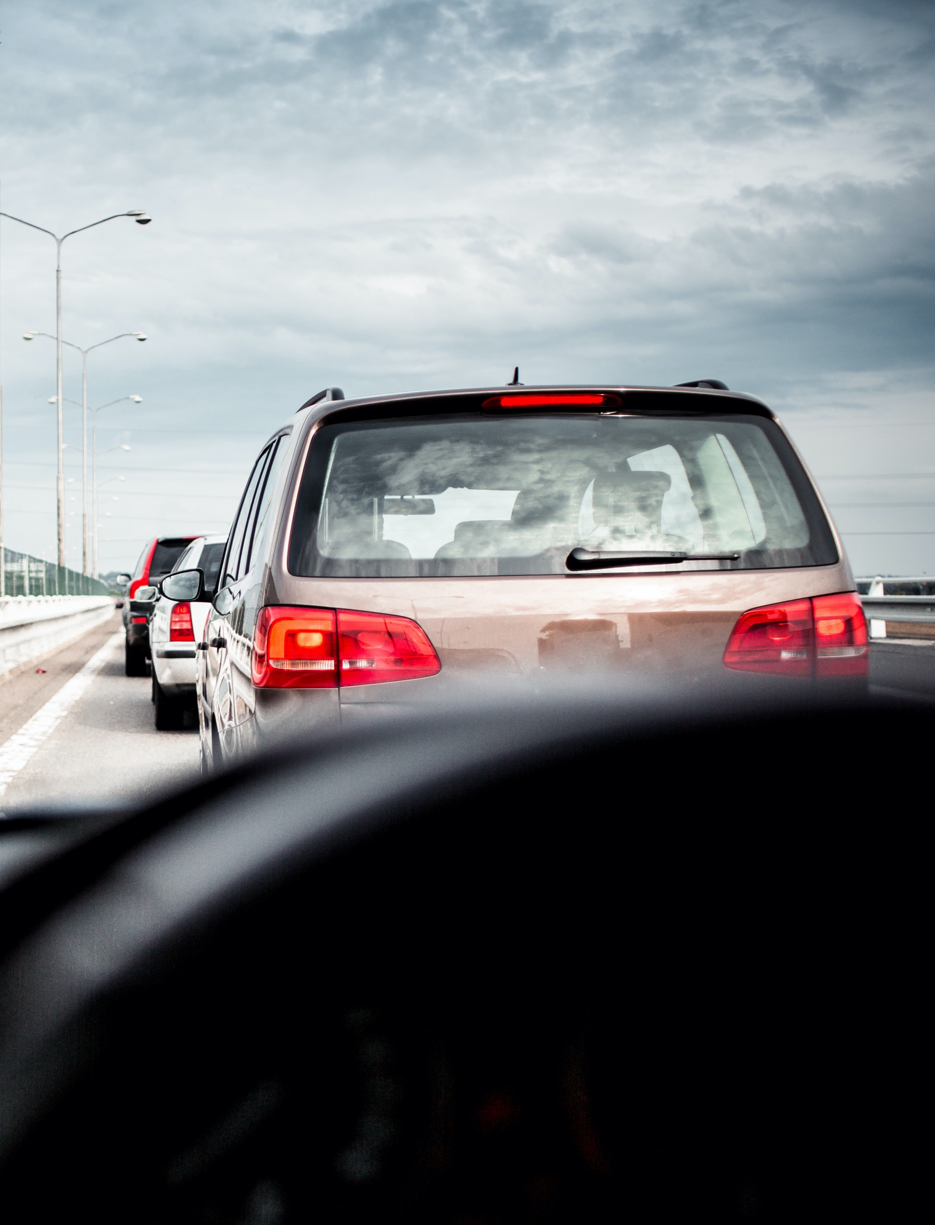
Funeral Processions
A funeral procession is a line of motor vehicles accompanying a vehicle carrying a deceased person. It can be escorted by the following vehicles:
  Vehicle continually displaying its emergency signal lamps flashing simultaneously and using lighted headlamps and identifying flags
  Escort vehicle displaying flashing or revolving red and amber light visible in all directions and keeping all other motor vehicles with lighted headlamps in close formation
Other drivers should yield ROW to the procession
Notes:
Narrative:
This slide includes text about funeral processions and yielding ROW. The occurrence of these type of processions has become more and more rare and can include peace officer involvement.
In fact, this subject is not covered in the Iowa Driver’s License Manual. The text above is a summary of the information contained in the Iowa Code 321.324A.
It defines what a “procession” is and indicated what other drivers should do. There is also the note that people in the procession can’t be charged with violating traffic rules and regulations relating to traffic signals and devices.
From Iowa Code 321.324A
“For purposes of this section, funeral procession means a procession of motor vehicles accompanying the body of a deceased person during daylight hours which is being escorted by a vehicle continually displaying its emergency signal lamps flashing simultaneously and using lighted headlamps and identifying flags, or an escort vehicle displaying a flashing or revolving red and amber light visible to pedestrians in all directions, and keeping all other motor vehicles with lighted headlamps in close formation.”
Image source: Viktor Hanacek from picjumbo.com

Slide 16
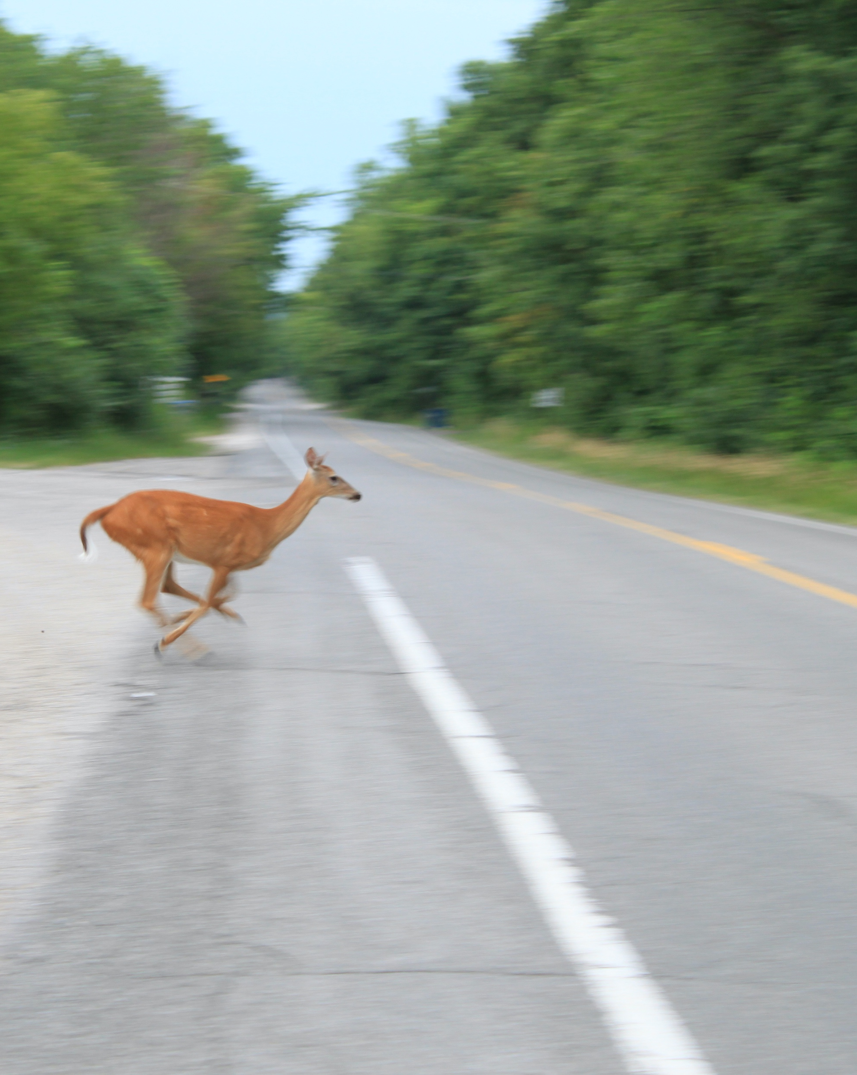
Animal Collisions
Keep a look out for animals crossing the roadway
Watch particularly for deer
  Sunrise and sunset are peak times
  October, November, and May are peak collision months
  Deer travel in groups—if you see one, expect others
If you don’t have time to stop, don’t swerve/veer—a more severe crash could result (e.g., head-on, roadside hazards)
Notes:
Narrative:
The Iowa Driver’s License Manual includes a discussion about “don’t veer for deer.” It discusses that animal collisions represent a leading cause of crashes in Iowa. This is especially related to deer collisions. It provides some facts about when deer-vehicle collisions occur most often—the months of October, November, and May and also at sunrise and sunset. However, of course, these collisions can happen in any month and throughout the day and night. It also notes that deer usually travel in groups, so if you see one, expect others. Scanning the roadway and roadside during these times and recognizing the distance capabilities of the headlights on a car are also topics that could be discussed here.
The percentage of deer-vehicle collisions that result in fatalities for the vehicle passengers, however, is quite low in comparison to some that are much more severe. This is origin of the “don’t veer for deer” slogan and advice. Situations where drivers veer into oncoming traffic or off the roadside can result in head-on crashes and/or fixed object crashes, and these have a higher percentage of fatality and severe injury crashes. The Iowa Driver’s License Manual, therefore, provides the advice that if there isn’t time to stop, don’t veer “…as this will likely result in a more severe crash.” This is likely to be a difficult discussion to have and, of course, these are often split-second decisions that are made by drivers.
It is also important to recognize and be aware of the fact that there are sometimes larger types of animals on Iowa roadways—domesticated and wild.
Image source: © Dwight Burdette / Wikimedia Commons / CC BY 3.0

Slide 17
Disclaimer Notice
This module was developed by the Institute for Transportation (InTrans) at Iowa State University for the Iowa Department of Transportation (Iowa DOT) with the purpose to provide the material for driver education instructors in Iowa. InTrans is responsible for the facts and the accuracy of the information presented herein as of May 1, 2025.
Driver education instructors may use the material in its entirety or may use any of the slides and material individually. The material is for educational purposes only. It is strictly prohibited to sell any part of this module.
If any of the material is reused, please credit the appropriate source. The resources used for information and images for the module are provided in the notes section. Other material can be cited as Iowa DOT.
For more information or questions, please contact Vania Boyd, Driver Education and Motorcycle Rider Education Manager, Iowa DOT, Vania.boyd@iowadot.us.

