Slide 1
The Dangers of Impaired Driving
Notes:
Narrative
This module was developed by the Institute for Transportation at Iowa State University for the Iowa Department of Transportation. The purpose is to provide additional material for driver education instructors in Iowa. This module focuses on driving while impaired. The material can be used in its entirety, or a driver education instructor can use any of the slides or material individually. Citations are provided for information sources and images. If these materials are used, please credit the appropriate source. Other material can be cited as Iowa DOT.
Image source:
AppleZoomZoom/Shutterstock.com

Slide 2
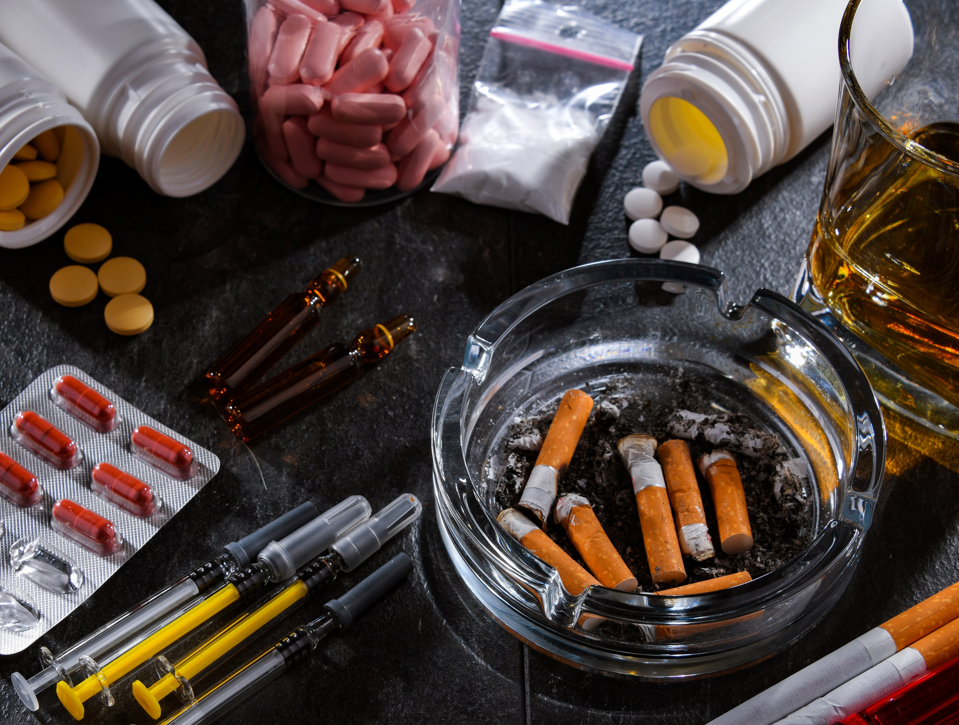
Learning Objectives
Help teens understand what driving impaired means
Help teens understand why driving under the influence of alcohol or drugs, or while drowsy, is dangerous
Provide tools for teen drivers to use so they can avoid making the decision to drive while impaired
Notes:
Narrative
The learning objectives for this module are as follows:
Help teens understand what driving impaired means
Help teens understand why driving under the influence of alcohol or drugs, or while drowsy, is dangerous
Provide tools for teen drivers to use so they can avoid making the decision to drive while impaired
Image source:
monticello/Shutterstock.com

Slide 3
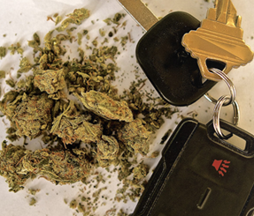
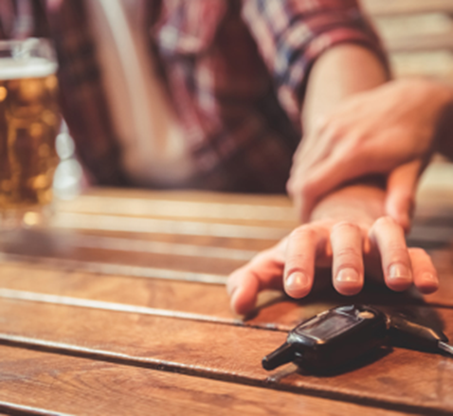
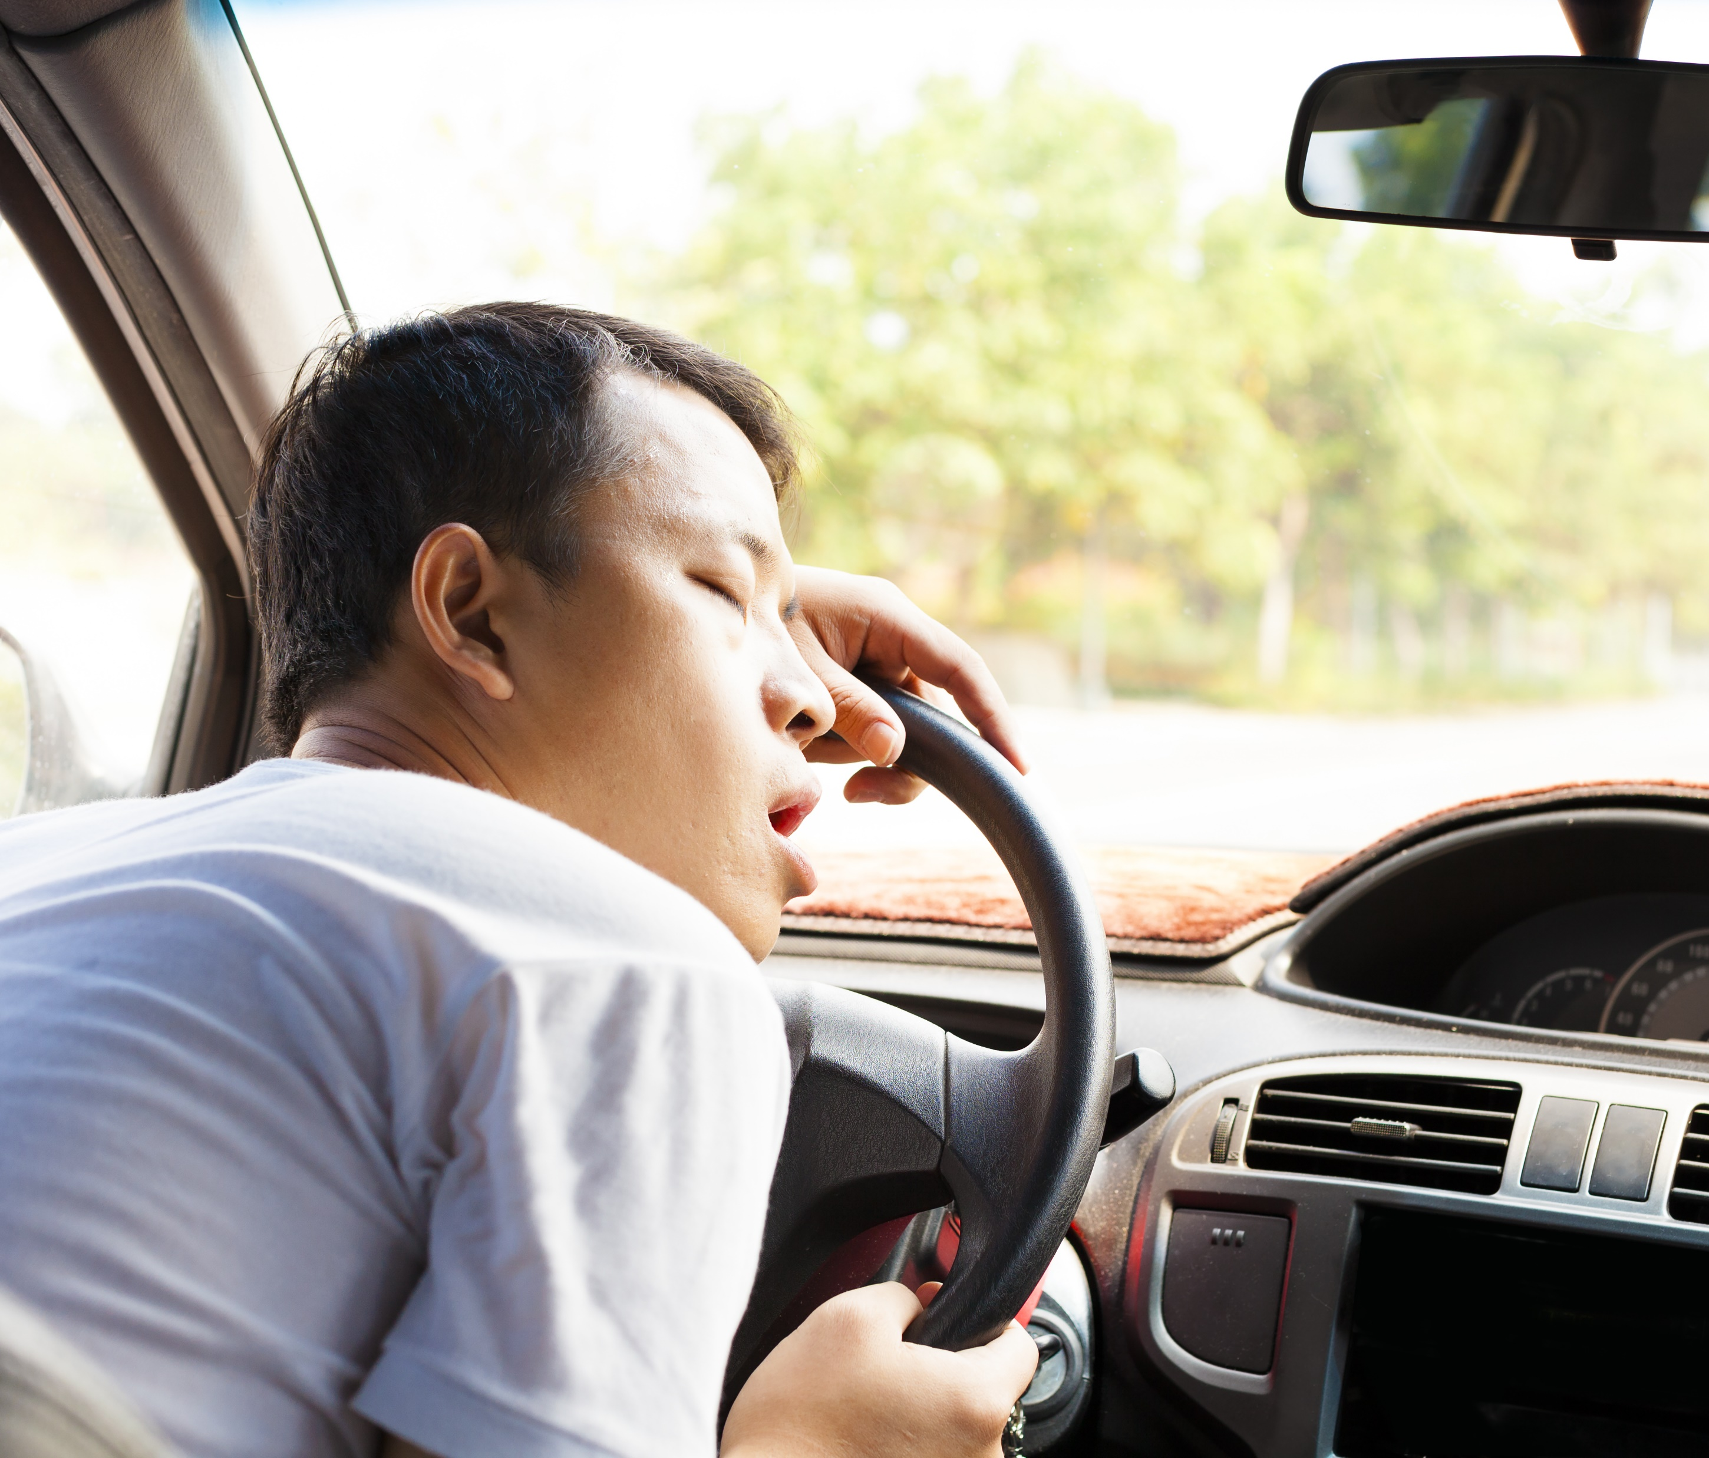
Main Causes of Impairment in Driving
DRUGS
ALCOHOL
DROWSY
Marijuana and Prescription Drugs
Beer and Wine
Exhausted and Sleepy
Notes:
Narrative
The three main causes of impairment in driving are drugs (illegal and prescribed), alcohol, and drowsiness.
Image sources:
Centers for Disease Control and Prevention (Drugs and Alcohol)
Tom Wang/Shutterstock.com (Drowsy)

Slide 4
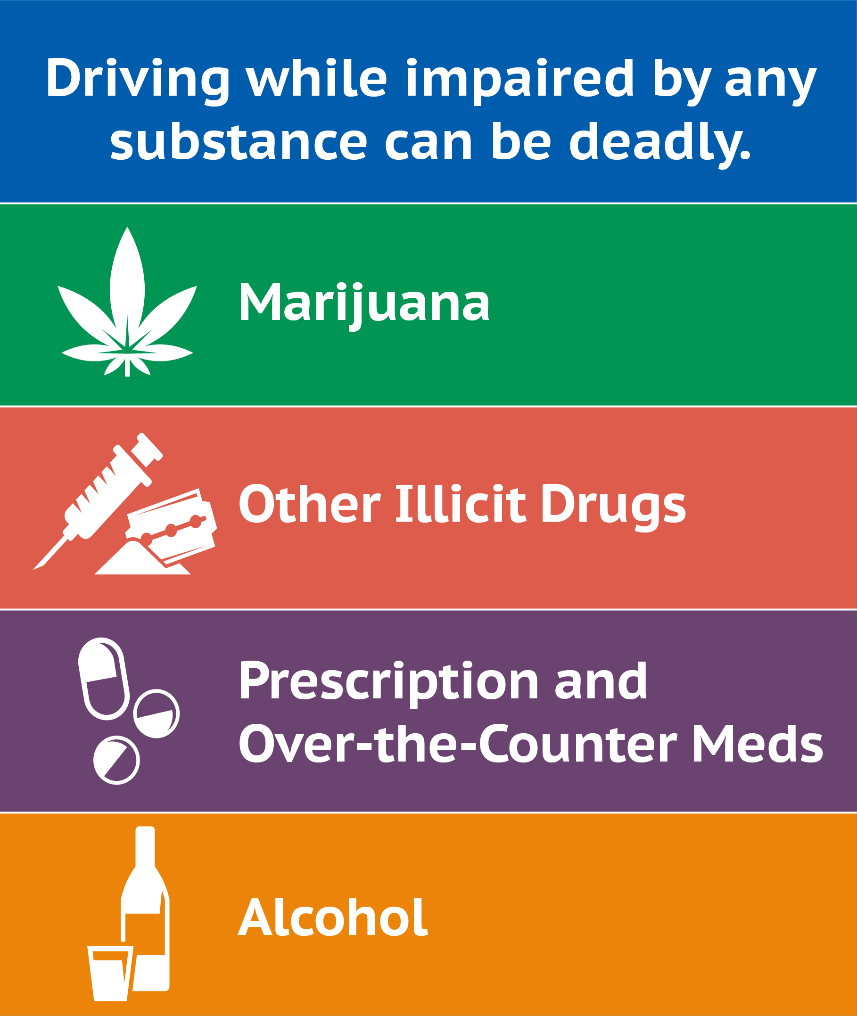
What Does Driving Impaired Mean?
Driving while impaired is illegal in the United States
Impaired driving happens when someone operates a vehicle while impaired by a substance such as marijuana, other illicit drugs, some prescribed or over-the-counter medicines, or alcohol
Notes:
Narrative:
Impaired driving happens when someone operates a vehicle while impaired by a substance such as marijuana, other illicit drugs, some prescribed or over-the-counter medicines, or alcohol. Driving under the influence of marijuana is illegal in all 50 states. Officers conduct a traffic stop when they observe inappropriate driving behavior. If a driver exhibits signs of impairment after being stopped, then the officer conducts pre-arrest screening tests for alcohol or drugs. In some instances, an officer with special training may be called upon to evaluate the driver.
Image source:
Centers for Disease Control and Prevention. https://www.cdc.gov/impaired-driving/media/pdfs/drug-impaired-driving-summary-sheet-ld-508.pdf.

Slide 5
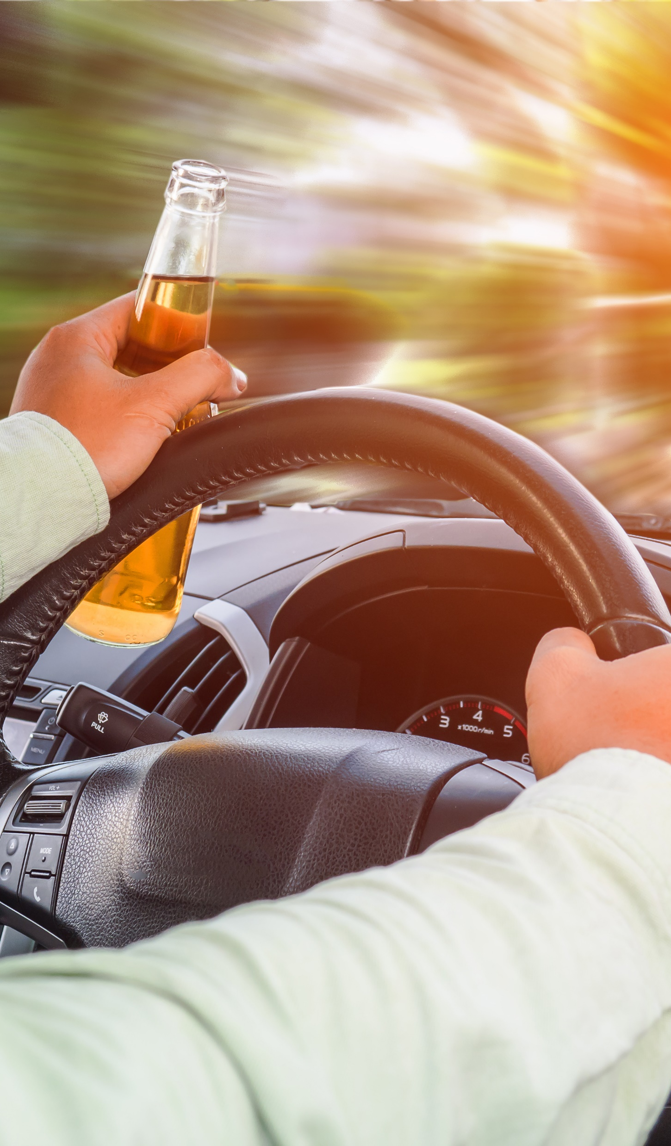
Alcohol-Impaired Driving
In 2021, 13,384 people were killed in crashes involving alcohol-impaired drivers in the United States.
Approximately one-third of all traffic crash fatalities in the United States involve drunk drivers (with BACs at or above 0.08 g/dL).
Although it’s illegal to drive when impaired by alcohol, in 2021, one person was killed every 39 minutes in a drunk-driving crash on our nation’s roads.
The rate of alcohol impairment among drivers involved in fatal crashes in 2021 was 2.8 times higher at night than during the day.
Males are more likely than females to be driving drunk when involved in fatal crashes (in 2021, 22% of males were driving drunk compared to 17% of females).
Polysubstance use (i.e., using more than one drug or using drugs and alcohol together) also makes driving dangerous.
Notes:
Narrative
In 2021, 13,384 people were killed in crashes involving alcohol-impaired drivers (defined as drivers or motorcycle riders with BACs of 0.08 g/dL or higher). This was an increase of 14.2% from the 11,718 fatalities in 2020.
Fatalities in crashes involving alcohol-impaired drivers continue to represent almost one-third (31%) of all motor vehicle fatalities in the United States.
Although it’s illegal to drive when impaired by alcohol, in 2021, one person was killed every 39 minutes in a drunk-driving crash on our nation’s roads.
The rate of alcohol impairment among drivers involved in fatal crashes in 2021 was 2.8 times higher at night than during the day.
Males are more likely than females to be driving drunk when involved in fatal crashes (in 2021, 22% of males were driving drunk compared to 17% of females).
Polysubstance use (i.e., using more than one drug or using drugs and alcohol together) also makes driving dangerous.
Resources
Information source:
NHTSA. 2023. Traffic Safety Facts: 2021 Data – Alcohol-Impaired Driving. National Highway Traffic Safety Administration, Washington, DC. https://crashstats.nhtsa.dot.gov/Api/Public/Publication/813450#:~:text=In%202021%20there%20were%2013%2C384%20people%20killed%20in%20alcohol%2Dimpaired,the%20United%20States%20in%202021.
Image source:
AppleZoomZoom/Shutterstock.com

Slide 6
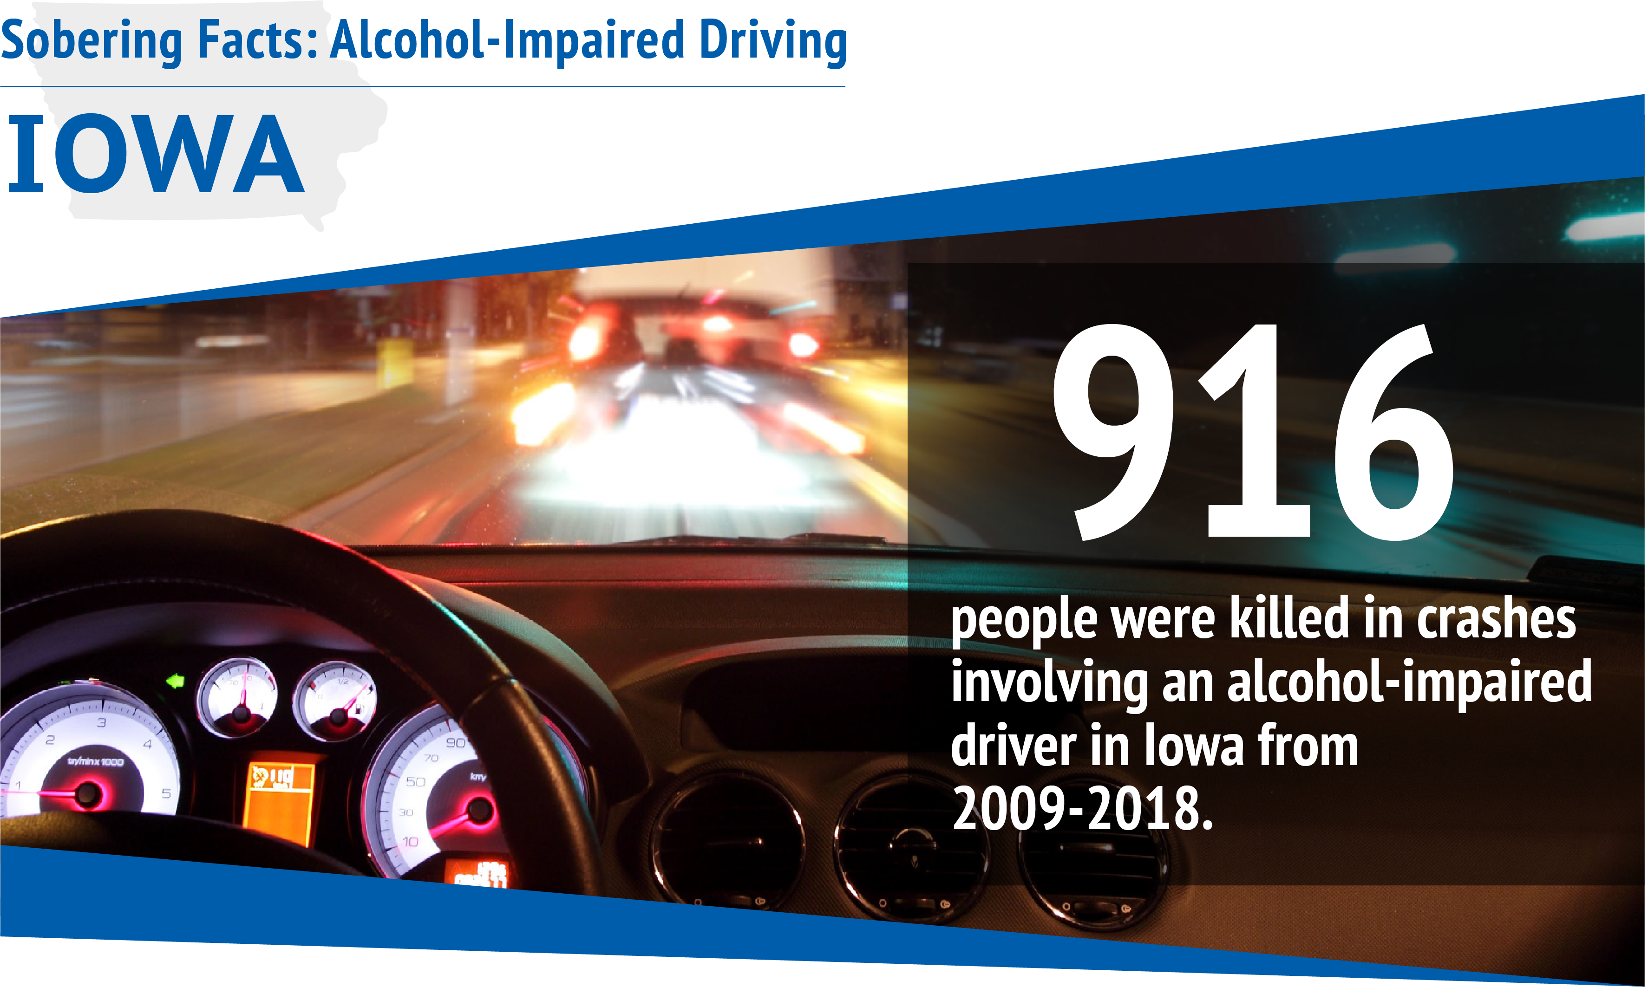
Notes:
Narrative
Impaired driving is a problem in Iowa too. A total of 916 people were killed in crashes involving an alcohol-impaired driver in Iowa from 2009 to 2018.
Resources
Information source:
CDC. 2020. Sobering Facts: Alcohol-Impaired Driving. Centers for Disease Control and Prevention, Atlanta, GA.
Image source:
Centers for Disease Control and Prevention

Slide 7
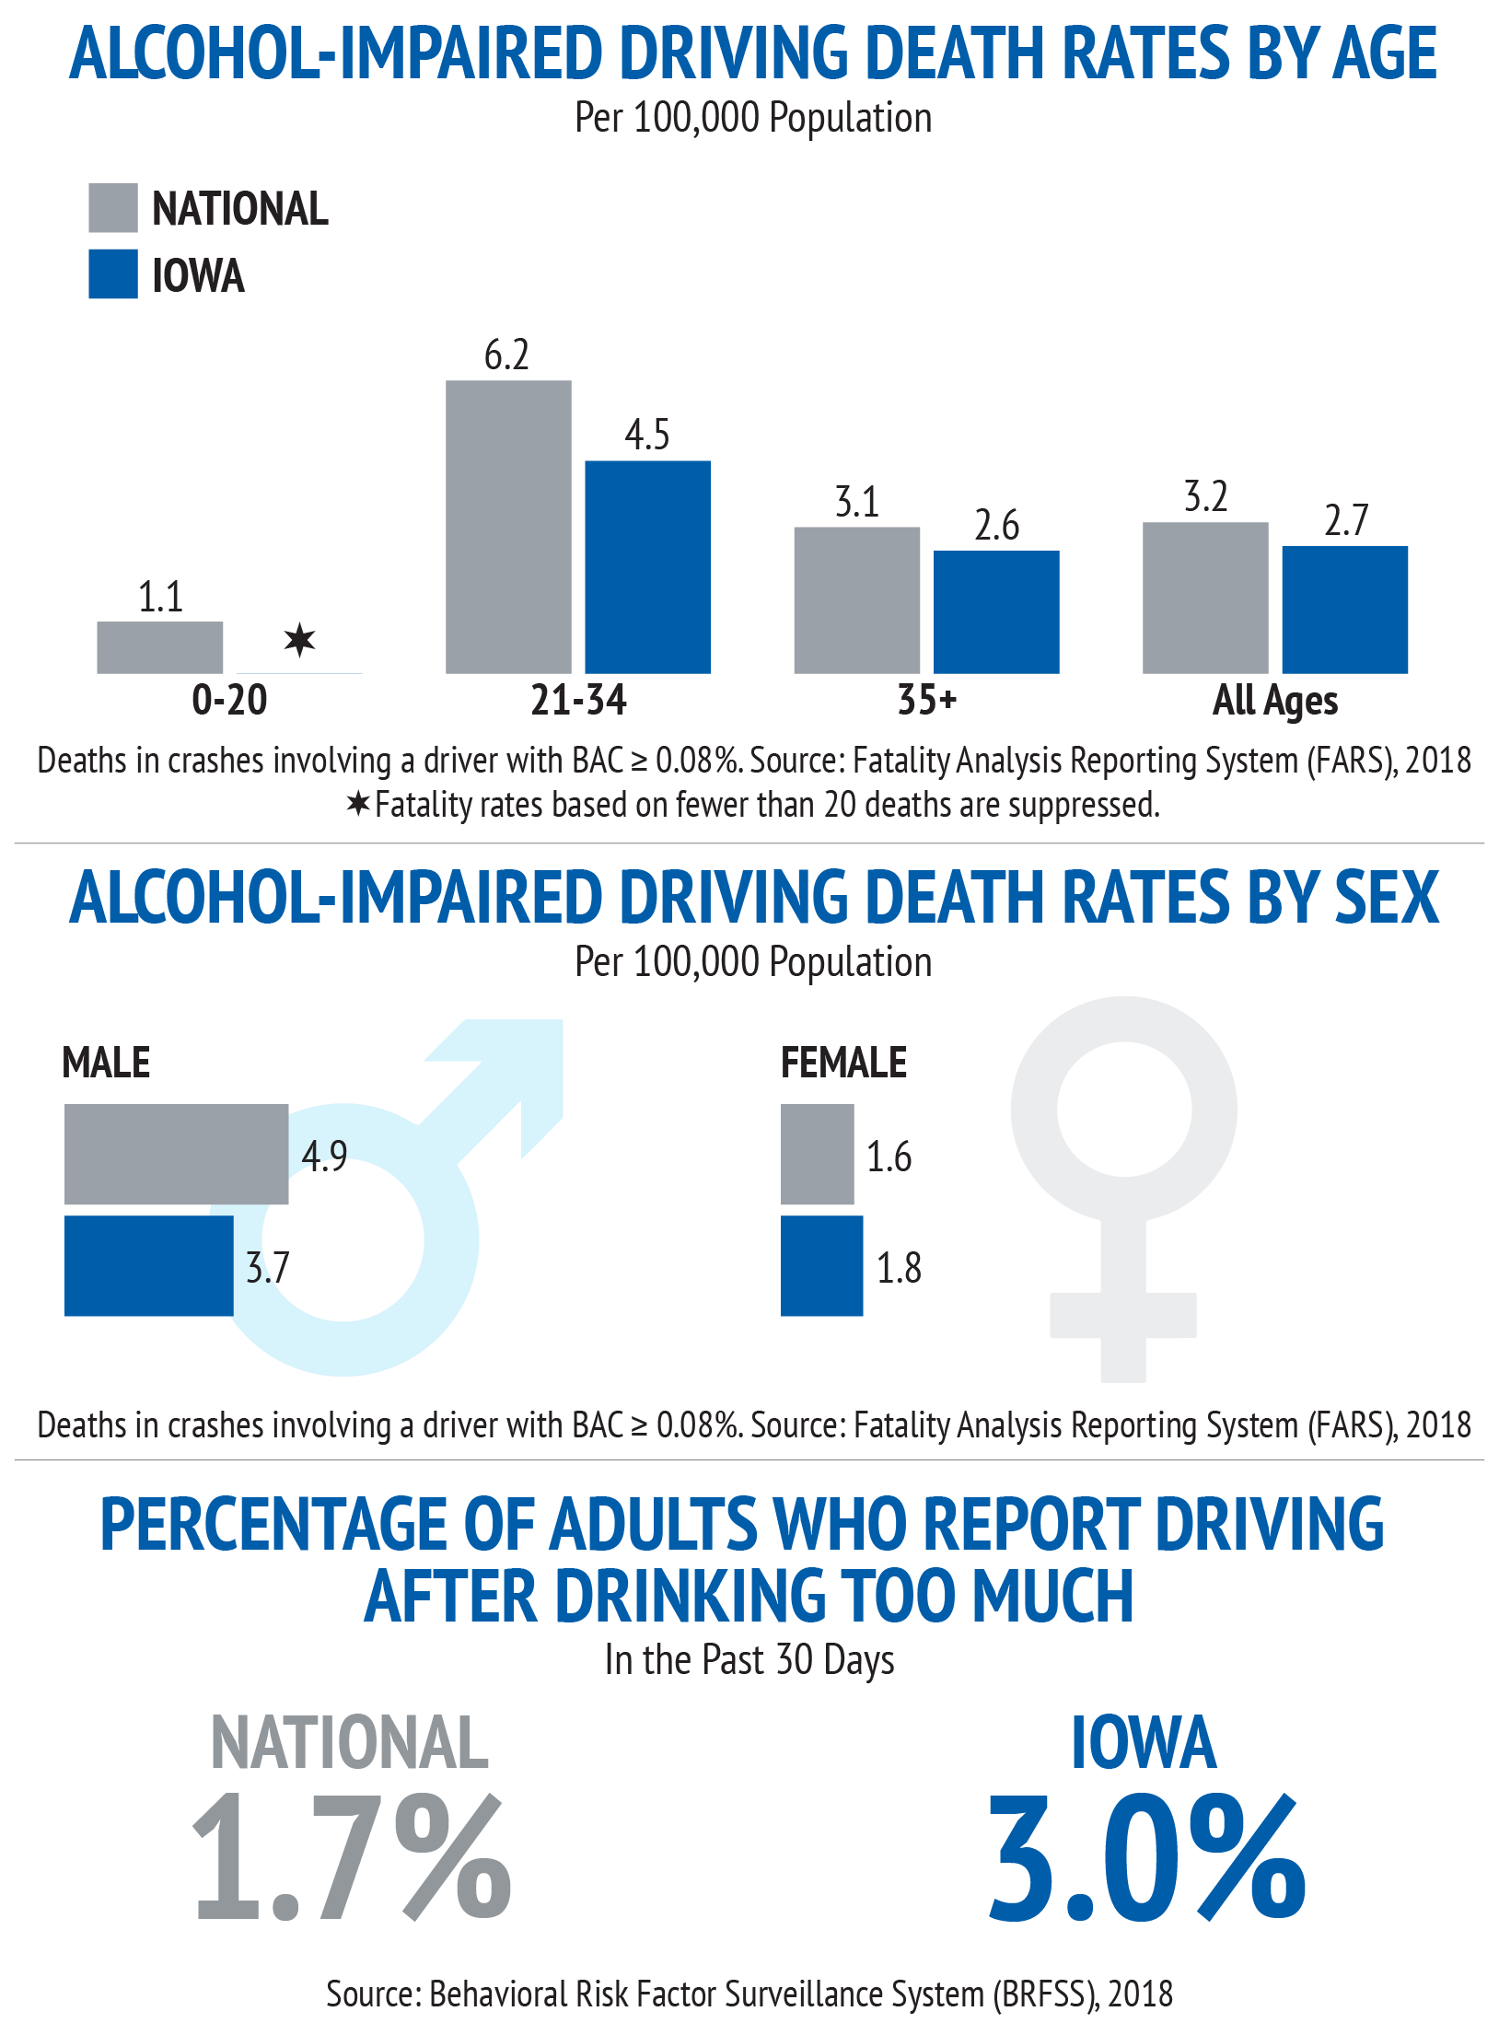
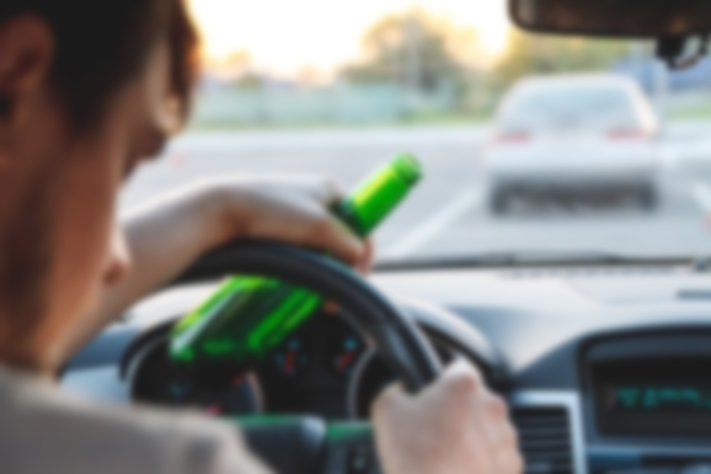
In Iowa:
It is illegal to drive with a BAC of 0.08% (or higher)
Publicized sobriety checkpoints are not allowed
Ignition interlocks are required for all (including first-time) convicted offenders
Notes:
Narrative
In Iowa, as well as other states, it is illegal to drive with a BAC of 0.08% because the crash risk increases exponentially at this point. The National Highway Traffic Safety Administration reports that drivers with a BAC of 0.08% are approximately 4 times more likely to crash and drivers with a BAC of 0.15% are about 12 times more likely to crash than drivers with a BAC of 0%. However, even smaller amounts can affect driving ability.
Resources
Information source:
NHTSA. 2024. Drunk Driving. National Highway Traffic Safety Administration, Washington, DC. https://www.nhtsa.gov/risky-driving/drunk-driving.
Image sources:
Behavioral Risk Factor Surveillance System, 2018 (Statistics)
perfectlab/Shutterstock.com

Slide 8

Iowa Law—What Could it Cost Me?
Up to $17,000, including court and arrest costs, DMV fines, fees and penalties, and additional insurance cost
Loss of freedom with up to 180 days in jail
Community service
§321J.2.
Iowa's OWI law states that it is unlawful to operate a motor vehicle in Iowa:
While under the influence of an alcoholic beverage or other drug or a combination of such substances
While having an alcohol concentration of 0.08% or more
While any amount of a controlled substance is present in the person, as measured in the person's blood or urine
Iowa's implied consent laws require all drivers to submit to a breath, blood, and/or urine test if there are reasonable grounds to believe the person was operating while intoxicated. Motorists who refuse testing generally face a license revocation of one year. If the driver has previous OWI license revocations, the revocation is for two years. If you are found guilty of an Iowa OWI, you will be required to serve at least 48 hours in jail and/or pay a $1,250 fine. The judge may waive up to half of that if there was no bodily injury or property damage caused by the offense. The primary law concerning OWI is Iowa Code §321J.2. A violation of this statute can result in a range of sanctions, depending on whether it's a first-time or subsequent offense.
Notes:
Narrative
Iowa laws are strict on impaired driving. It is illegal to operate a motor vehicle under the influence of an alcoholic beverage or other drug or a combination of such substances. A first-time DWI conviction can cost up to $17,000. That includes court and arrest costs, DMV fines, fees and penalties, alcohol education classes, attorney fees, and additional insurance costs.
Your license can be suspended for one year, and you could face 3 to 180 days in jail, depending on the severity of the crash.
Resources
Information source:
AAA. 2024. https://exchange.aaa.com/safety/substance-impaired-driving/.
Image source:
groenling/Flickr.com

Slide 9
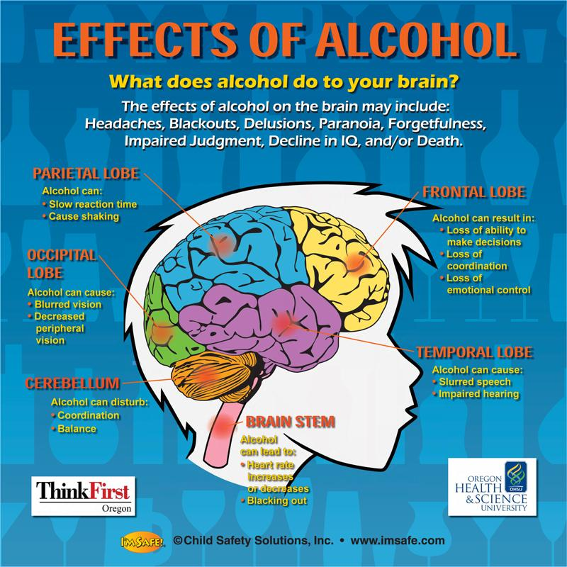
What Happens to Me When I Drink?
Slows thinking process
Creates sluggish feeling
Raises blood alcohol content (BAC) (takes 40 to 90 minutes to peak)
Damages links between neurons, (causes inability of brain to function)
Causes fatigue
Interferes with brain development
Increases chances of blackout
Notes:
Narrative
It is important to understand how alcohol and other substances affect your behavior, especially when you are operating a vehicle. Remember, you are sharing the road with other users, and it’s not only important for you to know how your body reacts so you can protect yourself, but you have a responsibility to keep fellow passengers and other road users safe.
Image source:
Child Safety Solutions, Inc.. Effects of Alcohol. https://imsafe.com.

Slide 10
What Happens to Me When I Drink?
Blood Alcohol Concentration (BAC)¹ | Typical Effects | Predictable Effects on Driving
.02 | Some loss of judgment Relaxation Slight body warmth Altered mood | Decline in visual functions (rapid tracking of a moving target) Decline in ability to perform two tasks at the same time (divided attention)
.05 | Exaggerated behavior May have loss of small-muscle control (e.g., focusing your eyes) Impaired judgment Usually good feeling Lowered alertness Release of inhibition | Reduced coordination Reduced ability to track moving objects Difficulty steering Reduced response to emergency driving situations
.08 | Muscle coordination becomes poor (e.g., balance, speech, vision, reaction time, and hearing) Harder to detect danger Impaired judgment, self-control, reasoning, and memory | Concentration Short-term memory loss Speed control Reduced information processing capability (e.g., signal detection, visual search) Impaired perception
.10 | Clear deterioration of reaction time and control Slurred speech, poor coordination, and slowed thinking | Reduced ability to maintain lane position and brake appropriately
.15 | Far less muscle control than normal Vomiting may occur (unless this level is reached slowly, or a person has developed a high tolerance for alcohol) Significant loss of balance | Substantial impairment in vehicle control, attention to driving task, and in necessary visual and auditory information processing
¹Information in this table shows the BAC level at which the effect usually is first observed and has been gathered from a variety of sources, including the National Highway Traffic Safety Administration, National Institute on Alcohol Abuse and Alcoholism, American Medical Association, and https://webmd.com.
Notes:
Narrative
Information in this table shows the BAC level at which the effect usually is first observed and has been gathered from a variety of sources, including the National Highway Traffic Safety Administration, National Institute on Alcohol Abuse and Alcoholism, American Medical Association, and https//webmd.com. Alcohol and driving is a dangerous combination that can lead to fatal crashes and injuries. Alcohol affects the ability to drive by impairing vision, reaction time, coordination, and judgment. It is illegal to drive with a BAC of 0.08% or higher in most states, and even a small amount of alcohol can reduce driving ability. Other drugs, such as marijuana, cocaine, and methamphetamine, can also impair driving and increase the risk of collisions.
Image source:
NHTSA. The ABCs of BAC: A Guide to Understanding Blood Alcohol Concentration and Alcohol Impairment. National Highway Traffic Safety Administration. https://www.nhtsa.gov/sites/nhtsa.gov/files/809844-theabcsofbac.pdf.

Slide 11
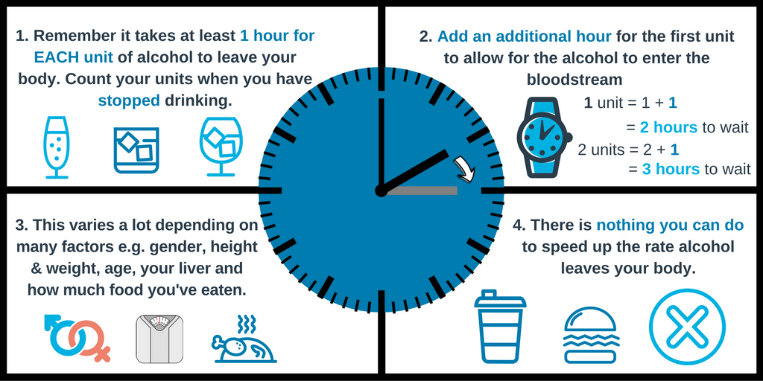
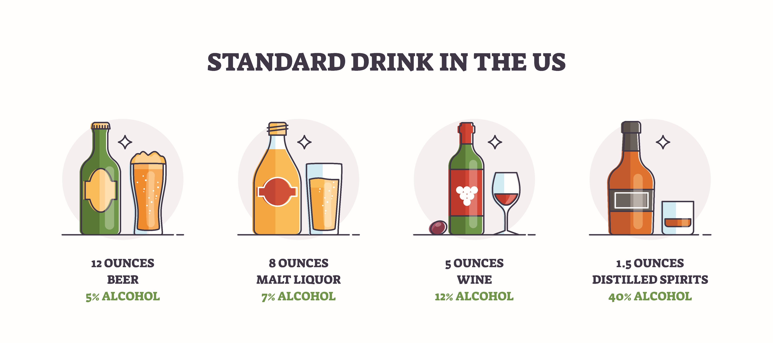
STANDARD DRINK IN THE US
Notes:
Narrative
It takes at least an hour for the body to metabolize one unit of alcohol, and this process starts after drinking is stopped. As an example, a standard 12 ounces of beer has an alcohol concentration of 5%. But when the alcohol concentration increases, the quantity required to make up a standard drink decreases. Increasing the number of standard drinks means that the body will require more time to metabolize the alcohol. The rate at which the body does this cannot be sped up by eating or drinking anything else.
Image sources:
VectorMine/Shutterstock.com (Standard Drink in the US)
IAM RoadSmart. https://x.com/IAMRoadSmart/status/811525681553281024 (Graphic)

Slide 12
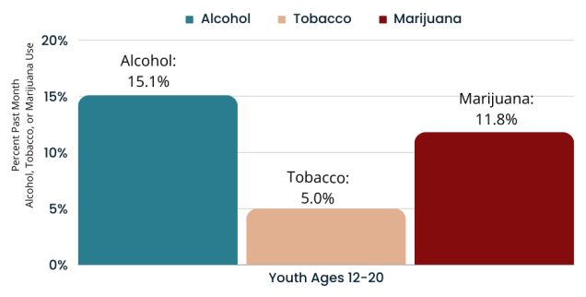
More Adolescents Use Alcohol than Tobacco or Marijuana
Many young drinkers binge when they drink
Binge drinking accounts for more than 90% of all alcohol consumed by youth
Youth ages 12–20 drink 3.2% of all alcohol consumed in the United States
Notes:
Narrative
The 2022 National Survey on drug use and health reported that the use of alcohol among youth was higher than tobacco and marijuana. Binge drinking was also very common among young drinkers and accounted for more than 90% of all alcohol consumed by youth. Binge drinking is a problem because it increases the amount of alcohol in the body and results in longer metabolizing periods.
Resources
Information source:
NIH. 2024. Alcohol’s Effect on Health. National Institute on Alcohol Abuse and Alcoholism. https://www.niaaa.nih.gov/publications/brochures-and-fact-sheets/underage-drinking.
Image source:
National Institute on Alcohol Abuse and Alcoholism. https://www.niaaa.nih.gov/publications/brochures-and-fact-sheets/underage-drinking

Slide 13
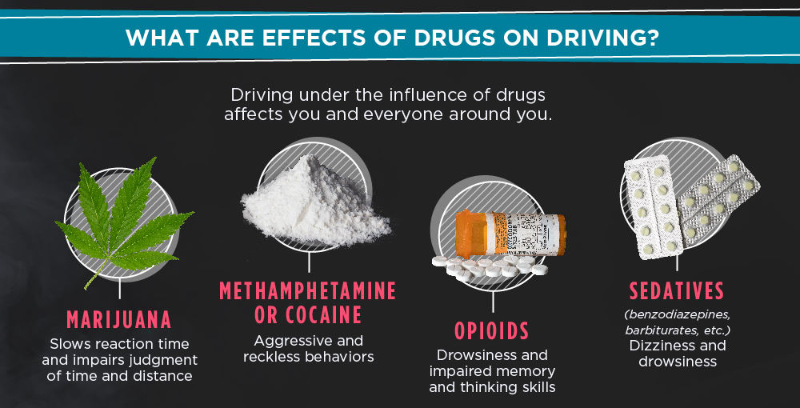
Notes:
Narrative:
Like driving under the influence of alcohol, driving under the influence of drugs can pose great risks to drivers, passengers, and other road users. Drugs can affect reaction time, impair judgement, and make drivers drowsy behind the wheel.
Image source:
National Institute on Drug Abuse. https://nida.nih.gov/research-topics/drugged-driving-infographic.

Slide 14
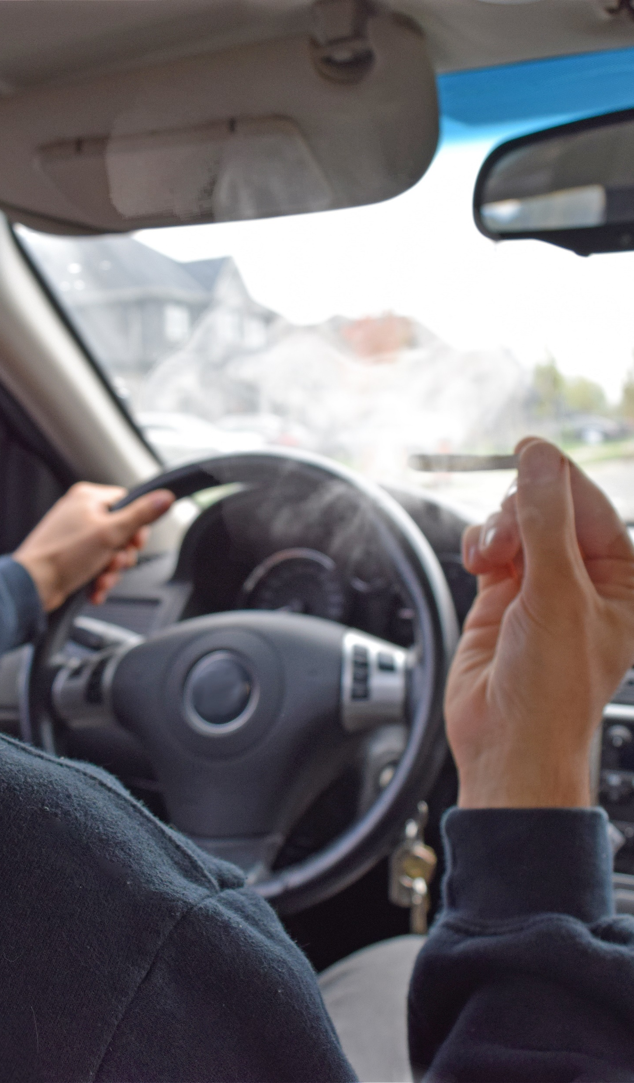
Marijuana-Impaired Driving
After alcohol, marijuana is the substance that is most often associated with impaired driving.
Although marijuana is illegal at the federal level in the United States, it is widely used. An estimated 48.2 million people reported using it at least once in 2019.
In 2017, about 1 in 8 high school drivers reported driving after using marijuana at least once during the past month.
Marijuana can impair important driving skills required for safe driving by slowing reaction time, impairing coordination, and distorting perception.
Notes:
Narrative
Marijuana is the next widely used drug after alcohol among youth. The effects of marijuana on driving include slowed reaction time, impaired coordination, and distorted perception. Although there is no science showing that drivers reliably become impaired at a specific level of marijuana in the blood, studies have shown an association between acute marijuana use and car crashes.
Resources
Information sources:
CDC. 2024. Marijuana Use and Driving. Centers for Disease Control and Prevention. https://www.cdc.gov/ore/pdf/MarijuanaFactSheets-Driving-508.pdf.
AAA Foundation for Traffic Safety. 2024. https://aaafoundation.org/.
Image source:
Aldo_Parrotta/Shutterstock.com

Slide 15
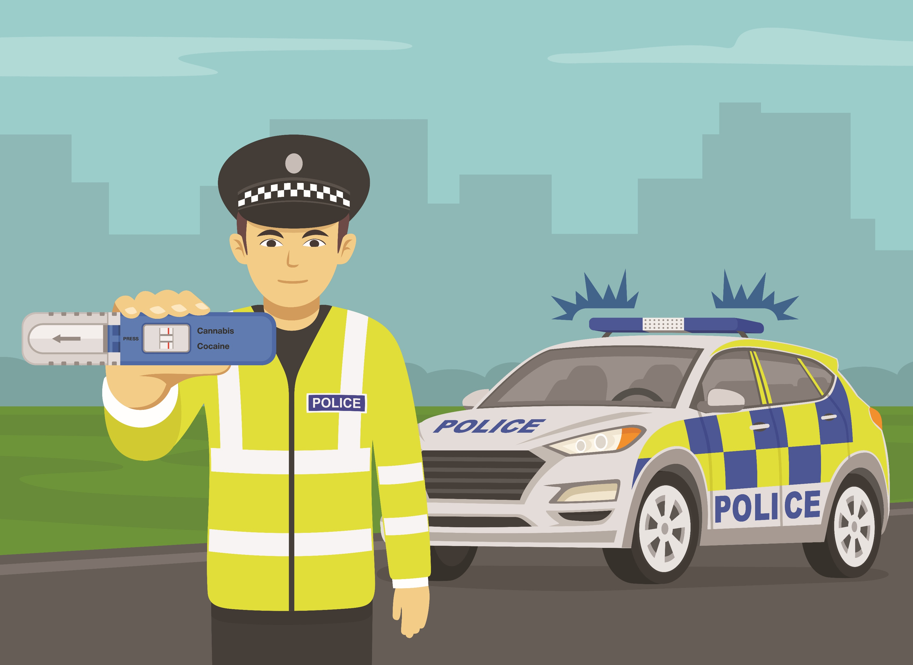
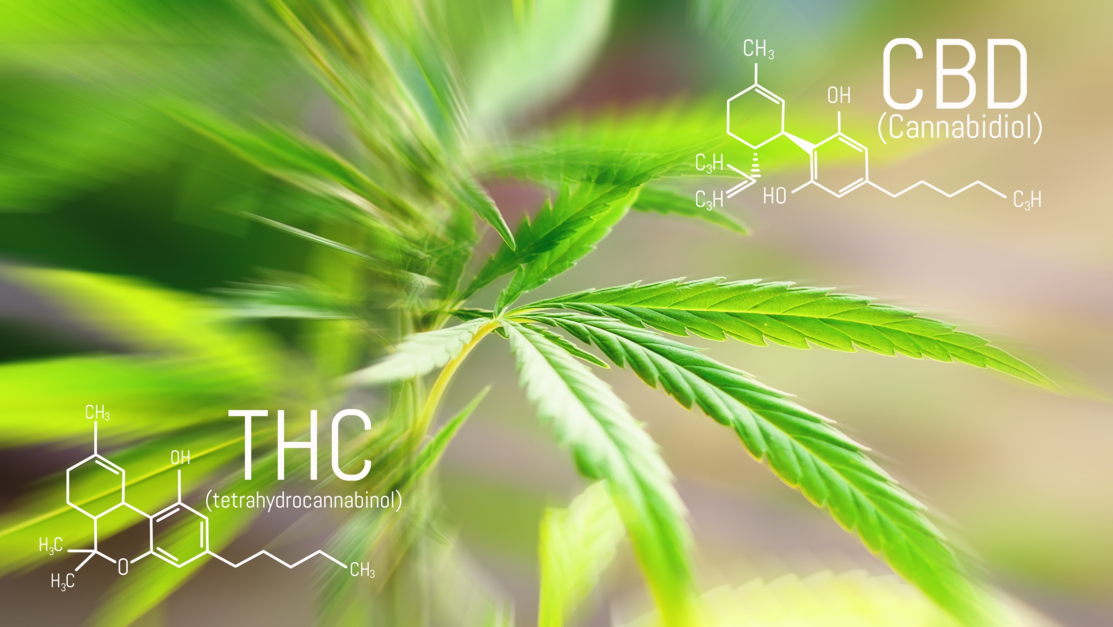
Marijuana Impairment
People react differently to marijuana. While some might not be impaired with high levels in their system, others will be unsafe even with low levels.
Because the length of time it takes to collect and test active THC blood levels is long, the results could show significantly different levels.
This makes it difficult to develop consistent and fair guidelines.
Notes:
Narrative
There is no science showing that drivers reliably become impaired at a specific level of marijuana in the blood. Depending on the individual, drivers with relatively high levels of marijuana in their system might not be impaired, while others with low levels may be unsafe behind the wheel. This finding is very different from alcohol impairment, where it is clear that crash risk increases significantly at higher BAC levels.
High THC levels may drop below legal thresholds before a test is administered to a suspected impaired driver. The average time to collect blood from a suspected driver is often more than two hours because taking a blood sample typically requires a warrant and transport to a facility. Active THC blood levels may decline significantly and could drop below legal limits during that time.
Marijuana can affect people differently, making it challenging to develop consistent and fair guidelines. For example, frequent users of marijuana can exhibit persistent levels of the drug long after use, while drug levels can decline more rapidly among occasional users.
Resources
Information source:
AAA Foundation for Traffic Safety. 2024. https://aaafoundation.org/.
Image sources:
Flat vectors/Shutterstock.com
PRO Stock Professional/Shutterstock.com

Slide 16
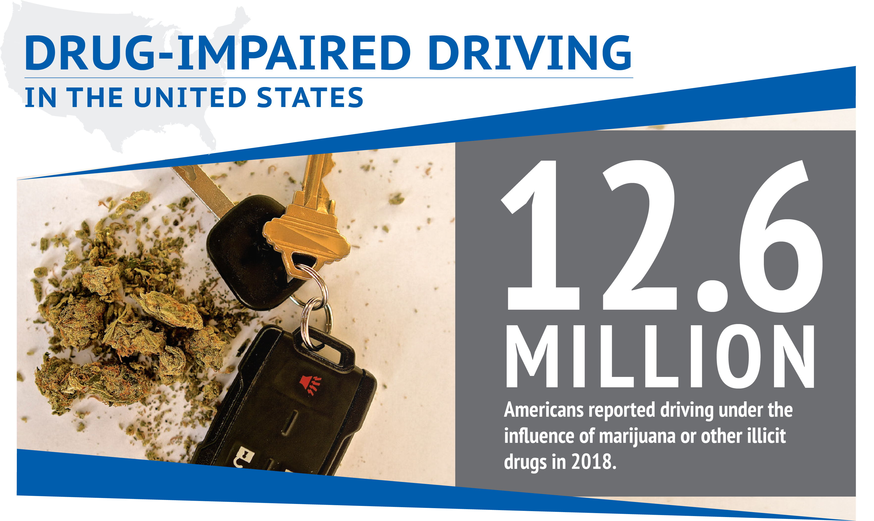
Each type of impaired driving has its own associated dangers that can lead to severe consequences.
Research shows marijuana nearly doubles the risk of a driver being involved in a motor vehicle crash, resulting in serious injury or death. Teens, in particular, have low-risk perception to drugged driving.
1 in 3 drivers killed in car crashes test positive for drugs
Notes:
Narrative
Marijuana is not the only illicit drug that is used. In 2018, 12.6 million Americans reported driving under the influence of an illicit drug.
Each type of impaired driving has its own associated dangers that can lead to severe consequences. Research has shown that marijuana nearly doubles the risk of a driver being involved in a motor vehicle crash resulting in serious injury or death. Teens, in particular, have a low-risk perception to drugged driving.
Resources
Information sources:
Li, M-C., J. E. Brady, C. J. DiMaggio, A. R. Lusardi, K. Y. Tzong, and G. Li. 2012. Marijuana Use and Motor Vehicle Crashes. Epidemiologic Reviews, Vol. 34, No. 1, pp. 65-72.
NIH. 2024. Alcohol’s Effect on Health. National Institute on Alcohol Abuse and Alcoholism. https://www.niaaa.nih.gov/publications/brochures-and-fact-sheets/underage-drinking.
Students Against Destructive Decisions (SADD). 2024. https://www.sadd.org/.
Image source:
Centers for Disease Control and Prevention. https://www.cdc.gov/impaired-driving/media/pdfs/drug-impaired-driving-summary-sheet-ld-508.pdf.

Slide 17
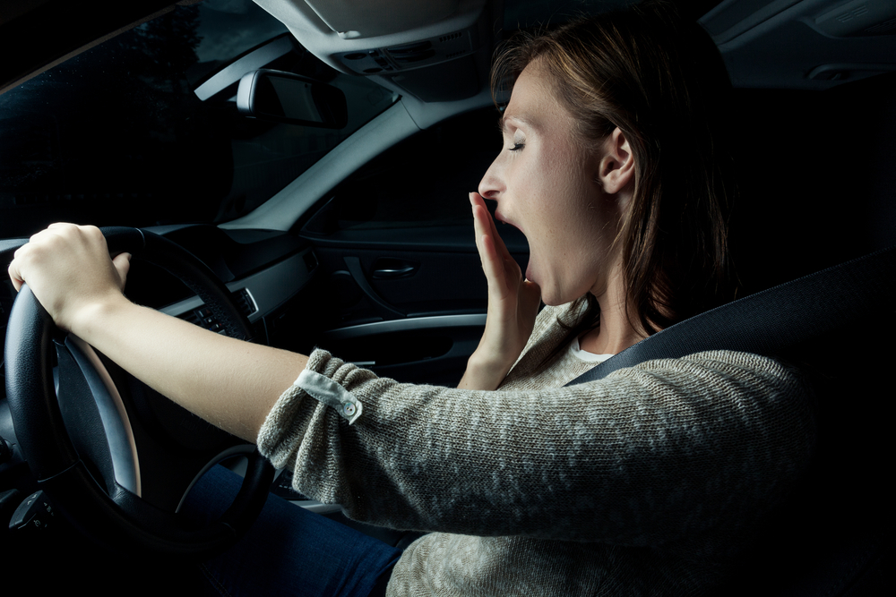
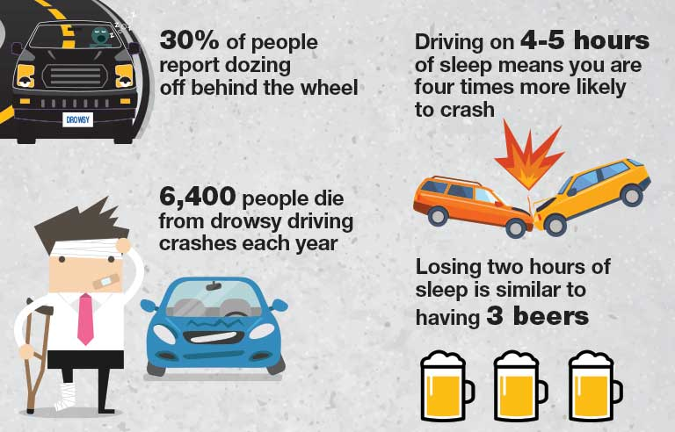
Drowsy Driving
Notes:
Narrative
Unlike drunk driving, drowsy driving can be harder to connect to a cause (such as having a drink). A person who gets eight hours of sleep a night can still feel fatigued because of untreated sleep disorders, including insomnia, sleep apnea, or narcolepsy. Drowsiness can also happen during a long shift or because of not getting enough sleep. Commercial drivers can have problems with fatigue after a long drive.
Drowsiness and fatigue both affect driving in several ways. First, they can cause reduced alertness, causing drivers to have reduced awareness and miss important traffic signals. Second, they can slow reaction time, which can cause fatal car accidents. Third, both conditions can impact the driver’s ability to make attentive decisions based on the risk factors for sleep-related crashes.
According to studies, being awake for a full day is the same as having a BAC of 0.10%. This is beyond the legal limit in every state in the US. Going 18 hours without sleep is the same as a BAC of 0.05%. It’s important to note that the risk of a sleep-related crash may increase sharply with alcohol.
Image sources:
National Safety Council. https://www.safetyandhealthmagazine.com/articles/17898-nsc-releases-poster-on-drowsy-driving (Graphic)
altafulla/Shutterstock.com

Slide 18


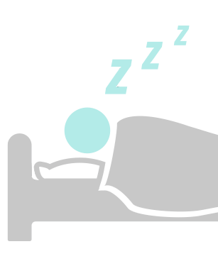
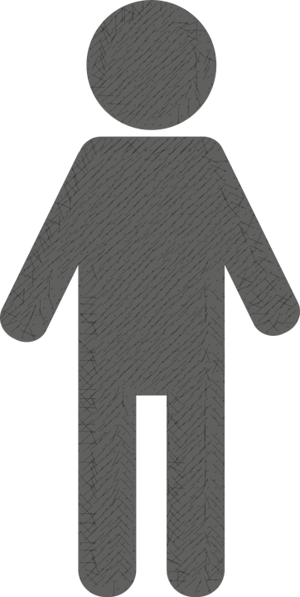

Facts About Drowsy Driving
ADULTS AGES 18–29
are much more likely to drive while drowsy compared to other age groups!
People tend to fall asleep while driving on
HIGH SPEED, LONG, OR RURAL HIGHWAYS.
SLEEP DEPRIVATION
increases the risk of a sleep-related crash! The more you sleep, the better you drive.
NEARLY 1/4
of adults in the United States say they know someone personally who has fallen asleep at the wheel
Notes:
Narrative
Drowsy driving is responsible for an estimated 6,000 fatal crashes in the United States each year, while drunk driving is responsible for around 10,000 deaths per year. Both drowsy driving and drunk driving impair a driver’s ability to stay alert and react to changing road conditions, but the effects of drowsiness are often underestimated. In fact, being awake for 17 hours straight can impair a driver’s reaction time and judgment as much as having a BAC of 0.05%. Additionally, drowsy driving is more common than drunk driving, with surveys indicating that up to 60% of drivers have driven drowsy at some point. Overall, both drowsy and drunk driving pose a serious risk to public safety, and drivers should prioritize getting enough sleep before getting behind the wheel or find alternative means of transportation if they are impaired.
Image source:
Adapted from Sleep Foundation. https//sleepfoundation.org/drowsy-driving.

Slide 19
60%
37%
DROWSY
DRIVING
LEADS TO
OF ADULT DRIVERS HAVE FALLEN ASLEEP WHILE DRIVING
OF ADULT DRIVERS HAVE DRIVEN WHILE DROWSY
100,000
36%
OF SHIFT
WORKERS
DRIVE WHILE DROWSY
AT LEAST A FEW TIMES
PER MONTH
MEN ARE MORE LIKELY THAN WOMEN TO DRIVE WHILE DROWSY
POLICE-REPORTED CRASHES EACH YEAR
(56% vs. 45%)
Notes:
Narrative
Drowsy driving is responsible for an estimated 6,000 fatal crashes in the United States each year, while drunk driving is responsible for around 10,000 deaths per year. Both drowsy driving and drunk driving impair a driver’s ability to stay alert and react to changing road conditions, but the effects of drowsiness are often underestimated. In fact, being awake for 17 hours straight can impair a driver’s reaction time and judgment as much as having a BAC of 0.05%. Additionally, drowsy driving is more common than drunk driving, with surveys indicating that up to 60% of drivers have driven drowsy at some point. Overall, both drowsy and drunk driving pose a serious risk to public safety, and drivers should prioritize getting enough sleep before getting behind the wheel or find alternative means of transportation if they are impaired.
Image source:
Recreated from Geico. https://living.geico.com/driving/auto/car-safety-insurance/how-to-avoid-drowsy-driving/.

Slide 20
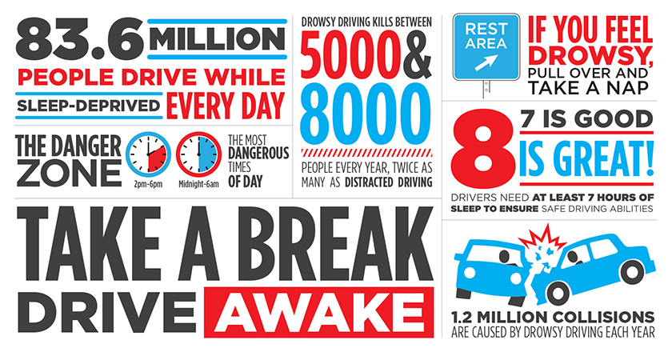
Notes:
Narrative
Drowsy driving is responsible for an estimated 6,000 fatal crashes in the United States each year, while drunk driving is responsible for around 10,000 deaths per year. Both drowsy driving and drunk driving impair a driver’s ability to stay alert and react to changing road conditions, but the effects of drowsiness are often underestimated. In fact, being awake for 17 hours straight can impair a driver’s reaction time and judgment as much as having a BAC of 0.05%. Additionally, drowsy driving is more common than drunk driving, with surveys indicating that up to 60% of drivers have driven drowsy at some point. Overall, both drowsy and drunk driving pose a serious risk to public safety, and drivers should prioritize getting enough sleep before getting behind the wheel or find alternative means of transportation if they are impaired.
Image source:
National Highway Traffic Safety Administration. https://www.trafficsafetymarketing.gov/get-materials/drowsy-driving/drive-awake.

Slide 21
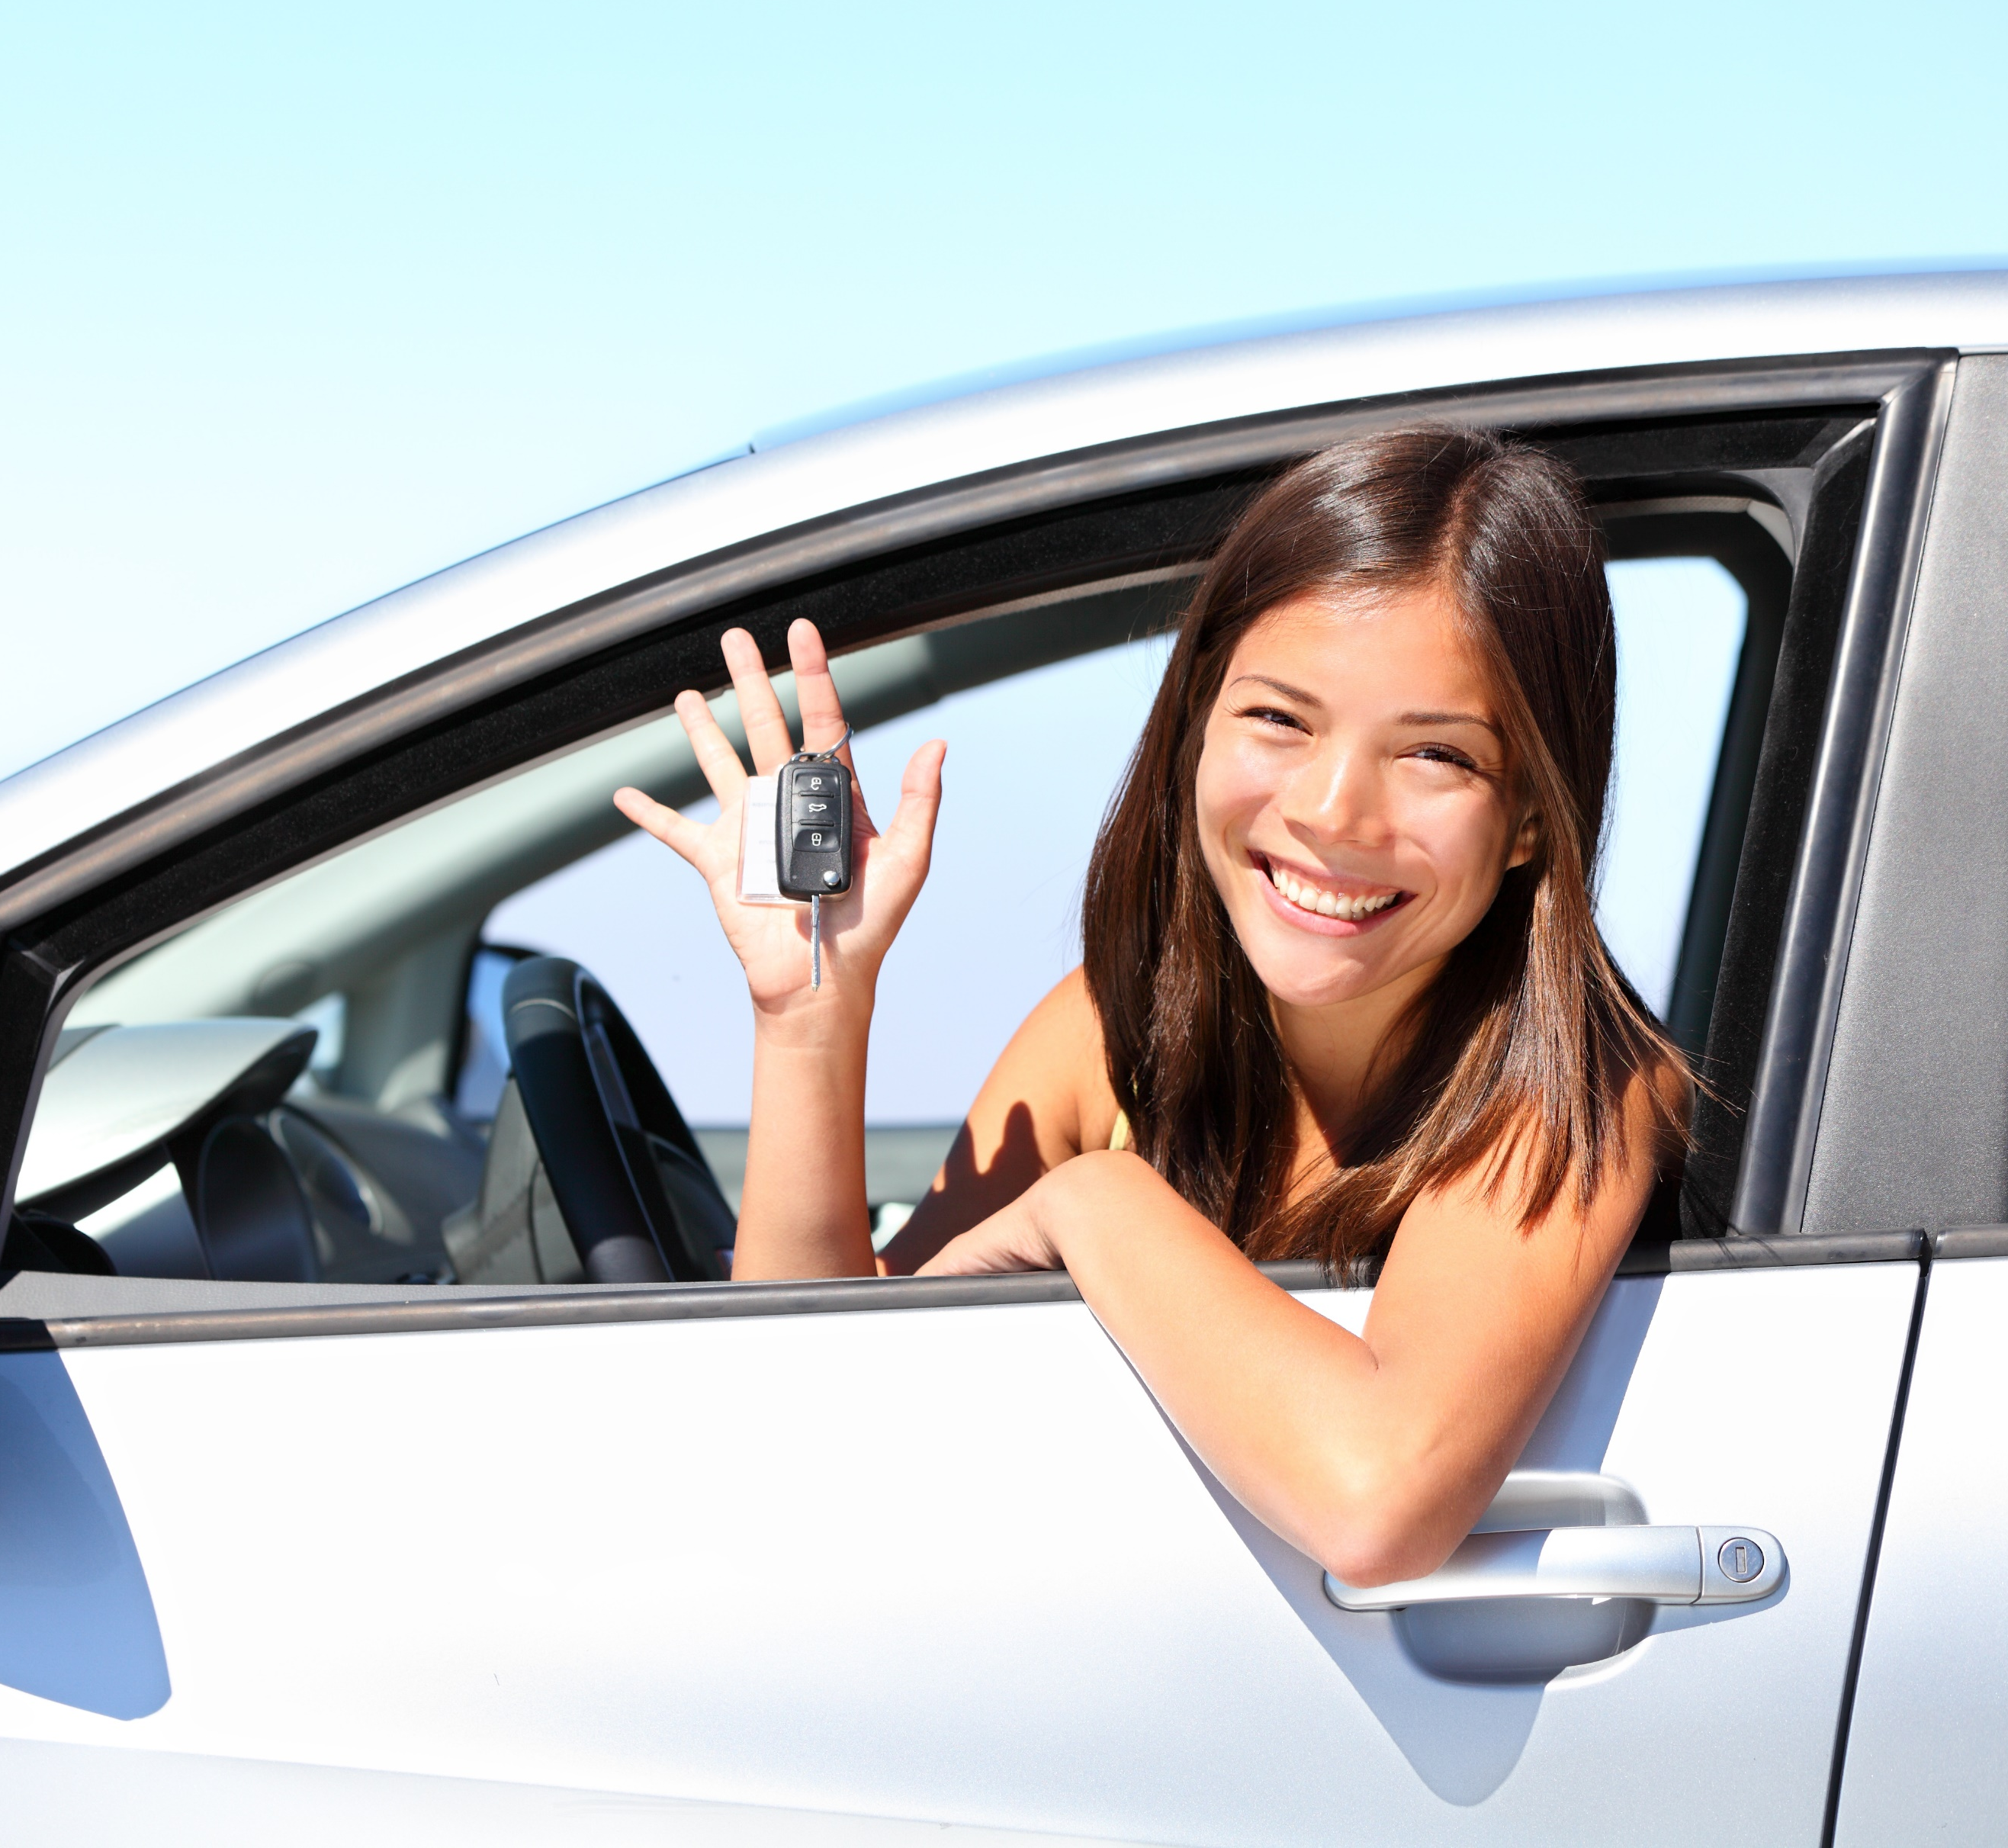
What Can I Do to Stay Safe on the Road?
8 in 10 teens say they would listen if a friend told them their driving behavior made them uncomfortable!
BE A ROLE MODEL
Set an example by living a “no-use electronics” lifestyle
Know how over the counter drugs and prescriptions affect you
Be a strong voice against driving impaired
Don’t be afraid to take the keys from impaired friends
Notes:
Narrative
You can keep yourself and others safe by setting an example and speaking up. Adopt safe driving practices like planning for a designated driver, avoiding alcohol when you need to drive later, getting enough rest before driving, and checking with your doctor about the side effects of both over-the-counter and prescription drugs before getting behind the wheel. Be a safe passenger by speaking up and turning down rides from impaired drivers.
Image source:
Maridav/Shutterstock.com

Slide 22
Disclaimer Notice
This module was developed by the Institute for Transportation (InTrans) at Iowa State University for the Iowa Department of Transportation (Iowa DOT) with the purpose to provide the material for driver education instructors in Iowa. InTrans is responsible for the facts and the accuracy of the information presented herein as of May 1, 2025.
Driver education instructors may use the material in its entirety or may use any of the slides and material individually. The material is for educational purposes only. It is strictly prohibited to sell any part of this module.
If any of the material is reused, please credit the appropriate source. The resources used for information and images for the module are provided in the notes section. Other material can be cited as Iowa DOT.
For more information or questions, please contact Vania Boyd, Driver Education and Motorcycle Rider Education Manager, Iowa DOT, Vania.boyd@iowadot.us.

