Slide 1
Risky Behavior
Notes:
Narrative
This module was developed by the Institute for Transportation at Iowa State University for the Iowa Department of Transportation. The purpose is to provide additional material for driver education instructors in Iowa. This module focuses on the impact of risky behavior. The material can be used in its entirety, or a driver education instructor can use any of the slides or material individually. Citations are provided for information sources and images. If these materials are used, please credit the appropriate source. Other material can be cited as Iowa DOT.
Image source: sirtravelalot/Shutterstock.com

Slide 2
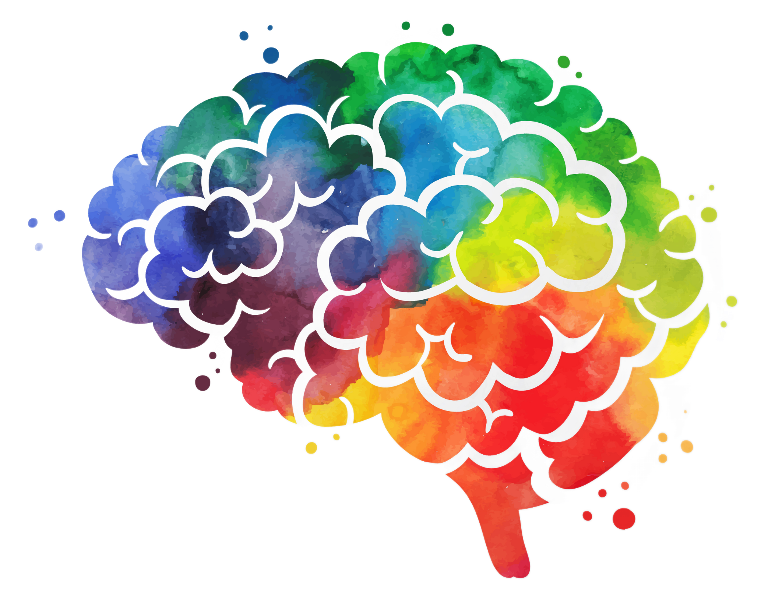
Learning Objectives
Understand the impacts of brain development that affect younger drivers
Identify risky behaviors and ways they can be counteracted
Notes:
Image source: Markovka/Shutterstock.com

Slide 3
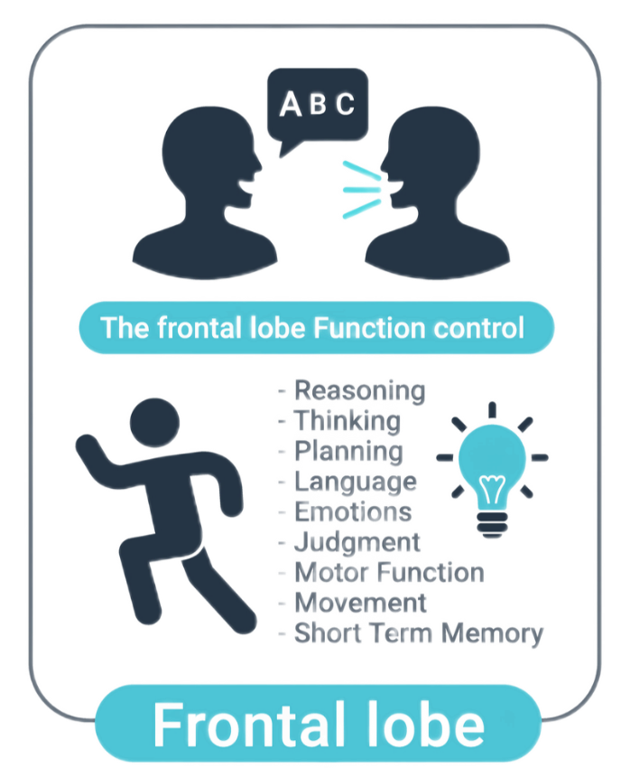
Brain Development and Driving
The frontal lobe of the brain controls judgement, impulse control, planning, organizing, and attention.
For teen drivers, that part of the brain is still developing, which impacts the following:
  Working memory—ability to maintain and manipulate pieces of information in the moment
  Inhibitory control—the ability to filter and resist irrelevant or distracting information and suppress impulses
  Set shifting—the ability to sustain or shift attention and responses with changing task demands
Notes:
Narrative
The brain is still developing during the middle teenage years, and this has several impacts on the driving task. Most notable, the frontal lobe of the brain, which serves as the “CEO,” is still developing. This means that judgement capabilities, impulse control, and information processing are not fully formed, and all of these play a role in the driving task.
Working memory affects the ability of a younger driver in maintaining and manipulating multiple pieces of information in the moment, such as making a determination of where to turn along a route while also following traffic controls such as signals.
Inhibitory control equates into a lower ability to resist distractions or suppress impulses, such as choosing to race a friend in another car down a multilane roadway.
Set shifting affects the ability to maintain or shift attention and respond with changing demands, such as checking mirrors to change lanes while also maintaining a vehicle’s path.
Information source: Children’s Hospital of Philadelphia. Center for Injury Research & Prevention. The Developing Brain and Teen Driving (https://injury.research.chop.edu/blog/posts/developing-brain-and-teen-driving)

Slide 4

Brain Development and Driving
For teenage drivers, these facts have several consequences:
  Maintaining and processing multiple pieces of information quickly is limited and can lead to negative driving outcomes
  Reduced inhibitions can lead to poor choices, risk taking and overconfidence, leading to traffic violations/citations and crashes
  Ability to maintain attention and shift focus when demands change is still developing, and distractions may affect ability to handle simultaneous driving decisions
Notes:
Narrative
These facts have several consequences for the teenage driver. It is more difficult to process multiple pieces of information quickly. Reduced inhibition can lead to poor decisions and negative outcomes. Finally, distractions, whether they are passengers, in-vehicle entertainment systems, or other causes, can be overwhelming at times and lead to traffic violations, crashes, etc.
Resources
Information source: National Library of Medicine. National Center for Biotechnology Information. Preventing Teen Motor Crashes: Contributions from the Behavioral and Social Sciences: Workshop Report (https://www.ncbi.nlm.nih.gov/books/NBK9662/)
Image source: VikaSuh/Shutterstock.com

Slide 5
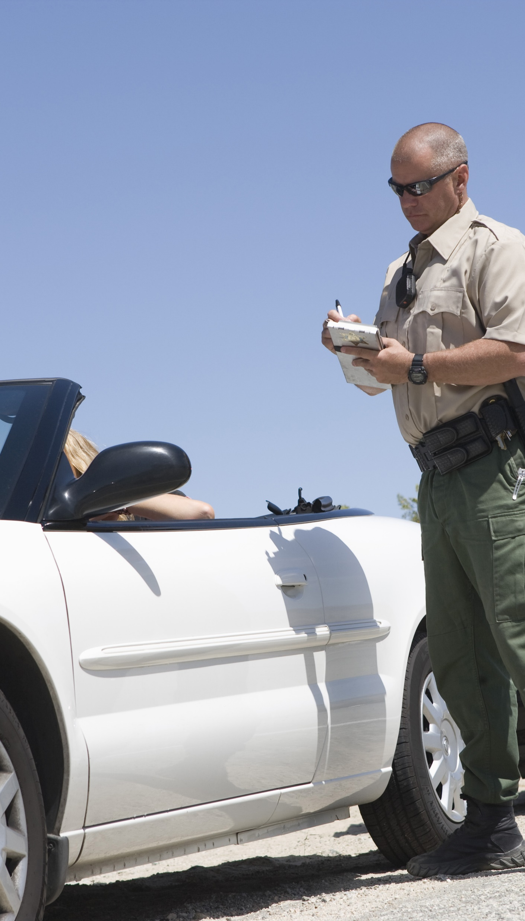
Understanding Consequences
Driving is a complex task with the potential for negative consequences stemming from poor decisions.
The consequences from poor driving decisions include the following:
  Tickets/citations
  Crashes resulting in injury and death
  Loss of license
Recognizing limitations and increased awareness of driving risk can help develop effective decision-making for younger drivers
Notes:
Narrative
Knowing this background on the brain and its development, it is important for teenage drivers to recognize their limitations and the possible outcomes that can result from mistakes or poor decisions. These consequences can include being ticketed for violations, with a consequent impact on the ability to achieve full licensure or maintain a permit or interim license. Vehicle crashes, particularly as speeds increase, lead to more severe outcomes, including major injuries and death. And finally, in addition to losing a license for traffic violations, poor driving decisions and actions can lead to parents or guardians limiting driving privileges or a license altogether.
The ability for a younger driver to recognize their own limitations and compensating for them by increased awareness of the risks associated with driving can help in developing better decision-making skills that will serve them both in the present and throughout their lives.
Resources
Information sources:
National Highway Traffic Safety Administration. Teen Driving (https://www.nhtsa.gov/road-safety/teen-driving)
National Highway Traffic Safety Administration. Risk Management (https://www.nhtsa.gov/sites/nhtsa.gov/files/documents/riskmanagement.pdf)
Image source: sirtravelalot/Shutterstock.com

Slide 6
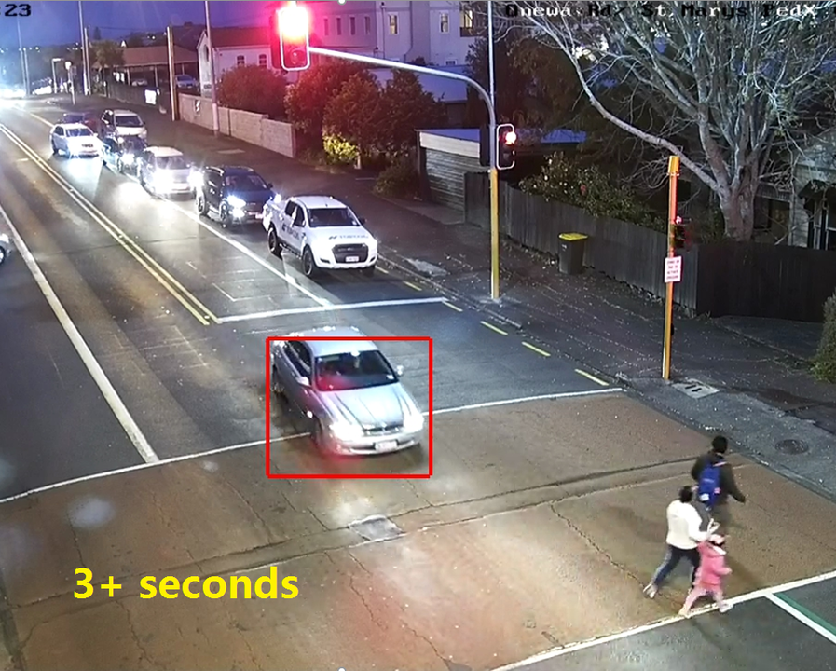
Risky Behavior
Overly emotional (angry, sad, etc.)
Tailgating
Distraction
Failure to signal
Speeding
Drowsy driving
Overconfident
Texting and cell phone use
Running signals/Stop signs
Aggressiveness
Not checking blind spots
Improper merging
Riding the brakes
Notes:
Narrative
Recognize that your brain is still developing, and, as a result, you may exhibit bad driving traits form time to time, often unintentionally. Some of those bad traits are listed here. Are there any others you can think of? You’re not alone, many older adults exhibit these too. If you recognize one or more of these traits as applying to yourself, you’re on your way toward addressing them so that they do not negatively affect your driving. Identify what the positive or opposite trait or action to these might be and how that can be applied to drive in a safer manner.
Resources
Information source: This list was developed based on recurring themes from the sources listed on other slides (and common sense).
Image source: Shane Ellison. Speed and Red Light Running is a Treacherous Cocktail. https://www.linkedin.com/pulse/speed-red-light-running-treacherous-cocktail-shane-ellison/

Slide 7
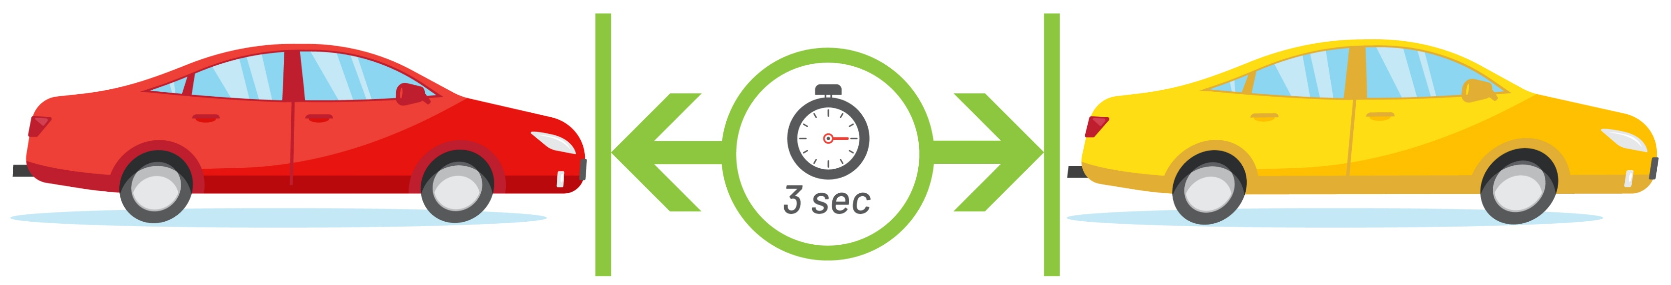
Managing Risk
Younger drivers should assess the driving situation they face and react accordingly to minimize risk.
While all risk cannot be removed from driving, steps can be taken by younger drivers to manage it, including the following:
  Avoid the risk by choosing not to attempt a driving action
  Prevent the risk by educating yourself, maintaining a safe vehicle, etc.
  Reduce the risk by increasing response time and vehicle control (slow down and maintain distance from vehicle(s) ahead)
Notes:
Narrative
Although younger drivers are inexperienced and face the issues discussed in prior slides, they can still complete the driving task safely by managing risk. Most importantly, the driving situation being presented to a driver should be assessed to determine the safest course of action, thus minimizing risk.
While risk cannot be entirely removed from the driving task, younger drivers can also manage it by avoiding the risk entirely if it can be avoided, preventing the risk itself through education and preparation, or at least reducing the risk by doing things like giving yourself more time to react, including driving slower and maintaining more distance between your vehicle and others.
Information source: National Highway Traffic Safety Administration. Risk Management (https://www.nhtsa.gov/sites/nhtsa.gov/files/documents/riskmanagement.pdf)

Slide 8
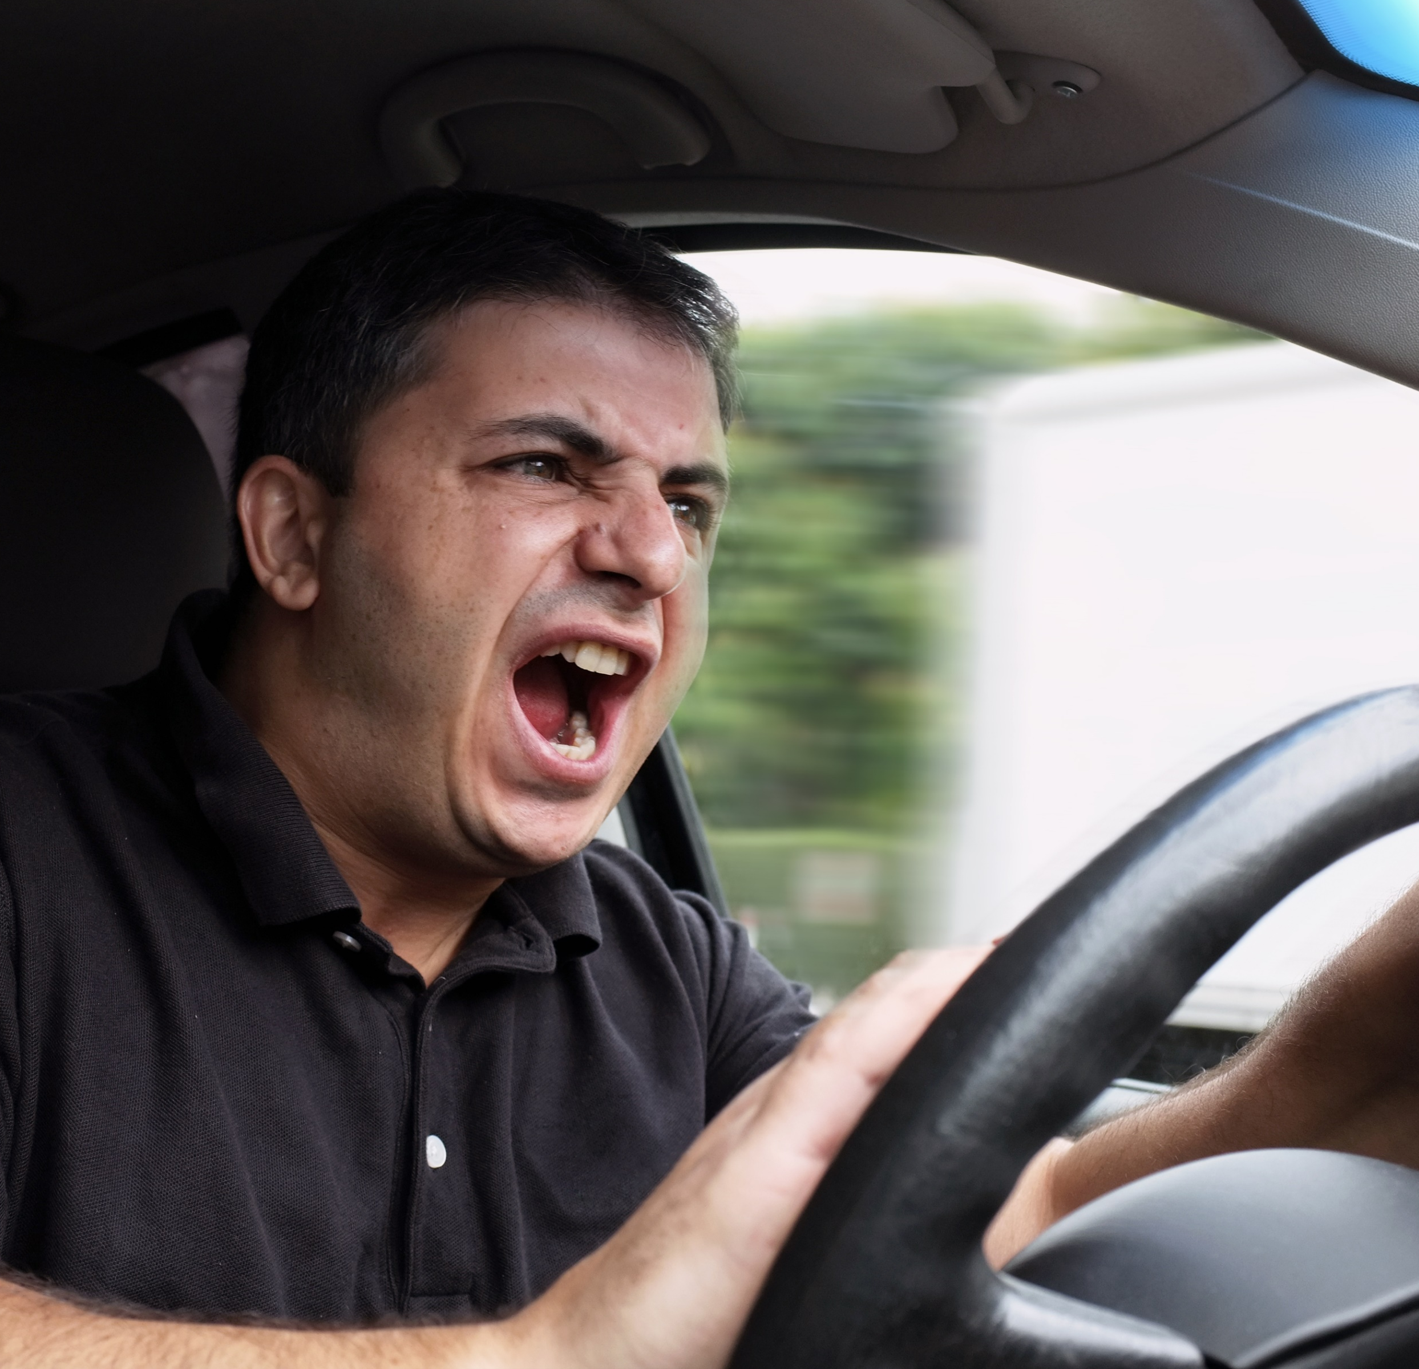
Driver Condition—Attitude/Emotions
Driving can be a stressful experience, so it is important that you have a handle on emotions and maintain a good attitude.
Research has found a correlation between the magnitude of negative emotions and the number of unsafe driving behaviors:
  Emotions impede ability to detect and respond to hazards
  Negative thoughts may lead to aggressive behaviors in response to other drivers
  Negative emotions may linger, resulting in continued poor driving
Notes:
Narrative
It is normal for driving to be stressful, especially when you are younger. However, throwing other emotions into the mix can make driving much more difficult. Because of this, it is important that as a driver, you maintain a good attitude and have you emotions in check. Driving while angry or upset can have an impact on your ability to safely drive.
The greater the negative emotions you are experiencing, the more unsafe driving behaviors you are likely to perform. For example, your ability to detect and respond to hazards is hindered. Negative or even angry thoughts can lead to aggressive driving. Be aware that negative emotions may linger, even if you think you are “over” it, which can lead to continued mistakes and poor driving.
Resources
Information source: Yi-Ching Lee and Flaura Winston. Stress Induction Techniques in a Driving Simulator and Reactions from Newly Licensed Drivers. (https://www.sciencedirect.com/science/article/pii/S136984781630119X?via%3Dihub)
Image source: Hayk_Shalunts/Shutterstock.com

Slide 9
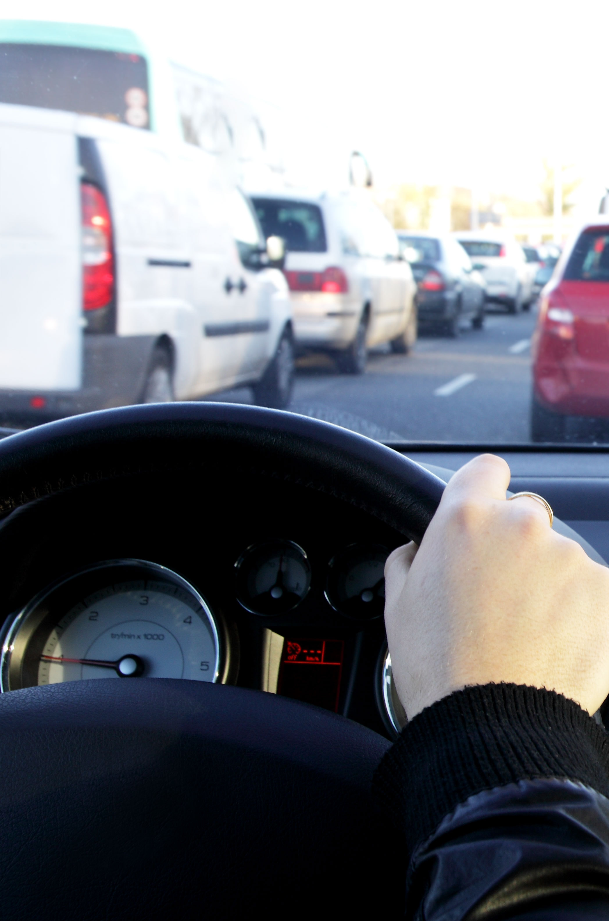
Driver Condition—Attitude/Emotions
How can you counteract this?
  Try to avoid driving until you are feeling calm
  Try to leave personal problems behind
  Practice relaxing—close your eyes, breathe evenly
  If traffic is stressful, use alternative routes or leave earlier
  Be patient and even-tempered
  Get adequate rest (sleep)
Notes:
Narrative
How can you address your emotions to make sure they don’t affect your driving?
Recognize when you’re upset and take time to calm down. Do your best to put personal problems behind while driving, if you can.
Practice relaxation techniques to put yourself in a better frame of mind.
If you find traffic to be the stressor, then see if there are different, less trafficked routes that you can safely take.
Maintain your temper, don’t let the driving actions of others get you upset or impatient.
As with life in general, get plenty of rest.
Resources
Information source: National Highway Traffic Safety Administration. Tips for Maintaining a Good Driver Attitude (https://www.nhtsa.gov/document/tips-maintaining-good-driver-attitude)
Image source: ambrozinio/Shutterstock.com

Slide 10
Additional Resources
AAA Foundation for Traffic Safety. Teen Driver Risk in Relation to Age and Number of Passengers.
https://aaafoundation.org/teen-driver-risk-relation-age-number-passengers/
Governor’s Highway Safety Association. Teen Driver Safety. https://www.ghsa.org/issues/teen-drivers
Notes:
These are resources that can be reviewed in conjunction with the slides in this section.

Slide 11
Disclaimer Notice
This module was developed by the Institute for Transportation (InTrans) at Iowa State University for the Iowa Department of Transportation (Iowa DOT) with the purpose to provide the material for driver education instructors in Iowa. InTrans is responsible for the facts and the accuracy of the information presented herein as of May 1, 2025.
Driver education instructors may use the material in its entirety or may use any of the slides and material individually. The material is for educational purposes only. It is strictly prohibited to sell any part of this module.
If any of the material is reused, please credit the appropriate source. The resources used for information and images for the module are provided in the notes section. Other material can be cited as Iowa DOT.
For more information or questions, please contact Vania Boyd, Driver Education and Motorcycle Rider Education Manager, Iowa DOT, Vania.boyd@iowadot.us.

