Slide 1
Distracted Driving
Notes:
Narrative
This module was developed by the Institute for Transportation at Iowa State University for the Iowa Department of Transportation. The purpose is to provide additional material for driver education instructors in Iowa. This module focuses on distracted driving. The material can be used in its entirety, or a driver education instructor can use any of the slides or material individually. Citations are provided for information sources and images. If these materials are used, please credit the appropriate source. Other material can be cited as Iowa DOT.
Image source: Iowa Department of Public Safety (https://dps.iowa.gov/divisions/commissioners-office/governors-traffic-safety/distracted-driving)

Slide 2
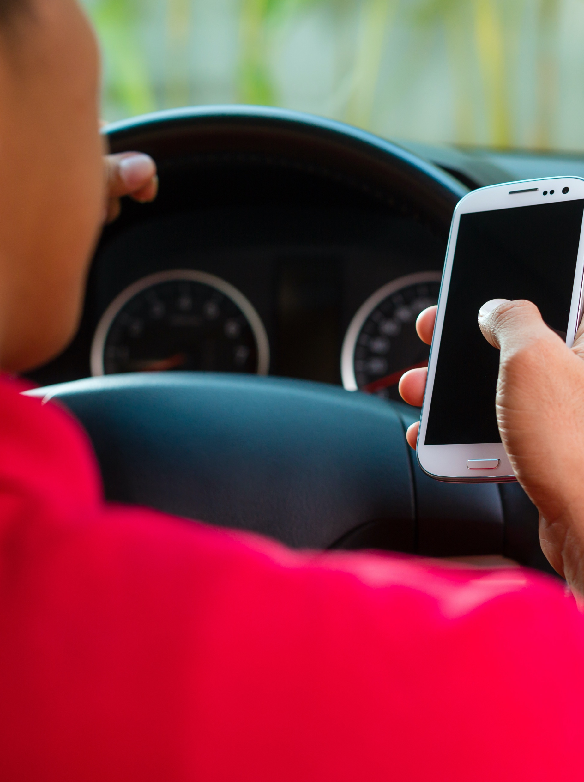
Learning Objectives
Help teen learners understand what distraction is
Help teen learners understand why distraction and driving are dangerous
Provide tools for teen drivers to actively avoid distraction
Notes:
Narrative
The learning objectives for this module are:
Help teen learners understand what distraction is
Help teen learners understand why distraction and driving are dangerous
Provide tools for teen drivers to actively avoid distraction
Image source: Kzenon/Shutterstock.com

Slide 3
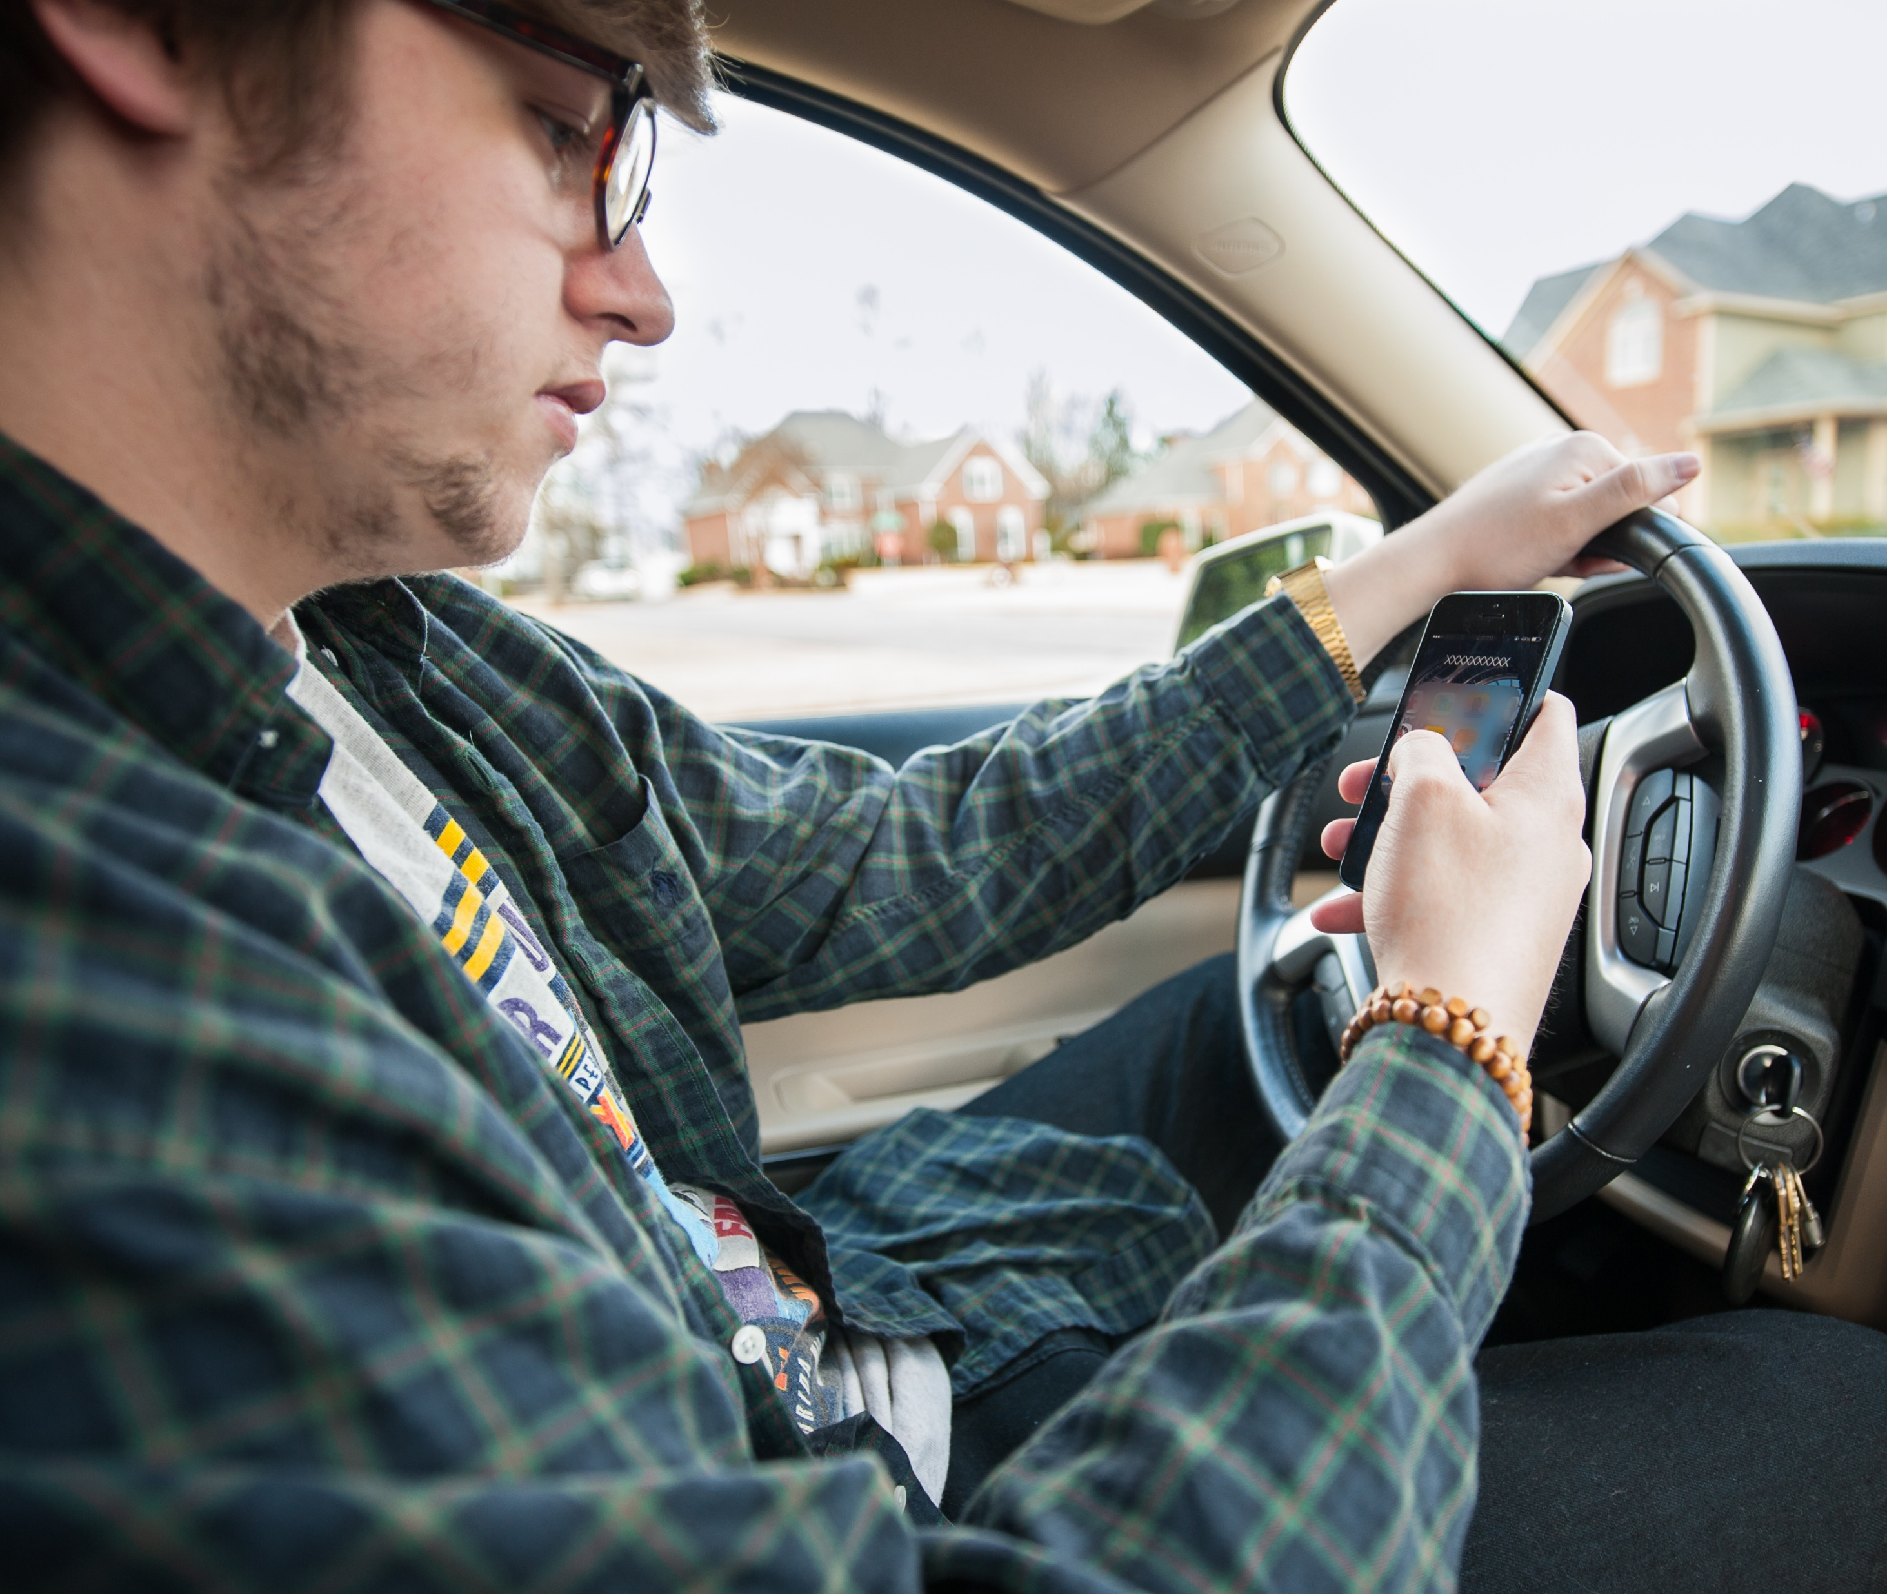
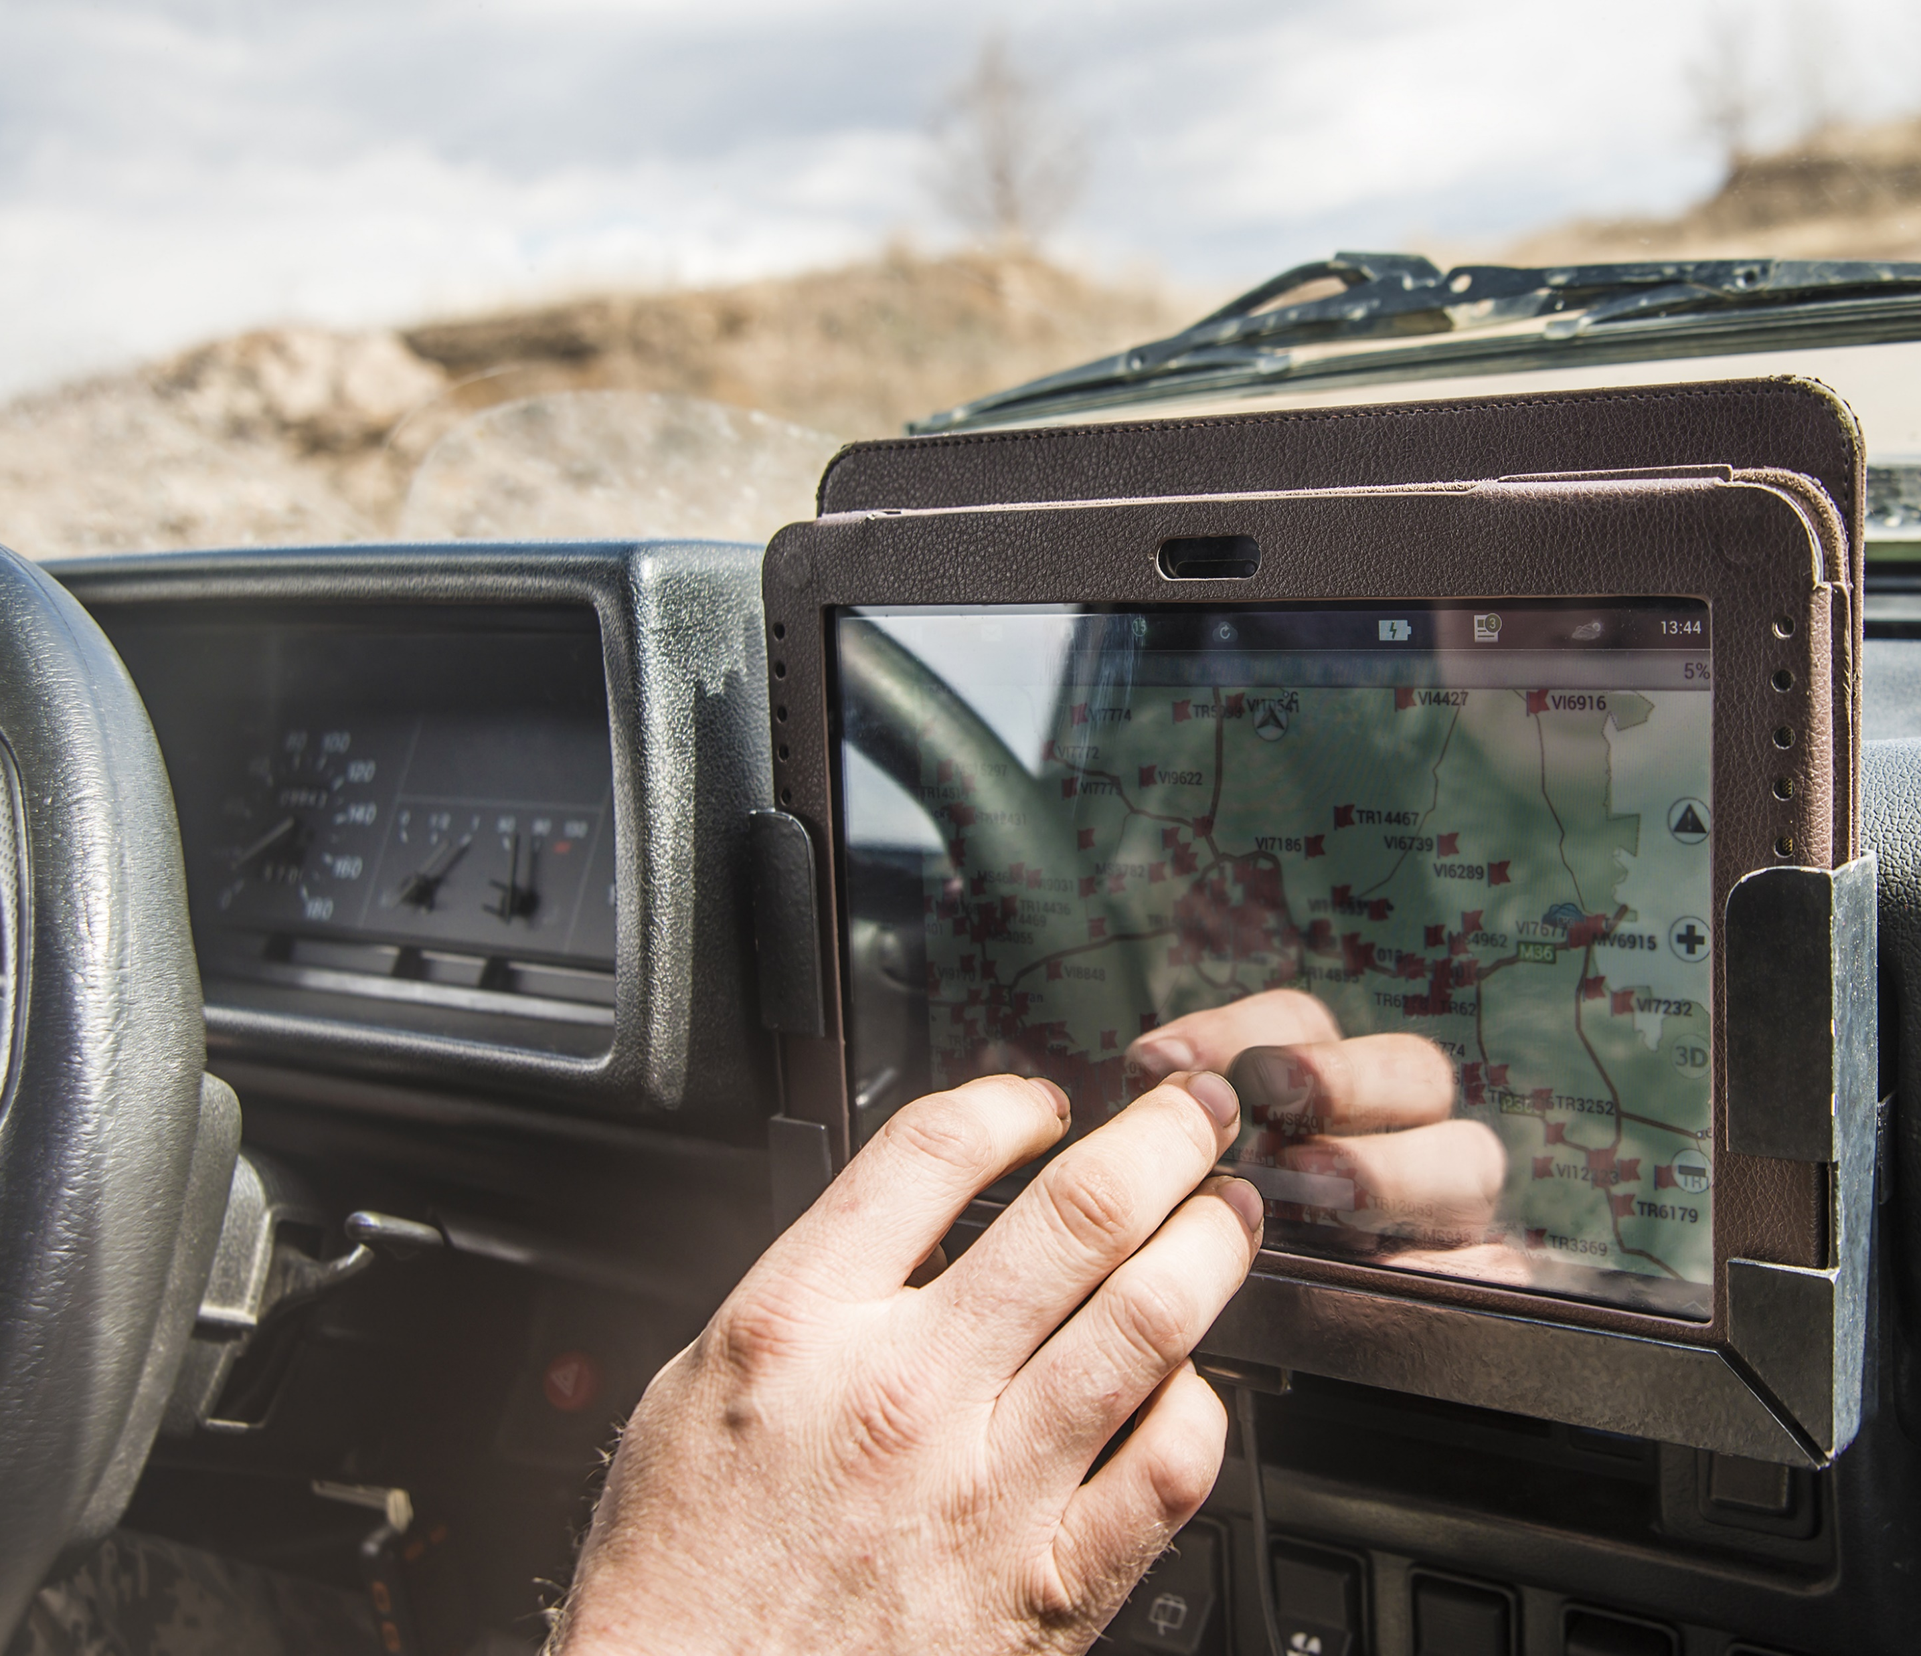
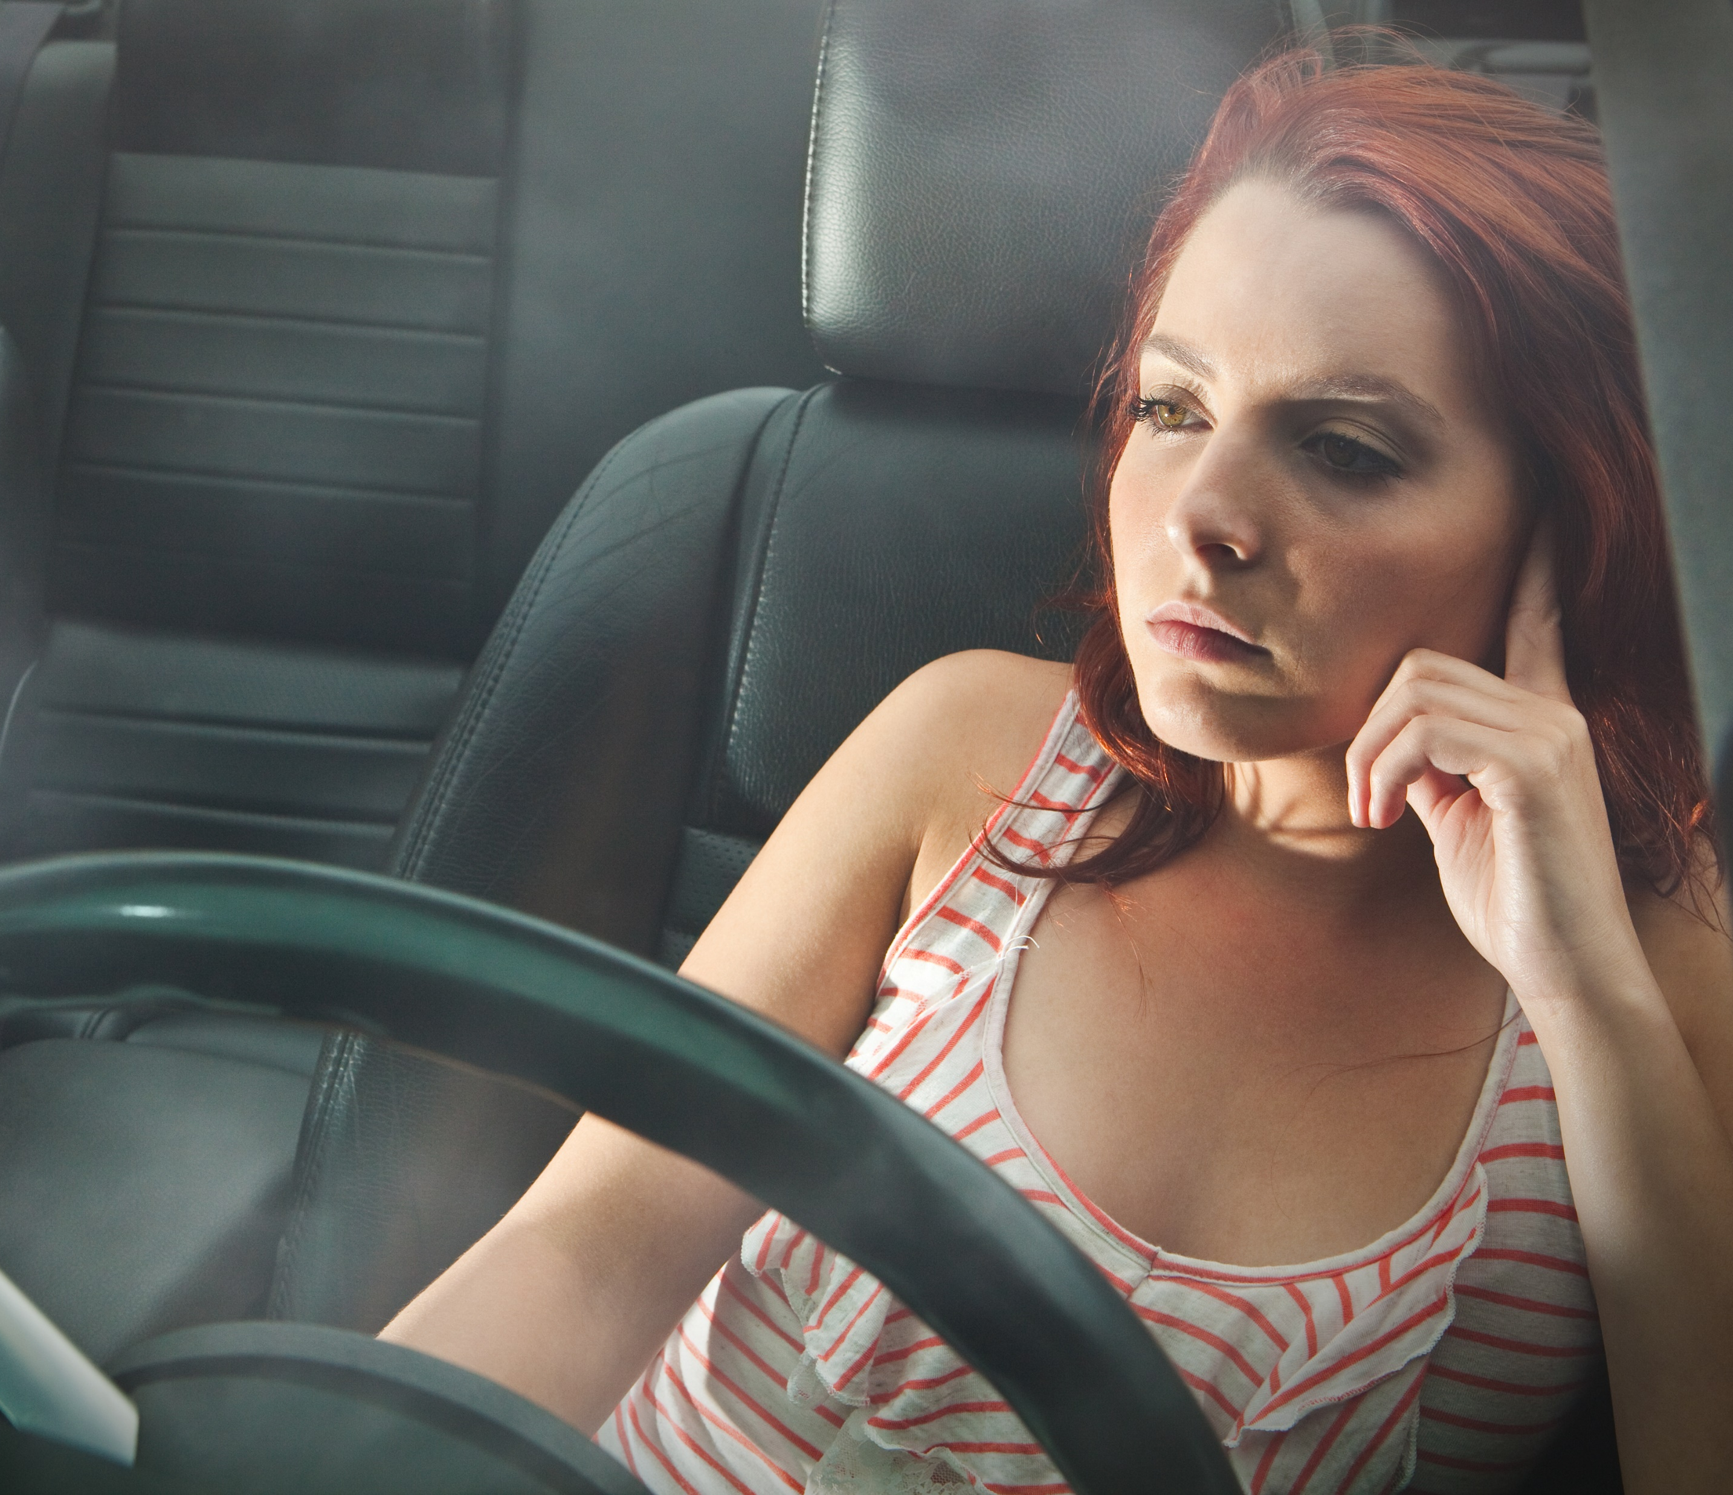
What is Distraction?
Anything that takes the driver’s attention away from the driving task
VISUAL
MANUAL
COGNITIVE
Eyes off road
Hands off wheel
Mind off driving
Notes:
Distraction is more than just sending a text or talking on your phone. Distracted driving can be defined as any activity that diverts the driver’s attention from the driving task. Distractions can be divided into 3 categories: visual, manual, and cognitive.
Visual distractions are those where you take your eyes off the road. This includes activities like looking at a text, turning your head to talk to a passenger, looking down to search for an object, reading a book, or watching a video. Visual distractions are particularly dangerous because they take your eyes and mind away from the driving tasks.
Manual distractions are those where you are touching or reaching for something like the radio. Manual distractions include adjusting the radio control, reaching for or picking up an object, eating, drinking, or putting on makeup. You might still be looking at the roadway but one or both hands is off the steering controls, which might make it difficult to control your vehicle in the case of the emergency. It also engages part of your brain to complete the activity.
Cognitive distractions include activities where you are thinking about something or not paying attention. You may still be looking at the roadway but your brain is not focused on the driving task. Anytime your mind is off the driving task, your brain has to shift attention back to the driving task.
You cannot drive safely unless the task of driving has your full attention. Any nondriving activity you engage in is a potential distraction and increases your risk of crashing (IOWA DPS, n.d.).
Resources
Information source: Governors Highway Safety Association. Directing Drivers’ Attention: A State Highway Safety Office Roadmap for Combating Distracted Driving. https://www.ghsa.org/resources/GHSA/GM/Distracted-Driving22#:~:text=GHSA's%20report%2C%20Directing%20Drivers'%20Attention,this%20deadly%20behavior%20socially%20unacceptable.
Image sources:
Leigh J/Shutterstock.com (visual)
maradon 333/Shutterstock.com (manual)
Paul Vasarhelyi/Shutterstock.com (cognitive)

Slide 4

What about Multitasking?
Texting
Driving
Driving
The brain cannot perform 2 complex tasks at the same time.
Instead, the brain handles tasks by switching focus and attention from one task to another.
Because it happens quickly, it erroneously feels like 2 tasks are being completed at the same time.
Notes:
Narrative
Multitasking is doing two or more things at the same time, such as watching a video and doing your homework. Many people, particularly teenagers, think they can multitask. However, your brain is not actually able to do more than one complex task at a time. In reality, instead of doing two things at once, your brain focuses attention on one task at a time and then switches the attention to a second task (or even third task). For instance, when you are talking on the phone while driving, even if your eyes are on the forward roadway, your brain focuses on the conversation; then, when you pay attention to the roadway, your brain switches focus back there. When your brain is focusing on the conversation, you are more likely to miss important things like a change in roadway conditions or the actions of vehicles around you.
Your brain can switch back and forth between tasks fairly quickly. As a result, you have the perception that you are “multitasking.” In reality, your brain is processing one thing at a time and may miss important information.
Resources
Information source: National Safety Council Online Distracted Driving Course. https://www.nsc.org/safety-training/defensive-driving/courses/online/distracted.
Image source: Deemka Studio/Shutterstock.com

Slide 5
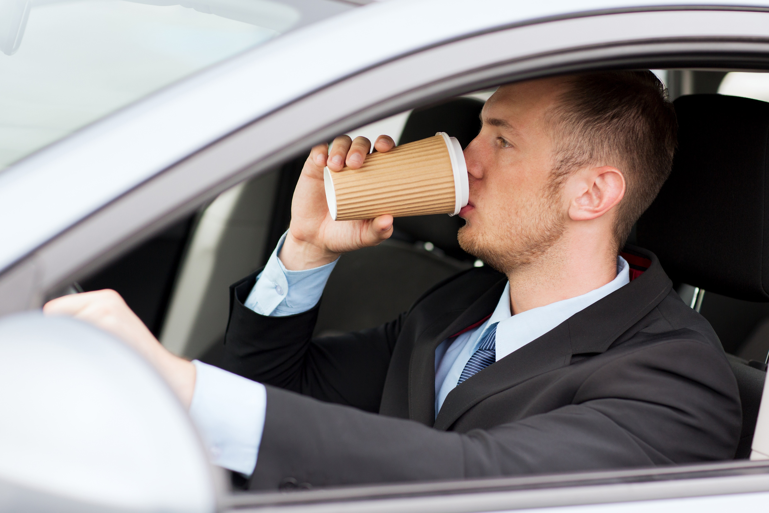
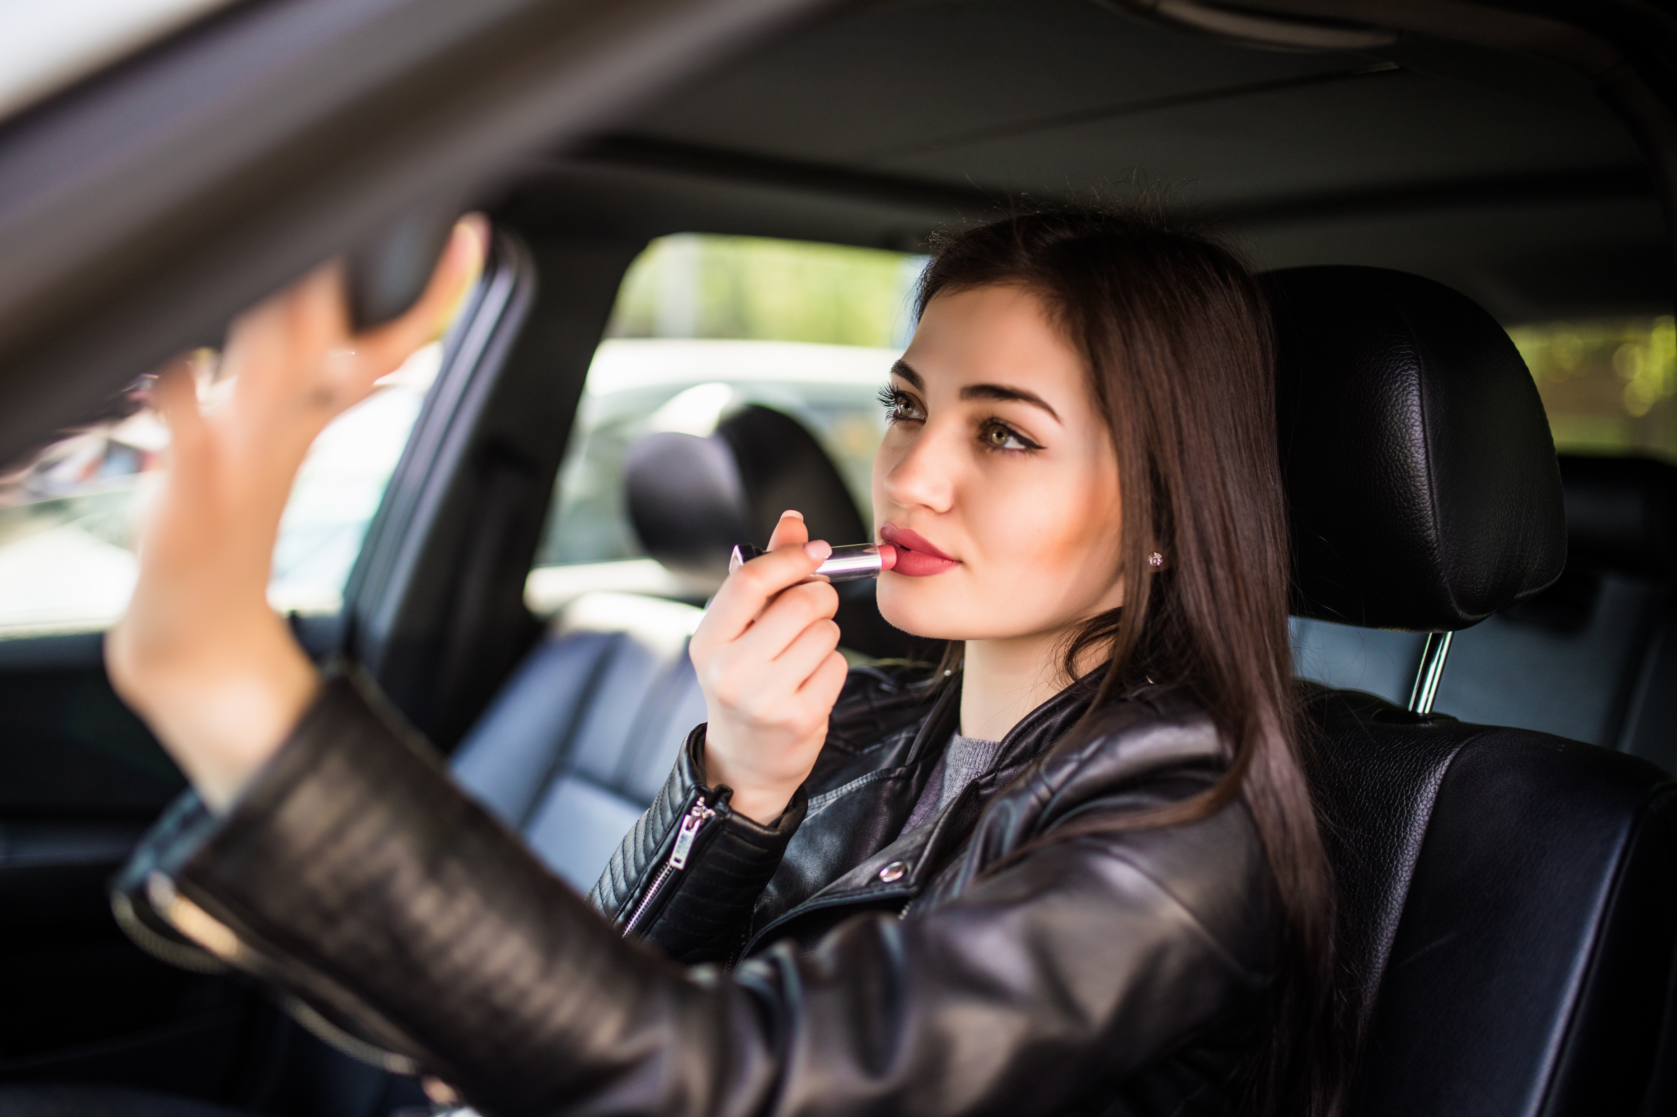
Common Distractions
Using vehicle controls (i.e., radio)
Cell phone (dialing, talking, and texting)
Eating and drinking
Wayfinding
Personal hygiene
Heated and emotional conversations
Operating unknown vehicle
Notes:
Narrative
Examples of common distractions include those listed on the slide. Many of these can involve combinations of visual, manual, or cognitive distraction.
Image Sources
Ground Picture/Shutterstock.com (drinking coffee)
Diana Grytsku/Shutterstock.com (applying lipstick)

Slide 6
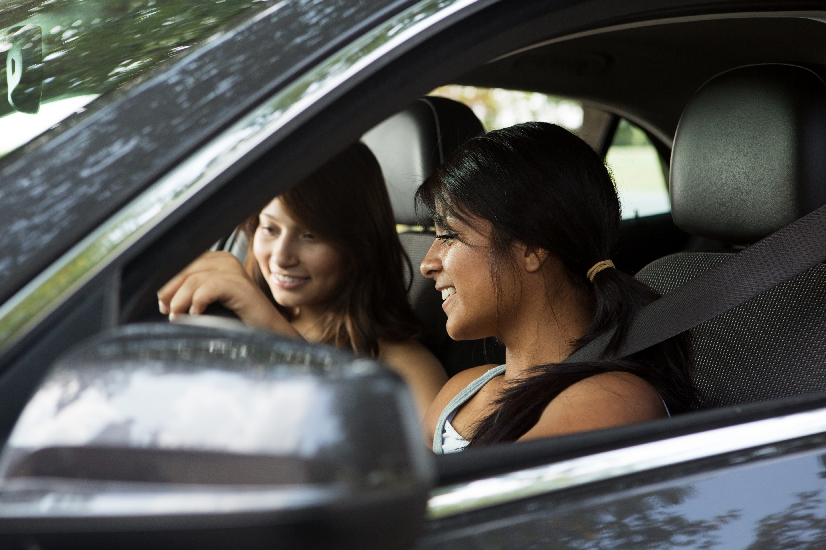
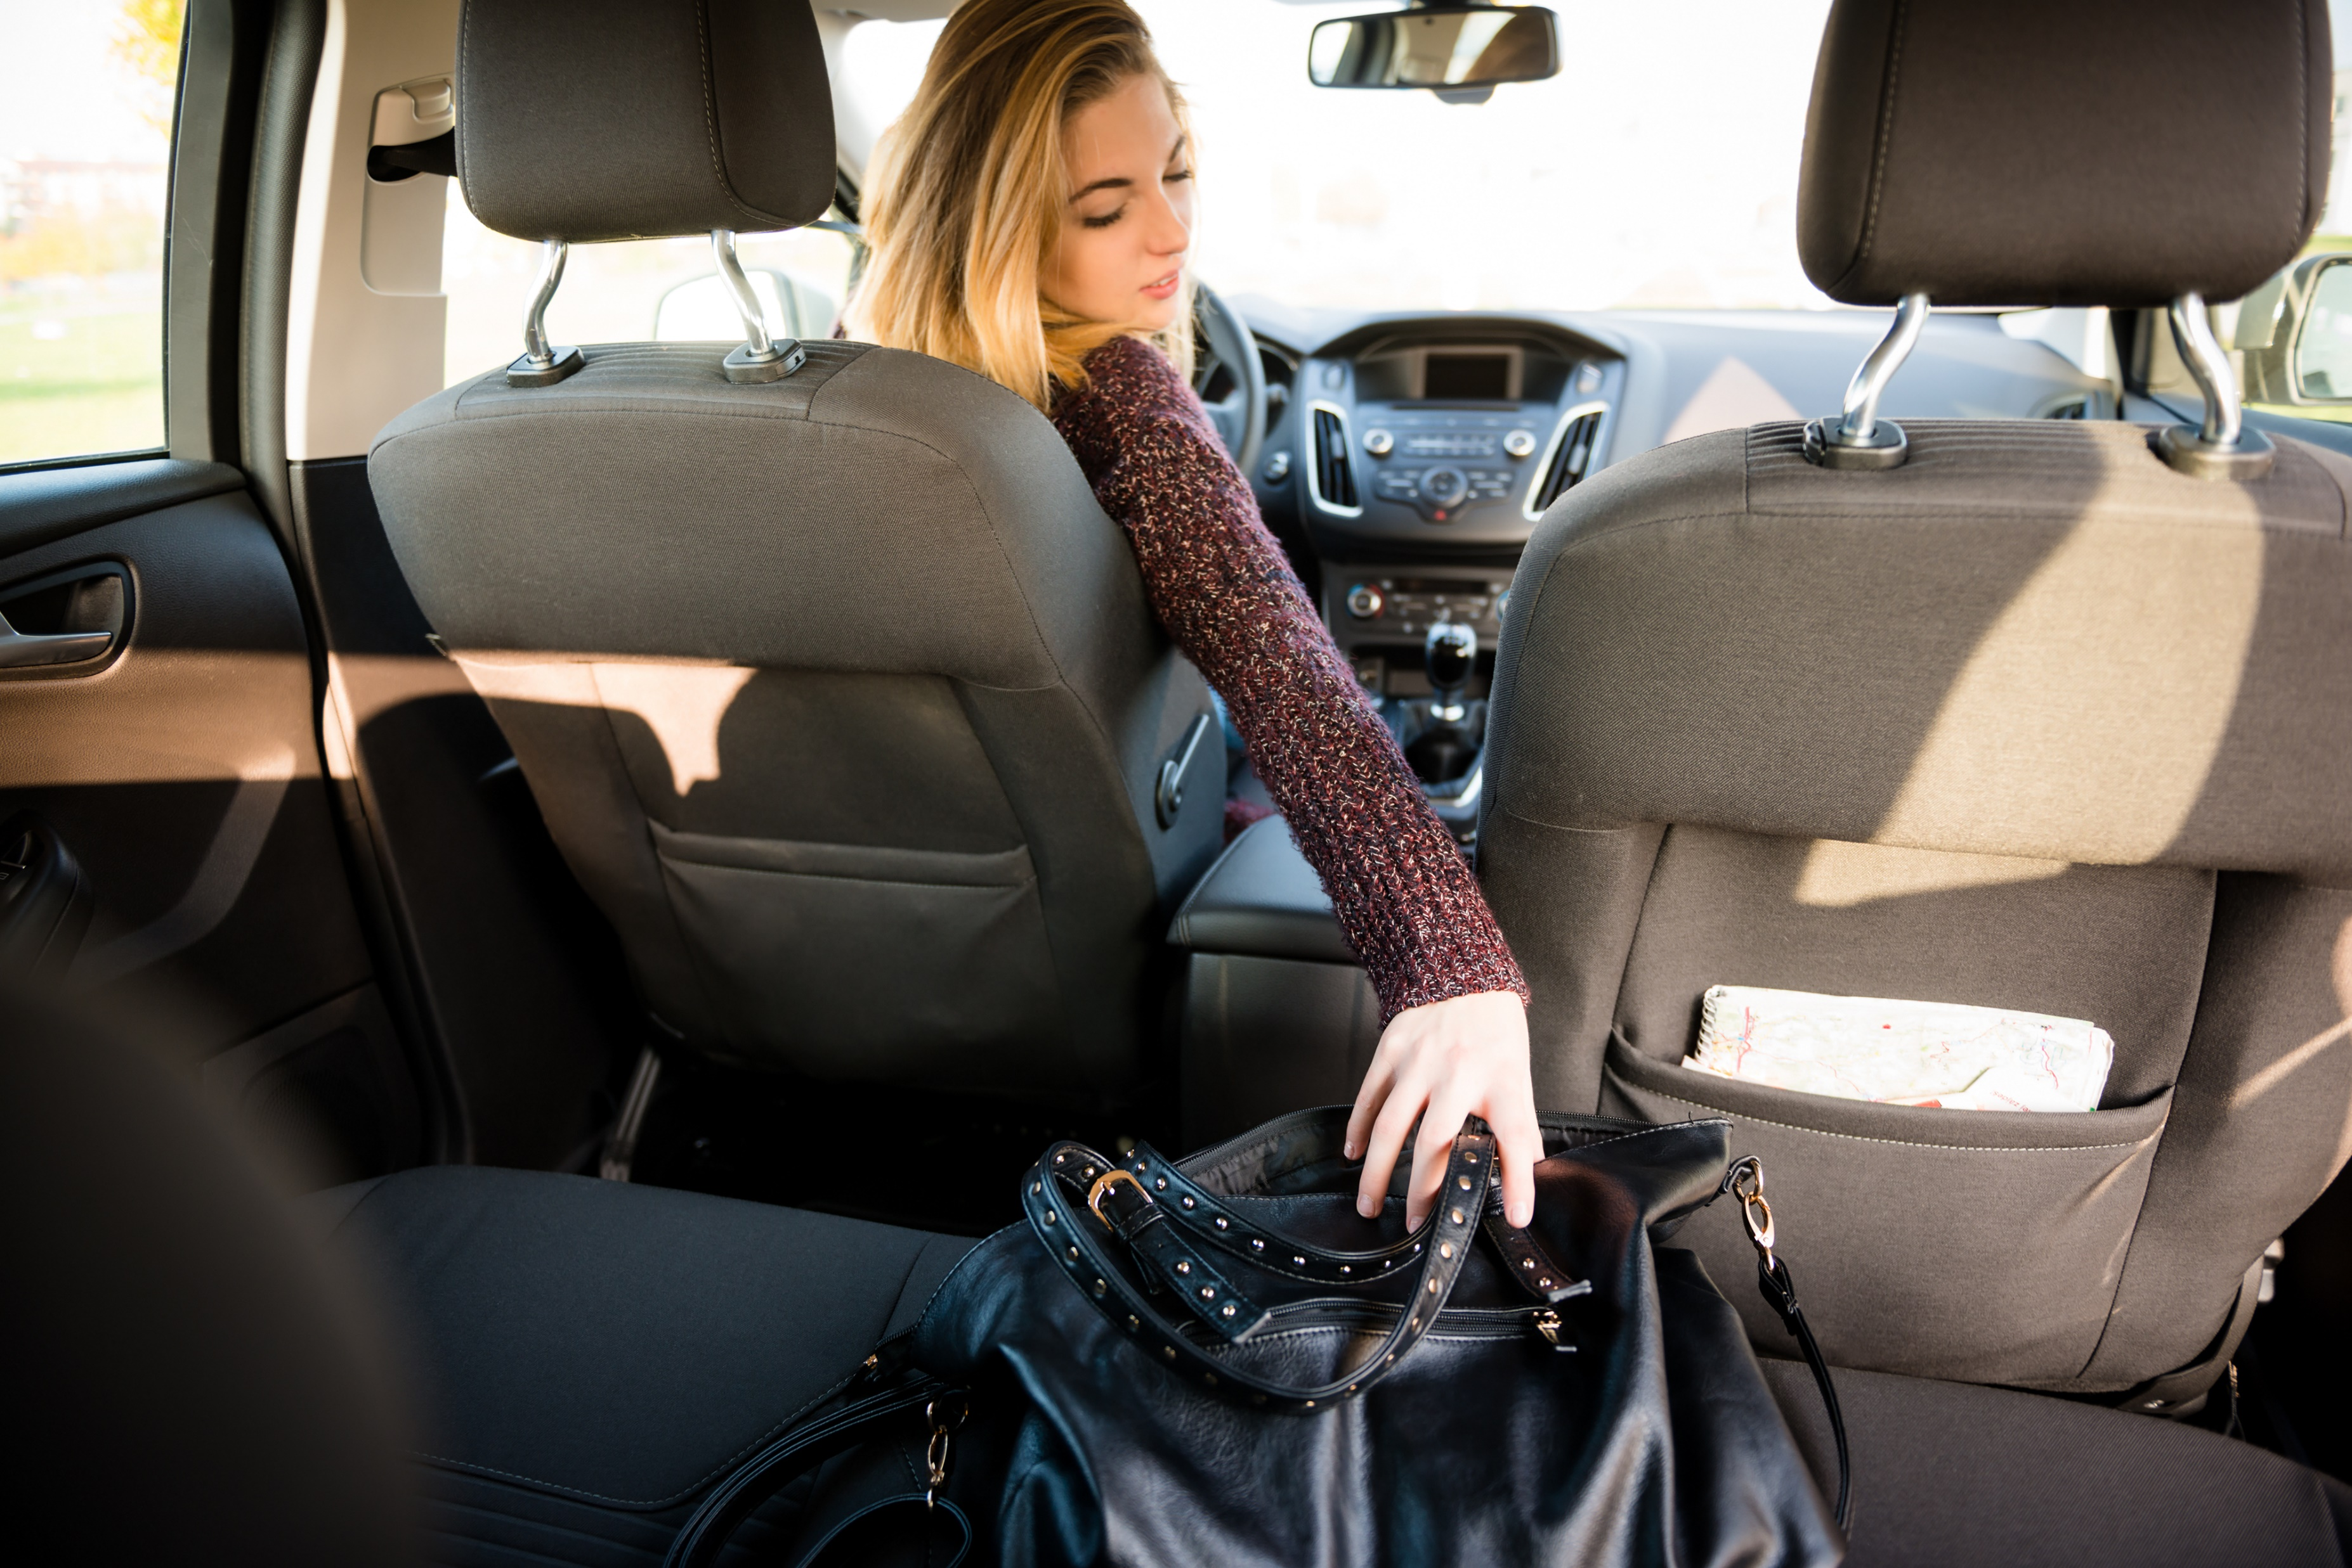
Common Distractions
Animals in vehicle
Interacting with passengers
Heated and emotional conversations
Singing
Daydreaming
Searching and reaching for items
Notes:
Narrative
This slide shows additional examples of distractions that can occur while driving.
Image Sources
Pixelheadphoto/Shutterstock.com (teens interacting)
Martin Novak/Shutterstock.com (reaching)

Slide 7
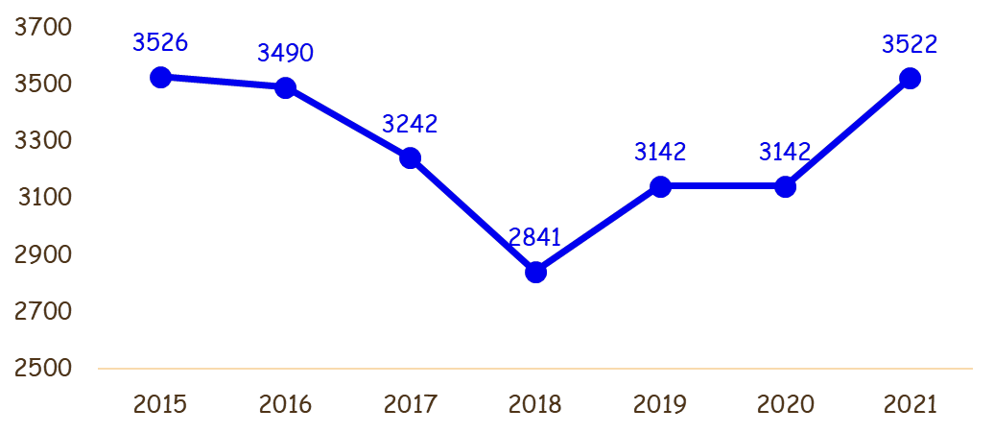

In the United States, around 3,000 people are killed in crashes involving a distracted driver every year
That’s
9
people per day
Notes:
Narrative
Distracted driving is a serious issue nationwide. Over 3,000 people are killed in crashes that involve a distracted driver each year—that is 9 people per day who die in distraction-related crashes.
Information source: National Highway Traffic Safety Administration. https://www.nhtsa.gov/.

Slide 8
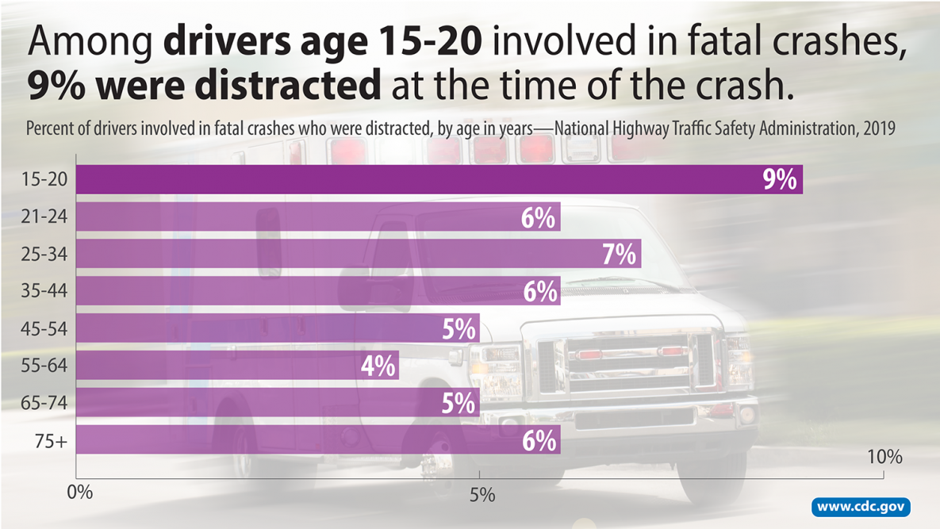
8
Notes:
Narrative
A summary characteristics associated with fatal crashes shows that distraction was a factor in 9% of drivers age 15 to 20. This is 3% higher than for drivers age 21 to 25 and 5% higher than drivers age 55 to 64.
Image source: Centers for Disease Control and Prevention. Distracted Driving Risk Factors. https://www.cdc.gov/distracted-driving/risk-factors/?CDC_AAref_Val=https://www.cdc.gov/transportationsafety/distracted_driving/index.html

Slide 9

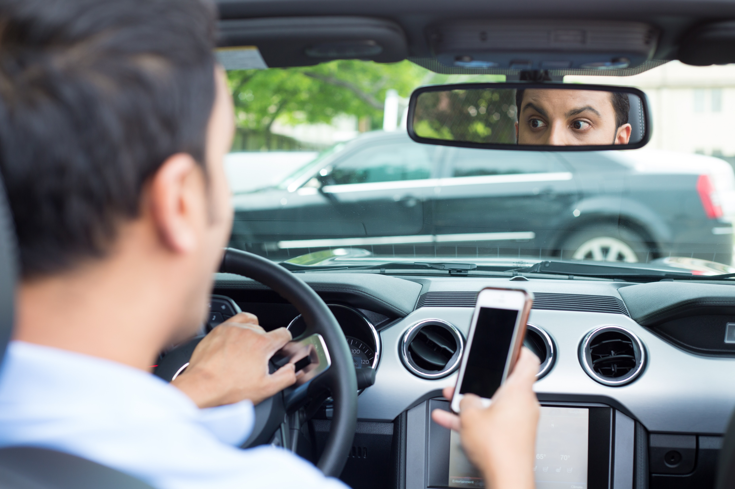


Iowa Statistics
In 2022, 9,201 distracted driving crashes in Iowa resulted in 20 deaths, 3,652 injured persons, and more than $81 million in property damage
(Iowa DPS 2023)
Drivers 16 and younger who were involved in crashes were
1.5 times more likely to be engaged with an electronic device,
1.3 times more likely to be manually using a cell phone, and
1.4 times more likely to be inattentive.
Notes:
Narrative
Distraction is an issue in Iowa as well as in other states. The Iowa Department of Public Safety (2023) estimated that 20 crash deaths, 3,652 crash injuries, and $81 million in property damage were attributed to distraction in 2022.
Iowa crash data were evaluated to assess differences in how distraction was a factor in crashes for drivers 16 and younger compared to drivers older than 16. Younger drivers were 1.5 times more likely to be engaged with an electronic device, 1.3 times more likely to be manually using a cell phone, and 1.4 times more likely to be inattentive.
Resources
Information sources:
Iowa Department of Public Safety. 2023. U Drive. U Text. U Pay. https://dps.iowa.gov/u-drive-u-text-u-pay#:~:text=In%202022%2C%209%2C201%20crashes%20on,million%20dollars%20in%20property%20damage.
Younger driver crash data were extracted from the Iowa DOT crash database and analyzed by researchers at the Institute for Transportation.
Image source: AshTproductions/Shutterstock.com

Slide 10
In Iowa, over 1,000 total crashes and over 400 injury crashes occur annually due to a driver distracted by cell phone use or other electronic device.
Notes:
Narrative
When considering just cell phone use, more than 1,000 crashes and 400 injury crashes occur annually due to the driver being distracted by a cell phone or other electronic device.
Information source: Dennis Kleen. Systems and Administration Bureau. Iowa Department of Transportation.

Slide 11
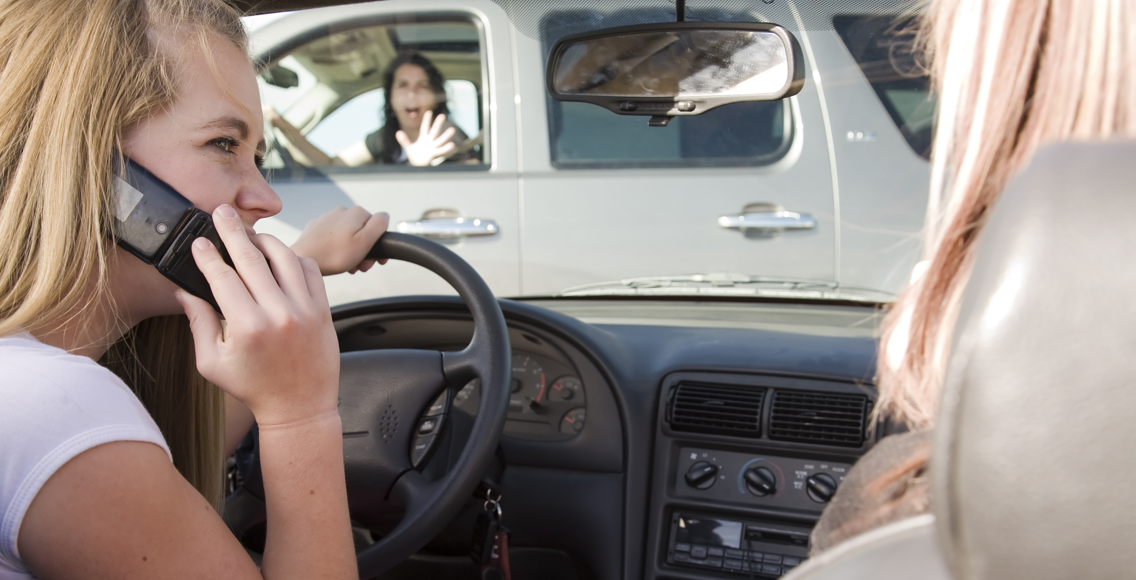
Why is Distraction a Problem?
Crash risk is 4x greater when using a
cell phone, which includes texting
(McEvoy et al. 2005)
Crash rate 2x greater when drivers are texting (Owens et al. 2018)
Notes:
Narrative
Additional statistics indicate that the crash risk is 4 times greater when the driver is using a cell phone in any capacity. This includes talking, dialing, and texting. More specifically, the crash rate is 2 times greater just for texting.
Resources
Information sources:
McEvoy S. P., M. R. Stevenson, A. T. McCartt, M. Woodward, C. Haworth, P. Palamara, R. Cercarelli. 2005. Role of Mobile Phones in Motor Vehicle Crashes Resulting in Hospital Attendance: A Case-Crossover Study. BMJ. https://pubmed.ncbi.nlm.nih.gov/16012176/.
Owens, J. M., T. A. Dingus, F. Guo, Y. Fang, M. Perez, and J. McClafferty. 2018. Crash Risk of Cell Phone Use While Driving: A Case-Crossover Analysis of Naturalistic Driving Data. AAA Foundation for Traffic Safety.
Image source: Alan Poulson Photography/Shutterstock.com

Slide 12






Teen drivers who used a cell phone took their eyes off the road an average of 4.1 seconds (Carney et al. 2015)
At 55 mph, that is like driving blind the length of a football field or the length of 4 and ½ semitrucks
65 mph
55 mph
45 mph
35 mph
25 mph
Notes:
Narrative
A study by the University of Iowa found that teen drivers who texted while driving took their eyes off the roadway an average of 4.1 seconds. This is like driving blind for over 4 seconds. If you were traveling 25 mph and glanced away for 4.1 seconds, you would travel 150 feet. At 55 mph, you would travel 331 feet, which is about the distance of a football field or the length of 4.5 semitrucks. While your eyes are off the roadway, any number of situations could arise, such as the vehicle ahead breaking or a child running in front of your car.
Resources
Information sources:
Carney, C., D. V. McGehee, K. Harland, M. Weiss, and M. Raby. 2015. Using Naturalistic Driving Data to Assess the Prevalence of Environmental Factors and Driver Behaviors in Teen Driver Crashes. Washington, DC: AAA Foundation for Traffic Safety. https://aaafoundation.org/using-naturalistic-driving-data-assess-prevalence-environmental-factors-driver-behaviors-teen-driver-crashes/.
Insurance Information Institute. 2023. Facts + Statistics: Distracted Driving. https://www.iii.org/fact-statistic/facts-statistics-distracted-driving.
Image source: EFKS/Shutterstock.com

Slide 13
What Is the Law?
IOWA LAW (SOURCE IOWA DPS, N.D.)
Effective July 1, 2017, Iowa's distracted driving law became a primary law meaning a law enforcement officer can stop any driver who is texting (reading, writing, or sending) or using any other portable electronic device, unless the motor vehicle is at a complete stop and off the traveled portion of the roadway. Previously, drivers 18 years or older had to break another traffic law before they could be stopped by a law enforcement officer.
Drivers under the age of 18 years are prohibited from using electronic devices entirely, unless the vehicle is stopped and off the traveled portion of the roadway or the device is permanently installed in the vehicle or operated through permanently installed equipment.
Drivers over the age of 18 may use their phones to talk while driving and as a GPS navigation system.
Also effective July 1, 2017, a driver using a cellphone and causing the death of another person has shown evidence of reckless driving and could face a felony conviction that includes up to 10 years in prison and a fine of up to $10,000.
The provision related to "reading" a text message does not apply to the following:
A member of a public safety agency performing official duties;
Health care professionals in the course of an emergency situation; or
A person receiving safety-related information, including emergency, traffic or weather alerts.
Notes:
Narrative
This slides shows Iowa law about distracted driving.
Information source: Iowa Department of Public Safety. n.d. Distracted Driving. https://dps.iowa.gov/divisions/commissioners-office/governors-traffic-safety.

Slide 14
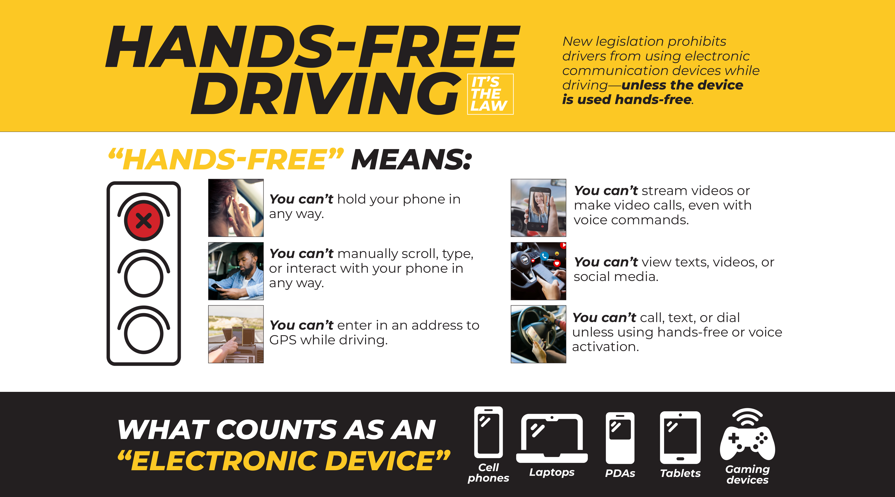

Slide 15
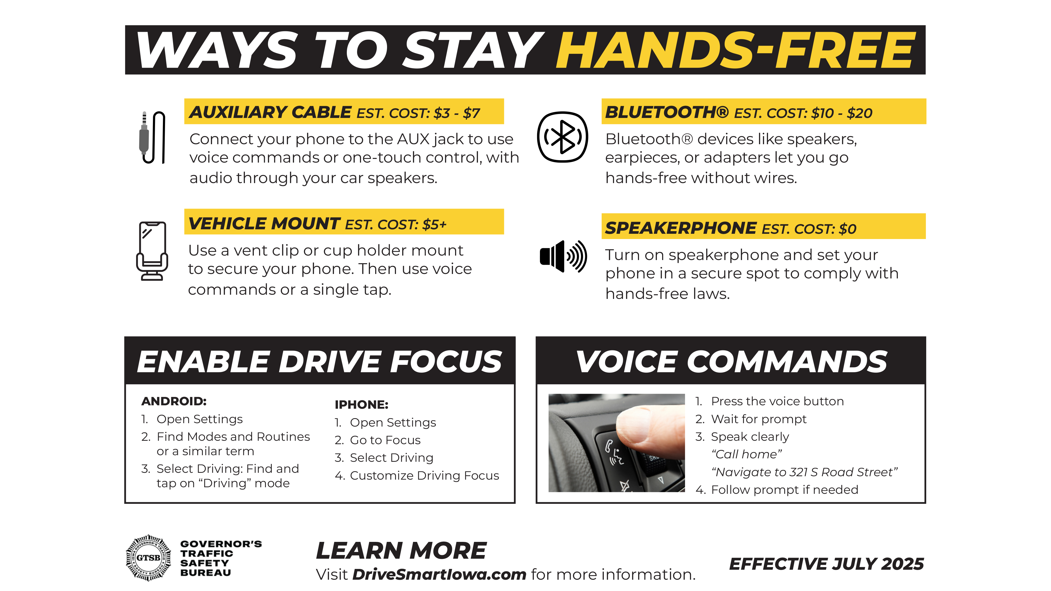

Slide 16
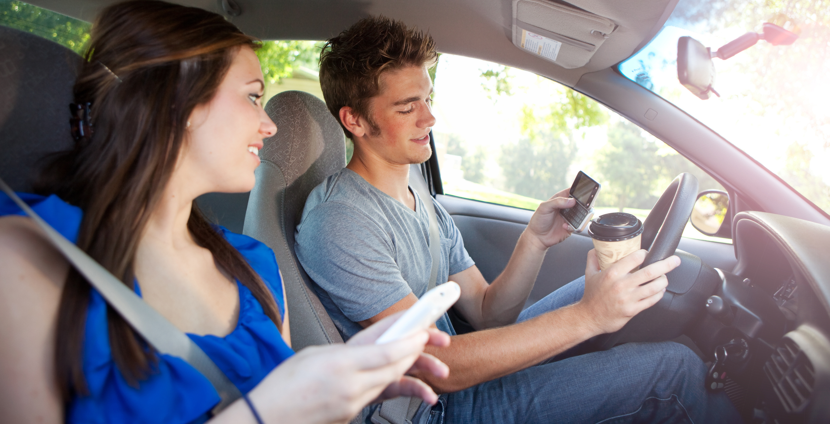
A survey by Liberty Mutual showed teens feel pressure to stay connected or to always be “on.”
This contributes to their need to talk, text, use social media, or engage in entertainment even while driving.
Notes:
Narrative
It might seem easy to just tell drivers not to use their phones or engage in other distractions. However, we often compelled to answer a call or respond to a text even when we know we shouldn’t. A study showed teens feel pressure to always be engaged and stay connected. This contributes to the feeling that you have to answer a call, respond to a text, or watch entertainment on your phone. For instance, people get used to getting an immediate response to a text or call. Or, using your phone all the time has become a habit and it is difficult to put it down even when driving. Even parents can contribute to the problem. They may expect their teen to respond quickly or let them know where they are.
Resources
Information source:
Liberty Mutual. 2015. New Study Finds Teens "Fear of Missing Out" is Proving to be Dangerous. https://www.libertymutualgroup.com/about-lm/news/articles/new-study-finds-teens-fear-missing-out-proving-be-dangerous.
Image source: Sean Locke Photography/Shutterstock.com

Slide 17
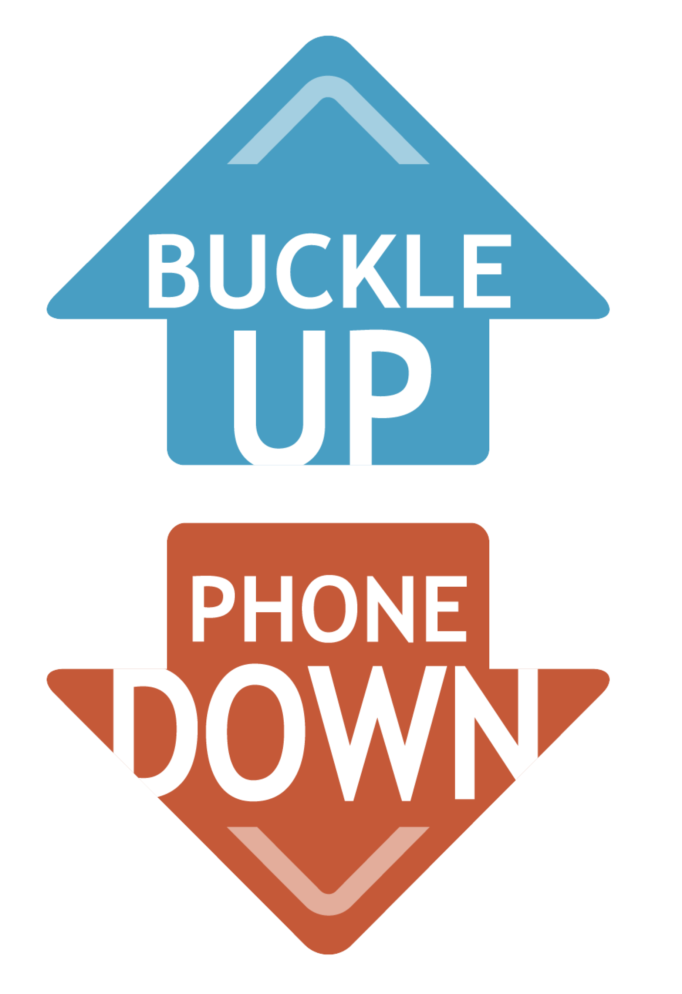
Strategies to Reduce Distracted Driving
Put the phone down:
Checking your phone while at a signal or in stopped traffic is still dangerous.
Turn it off
Your mind is focused on your phone and not ready to react to unexpected situations.
Put it on silent
Place it out of reach
Having your phone off or out of reach avoids temptation.
Notes:
Narrative
The following slides present strategies to reduce distracted driving.
The first strategy is to always put your phone out of reach when driving—that way you are not tempted to answer a call or text. It’s best to turn the phone off, put it in silent mode, or place it out of reach. Some drivers like to keep their phone handy and feel safe checking texts while driving slowly or stopped at a signal. This is still dangerous since your hands and mind are focused on your phone and not on the roadway around you. As a result, you may not be ready to react to unexpected situations or remember to scan around you.
Turning your phone off or silencing it takes away the temptation to use the phone.
Resources
Information sources:
Walshe, E. 2021. Rethinking Cell Phone Use While Driving Prevention. Children’s Hospital of Philadelphia Center for Injury Research & Prevention. https://injury.research.chop.edu/blog/posts/rethinking-cell-phone-use-while-driving-prevention.
Governors Highway Safety Association. 2023. Directing Drivers’ Attention: A State Highway Safety Office Roadmap for Combating Distracted Driving.
https://www.ghsa.org/resources/GHSA/GM/Distracted-Driving22#:~:text=GHSA's%20report%2C%20Directing%20Drivers'%20Attention,this%20deadly%20behavior%20socially%20unacceptable.
AmFam Team. 2022. How to Prevent Distracted Driving. American Family Insurance. https://www.amfam.com/resources/articles/on-the-road/prevent-distracted-driving.
Children’s Hospital of Philadelphia Research Institute. 2022. Cell Phone Use and Texting While Driving Facts and Statistics. https://www.teendriversource.org/teen-crash-risks-prevention/distracted-driving/cell-phones.
Image source: Missouri Department of Transportation (https://www.modot.org/bupd-starter-kit)

Slide 18
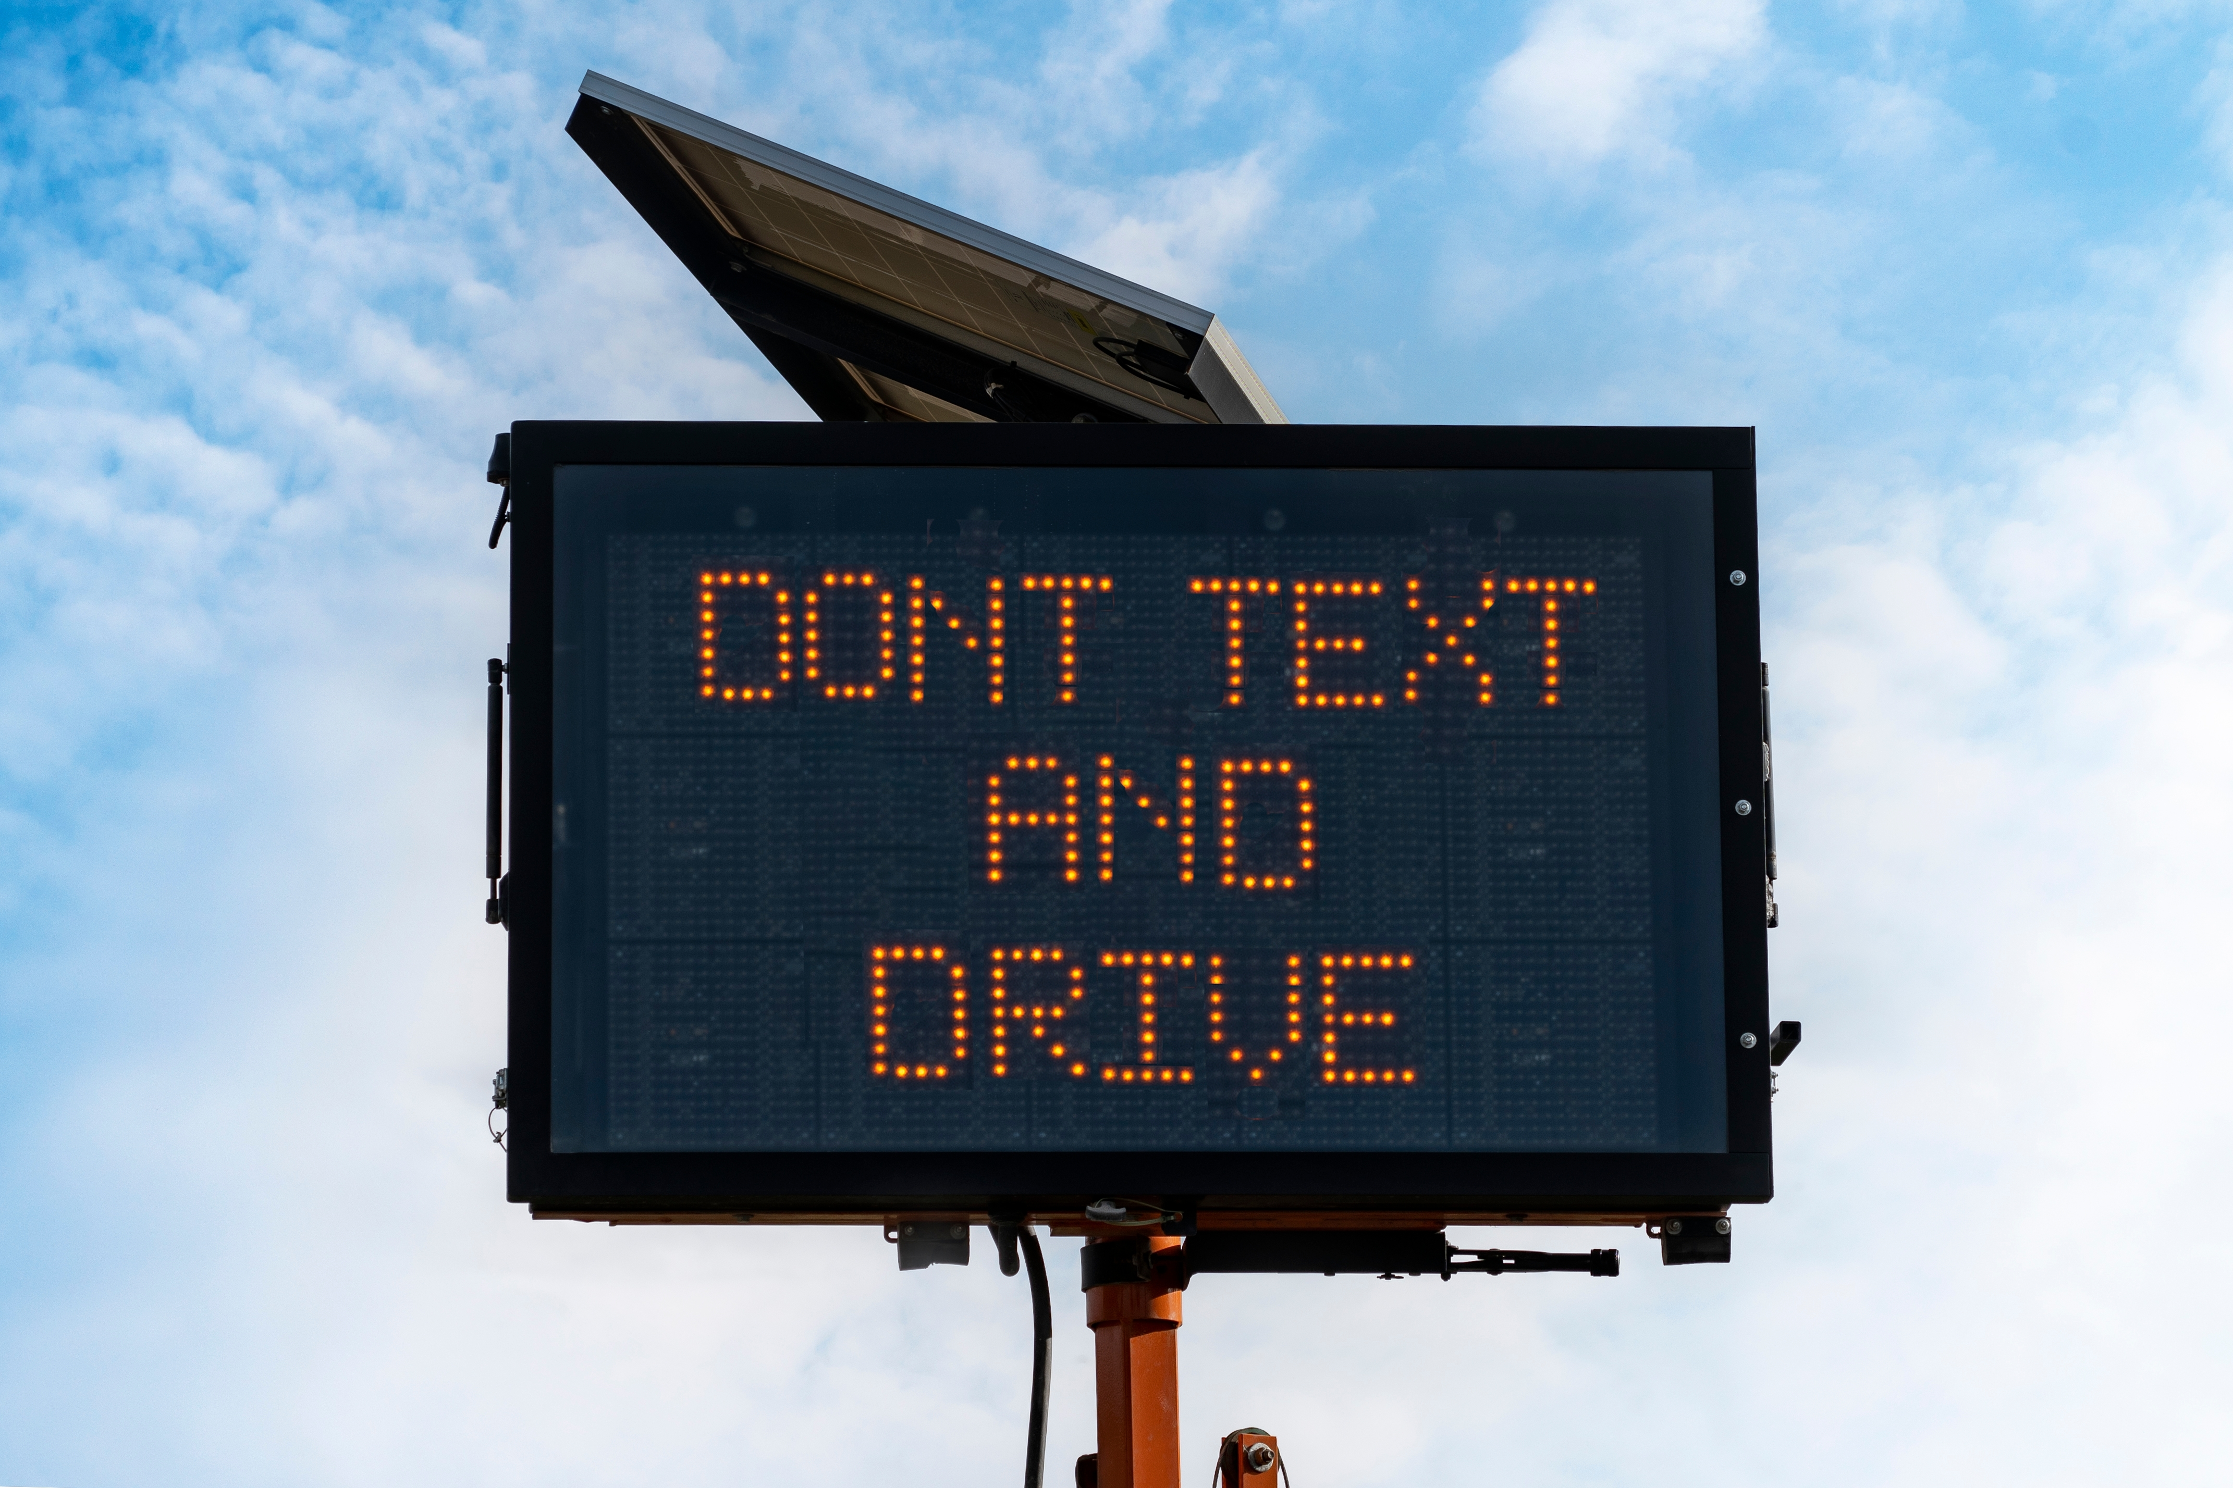
Strategies to Reduce Distracted Driving
Spread the word:
Use an app that blocks texts and tells callers you are driving
Send necessary texts before you drive
Remind friends and parents you don’t text and drive
Notes:
Narrative
Another strategy is the spread the word. You can use an app that blocks text and calls with a message that you are driving. This lets family and friends know you can’t get back to them right away. You can also send any necessary texts, such as telling your parents you are on the way, before you start driving. That way you can focus on driving. You can also remind your friends and parents that you don’t text and drive. If a friend bugs you about not getting back to them right away, you can remind them that you want to keep everyone safe. Having the conversation ahead of time sets expectations.
Resources
Information sources:
Walshe, E. 2021. Rethinking Cell Phone Use While Driving Prevention. Children’s Hospital of Philadelphia Center for Injury Research & Prevention. https://injury.research.chop.edu/blog/posts/rethinking-cell-phone-use-while-driving-prevention.
Governors Highway Safety Association. 2023. Directing Drivers’ Attention: A State Highway Safety Office Roadmap for Combating Distracted Driving.
https://www.ghsa.org/resources/GHSA/GM/Distracted-Driving22#:~:text=GHSA's%20report%2C%20Directing%20Drivers'%20Attention,this%20deadly%20behavior%20socially%20unacceptable.
AmFam Team. 2022. How to Prevent Distracted Driving. American Family Insurance. https://www.amfam.com/resources/articles/on-the-road/prevent-distracted-driving.
Children’s Hospital of Philadelphia Research Institute. 2022. Cell Phone Use and Texting While Driving Facts and Statistics. https://www.teendriversource.org/teen-crash-risks-prevention/distracted-driving/cell-phones.
Image source: Urban Images/Shutterstock.com

Slide 19
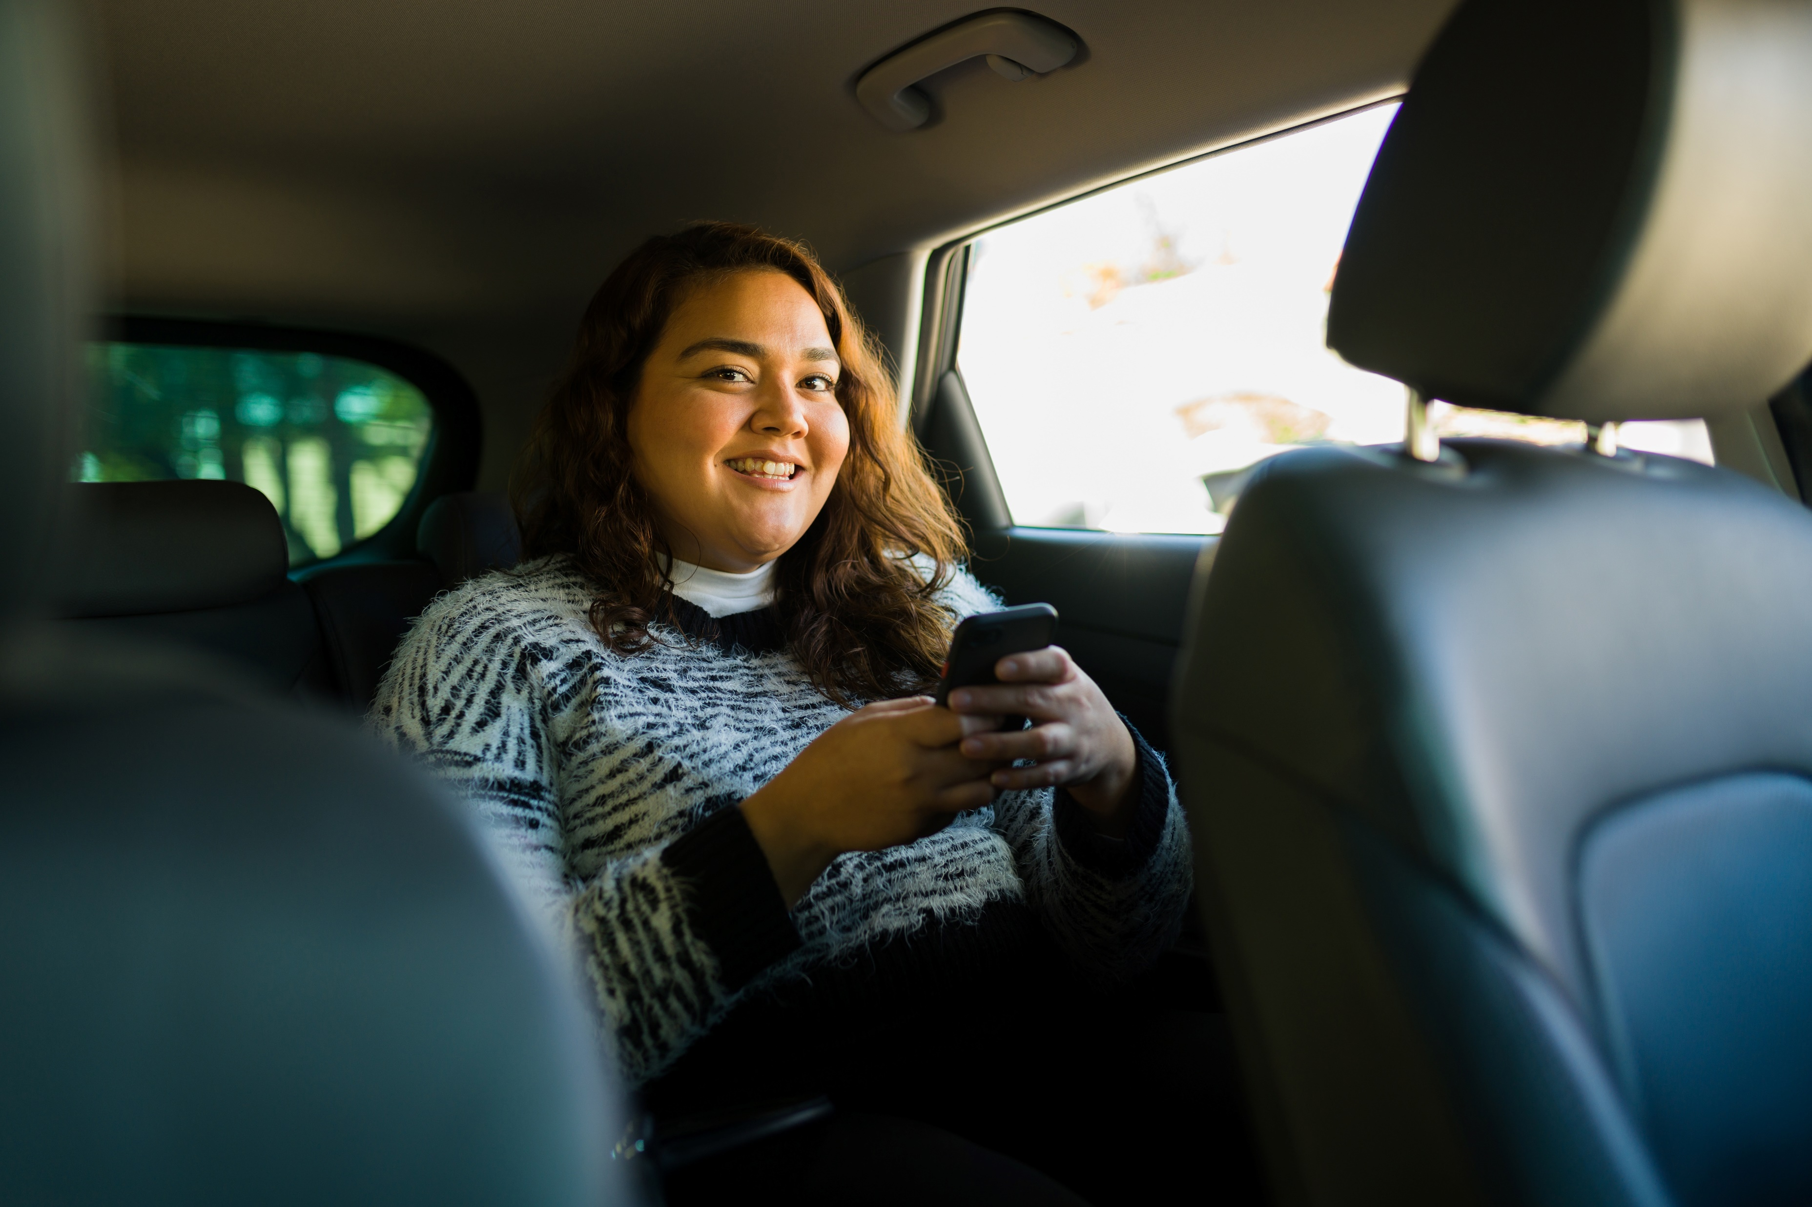
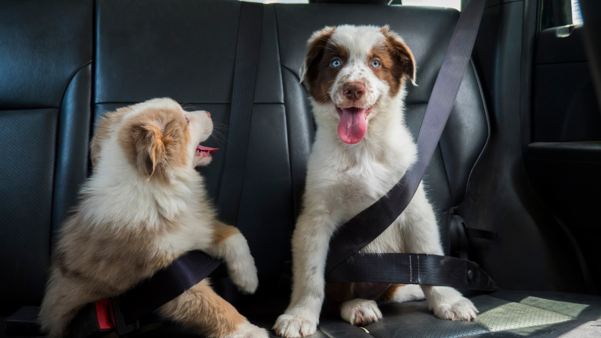
Strategies to Reduce Distracted Driving
Enlist a passenger to assist:
Navigate for you
Answer calls and texts
Prepare your trip before you go:
Eat and take care of personal hygiene
Set up your radio and car controls
Go over navigation
Secure pets
Set up music
Notes:
Narrative
Another strategy is to get a passenger to help you out. They can answer texts, follow navigation instructions, adjust radio controls, etc. This way you can focus on the roadway.
Another way to reduce the chances you will be distracted while driving is to think about things you need to take care of before the trip. Getting up a few minutes earlier saves the need to apply makeup, eat breakfast, or take care of other hygiene while driving. You can also check your car controls, such as heat, radio station, or volume, before you start driving. Some people like to have a pet in their car, but a loose pet can get in the way of driving and distract you from the road. Securing your pet keeps them safe and prevents you from being distracted.
Resources
Information sources:
Walshe, E. 2021. Rethinking Cell Phone Use While Driving Prevention. Children’s Hospital of Philadelphia Center for Injury Research & Prevention. https://injury.research.chop.edu/blog/posts/rethinking-cell-phone-use-while-driving-prevention.
Governors Highway Safety Association. 2023. Directing Drivers’ Attention: A State Highway Safety Office Roadmap for Combating Distracted Driving.
https://www.ghsa.org/resources/GHSA/GM/Distracted-Driving22#:~:text=GHSA's%20report%2C%20Directing%20Drivers'%20Attention,this%20deadly%20behavior%20socially%20unacceptable.
AmFam Team. 2022. How to Prevent Distracted Driving. American Family Insurance. https://www.amfam.com/resources/articles/on-the-road/prevent-distracted-driving.
Children’s Hospital of Philadelphia Research Institute. 2022. Cell Phone Use and Texting While Driving Facts and Statistics. https://www.teendriversource.org/teen-crash-risks-prevention/distracted-driving/cell-phones.
Images sources:
antoniodiaz/Shutterstock.com (passenger)
StockMediaSeller/Shutterstock.com (belted dogs)

Slide 20

Strategies to Reduce Distracted Driving
Pinky Swear:
Make a commitment to yourself that you won’t use your phone while driving
Make a pact with your friends to not engage in distracting behavior
Ask your parents to remind you and do their part to avoid calling or texting to see where you are
37%
of teens text to coordinate or confirm event details with friends
55%
of teens text while driving to update parents
Notes:
Narrative
A lot of programs have teen drivers sign a pledge to not use their phone or engage in distracting behaviors while driving. You can make a pledge to yourself not to use your phone while driving. You can make a pact with your friends to help each other not to text or use the phone while driving. A study showed 37% of texting was teens coordinating with friends. Making a plan ahead of time means your friends can help you avoid distractions. Another study showed 55% of teens who texted while driving were updating their parents about where they were. Enlisting your parents to help you avoid texting and driving can help take away one of the number one reasons teen drivers feel a need to text.
Resources
Information sources:
Walshe, E. 2021. Rethinking Cell Phone Use While Driving Prevention. Children’s Hospital of Philadelphia Center for Injury Research & Prevention. https://injury.research.chop.edu/blog/posts/rethinking-cell-phone-use-while-driving-prevention.
Governors Highway Safety Association. 2023. Directing Drivers’ Attention: A State Highway Safety Office Roadmap for Combating Distracted Driving.
https://www.ghsa.org/resources/GHSA/GM/Distracted-Driving22#:~:text=GHSA's%20report%2C%20Directing%20Drivers'%20Attention,this%20deadly%20behavior%20socially%20unacceptable.
AmFam Team. 2022. How to Prevent Distracted Driving. American Family Insurance. https://www.amfam.com/resources/articles/on-the-road/prevent-distracted-driving.
Children’s Hospital of Philadelphia Research Institute. 2022. Cell Phone Use and Texting While Driving Facts and Statistics. https://www.teendriversource.org/teen-crash-risks-prevention/distracted-driving/cell-phones.
Image source: Monkey Business Images/Shutterstock.com

Slide 21
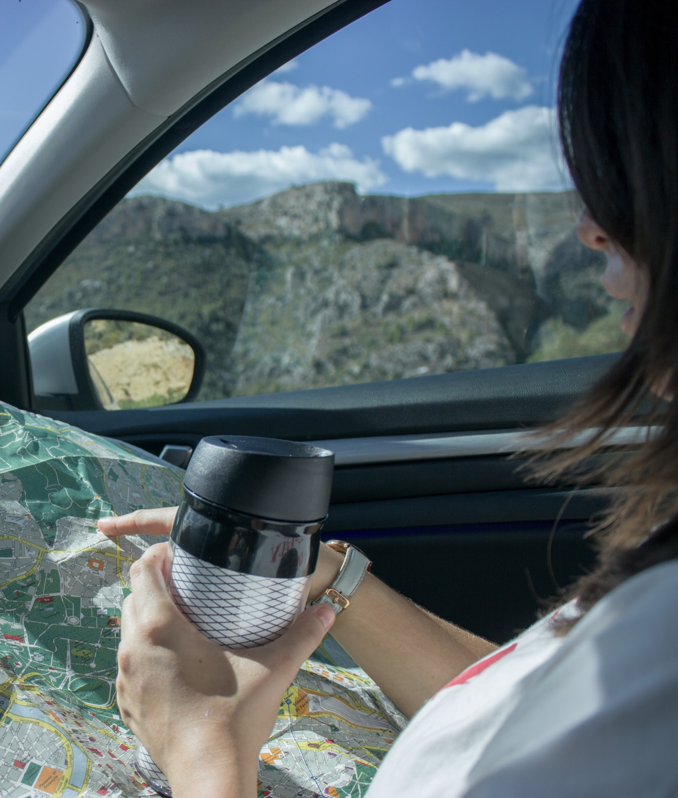
Strategies to Reduce Distracted Driving
Speak up:
Learn to speak up in a nonconfrontational manner when someone is driving distracted
Pull over to pick it up:
Calls and texts
Dropped objects
Check navigation
Notes:
Narrative
Another strategy is to pull over if you need to pick something up. Reaching for things takes both of your hands off the steering wheel and your eyes off the road. If you absolutely need to take a text or call, wait until you can pull over to answer.
You might also be a passenger in a vehicle when another driver becomes distracted. This puts you at risk. Using words like “It makes me uncomfortable when ….” helps avoid confrontation but reminds the driver that what they are doing is unsafe.
Resources
Information sources:
Walshe, E. 2021. Rethinking Cell Phone Use While Driving Prevention. Children’s Hospital of Philadelphia Center for Injury Research & Prevention. https://injury.research.chop.edu/blog/posts/rethinking-cell-phone-use-while-driving-prevention.
Governors Highway Safety Association. 2023. Directing Drivers’ Attention: A State Highway Safety Office Roadmap for Combating Distracted Driving.
https://www.ghsa.org/resources/GHSA/GM/Distracted-Driving22#:~:text=GHSA's%20report%2C%20Directing%20Drivers'%20Attention,this%20deadly%20behavior%20socially%20unacceptable.
AmFam Team. 2022. How to Prevent Distracted Driving. American Family Insurance. https://www.amfam.com/resources/articles/on-the-road/prevent-distracted-driving.
Children’s Hospital of Philadelphia Research Institute. 2022. Cell Phone Use and Texting While Driving Facts and Statistics. https://www.teendriversource.org/teen-crash-risks-prevention/distracted-driving/cell-phones.
Images source: hella,ka/Shutterstock.com

Slide 22
Disclaimer Notice
This module was developed by the Institute for Transportation (InTrans) at Iowa State University for the Iowa Department of Transportation (Iowa DOT) with the purpose to provide the material for driver education instructors in Iowa. InTrans is responsible for the facts and the accuracy of the information presented herein as of May 1, 2025.
Driver education instructors may use the material in its entirety or may use any of the slides and material individually. The material is for educational purposes only. It is strictly prohibited to sell any part of this module.
If any of the material is reused, please credit the appropriate source. The resources used for information and images for the module are provided in the notes section. Other material can be cited as Iowa DOT.
For more information or questions, please contact Vania Boyd, Driver Education and Motorcycle Rider Education Manager, Iowa DOT, Vania.boyd@iowadot.us.

