Slide 1
Challenging Roadways
Notes:
Narrative
This module was developed by the Institute for Transportation at Iowa State University for the Iowa Department of Transportation. The purpose is to provide additional material for driver education instructors in Iowa. This module focuses on challenging roadways. The material can be used in its entirety, or a driver education instructor can use any of the slides or material individually. Citations are provided for information sources and images. If these materials are used, please credit the appropriate source. Other material can be cited as Iowa DOT.
Image source: Institute for Transportation at Iowa State University

Slide 2
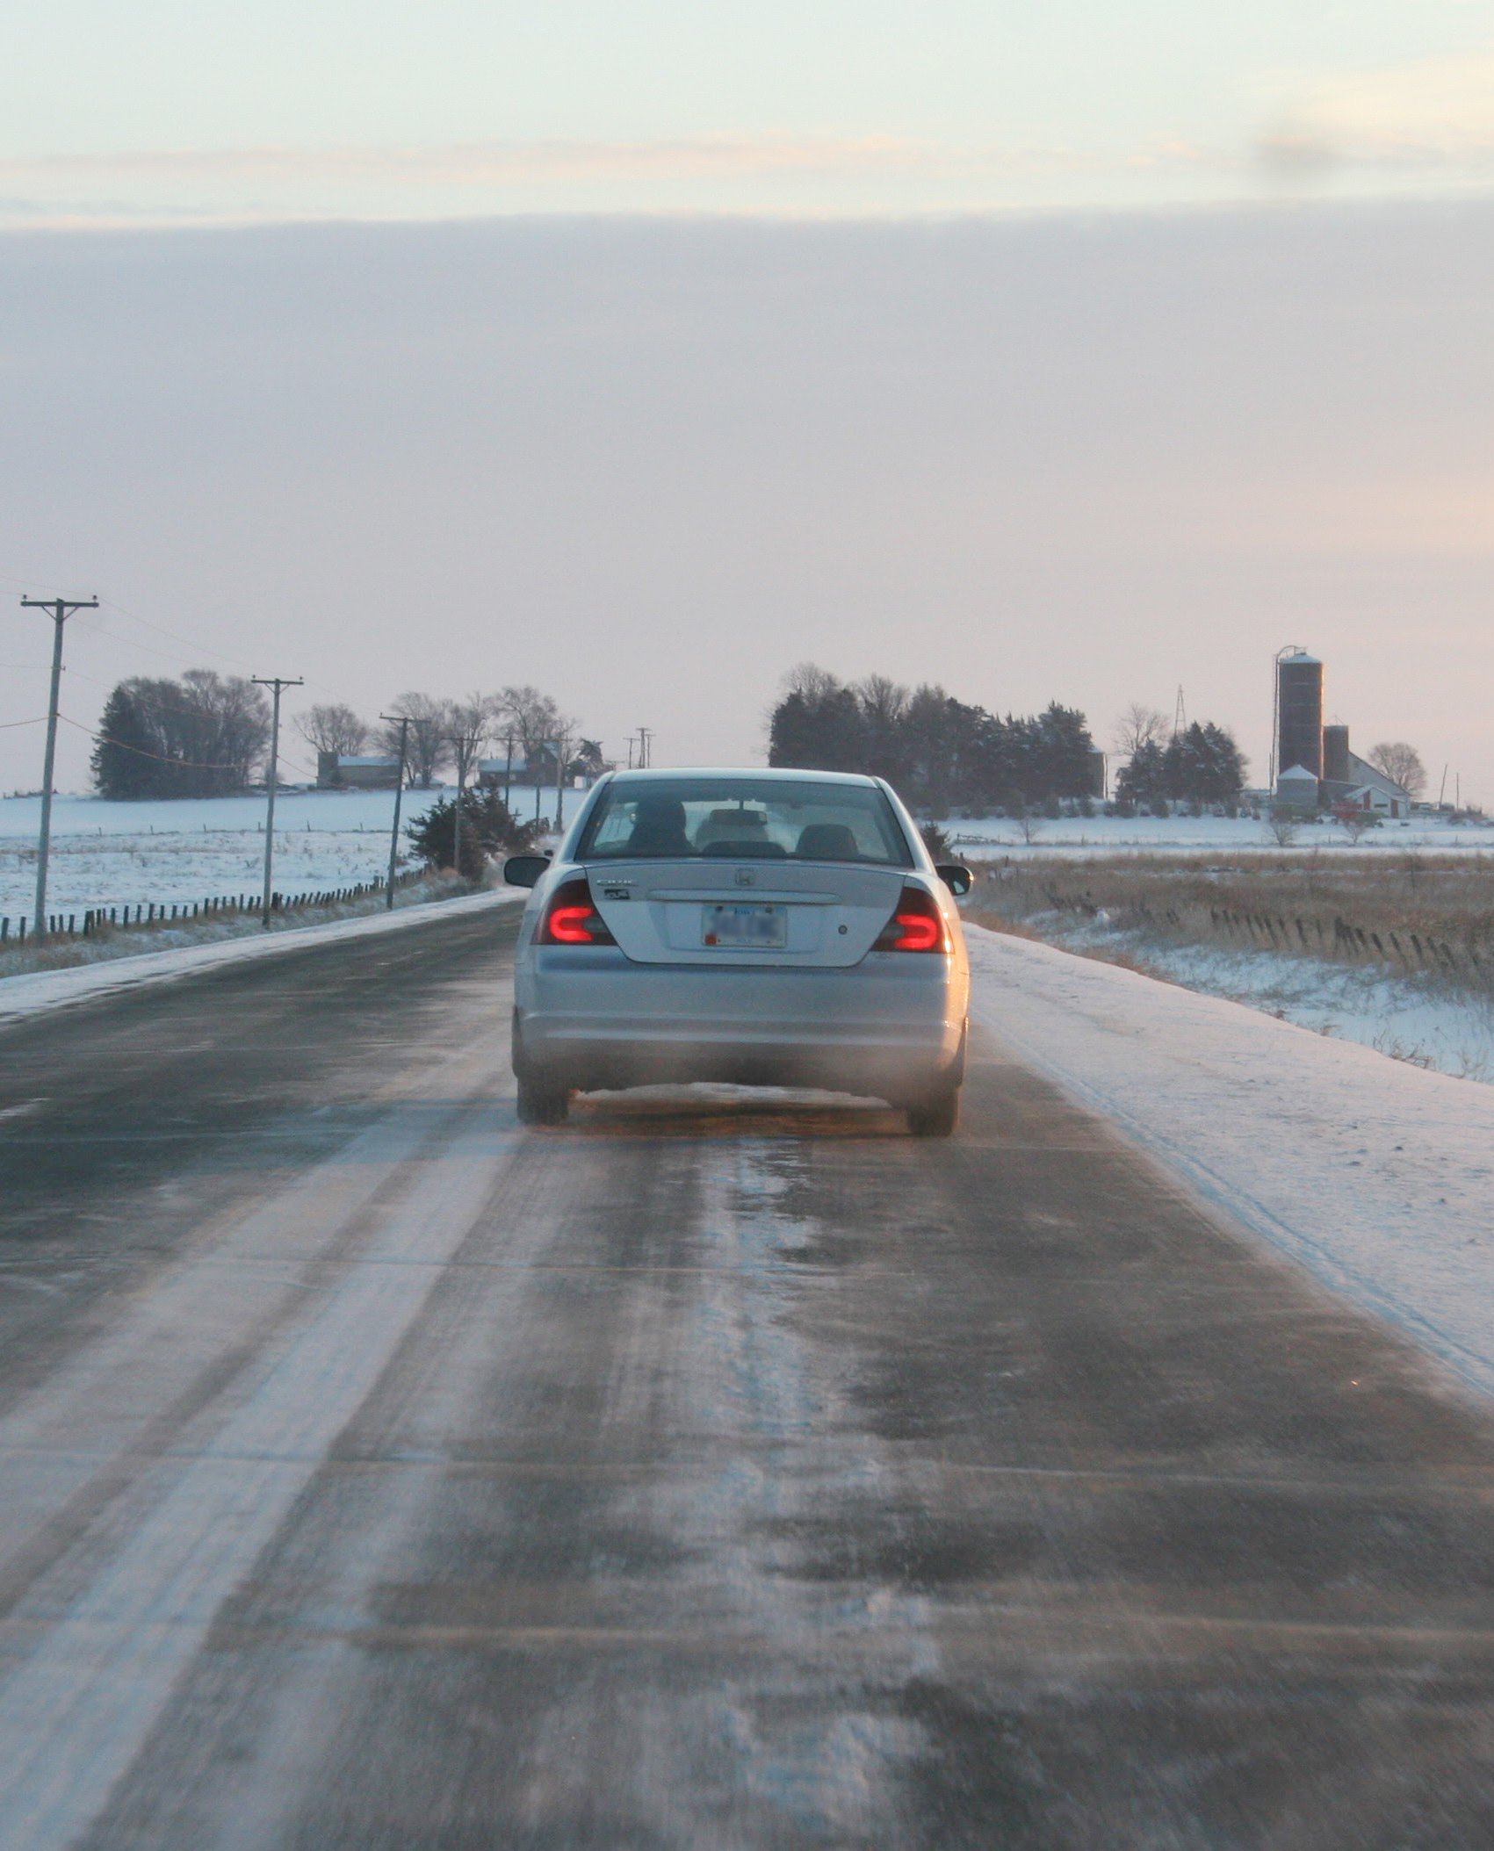
Learning Objectives
Identify the challenges that different roadways and conditions present
Understand the steps you can take to safely drive on challenging roadways and in different conditions
Notes:
Narrative
The learning objectives for this module are the following:
Identify the challenges that different roadways and conditions present
Understand the steps you can take to safely drive on challenging roadways and in different conditions
Image source: Institute for Transportation at Iowa State University

Slide 3
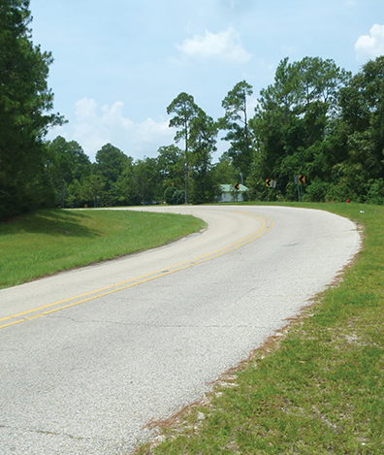
Iowa Crash Data
In Iowa, rural teen crashes are nearly five times more likely to lead to a fatal or severe injury
5.6% of crashes involving drivers under the age of 16 and 2.8% of crashes involving drivers between the ages of 16 and 18 occur on secondary (i.e., rural) roads
Notes:
Narrative
For younger drivers, different roadway features can present challenges. That is particularly true of rural roadways, where higher speeds, a different vehicle mix, and terrain features (among other items) can lead to a higher potential for crashes. In Iowa, the figures bear this out. Rural crashes involving teens are five times more likely to lead to death or severe injuries, and it is important for younger drivers to know that when crashes happen in rural areas, response times for fire, EMS, and police are longer. While most crashes for younger drivers happen in more developed areas, such as cities, a portion of crashes do happen on rural areas. For drivers under the age of 16, 5.6% of crashes happened on rural roads, while for drivers between the ages of 16 and 18, 2.8% of crashes happened on rural roads.
Resources
Information sources:
Peek-Asa, C., C. Britton, T. Young, M. Pawlovich, and S. Falb. 2010. Teenage driver crash incidence and factors influencing crash injury by rurality. Journal of Safety Research, Vol. 41, No. 6, pp. 487–492.
Oneyear, N. 2023. Factors Contributing to Younger Driver Crashes. Data Report. Iowa Department of Transportation.
Image source: Federal Highway Administration

Slide 4

Unpaved/Gravel Roadways
Unpaved roadways, compared to paved, present several unique hazards that drivers should be aware of and prepared for:
  Reduced traction (loose gravel)
  Washboarding
  Soft shoulders
  Reduced visibility (vegetation, hills, etc.)
  Uncontrolled intersections
  Narrower roadways/bridges
  Steep hills
  Sharp curves
Notes:
Narrative
There are several features of rural roadways that may present challenges to drivers, but especially to younger drivers who may be encountering them for the first time or infrequently. Many roads in rural areas are unpaved gravel roadways, which have several features that drivers need to be aware of and be prepared for. The gravel may become loose and cause traction and stability problems, and washboarding, or ripples in the roadway surface, may also be present. Some rural roadways have soft (or no) shoulders, and dust and heavy vegetation may impact visibility. Larger vehicles, specifically farm equipment, may also be encountered. Rural roads often have uncontrolled intersections where no traffic approaching the intersection is presented with a Stop or Yield sign but is rather expected to yield the right-of-way if needed. Some rural roadways are narrower, and many roadways have steeper hills and sharper curves. Drivers should slow down when approaching steeper hills and sharper curves and be prepared to encounter approaching traffic in the opposite direction.
Resources
Information source:
Iowa Department of Transportation. 2024. Iowa Driver’s License Manual. https://iowadot.gov/mvd/driverslicense/dlmanual/dlmanual.pdf.
Image source: Bill Chizek/Shutterstock.com

Slide 5
Unpaved/Gravel Roadways:
Reduced Traction
CHALLENGE:
Reduced traction (loose gravel)
SOLUTION:
Less traction vs. pavement means reduced ability for stable control
May cause vehicle to skid when braking
Builds up on the sides of the road and may pull vehicle if encountered
Slow down
Avoid sudden turning
Accelerate and brake slowly
Maintain a safe distance
Notes:
Narrative
There are several features of rural roadways that may present challenges to drivers, but especially to younger drivers who may be encountering them for the first time or infrequently. Many roads in rural areas are unpaved gravel roadways, which have several features that drivers need to be aware of and be prepared for. The gravel may become loose and cause traction and stability problems, and washboarding, or ripples in the roadway surface, may also be present. Some rural roadways have soft (or no) shoulders, and dust and heavy vegetation may impact visibility. Larger vehicles, specifically farm equipment, may also be encountered. Rural roads often have uncontrolled intersections where no traffic approaching the intersection is presented with a Stop or Yield sign but is rather expected to yield the right-of-way if needed. Some rural roadways are narrower, and many roadways have steeper hills and sharper curves.
Resources
Information source:
Iowa Department of Transportation. 2024. Iowa Driver’s License Manual. https://iowadot.gov/mvd/driverslicense/dlmanual/dlmanual.pdf.
Image source: Bill Chizek/Shutterstock.com

Slide 6
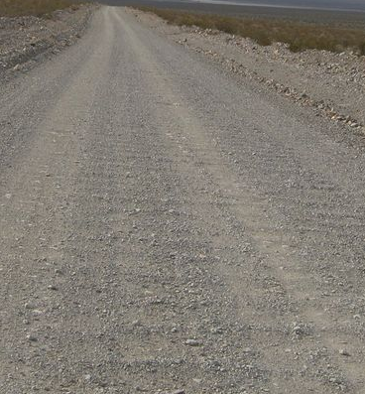
Unpaved/Gravel Roadways: Washboarding
CHALLENGE:
Washboarding
SOLUTION:
Formation of ripples on roadway surface that produces vibratory sensation in vehicle
Back off the accelerator and allow vehicle to slow down without braking
Accelerate after washboarded section has ended
Notes:
Narrative
There are several features of rural roadways that may present challenges to drivers, but especially to younger drivers who may be encountering them for the first time or infrequently. Many roads in rural areas are unpaved gravel roadways, which have several features that drivers need to be aware of and be prepared for. The gravel may become loose and cause traction and stability problems, and washboarding, or ripples in the roadway surface, may also be present. Some rural roadways have soft (or no) shoulders, and dust and heavy vegetation may impact visibility. Larger vehicles, specifically farm equipment, may also be encountered. Rural roads often have uncontrolled intersections where no traffic approaching the intersection is presented with a Stop or Yield sign but is rather expected to yield the right-of-way if needed. Some rural roadways are narrower, and many roadways have steeper hills and sharper curves.
Resources
Information source:
Iowa Department of Transportation. 2024. Iowa Driver’s License Manual. https://iowadot.gov/mvd/driverslicense/dlmanual/dlmanual.pdf.
Image source: National Park Service. https://www.facebook.com/DeathValleyNPS/posts/dreaming-about-leaving-the-pavement-and-heading-out-on-a-backroad-adventure-what/4468967759794138/

Slide 7
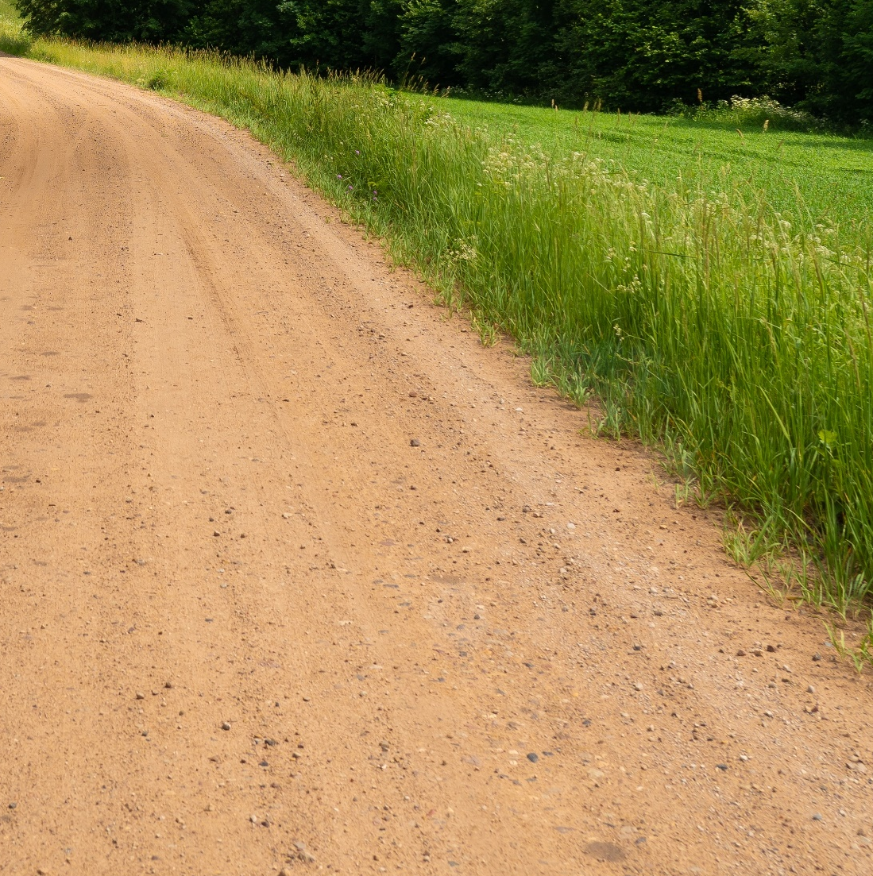
Unpaved/Gravel Roadways:
Soft Shoulders
CHALLENGE:
Soft shoulders
SOLUTION:
Make control more difficult
May pull vehicle toward ditch
Generally, drive toward the center of the roadway
Slow down and move over gradually when approaching another vehicle
Notes:
Narrative
There are several features of rural roadways that may present challenges to drivers, but especially to younger drivers who may be encountering them for the first time or infrequently. Many roads in rural areas are unpaved gravel roadways, which have several features that drivers need to be aware of and be prepared for. The gravel may become loose and cause traction and stability problems, and washboarding, or ripples in the roadway surface, may also be present. Some rural roadways have soft (or no) shoulders, and dust and heavy vegetation may impact visibility. Larger vehicles, specifically farm equipment, may also be encountered. Rural roads often have uncontrolled intersections where no traffic approaching the intersection is presented with a Stop or Yield sign but is rather expected to yield the right-of-way if needed. Some rural roadways are narrower, and many roadways have steeper hills and sharper curves.
Resources
Information source:
Iowa Department of Transportation. 2024. Iowa Driver’s License Manual. https://iowadot.gov/mvd/driverslicense/dlmanual/dlmanual.pdf.
Image source: Miervaldis Ozols/Shutterstock.com

Slide 8
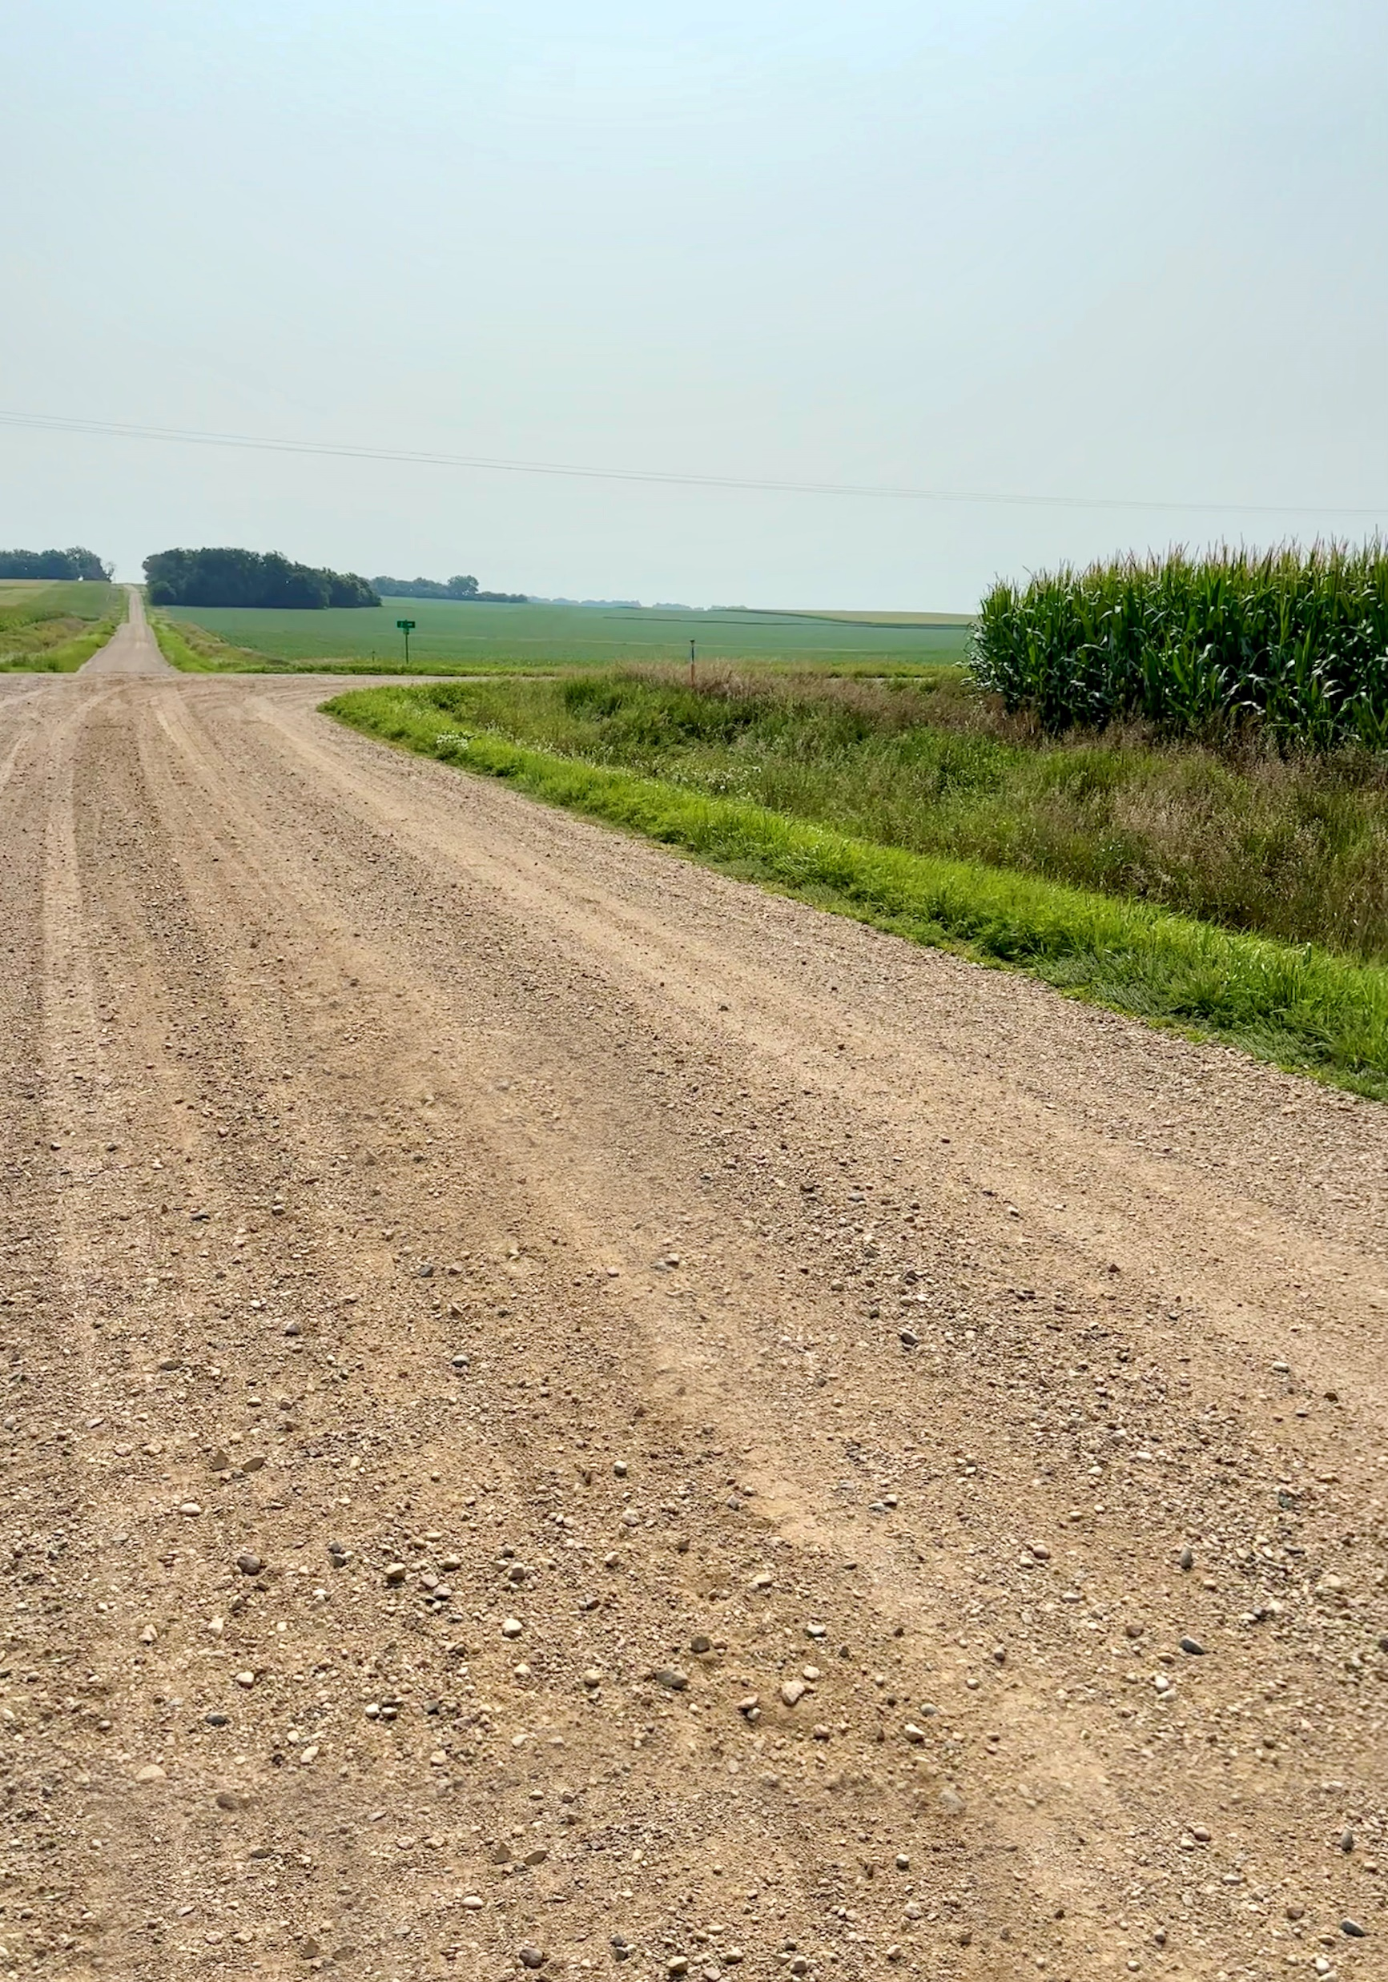
Unpaved/Gravel Roadways:
Reduced Visibility
CHALLENGE: Reduced visibility due to insufficient sight distance
SOLUTION:
Trees, cornfields, and buildings can block view of oncoming or entering vehicles
Dust, fog, rain, and snow can reduce the distance you can see
Identify blind spots to anticipate and be prepared for potential dangers
If you can’t see ahead, do the following:
  Slow down
  Put more space between you and the vehicle ahead
Notes:
Narrative
Another common issue on rural, unpaved roads is dust and visibility in general. Dry gravel roads can have dust kicked up by vehicles, which affects your ability to see ahead. Similarly, rural areas have a variety of vegetation, and this can affect your ability to see other vehicles, especially at intersections. As a driver, it is helpful to recognize when such conditions are present and to slow down when you can see a sufficient distance ahead and might have to make unexpected stops, and, if you are following another vehicle, to put more distance between your vehicle and theirs.
Steep hills and sharp curves are another common feature of rural driving. When passing through such locations, slow down, and if you’re on an unpaved roadway and driving in the center, begin to move to the right of the road in anticipation of the potential that you might have to meet and pass a vehicle in the other direction that you can’t see yet. Also, be mindful of advisory speeds that may be posted in advance of curves and slow down to that speed.
Resources
Information sources:
Iowa Department of Transportation. 2024. Iowa Driver’s License Manual. https://iowadot.gov/mvd/driverslicense/dlmanual/dlmanual.pdf.
Iowa Department of Transportation. Rural Road Crashes: They’re Preventable. https://iowadot.gov/mvd/resources/rural_discussion_guide.pdf?did=361.
Image source: Institute for Transportation at Iowa State University

Slide 9
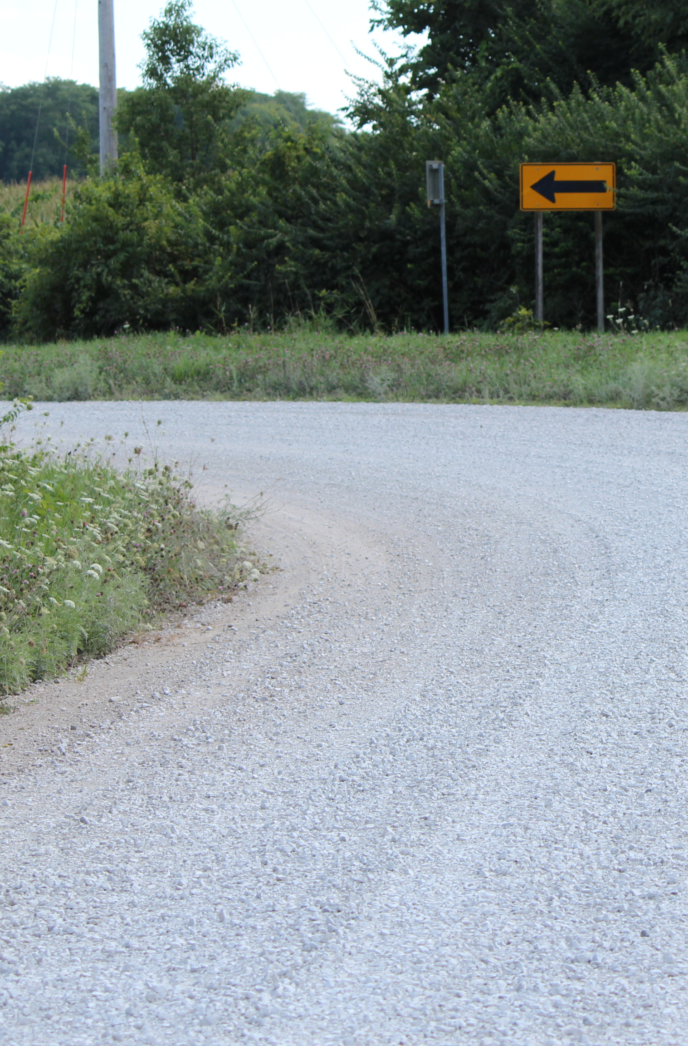
Unpaved/Gravel Roadways:
Reduced Visibility
CHALLENGE: Reduced visibility due to objects blocking view of roadway
SOLUTION:
Windy roadway
Steep hills and sharp curves
Before reaching the crest of hills or entering a curve, slow down and move to the right
Be mindful of any posted warning signs and speeds for the feature as you approach
Notes:
Narrative
Another common issue on rural, unpaved roads is dust and visibility in general. Dry gravel roads can have dust kicked up by vehicles, which affects your ability to see ahead. Similarly, rural areas have a variety of vegetation, and this can affect your ability to see other vehicles, especially at intersections. As a driver, it is helpful to recognize when such conditions are present and to slow down when you can see a sufficient distance ahead and might have to make unexpected stops, and, if you are following another vehicle, to put more distance between your vehicle and theirs.
Steep hills and sharp curves are another common feature of rural driving. When passing through such locations, slow down, and if you’re on an unpaved roadway and driving in the center, begin to move to the right of the road in anticipation of the potential that you might have to meet and pass a vehicle in the other direction that you can’t see yet. Also, be mindful of advisory speeds that may be posted in advance of curves and slow down to that speed.
Resources
Information sources:
Iowa Department of Transportation. 2024. Iowa Driver’s License Manual. https://iowadot.gov/mvd/driverslicense/dlmanual/dlmanual.pdf.
Iowa Department of Transportation. Rural Road Crashes: They’re Preventable. https://iowadot.gov/mvd/resources/rural_discussion_guide.pdf?did=361.
Image source: Institute for Transportation at Iowa State University

Slide 10
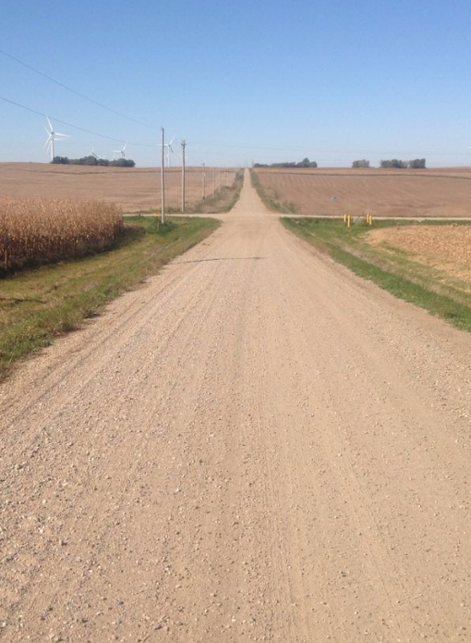
Unpaved/Gravel Roadways: Uncontrolled Intersections
CHALLENGE: Uncontrolled intersections
SOLUTION:
Intersection where no approaches are controlled by a Stop or Yield sign
Particularly problematic if there are buildings, tall corn, etc., blocking the view
Vehicle that arrives first has ROW
When 2 vehicles arrive at the same time, the vehicle on left yields
Slow down and look for oncoming traffic
Be prepared to stop
Don’t rely on dust clouds
Notes:
Narrative
Uncontrolled intersections are locations that do not have Stop or Yield signs. Drivers should use caution when approaching and passing through these intersections. Be aware that buildings, tall corn, and other items can limit your view of traffic approaching on other legs of the intersection. You should never rely on dust along a crossroad to indicate that a vehicle is approaching. The appropriate action is to slow down when approaching an uncontrolled intersection and be prepared to stop. If you can’t see, come to a stop (as you would at a Stop sign) and check the crossroad to determine when it is safe to proceed.
Resources
Information source:
Iowa Department of Transportation. 2024. Iowa Driver’s License Manual. https://iowadot.gov/mvd/driverslicense/dlmanual/dlmanual.pdf.
Image source: Crawford County, IA. https://www.news.iowadot.gov/.a/6a00e552358ec4883401b8d1971379970c-pi

Slide 11
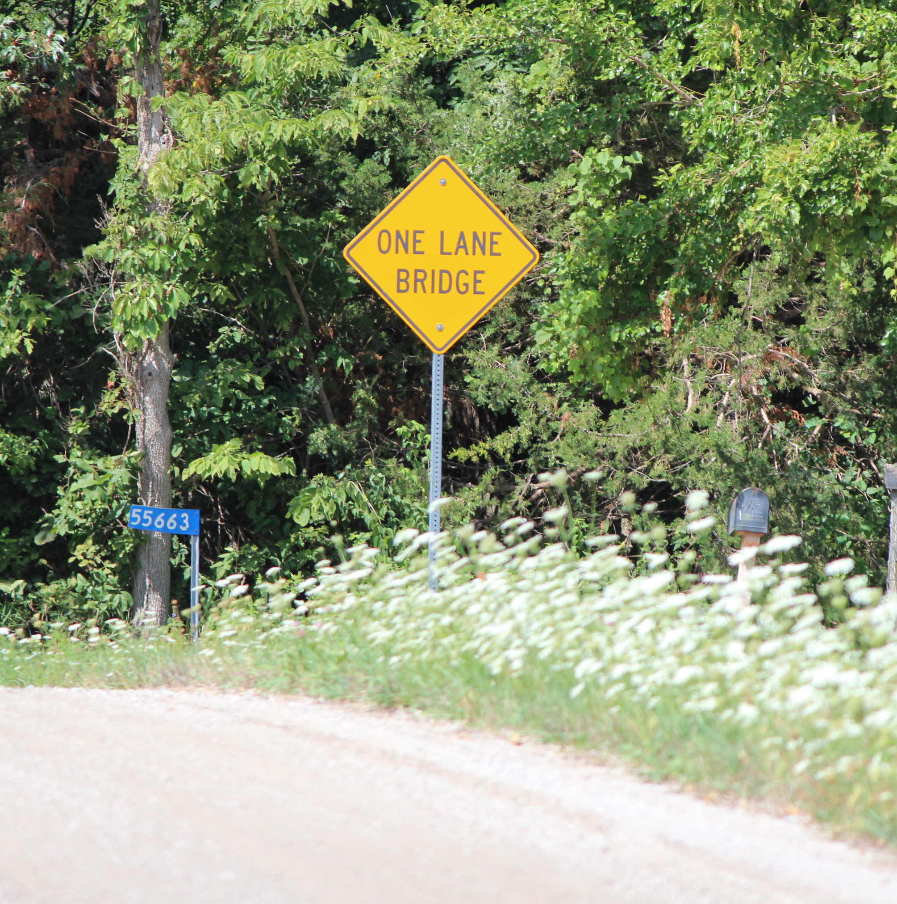
Unpaved/Gravel Roadways:
Narrow Bridges
CHALLENGE: Narrow bridges
SOLUTION:
Lane narrows leaving less room for oncoming vehicles to pass
Watch for signs
Slow down and be prepared to stop for oncoming traffic
Notes:
Narrative
Narrow bridges are also present on rural roads and generally don’t allow for two vehicles to pass each other at the same time. Drivers should watch for signs indicating that a narrow bridge is ahead and slow down and prepare to stop if another vehicle is approaching in the other direction. Regardless, it is also a good idea to slow down when approaching a narrow bridge, as the roadway width will not be as great and there will be less room to maneuver.
Resources
Information source:
Iowa Department of Transportation. 2024. Iowa Driver’s License Manual. https://iowadot.gov/mvd/driverslicense/dlmanual/dlmanual.pdf.
Image source: Institute for Transportation at Iowa State University

Slide 12
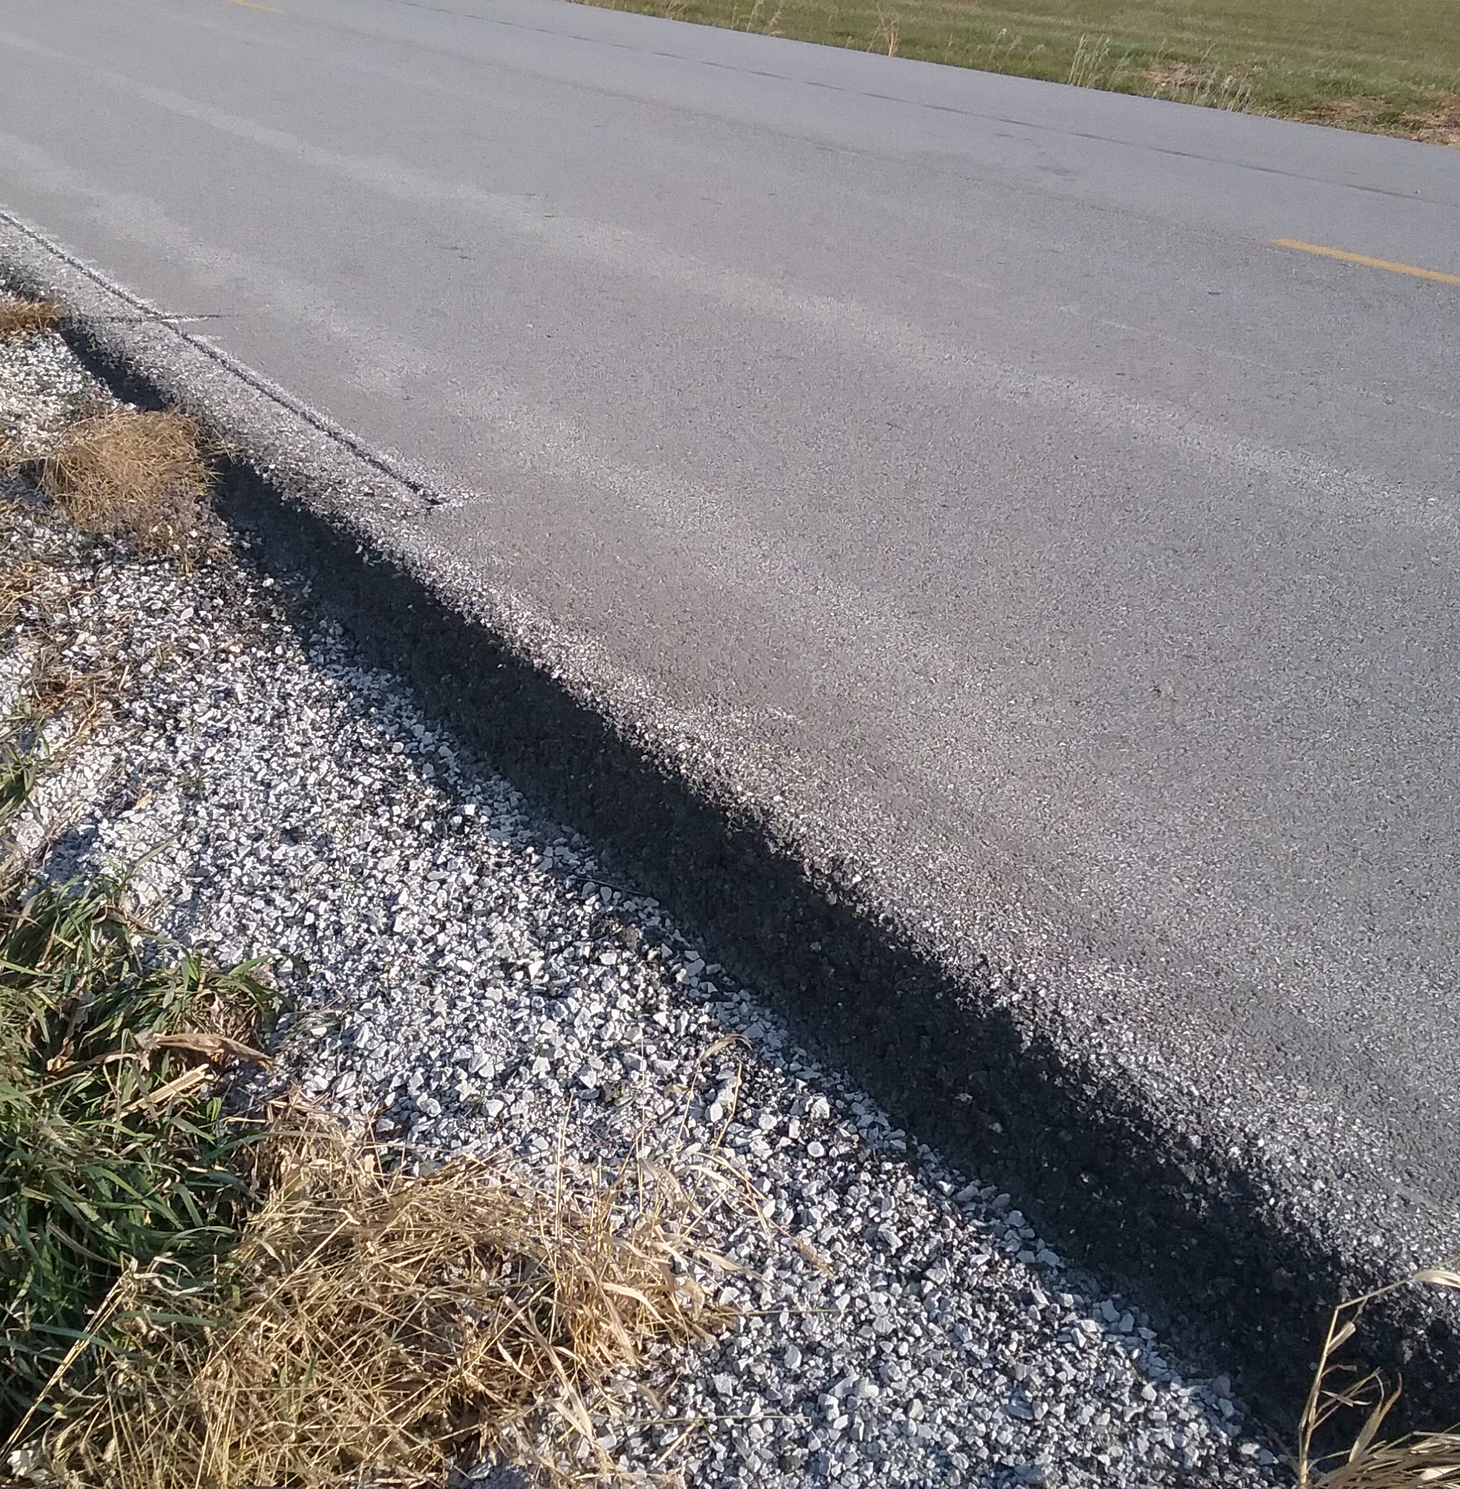
Edge Drop-Off
Not all paved roads have paved shoulders, but the shoulders may have an edge drop-off
  This abrupt edge is the difference between the pavement and shoulder surfaces
Edge drop-off along gravel and unpaved shoulders can make a vehicle more difficult to control
If you drift onto a shoulder, do the following:
  Remain calm and do not jerk the wheel to get back on the roadway
  Ease off the accelerator and do not brake
  Slowly apply steering to return to the roadway
  Gradually ease back onto the roadway and reaccelerate
Notes:
Narrative
Some roadways have a paved travel way and gravel or earth shoulders. Due to edge rut, there may be a vertical drop off between the paved roadway and the shoulder. Additionally, your vehicle will maneuver differently on a gravel surface compared to a paved surface. If you drift onto an unpaved shoulder, don’t jerk the wheel to get back on the roadway. Instead, ease off the accelerator to slow down without braking. Once you have slowed, slowly apply steering to regain the roadway/lane. If you encounter resistance, do not apply excessive steering, but, rather, continue to slow down and be prepared to climb back up the edge of the pavement slowly. When you begin to regain the roadway/lane, continue to ease back to your intended path and, once you’re back in it, reaccelerate.
Resources
Information source:
MBPublicInsurance. 60 Second Driver - Off-Road Recovery. https://www.youtube.com/watch?v=OQqy9WhPsYg
Image source: Institute for Transportation at Iowa State University

Slide 13
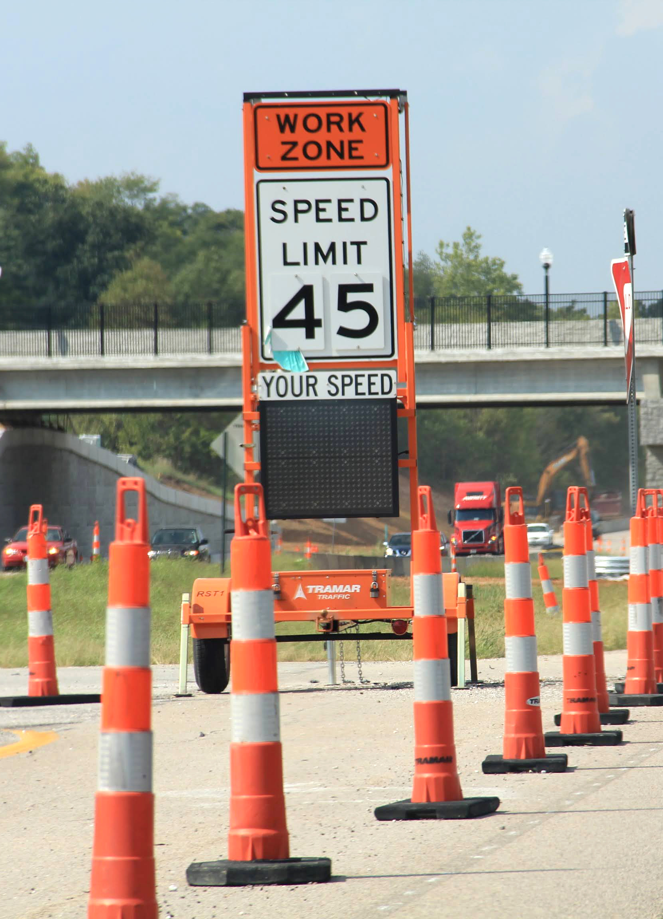
Work Zones
While only 0.6% of crashes for drivers under the age of 16 and 1.2% of crashes for drivers between the ages of 16 and 18 occurred in work zones, these areas represent a change from the normal driving environment
Work zones present different dangers:
  Vehicles passing through work zones travelling at different speeds (speed differential)
  Lane changes and merging
  Uneven surfaces and debris
  Presence of workers and equipment adjacent to the vehicle lane
Notes:
Narrative
Work zone statistics from Iowa do not show large numbers of crashes involving younger drivers, but the nature of these areas still present a challenge. Work zones represent a change from the normal driving environment. As a result, work zones present drivers with various dangers, including speed differentials between vehicles, lane changes, closures and merges, potential uneven driving surfaces or material debris in the roadway, and the presence of workers in close proximity to the travel lane.
Resources
Information sources:
Iowa Department of Transportation. 2024. Iowa Driver’s License Manual. https://iowadot.gov/mvd/driverslicense/dlmanual/dlmanual.pdf
Ford, G. L., Jr., and D, L. Picha. 2000. Teenage Drivers’ Understanding of Traffic Control Devices. Transportation Research Record: Journal of the Transportation Research Board, Vol. 1708.
Image source: Institute for Transportation at Iowa State University

Slide 14
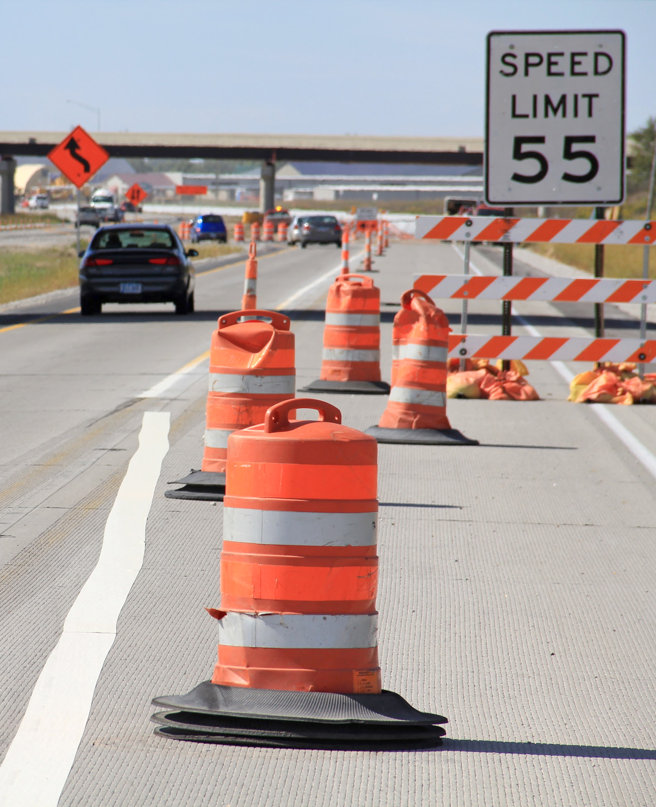
Driving Through Work Zones
Drivers may be confused by the combination of devices in work zones
  Orange is the basic color of work zone signs and warning devices (cones, barrels, etc.)
  Pavement markings will still be yellow and white
Stay alert and drive cautiously
  Give your full attention to driving
  Follow posted speed limit
  Be alert to detour signing and road closures
  Obey instructions provided by signs and flagging personnel
  Maintain a safe distance
  Be prepared for lane changes and merge as soon as possible
  Be patient
Notes:
Narrative
All of the different things going on in a work zone can be overwhelming to a younger driver, so there are a few basics to keep in mind. First, orange is the color of work zones, and all the signs and devices pertaining to the work zone are going to be this color. However, pavement markings will remain the normal yellow or white color. When driving through a work zone, focus on driving, follow the posted speed limit, be prepared to slow down for other vehicles or equipment, and follow detour signing (not your GPS), as well as any personnel directing traffic, such as flaggers. It is best to keep a bit of distance between your vehicle and the one ahead of you. Be prepared for lane changes, and if a lane is closed, merge into the adjacent lane as soon as possible (not at the last second). Finally, be patient, as being frustrated by road work or the behaviors of other drivers will distract you from your primary task, which is to drive safely.
Finally, be aware that speed limits may be lowered during construction, so pay attention to signing.
Resources
Information sources:
Iowa Department of Transportation. 2024. Iowa Driver’s License Manual. https://iowadot.gov/mvd/driverslicense/dlmanual/dlmanual.pdf
National Workzone Safety information Clearinghouse. Teenage Drivers. https://workzonesafety.org/work_zone_topics/teenage-drivers/
Washington Department of Transportation. Work Zone Safety Driving Tips. https://www.wsdot.wa.gov/safety/brake/pdf/WorkZoneSafetyDrivingTips.pdf
Work Zone Safe. https://work-zone-safe.teachable.com/p/about2
Image source: Institute for Transportation at Iowa State University

Slide 15
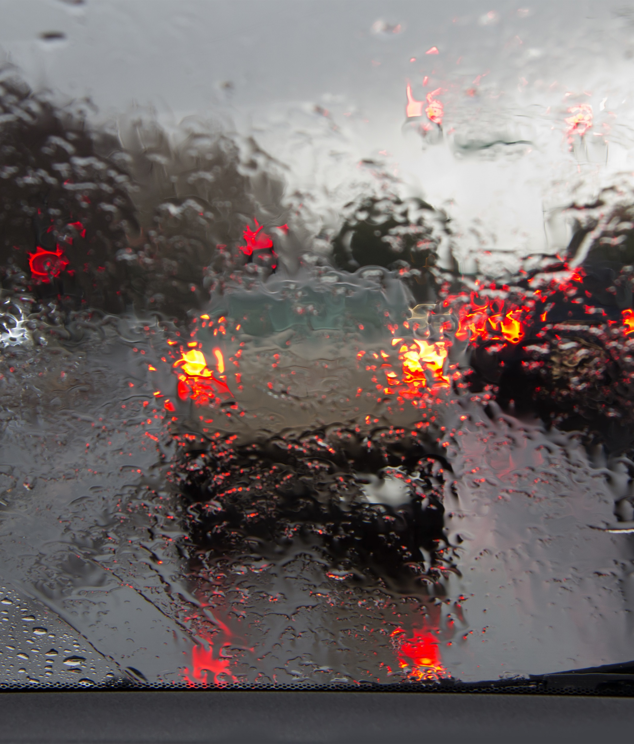
Inclement Weather
6.6% of all crashes involving drivers under the age of 16 and 5.7% of crashes involving drivers between the ages of 16 and 18 occurred in the rain
Be prepared before you travel and know what the weather will be
If severe weather is expected, postpone or adjust your trip if possible
In general, slow down and increase your following distance
Be prepared to stop further in advance
Do not use cruise control (in any weather, rain or snow)
Be familiar with your antilock brakes (if equipped) and how they feel when activated
Notes:
Narrative
Weather can present a challenge for younger drivers. While you are likely to have practiced in different rain and snow conditions, it often takes years of experience to be fully prepared for driving in these conditions, which can widely vary by roadway location. Iowa crash data bears out that weather does present challenges to younger drivers, with 6.6% of all crashes involving drivers under the age of 16 and 5.7% of crashes involving drivers between the ages of 16 and 18 occurring in the rain.
Despite the challenges that weather conditions present, there are steps that can be taken to help you drive safely. First, be prepared by knowing what the weather will be. If severe weather is forecasted, whether that be a thunderstorm, blowing snow, ice, etc., consider postponing or cancelling your trip, especially if it is not necessary. If you do need to travel, slow down as you drive, and increase the distance between your vehicle and the ones ahead of you. Be aware that the driving surface may be slippery, so begin to slow and stop further in advance. Never use your cruise control during snowy, rainy, or icy conditions. Using cruise control during inclement weather can result in your vehicle losing traction unexpectedly. Finally, many vehicles are now equipped with antilock brakes. If you have an equipped vehicle, be familiar with how they activate and feel. For example, you might practice driving and braking in an empty parking lot after a snowfall to have a chance to activate the antilock braking system in a controlled environment.
Resources
Information sources:
Iowa Department of Transportation. 2024. Iowa Driver’s License Manual. https://iowadot.gov/mvd/driverslicense/dlmanual/dlmanual.pdf
Iowa Department of Transportation. 2024. Iowa Crash Analysis Tool. https://icat.iowadot.gov/
Image source: Galina Gutarin/Shutterstock.com

Slide 16
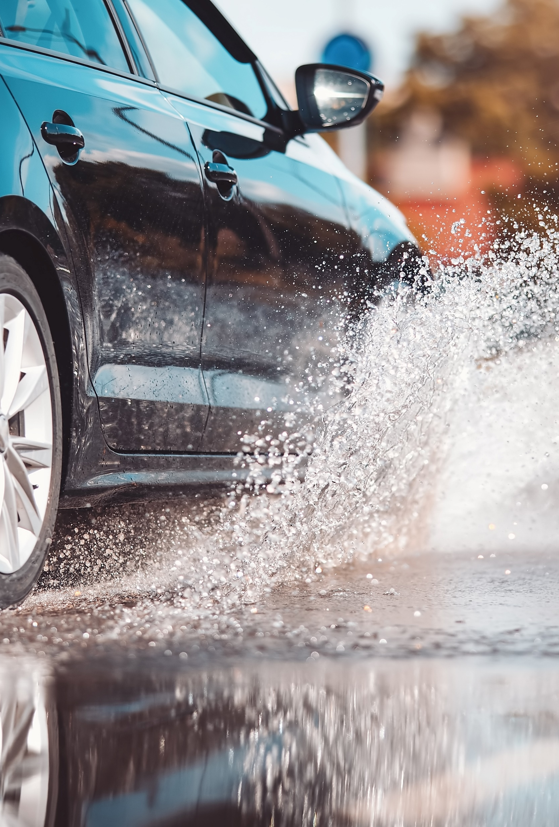
Inclement Weather: Rain
Rain can increase roadway surface slickness and affect traction and braking
  Use your wipers and turn on your headlights
  Do not use cruise control
  Slow down and maintain a safe following distance
  Use your brakes cautiously and beware of hydroplaning
Notes:
Narrative
The effects of rain on a roadway are primary related to producing slickness on the driving surface and the impact of that slickness on vehicle traction. When it is raining, turn your wipers and headlights on. To ensure that you do not lose control, do not use cruise control, slow down and keep distance between your vehicle and the ones ahead of you, and use your brakes cautiously (i.e., don’t hard brake). Be aware that there is a potential to hydroplane (or slide across the roadway surface when braking) because of a loss of friction from roadway slickness or standing water. In some cases, rain washes oil and other material off the roadway, which can also reduce friction.
Resources
Information sources:
Iowa Department of Transportation. 2024. Iowa Driver’s License Manual. https://iowadot.gov/mvd/driverslicense/dlmanual/dlmanual.pdf
AAA. 2022. Wet Weather Driving Tips. https://exchange.aaa.com/safety/driving-advice/wet-weather-driving-tips/
San Jose Fire Department. 10 Tips for Driving in the Rain. https://www.youtube.com/watch?v=seMOxk6AVvY
Image source: LeManna/Shutterstock.com

Slide 17

Inclement Weather: Snow/Ice
Clean off your vehicle before driving and make sure all windows and headlights/taillights are clear
Beware of black ice (especially on bridges)
Accelerate slowly to avoid tire spin
Do not use cruise control
Drive slowly, maintain a safe following distance, and begin to slow for stopping sooner
Brake only while traveling straight, as stopping distances can be 10 times greater in snow/ice
Notes:
Narrative
During snowstorms, make sure to clean off all windows before you begin to drive (don’t count on the snow to just blow off). Also, clean off your headlights and taillights so you can be visible to other vehicles in low-visibility conditions. While a road may look clear, there is the potential for black ice. This is especially true around bridges where a difference in roadway temperatures can cause ice to form on the bridge before other portions of the roadway. However, black ice can be present anywhere, so always anticipate a roadway being slippery. When you begin to drive in snow or on ice, accelerate slowly (don’t just step on the gas). You want to begin moving slowly and keep control of your vehicle. Once again, do not use your cruise control. As always, drive slowly and maintain your distance from other vehicles. When braking, brake while travelling straight (don’t turn the wheel and brake). Bear in mind that on snowy and icy surfaces, it can take up to 10 times the distance to stop compared to normal distances.
Resources
Information sources:
Iowa Department of Transportation. 2024. Iowa Driver’s License Manual. https://iowadot.gov/mvd/driverslicense/dlmanual/dlmanual.pdf
Clear Roads. 2024. Winter Driving. https://www.clearroads.org/winter-driving-tips/
Iowa Department of Transportation. 2024. Winter Travel Information. https://iowadot.gov/maintenance/winter-operations/winter-travel-information.
Image source: LeManna/Shutterstock.com

Slide 18
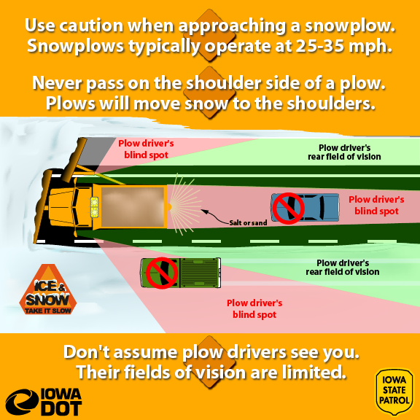
Inclement Weather: Snowplows
Use caution when approaching a snowplow
  Approach at a reduced speed
  Never pass on the shoulder
  Stay back and wait until it is safe to pass
  Allow plenty of room when passing and be aware of blowing snow affecting your visibility
Notes:
Narrative
In addition to focusing on keeping your vehicle under control in winter weather, you also need to be prepared to operate it in the vicinity of snowplows. When you are approaching a snowplow, particularly when coming up from behind, approach at a reduced speed and keep your distance. Never pass a plow on the shoulder. If you do need to pass a plow, stay back until you have determined you can safely complete the pass—this means no oncoming traffic is approaching and you have good visibility. Visibility is key for two reasons: (1) blowing snow from the plow can restrict your ability to see and (2) blowing snow, and blind spots on the plow equipment in general, can limit the ability of a plow operator to see you.
Resources
Information sources:
Iowa Department of Transportation. 2024. Iowa Driver’s License Manual. https://iowadot.gov/mvd/driverslicense/dlmanual/dlmanual.pdf
Illinois Department of Transportation. Don’t Crowd the Plow. https://www.youtube.com/watch?v=KoKxZegdRwk&t=6s.
Image source:
Iowa State Patrol, Iowa DOT

Slide 19
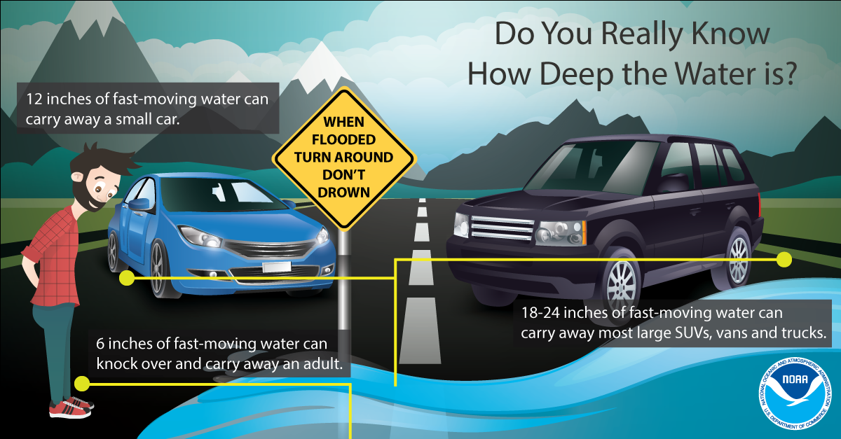
Inclement Weather: Other Conditions
FOG
FLOODING
Use low beam headlights not high (they reflect off the fog)
Slow down until your speed matches your ability to see
Get off the roadway and find a place to park and wait if needed
A small amount of water can sweep away a vehicle, including trucks
Never drive into or through a flooded roadway
“Turn around, don’t drown”
TORNADOES
Seek shelter in a sturdy building (stay away from bridges and overpasses)
If you can’t get to a building, pull over, get below window level, keep seatbelts fastened, and cover head
Alternatively, take cover in a low-lying ditch or ravine and cover head
Notes:
Narrative
Other weather conditions can present different challenges to drivers. Fog limits visibility, so you will need to turn your headlights on. Remember to use your low beams, as the bright lights will only reflect off the fog. Slow down until your speed matches your ability to see. If you think it is unsafe to drive because visibility is so poor, get off the roadway and find a safe place to park. Do not park on the roadside/shoulder.
If you encounter flooding or water over the roadway, do not attempt to drive through it. Even a small amount of running water can sweep away a vehicle. The roadway may also be washed out.
If you are in the vicinity of a tornado, seek sturdy shelter, but don’t park under and overpass or seek refuge under a bridge. If you can’t get to shelter, pull off the roadway, get your head below window level, and keep your seatbelt on. Cover your head to shield it from glass and debris. Another option is to take cover in a low-lying ditch or ravine, but once again, cover your head.
Resources
Information source:
Iowa Department of Transportation. 2024. Iowa Driver’s License Manual. https://iowadot.gov/mvd/driverslicense/dlmanual/dlmanual.pdf
Image source: National Oceanic and Atmospheric Administration

Slide 20
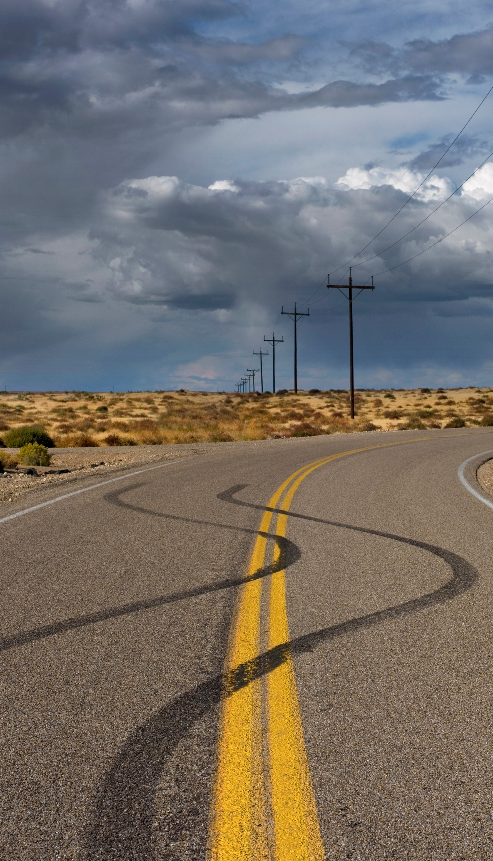
Skidding
Rear wheel
  Ease off the accelerator or take your foot off the brake
  Shift to neutral if you have an automatic transmission
  Initially steer in the direction you want the front wheels to go
  Before the rear wheels stop skidding right or left, counter-steer until you are going in the desired direction
  Once traveling straight, shift back into drive
Front wheel
  Ease off the accelerator or take your foot off the brake
  Shift to neutral if you have an automatic transmission
  If front wheels were turned before the skid, leave them turned
  Wait for the front wheels to grip the road, then start to steer in the desired direction
  Once traveling straight, shift back into drive
Notes:
Narrative
Skidding can occur in any of the different situations previously discussed, including on gravel roads, during inclement weather, and even on dry pavements if the surface has become polished and lacks friction. If you ever find yourself in a skid, there are a few different things you should do. If it is your rear wheels that are skidding, ease off the accelerator to slow down or take your foot off the brake. Don’t brake suddenly. Initially, steer in the direction you want your front wheels to go, and then counter-steer in the direction you want to go. Once you are travelling straight and have slowed, shift back into drive and slowly accelerate.
If it is your front tires that are skidding, again, ease off the accelerator to slow down or take your foot off the brake. Don’t brake suddenly. If you were making a turn when the skid began, leave your wheels turned and wait for the front wheels to begin to grip the road again. Once you have traction, steer in your desired direction, and then, once you are going straight, shift back into drive and slowly accelerate.
Resources
Information sources:
Missouri Department of Transportation. 2022. Recovering from a Skid. https://www.modot.org/recovering-skid.
GEICO Insurance. How to Correct a Skid. https://www.youtube.com/watch?v=a3PQD_tv-bk.
Image source: Westwind Image2/Shutterstock.com

Slide 21
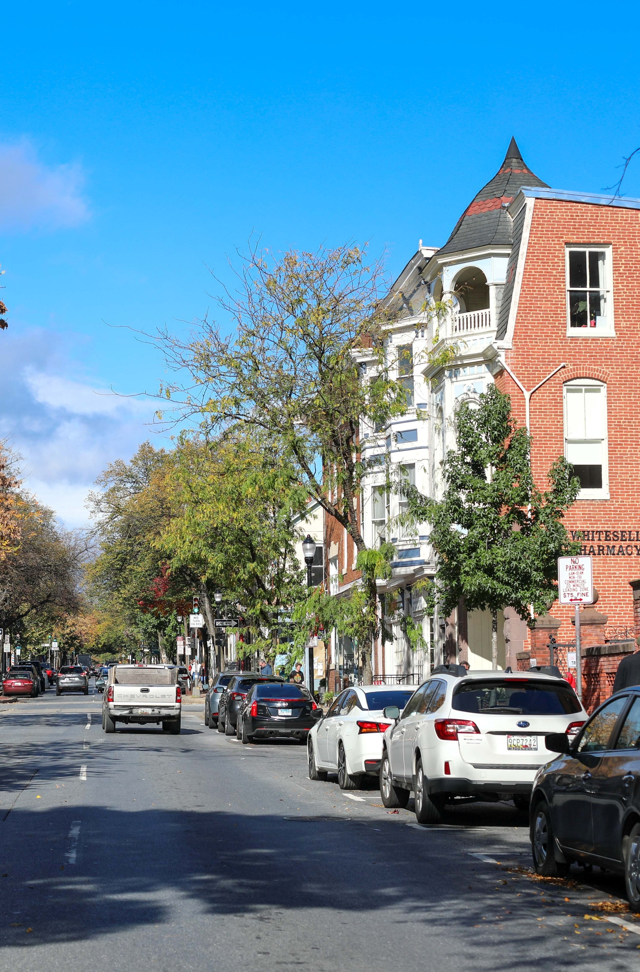
Parking
While it may seem like a basic driving task, parking still can present challenges
In 2020, over 400 pedestrian fatalities and 13,000 injuries occurred in parking lots/garages
Be aware of pedestrians, especially when backing out
Practice in an empty parking lot
  Go slow and adjust mirrors as needed
  Look over your shoulder when backing out
  Get out when you’ve parked and see the results, as it may take multiple tries
If parking on a street, park in the designated area and as far from traffic as possible
Observe parking restrictions/prohibitions
Notes:
Narrative
Another aspect of driving that presents a challenge to some younger drivers is parking. While it may seem basic, it does take practice, just like any other driving skill. Nationally, over 400 fatalities and 13,000 injuries occurred in parking lots/garages (all ages of drivers/not just teens). So, it is important to be aware of pedestrians in the vicinity of your vehicle and to keep in mind that someone may be behind you when you are backing out. Always look behind you as you back out and do not rely solely on a vehicle’s backup camera to see a pedestrian. In general, practice your parking skills. Start out by finding an empty parking lot. Take your time and use your mirrors when you need to, as well as look over your shoulder. When practicing, and once you’ve parked, get out of your vehicle and see how you did. Keep in mind that it will take time and practice to get good at lining up in the parking spot.
When you park a vehicle, be aware of and follow posted parking restrictions or prohibitions. Also, avoid parking in areas and in front of features such as crosswalks, fire hydrants, driveways, and railroad crossings.
Resources
Information sources:
Iowa Department of Transportation. 2024. Iowa Driver’s License Manual. https://iowadot.gov/mvd/driverslicense/dlmanual/dlmanual.pdf
National Safety Council Injury Facts. 2024. Crash Figures Spreedsheet. https://injuryfacts.nsc.org/motor-vehicle/overview/type-of-crash/.
National Safety Council. Backing Up and Parking Lessons for Teens. https://www.youtube.com/watch?v=YGFI9FoHiOI&t=1s.
International Parking Institute. How To Park: The Must-Read Manual for Teen Drivers. https://www.parking.org/wp-content/uploads/2015/12/How-to-Park.pdf.
Image source: Nicole Glass Photography/Shutterstock.com

Slide 22
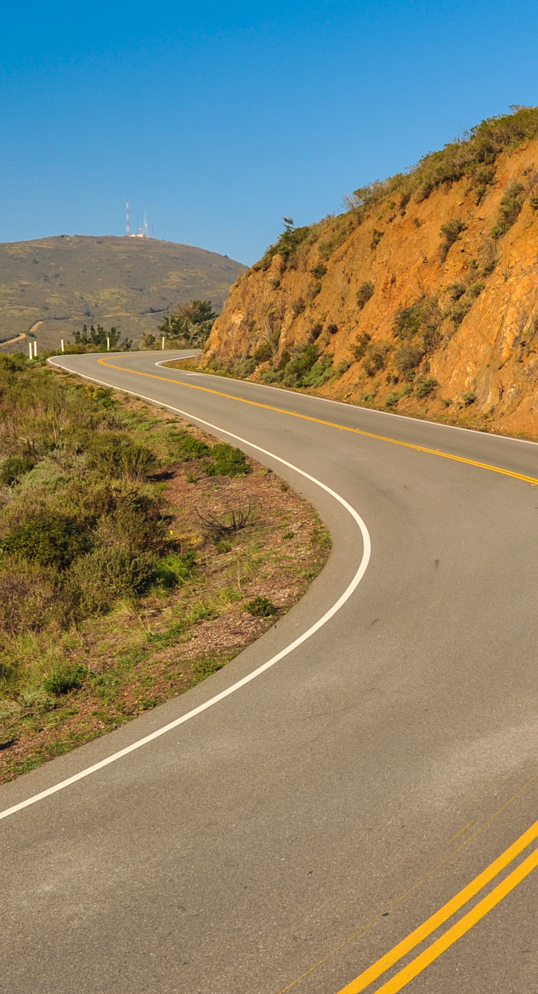
Strategies to Drive Challenging Roadways Safely
There are several things you can do to safely drive on challenging roadways:
  Plan in advance, be aware of weather and traffic conditions, and postpone travel if safety is a concern
  Minimize distractions
  Wear a seatbelt
  Slow down and pass cautiously
  Be aware of poor driving surfaces
  Watch for obstacles (slower/larger vehicles, ATVs, wildlife, etc.)
  Keep an eye on your travel lane for curves, hills, etc.
  Prepare for emergencies, including packing an emergency kit and telling someone where you are going
Notes:
Narrative
In general, and aside from the items discussed throughout these slides, there are some basic strategies to always employ to ensure that you are driving challenging roadways safely:
Planning ahead goes a long way toward being prepared. This includes knowing what the weather will be like, what to expect from traffic, and determining whether you should proceed with a trip.
As a young driver, it is important to minimize distractions in the vehicle so you can concentrate on the road. Always wear a seatbelt.
Don’t speed, drive at a reasonable speed, and when you need to pass, do so cautiously. Do not pass until you have adequate time to do so.
On unpaved roads, be aware that the driving surface won’t be perfect and can have loose gravel, washboarding, etc. These can affect your ability to steer and control the vehicle.
Watch for obstacles, whether they are slow-moving vehicles, animals, or other unexpected items in or adjacent to the roadway.
Be aware of approaching curves and hills, and slow down to the advised speed for that feature if one is posted.
Be prepared for emergencies and have a kit (especially in winter). Also, let someone know where you are going and the route you plan to take for a longer trip.
Resources
Information sources:
Texas Department of Insurance. 5 Tips for Safe Rural Driving. https://www.tdi.texas.gov/tips/safety/driving-rural.html.
Safety Considerations When Driving on Rural Roads. http://vivoni.asu.edu/sonora/www/pages/safety_considerations_when_driving_on_rural_roads.pdf
Image source: Frank Fennema/Shutterstock.com

Slide 23
Additional Resources
Governor’s Highway Safety Association. America’s Rural Roads: Beautiful and Deadly. https://www.ghsa.org/sites/default/files/2022-09/America%E2%80%99s%20Rural%20Roads%20-%20Beautiful%20and%20Deadly%20FNL.pdf
Iowa Department of Transportation. Road conditions. https://511ia.org/
National Highway Traffic Safety Administration. Teen Driving. https://www.nhtsa.gov/road-safety/teen-driving
Notes:
Additional resources that may be of use.

Slide 24
Disclaimer Notice
This module was developed by the Institute for Transportation (InTrans) at Iowa State University for the Iowa Department of Transportation (Iowa DOT) with the purpose to provide the material for driver education instructors in Iowa. InTrans is responsible for the facts and the accuracy of the information presented herein as of May 1, 2025.
Driver education instructors may use the material in its entirety or may use any of the slides and material individually. The material is for educational purposes only. It is strictly prohibited to sell any part of this module.
If any of the material is reused, please credit the appropriate source. The resources used for information and images for the module are provided in the notes section. Other material can be cited as Iowa DOT.
For more information or questions, please contact Vania Boyd, Driver Education and Motorcycle Rider Education Manager, Iowa DOT, Vania.boyd@iowadot.us.

